Slide 1

AQA GCSE PHYSICS · PAPER 1 · FOUNDATION & HIGHER
Mass number, atomic number and isotopes
Atomic structure
Lesson 2 of 10
openrevise.com

Slide 2

AQA GCSE PHYSICS · PAPER 1 · FOUNDATION & HIGHER
Warm-up
Answer each one, then check.
1
How many protons does carbon have?
2
What is an element?
3
What is an ion?
4
What does the atomic number tell you?
5
What is a neutron?
Atomic structure
openrevise.com
Lesson 2 of 10

Slide 3
AQA GCSE PHYSICS · PAPER 1 · FOUNDATION & HIGHER
Warm-up - Answers
How many protons does carbon have?
6
1
What is an element?
A substance with only one type of atom
2
What is an ion?
A charged atom
3
What does the atomic number tell you?
The number of protons
4
What is a neutron?
A neutral particle in the nucleus
5
Atomic structure
openrevise.com
Lesson 2 of 10

Slide 4

AQA GCSE PHYSICS · PAPER 1 · FOUNDATION & HIGHER
Learning Objectives
Define atomic number and mass number.
1
Work out the numbers of protons, neutrons and electrons in an atom.
2
Explain what isotopes are and relate differences in isotope symbols to identities, charges and masses.
3
Explain how atoms become positive ions.
4
Atomic structure
openrevise.com
Lesson 2 of 10

Slide 5

AQA GCSE PHYSICS · PAPER 1 · FOUNDATION & HIGHER
ATOMIC NUMBER AND MASS NUMBER
The atomic number is the number of protons in an atom. The mass number is the total number of protons and neutrons.
Isotopes of an element have the same number of protons but different numbers of neutrons.
Atomic structure
openrevise.com
Lesson 2 of 10

Slide 6
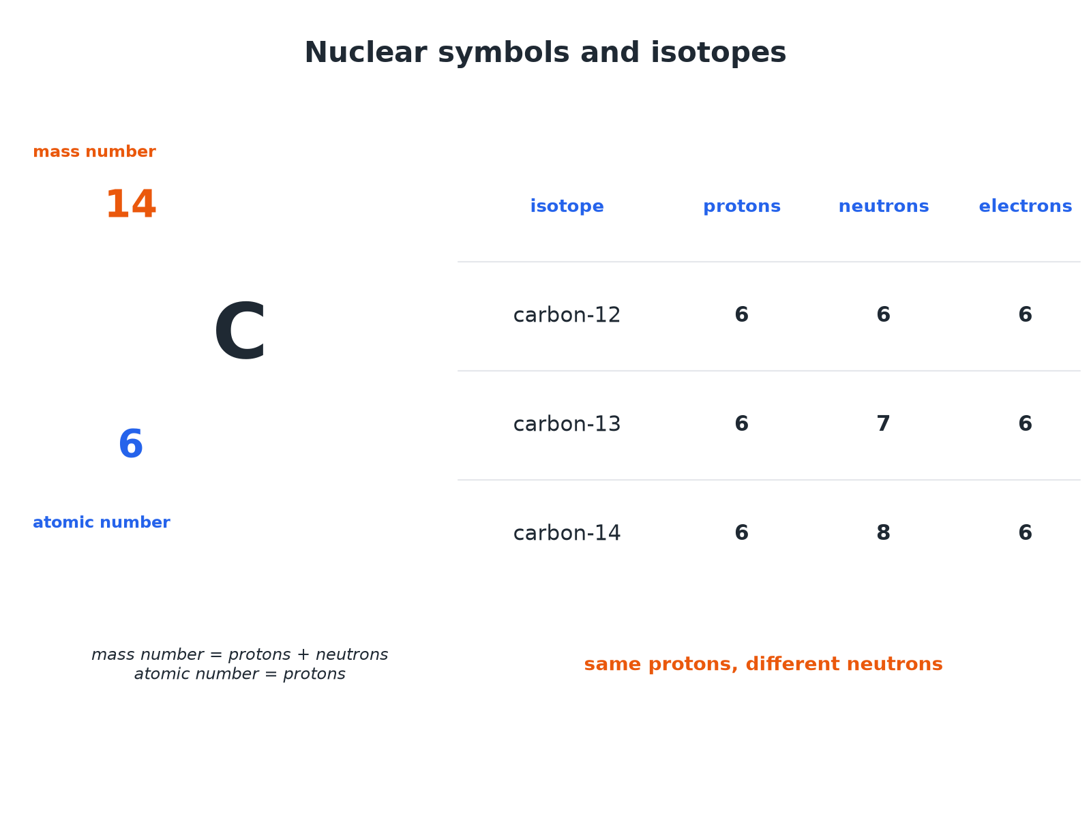

AQA GCSE PHYSICS · PAPER 1 · FOUNDATION & HIGHER
Nuclear Symbols and Isotopes
Same number of protons, different numbers of neutrons.
Atomic structure
openrevise.com
Lesson 2 of 10

Slide 7

AQA GCSE PHYSICS · PAPER 1 · FOUNDATION & HIGHER
Counting Particles
An atom of ¹⁴₆C is neutral. How many protons, neutrons and electrons does it have?
Protons
Atomic number = 6
1
Neutrons
Mass number − atomic number = 14 − 6 = 8
2
Electrons
Same as protons in a neutral atom = 6
3
ANSWER
6 protons, 8 neutrons and 6 electrons.
Atomic structure
openrevise.com
Lesson 2 of 10

Slide 8
AQA GCSE PHYSICS · PAPER 1 · FOUNDATION & HIGHER
Isotopes
Compare the atoms ³⁵₁₇Cl and ³⁷₁₇Cl.
Protons
Both have 17
1
Electrons
Both have 17 if neutral
2
Neutrons
35 − 17 = 18 and 37 − 17 = 20
3
ANSWER
They are isotopes: the same number of protons and electrons but different numbers of neutrons (2 more in chlorine-37).
Atomic structure
openrevise.com
Lesson 2 of 10

Slide 9
AQA GCSE PHYSICS · PAPER 1 · FOUNDATION & HIGHER
Ions
A sodium atom ²³₁₁Na loses one electron. Describe the ion formed.
Protons
Still 11
1
Electrons
Now 10
2
Charge
One more proton than electrons: +1
3
ANSWER
A positive ion, Na⁺, with 11 protons, 12 neutrons and 10 electrons.
Atomic structure
openrevise.com
Lesson 2 of 10

Slide 10

AQA GCSE PHYSICS · PAPER 1 · FOUNDATION & HIGHER
Key Ideas
Learn these.
Element
Determined by the number of protons.
Isotopes
Same element, so same chemical properties, but different masses.
Charge
Ions have an unequal number of protons and electrons.
Symbols
The mass number is the top number; the atomic number is the bottom number.
Atomic structure
openrevise.com
Lesson 2 of 10

Slide 11

AQA GCSE PHYSICS · PAPER 1 · FOUNDATION & HIGHER
Key Terms
Atomic number
The number of protons in an atom.
Mass number
The total number of protons and neutrons.
Isotopes
Atoms of the same element with different numbers of neutrons.
Ion
An atom that has lost or gained electrons.
Element
A substance made of atoms with the same number of protons.
Nuclide
A particular type of nucleus, such as carbon-14.
Atomic structure
openrevise.com
Lesson 2 of 10

Slide 12

AQA GCSE PHYSICS · PAPER 1 · FOUNDATION & HIGHER
YOUR TASK
10 minutes
Fill the Table
For ⁷₃Li and ⁶₃Li, state the number of protons, neutrons and electrons in each neutral atom. Explain why they are isotopes.
Use atomic number for protons.
1
Mass number minus atomic number for neutrons.
2
WHAT A GOOD ANSWER SHOWS
Li-7: 3 protons, 4 neutrons, 3 electrons. Li-6: 3 protons, 3 neutrons, 3 electrons. They have the same number of protons but different numbers of neutrons.
Atomic structure
openrevise.com
Lesson 2 of 10
Notes:
Ask which one is heavier.

Slide 13
AQA GCSE PHYSICS · PAPER 1 · FOUNDATION & HIGHER
Can I...?
Define atomic number.
Define isotopes.
Define mass number.
Compare two isotopes.
Work out neutrons.
Explain positive ions.
Read a nuclear symbol.
Say why isotopes react the same.
Atomic structure
openrevise.com
Lesson 2 of 10

Slide 14
AQA GCSE PHYSICS · PAPER 1 · FOUNDATION & HIGHER
Summary & Exam Focus
Atomic number = protons.
Mass number = protons + neutrons.
Isotopes: same protons, different neutrons.
A positive ion has lost electrons.
EXAM FOCUS
An atom has 6 protons and 8 neutrons. State its mass number. (1 mark)
Add protons and neutrons.
openrevise.com

Slide 15
AQA GCSE PHYSICS · PAPER 1 · FOUNDATION & HIGHER
Exam Practice: Mass number, atomic number and isotopes
Answer all questions. Use the mark allocation as a guide to how much to write. · 14 minutes
Question 1 · 2 marks · Calculate
An atom of carbon-14 is represented as ¹⁴₆C. State the number of protons and the number of neutrons in the atom.
Question 2 · 2 marks · Explain
Explain what is meant by isotopes.
Question 3 · 3 marks · Compare
Chlorine has two isotopes: ³⁵₁₇Cl and ³⁷₁₇Cl. State one similarity and one difference between atoms of these isotopes.
Atomic structure
openrevise.com
Lesson 2 of 10

Slide 16
AQA GCSE PHYSICS · PAPER 1 · FOUNDATION & HIGHER
Exam Practice: Mass number, atomic number and isotopes (cont.)
Question 4 · 3 marks · Explain
A lithium atom ⁷₃Li becomes a positive ion. Explain how this happens and give the number of electrons in the ion if the charge is +1.
Question 5 · 3 marks · Calculate
An atom of uranium-235 has 92 protons. Calculate the number of neutrons and the number of electrons in a neutral atom of uranium-235.
Atomic structure
openrevise.com
Lesson 2 of 10

Slide 17
AQA GCSE PHYSICS · PAPER 1 · FOUNDATION & HIGHER
Question 1 · 2 marks · Calculate
“
An atom of carbon-14 is represented as ¹⁴₆C. State the number of protons and the number of neutrons in the atom.
HOW TO ANSWER IT
Command word: Calculate. Worth 2 marks, so plan before writing.
Atomic structure
openrevise.com
Lesson 2 of 10

Slide 18
AQA GCSE PHYSICS · PAPER 1 · FOUNDATION & HIGHER
Question 1 · mark scheme
2 marks available. Award a mark for each point made.
6 protons
1 mark
8 neutrons
1 mark
Atomic structure
openrevise.com
Lesson 2 of 10

Slide 19
AQA GCSE PHYSICS · PAPER 1 · FOUNDATION & HIGHER
Question 2 · 2 marks · Explain
“
Explain what is meant by isotopes.
HOW TO ANSWER IT
Command word: Explain. Worth 2 marks, so plan before writing.
Atomic structure
openrevise.com
Lesson 2 of 10

Slide 20
AQA GCSE PHYSICS · PAPER 1 · FOUNDATION & HIGHER
Question 2 · mark scheme
2 marks available. Award a mark for each point made.
Same number of protons or same element
1 mark
Different number of neutrons
1 mark
Atomic structure
openrevise.com
Lesson 2 of 10

Slide 21
AQA GCSE PHYSICS · PAPER 1 · FOUNDATION & HIGHER
Question 3 · 3 marks · Compare
“
Chlorine has two isotopes: ³⁵₁₇Cl and ³⁷₁₇Cl. State one similarity and one difference between atoms of these isotopes.
HOW TO ANSWER IT
Command word: Compare. Worth 3 marks, so plan before writing.
Atomic structure
openrevise.com
Lesson 2 of 10

Slide 22
AQA GCSE PHYSICS · PAPER 1 · FOUNDATION & HIGHER
Question 3 · mark scheme
3 marks available. Award a mark for each point made.
Similarity
1 mark
Difference in neutrons
1 mark
With numbers or different mass
1 mark
Atomic structure
openrevise.com
Lesson 2 of 10

Slide 23
AQA GCSE PHYSICS · PAPER 1 · FOUNDATION & HIGHER
Question 4 · 3 marks · Explain
“
A lithium atom ⁷₃Li becomes a positive ion. Explain how this happens and give the number of electrons in the ion if the charge is +1.
HOW TO ANSWER IT
Command word: Explain. Worth 3 marks, so plan before writing.
Atomic structure
openrevise.com
Lesson 2 of 10

Slide 24
AQA GCSE PHYSICS · PAPER 1 · FOUNDATION & HIGHER
Question 4 · mark scheme
3 marks available. Award a mark for each point made.
Loses an electron
1 mark
3 protons and 2 electrons
1 mark
More protons than electrons gives positive charge
1 mark
Atomic structure
openrevise.com
Lesson 2 of 10

Slide 25
AQA GCSE PHYSICS · PAPER 1 · FOUNDATION & HIGHER
Question 5 · 3 marks · Calculate
“
An atom of uranium-235 has 92 protons. Calculate the number of neutrons and the number of electrons in a neutral atom of uranium-235.
HOW TO ANSWER IT
Command word: Calculate. Worth 3 marks, so plan before writing.
Atomic structure
openrevise.com
Lesson 2 of 10

Slide 26
AQA GCSE PHYSICS · PAPER 1 · FOUNDATION & HIGHER
Question 5 · mark scheme
3 marks available. Award a mark for each point made.
Neutrons = mass number − atomic number
1 mark
143
1 mark
92 electrons
1 mark
Atomic structure
openrevise.com
Lesson 2 of 10

