Slide 1

AQA GCSE PHYSICS · PAPER 1 · FOUNDATION & HIGHER
Radioactive decay and nuclear radiation
Atomic structure
Lesson 4 of 10
openrevise.com

Slide 2

AQA GCSE PHYSICS · PAPER 1 · FOUNDATION & HIGHER
Warm-up
Answer each one, then check.
1
What is an unstable nucleus?
2
What is an ion?
3
What is a Geiger-Müller tube used for?
4
What is a helium nucleus made of?
5
What is the unit of activity?
Atomic structure
openrevise.com
Lesson 4 of 10

Slide 3
AQA GCSE PHYSICS · PAPER 1 · FOUNDATION & HIGHER
Warm-up - Answers
What is an unstable nucleus?
A nucleus that will change to become more stable
1
What is an ion?
A charged atom
2
What is a Geiger-Müller tube used for?
Detecting radiation
3
What is a helium nucleus made of?
Two protons and two neutrons
4
What is the unit of activity?
The becquerel (Bq)
5
Atomic structure
openrevise.com
Lesson 4 of 10

Slide 4

AQA GCSE PHYSICS · PAPER 1 · FOUNDATION & HIGHER
Learning Objectives
Describe radioactive decay as a random process.
1
Define activity and count rate.
2
Name the types of nuclear radiation and describe them.
3
Compare alpha, beta and gamma in penetration, range in air and ionising power, and apply this to uses.
4
Atomic structure
openrevise.com
Lesson 4 of 10

Slide 5

AQA GCSE PHYSICS · PAPER 1 · FOUNDATION & HIGHER
RADIOACTIVE DECAY
Some atomic nuclei are unstable. The nucleus gives out radiation as it changes to become more stable: this is radioactive decay, and it is a random process.
Activity is the rate at which a source decays, measured in becquerel (Bq). Count rate is the number of decays recorded each second by a detector.
Atomic structure
openrevise.com
Lesson 4 of 10

Slide 6
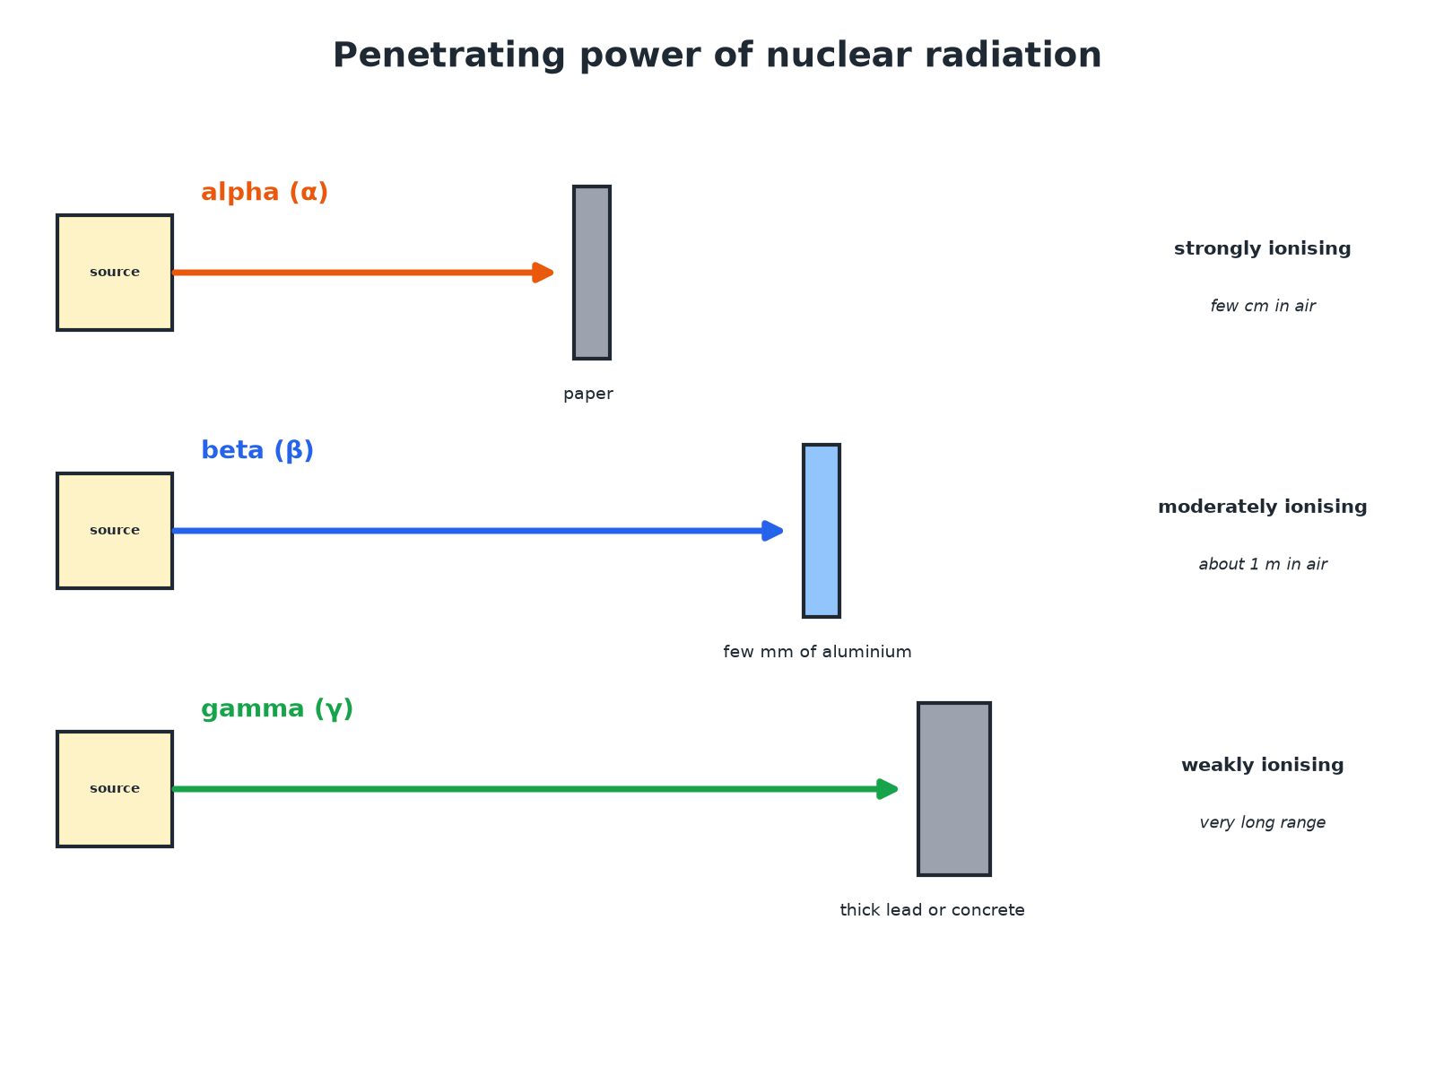

AQA GCSE PHYSICS · PAPER 1 · FOUNDATION & HIGHER
Penetrating Power
The more ionising, the less penetrating.
Atomic structure
openrevise.com
Lesson 4 of 10

Slide 7

AQA GCSE PHYSICS · PAPER 1 · FOUNDATION & HIGHER
Types of Radiation
Learn the properties.
Radiation
What it is
Stopped by
Range in air
Ionising power
Alpha (α)
Two protons and two neutrons (a helium nucleus)
A sheet of paper or a few cm of air
A few cm
Strongly ionising
Beta (β)
A high-speed electron from a neutron changing into a proton
A few mm of aluminium
About 1 m
Moderately ionising
Gamma (γ)
Electromagnetic radiation from the nucleus
Thick lead or several metres of concrete
Very long
Weakly ionising
Neutron (n)
A neutron from the nucleus
Thick concrete or water
Long
Indirectly ionising
Atomic structure
openrevise.com
Lesson 4 of 10

Slide 8

AQA GCSE PHYSICS · PAPER 1 · FOUNDATION & HIGHER
Choosing a Source
Which radiation would you use for a smoke detector, and why?
Detector
Uses alpha radiation ionising the air between two plates to make a small current
1
Why alpha
It is strongly ionising but stopped by paper, so is safe outside the detector
2
Smoke
Absorbs the alpha particles, the current falls and the alarm sounds
3
ANSWER
Alpha: it ionises air strongly (to give a current) but cannot escape the device.
Atomic structure
openrevise.com
Lesson 4 of 10

Slide 9
AQA GCSE PHYSICS · PAPER 1 · FOUNDATION & HIGHER
Monitoring Thickness
Which radiation could be used to monitor the thickness of aluminium foil? Explain.
Alpha
Absorbed completely by the foil: no use
1
Gamma
Passes through almost unchanged, so the thickness has little effect
2
Beta
Partly absorbed: the count on the other side changes with thickness
3
ANSWER
Beta radiation: it is partly absorbed by thin foil, so changes in the count rate show changes in thickness.
Atomic structure
openrevise.com
Lesson 4 of 10

Slide 10

AQA GCSE PHYSICS · PAPER 1 · FOUNDATION & HIGHER
Key Ideas
Getting the exam points.
Random
It is not possible to predict when a particular nucleus will decay.
Activity or count rate
Activity in becquerel (Bq); count rate is the number of counts per second on a detector.
Ionising
Radiation that removes electrons from atoms to make ions can damage living cells.
Choose the radiation
Match penetration and ionising power to the job, and think about safety.
Atomic structure
openrevise.com
Lesson 4 of 10

Slide 11

AQA GCSE PHYSICS · PAPER 1 · FOUNDATION & HIGHER
Key Terms
Radioactive decay
The random process in which an unstable nucleus emits radiation.
Activity
The rate at which a source decays, in becquerel.
Count rate
Number of decays detected each second.
Ionising
Able to knock electrons off atoms.
Alpha particle
Two protons and two neutrons.
Gamma ray
Electromagnetic radiation from the nucleus.
Atomic structure
openrevise.com
Lesson 4 of 10

Slide 12

AQA GCSE PHYSICS · PAPER 1 · FOUNDATION & HIGHER
YOUR TASK
12 minutes
Which Radiation?
For each use, choose alpha, beta or gamma and explain: (a) a smoke detector, (b) checking for a leak in an underground pipe using a tracer, (c) monitoring the thickness of paper in a factory.
Match penetration to the job.
1
Consider safety.
2
WHAT A GOOD ANSWER SHOWS
(a) Alpha: strongly ionising, stopped by paper. (b) Gamma: penetrates soil and can be detected above ground. (c) Beta: partly absorbed by paper so the count changes with thickness.
Atomic structure
openrevise.com
Lesson 4 of 10
Notes:
Ask learners to say why alpha would not work for (b).

Slide 13
AQA GCSE PHYSICS · PAPER 1 · FOUNDATION & HIGHER
Can I...?
Define radioactive decay.
State what stops each.
Say decay is random.
Compare ionising powers.
Define activity and count rate.
Choose a source for a use.
Describe alpha, beta and gamma.
Explain a choice.
Atomic structure
openrevise.com
Lesson 4 of 10

Slide 14
AQA GCSE PHYSICS · PAPER 1 · FOUNDATION & HIGHER
Summary & Exam Focus
Alpha: helium nucleus; beta: fast electron; gamma: EM wave.
Penetration: alpha < beta < gamma.
Ionising power: alpha > beta > gamma.
Activity in Bq; count rate per second.
EXAM FOCUS
Describe what an alpha particle is. (1 mark)
Two protons and two neutrons.
openrevise.com

Slide 15
AQA GCSE PHYSICS · PAPER 1 · FOUNDATION & HIGHER
Exam Practice: Radioactive decay and nuclear radiation
Answer all questions. Use the mark allocation as a guide to how much to write. · 18 minutes
Question 1 · 2 marks · State
Describe what an alpha particle is and what a gamma ray is.
Question 2 · 3 marks · Complete
Complete the sentences. Alpha radiation is stopped by a ______. Beta radiation is stopped by a few millimetres of ______. Gamma radiation…
Question 3 · 3 marks · Explain
A smoke detector contains a source of alpha radiation. Explain why alpha radiation is used and not gamma radiation.
Atomic structure
openrevise.com
Lesson 4 of 10

Slide 16
AQA GCSE PHYSICS · PAPER 1 · FOUNDATION & HIGHER
Exam Practice: Radioactive decay and nuclear radiation (cont.)
Question 4 · 3 marks · Explain
A factory monitors the thickness of aluminium foil by measuring the radiation that passes through it. Explain why a source of beta…
Question 5 · 6 marks · Evaluate
Radioactive sources are used in industry and medicine. Compare the properties of alpha, beta and gamma radiation and evaluate which is best…
Atomic structure
openrevise.com
Lesson 4 of 10

Slide 17
AQA GCSE PHYSICS · PAPER 1 · FOUNDATION & HIGHER
Question 1 · 2 marks · State
“
Describe what an alpha particle is and what a gamma ray is.
HOW TO ANSWER IT
Command word: State. Worth 2 marks, so plan before writing.
Atomic structure
openrevise.com
Lesson 4 of 10

Slide 18
AQA GCSE PHYSICS · PAPER 1 · FOUNDATION & HIGHER
Question 1 · mark scheme
2 marks available. Award a mark for each point made.
Alpha: two protons and two neutrons
1 mark
Gamma: electromagnetic radiation
1 mark
Atomic structure
openrevise.com
Lesson 4 of 10

Slide 19
AQA GCSE PHYSICS · PAPER 1 · FOUNDATION & HIGHER
Question 2 · 3 marks · Complete
“
Complete the sentences. Alpha radiation is stopped by a ______. Beta radiation is stopped by a few millimetres of ______. Gamma radiation is reduced by thick ______.
HOW TO ANSWER IT
Command word: Complete. Worth 3 marks, so plan before writing.
Atomic structure
openrevise.com
Lesson 4 of 10

Slide 20
AQA GCSE PHYSICS · PAPER 1 · FOUNDATION & HIGHER
Question 2 · mark scheme
3 marks available. Award a mark for each point made.
Paper
1 mark
Aluminium
1 mark
Lead or concrete
1 mark
Atomic structure
openrevise.com
Lesson 4 of 10

Slide 21
AQA GCSE PHYSICS · PAPER 1 · FOUNDATION & HIGHER
Question 3 · 3 marks · Explain
“
A smoke detector contains a source of alpha radiation. Explain why alpha radiation is used and not gamma radiation.
HOW TO ANSWER IT
Command word: Explain. Worth 3 marks, so plan before writing.
Atomic structure
openrevise.com
Lesson 4 of 10

Slide 22
AQA GCSE PHYSICS · PAPER 1 · FOUNDATION & HIGHER
Question 3 · mark scheme
3 marks available. Award a mark for each point made.
Alpha strongly ionising
1 mark
Stopped by paper or air so safe
1 mark
Gamma penetrates and weakly ionising
1 mark
Atomic structure
openrevise.com
Lesson 4 of 10

Slide 23
AQA GCSE PHYSICS · PAPER 1 · FOUNDATION & HIGHER
Question 4 · 3 marks · Explain
“
A factory monitors the thickness of aluminium foil by measuring the radiation that passes through it. Explain why a source of beta radiation is used and not alpha or gamma radiation.
HOW TO ANSWER IT
Command word: Explain. Worth 3 marks, so plan before writing.
Atomic structure
openrevise.com
Lesson 4 of 10

Slide 24
AQA GCSE PHYSICS · PAPER 1 · FOUNDATION & HIGHER
Question 4 · mark scheme
3 marks available. Award a mark for each point made.
Alpha absorbed completely
1 mark
Gamma passes through unchanged
1 mark
Beta partly absorbed so count rate shows the thickness
1 mark
Atomic structure
openrevise.com
Lesson 4 of 10

Slide 25
AQA GCSE PHYSICS · PAPER 1 · FOUNDATION & HIGHER
Question 5 · 6 marks · Evaluate
“
Radioactive sources are used in industry and medicine. Compare the properties of alpha, beta and gamma radiation and evaluate which is best to use as a tracer inside the body.
HOW TO ANSWER IT
Command word: Evaluate. Worth 6 marks, so plan before writing.
Atomic structure
openrevise.com
Lesson 4 of 10

Slide 26
AQA GCSE PHYSICS · PAPER 1 · FOUNDATION & HIGHER
Question 5 · mark scheme
6 marks available. Award a mark for each point made.
Level 3 (5 to 6 marks): properties of all three (penetration, range, ionising power), the tracer needs to pass out of the body to be detected outside, and a justified conclusion that gamma is best
5 to 6 marks
Level 2 (3 to 4 marks): properties of at least two types with some link to use as a tracer
3 to 4 marks
Level 1 (1 to 2 marks): simple statements about the radiation
1 to 2 marks
Atomic structure
openrevise.com
Lesson 4 of 10

