Slide 1

AQA GCSE PHYSICS · PAPER 1 · FOUNDATION & HIGHER
Radioactive contamination and irradiation
Atomic structure
Lesson 7 of 10
openrevise.com

Slide 2

AQA GCSE PHYSICS · PAPER 1 · FOUNDATION & HIGHER
Warm-up
Answer each one, then check.
1
What is ionising radiation?
2
What are alpha, beta and gamma?
3
Which radiation is most penetrating?
4
What is a hazard?
5
What does peer review mean?
Atomic structure
openrevise.com
Lesson 7 of 10

Slide 3
AQA GCSE PHYSICS · PAPER 1 · FOUNDATION & HIGHER
Warm-up - Answers
What is ionising radiation?
Radiation that can knock electrons off atoms
1
What are alpha, beta and gamma?
Types of nuclear radiation
2
Which radiation is most penetrating?
Gamma
3
What is a hazard?
Something that could cause harm
4
What does peer review mean?
Checking by other scientists before results are accepted
5
Atomic structure
openrevise.com
Lesson 7 of 10

Slide 4

AQA GCSE PHYSICS · PAPER 1 · FOUNDATION & HIGHER
Learning Objectives
Define radioactive contamination and irradiation.
1
Compare the hazards of contamination and irradiation.
2
Describe precautions when handling sources.
3
Explain why studies on the effects of radiation are published and peer reviewed.
4
Atomic structure
openrevise.com
Lesson 7 of 10

Slide 5

AQA GCSE PHYSICS · PAPER 1 · FOUNDATION & HIGHER
CONTAMINATION VS IRRADIATION
Radioactive contamination is the unwanted presence of materials containing radioactive atoms on other materials. Irradiation is exposing an object to nuclear radiation: the irradiated object does not become radioactive.
The hazard from contamination is due to the decay of the contaminating atoms; the type of radiation emitted affects the level of hazard.
Atomic structure
openrevise.com
Lesson 7 of 10

Slide 6
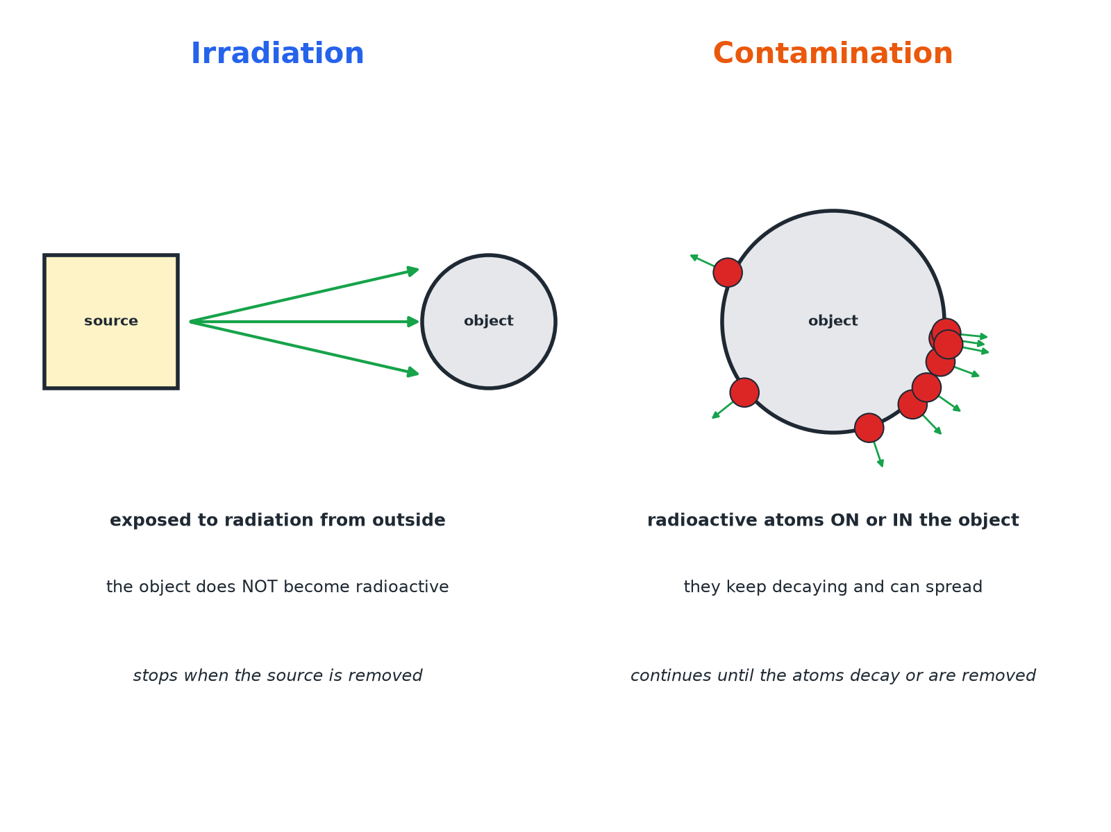

AQA GCSE PHYSICS · PAPER 1 · FOUNDATION & HIGHER
Contamination and Irradiation
Contamination puts radioactive atoms on the object itself.
Atomic structure
openrevise.com
Lesson 7 of 10

Slide 7

AQA GCSE PHYSICS · PAPER 1 · FOUNDATION & HIGHER
Which Is More Hazardous?
IRRADIATION
CONTAMINATION
• The object is exposed from outside.
• It stops when the source is removed or shielded.
• The object does not become radioactive.
• Hazard depends on the type of radiation and time exposed.
• Radioactive atoms are on or in the object.
• Radiation continues until the atoms decay or are removed.
• Alpha sources inside the body are very dangerous.
• Can spread to other objects.
Atomic structure
openrevise.com
Lesson 7 of 10

Slide 8

AQA GCSE PHYSICS · PAPER 1 · FOUNDATION & HIGHER
Precautions When Using Sources
Protect against irradiation and contamination.
1
2
3
4
5
Distance
Handle sources with tongs; keep away.
Time
Keep exposure times short.
Shielding
Store sources in lead-lined containers.
Protective clothing
Gloves and coats stop contamination.
Hygiene
No eating or drinking; wash hands.
Atomic structure
openrevise.com
Lesson 7 of 10

Slide 9

AQA GCSE PHYSICS · PAPER 1 · FOUNDATION & HIGHER
Comparing Hazards
Explain why an alpha source is not very hazardous outside the body but is very hazardous if swallowed.
Outside
Alpha is stopped by air, paper or skin
1
Inside
Contamination puts the source in contact with living cells
2
Ionising
Alpha is strongly ionising and damages cells
3
ANSWER
Outside, alpha cannot penetrate skin; inside it is contamination and its strong ionising damages cells.
Atomic structure
openrevise.com
Lesson 7 of 10

Slide 10

AQA GCSE PHYSICS · PAPER 1 · FOUNDATION & HIGHER
Peer Review
Why it matters.
Publish and share
Findings on the effects of radiation on humans must be published so that other scientists can check them.
Peer review
Other scientists check the methods and conclusions before they are accepted.
Trust
This makes conclusions more reliable and helps set safety rules.
Atomic structure
openrevise.com
Lesson 7 of 10

Slide 11

AQA GCSE PHYSICS · PAPER 1 · FOUNDATION & HIGHER
Key Terms
Contamination
The unwanted presence of radioactive atoms on or in other materials.
Irradiation
Exposure to nuclear radiation without radioactive atoms being transferred.
Shielding
Material used to absorb radiation.
Peer review
Checking of scientific work by other scientists.
Hazard
Something that could cause harm.
Precaution
An action to reduce a risk.
Atomic structure
openrevise.com
Lesson 7 of 10

Slide 12

AQA GCSE PHYSICS · PAPER 1 · FOUNDATION & HIGHER
YOUR TASK
12 minutes
Compare the Hazards
A worker handles a gamma source with tongs and a worker accidentally spills a solution containing radioactive iodine on their skin. Say which is irradiation and which is contamination, and compare the hazards.
Name each.
1
Compare how long exposure lasts.
2
WHAT A GOOD ANSWER SHOWS
The gamma source: irradiation (they are exposed while nearby, they do not become radioactive). The spill: contamination (radioactive atoms are on the skin and keep decaying). Contamination can continue and be spread or absorbed, so is more serious unless removed.
Atomic structure
openrevise.com
Lesson 7 of 10
Notes:
Ask what should be done immediately.

Slide 13
AQA GCSE PHYSICS · PAPER 1 · FOUNDATION & HIGHER
Can I...?
Define contamination.
Give precautions.
Define irradiation.
Explain why peer review matters.
Explain irradiated objects are not radioactive.
Explain why alpha is dangerous inside the body.
Compare the hazards.
Choose safe handling.
Atomic structure
openrevise.com
Lesson 7 of 10

Slide 14
AQA GCSE PHYSICS · PAPER 1 · FOUNDATION & HIGHER
Summary & Exam Focus
Contamination: radioactive atoms on or in the object.
Irradiation: exposed to radiation; not radioactive.
Hazard depends on the type of radiation.
Peer review checks findings.
EXAM FOCUS
State the difference between contamination and irradiation. (2 marks)
Contamination involves radioactive atoms on the object; irradiation is exposure without the object becoming radioactive.
openrevise.com

Slide 15
AQA GCSE PHYSICS · PAPER 1 · FOUNDATION & HIGHER
Exam Practice: Radioactive contamination and irradiation
Answer all questions. Use the mark allocation as a guide to how much to write. · 13 minutes
Question 1 · 2 marks · State
Explain the difference between radioactive contamination and irradiation.
Question 2 · 3 marks · Explain
A student says that a person who has been irradiated by a gamma source is now radioactive. Explain why the student is wrong.
Question 3 · 2 marks · Suggest
Give two precautions that should be taken when a teacher handles a radioactive source.
Atomic structure
openrevise.com
Lesson 7 of 10

Slide 16
AQA GCSE PHYSICS · PAPER 1 · FOUNDATION & HIGHER
Exam Practice: Radioactive contamination and irradiation (cont.)
Question 4 · 3 marks · Compare
Compare the hazards of contamination and irradiation from an alpha source.
Question 5 · 2 marks · Explain
Scientists who study the effects of radiation on humans publish their findings. Explain why it is important that the findings are peer…
Atomic structure
openrevise.com
Lesson 7 of 10

Slide 17
AQA GCSE PHYSICS · PAPER 1 · FOUNDATION & HIGHER
Question 1 · 2 marks · State
“
Explain the difference between radioactive contamination and irradiation.
HOW TO ANSWER IT
Command word: State. Worth 2 marks, so plan before writing.
Atomic structure
openrevise.com
Lesson 7 of 10

Slide 18
AQA GCSE PHYSICS · PAPER 1 · FOUNDATION & HIGHER
Question 1 · mark scheme
2 marks available. Award a mark for each point made.
Contamination: radioactive atoms present on other materials
1 mark
Irradiation: exposure and the object does not become radioactive
1 mark
Atomic structure
openrevise.com
Lesson 7 of 10

Slide 19
AQA GCSE PHYSICS · PAPER 1 · FOUNDATION & HIGHER
Question 2 · 3 marks · Explain
“
A student says that a person who has been irradiated by a gamma source is now radioactive. Explain why the student is wrong.
HOW TO ANSWER IT
Command word: Explain. Worth 3 marks, so plan before writing.
Atomic structure
openrevise.com
Lesson 7 of 10

Slide 20
AQA GCSE PHYSICS · PAPER 1 · FOUNDATION & HIGHER
Question 2 · mark scheme
3 marks available. Award a mark for each point made.
Irradiation is exposure
1 mark
No radioactive atoms transferred
1 mark
So the person is not radioactive
1 mark
Atomic structure
openrevise.com
Lesson 7 of 10

Slide 21
AQA GCSE PHYSICS · PAPER 1 · FOUNDATION & HIGHER
Question 3 · 2 marks · Suggest
“
Give two precautions that should be taken when a teacher handles a radioactive source.
HOW TO ANSWER IT
Command word: Suggest. Worth 2 marks, so plan before writing.
Atomic structure
openrevise.com
Lesson 7 of 10

Slide 22
AQA GCSE PHYSICS · PAPER 1 · FOUNDATION & HIGHER
Question 3 · mark scheme
2 marks available. Award a mark for each point made.
First precaution
1 mark
Second precaution
1 mark
Atomic structure
openrevise.com
Lesson 7 of 10

Slide 23
AQA GCSE PHYSICS · PAPER 1 · FOUNDATION & HIGHER
Question 4 · 3 marks · Compare
“
Compare the hazards of contamination and irradiation from an alpha source.
HOW TO ANSWER IT
Command word: Compare. Worth 3 marks, so plan before writing.
Atomic structure
openrevise.com
Lesson 7 of 10

Slide 24
AQA GCSE PHYSICS · PAPER 1 · FOUNDATION & HIGHER
Question 4 · mark scheme
3 marks available. Award a mark for each point made.
Irradiation by alpha: low hazard, absorbed
1 mark
Contamination inside the body: high hazard
1 mark
Alpha strongly ionising
1 mark
Atomic structure
openrevise.com
Lesson 7 of 10

Slide 25
AQA GCSE PHYSICS · PAPER 1 · FOUNDATION & HIGHER
Question 5 · 2 marks · Explain
“
Scientists who study the effects of radiation on humans publish their findings. Explain why it is important that the findings are peer reviewed.
HOW TO ANSWER IT
Command word: Explain. Worth 2 marks, so plan before writing.
Atomic structure
openrevise.com
Lesson 7 of 10

Slide 26
AQA GCSE PHYSICS · PAPER 1 · FOUNDATION & HIGHER
Question 5 · mark scheme
2 marks available. Award a mark for each point made.
Findings checked by other scientists
1 mark
So more reliable or valid
1 mark
Atomic structure
openrevise.com
Lesson 7 of 10

