Slide 1

AQA GCSE PHYSICS · PAPER 1 · FOUNDATION & HIGHER
Background radiation
Atomic structure
Lesson 8 of 10
openrevise.com

Slide 2

AQA GCSE PHYSICS · PAPER 1 · FOUNDATION & HIGHER
Warm-up
Answer each one, then check.
1
What is radiation?
2
Name a rock that contains radioactive material.
3
What does mSv stand for?
4
Where do cosmic rays come from?
5
What is a Geiger-Müller tube?
Atomic structure
openrevise.com
Lesson 8 of 10

Slide 3
AQA GCSE PHYSICS · PAPER 1 · FOUNDATION & HIGHER
Warm-up - Answers
What is radiation?
Energy emitted as waves or particles
1
Name a rock that contains radioactive material.
Granite
2
What does mSv stand for?
Millisievert
3
Where do cosmic rays come from?
Space
4
What is a Geiger-Müller tube?
A detector of radiation
5
Atomic structure
openrevise.com
Lesson 8 of 10

Slide 4

AQA GCSE PHYSICS · PAPER 1 · FOUNDATION & HIGHER
Learning Objectives
Describe the sources of background radiation.
1
Explain why radiation dose varies with location and occupation.
2
Use data on radiation dose in millisieverts.
3
Atomic structure
openrevise.com
Lesson 8 of 10

Slide 5

AQA GCSE PHYSICS · PAPER 1 · FOUNDATION & HIGHER
BACKGROUND RADIATION
Background radiation is around us all of the time. It comes from natural sources such as rocks and cosmic rays and from man-made sources such as fallout from nuclear weapon tests and accidents.
Radiation dose is measured in sieverts (Sv). 1000 millisieverts (mSv) = 1 sievert. You do not need to recall the unit.
Atomic structure
openrevise.com
Lesson 8 of 10

Slide 6
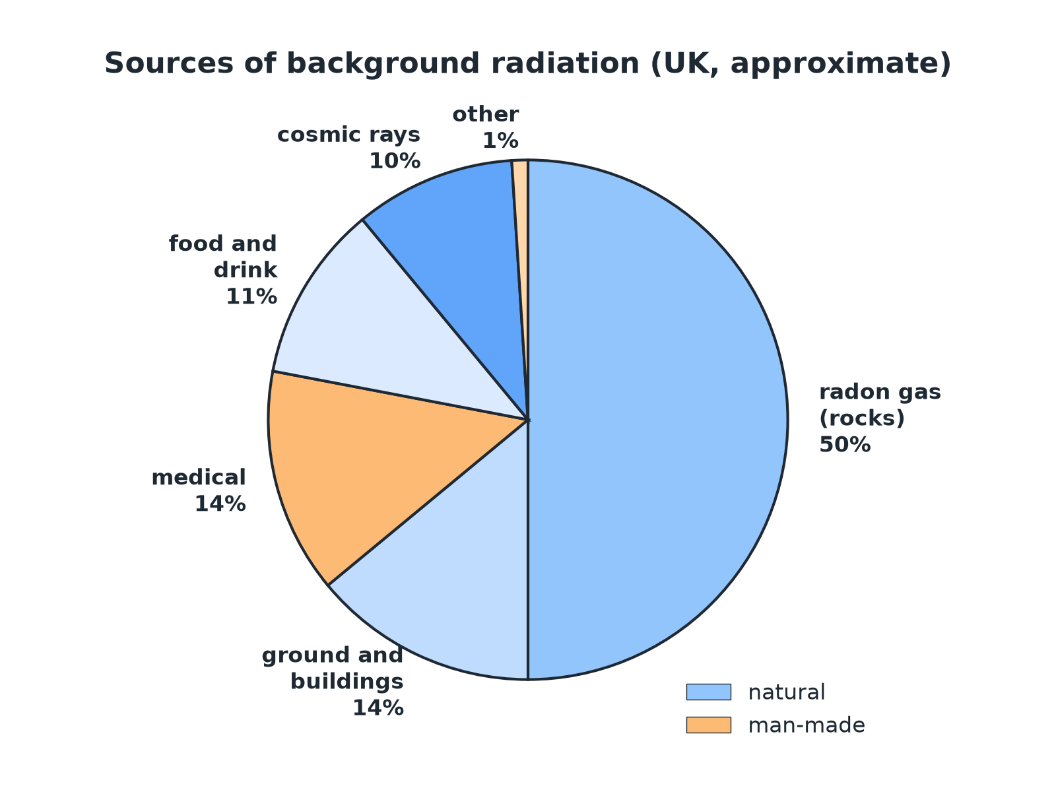

AQA GCSE PHYSICS · PAPER 1 · FOUNDATION & HIGHER
Sources of Background Radiation
Most background radiation is natural.
Atomic structure
openrevise.com
Lesson 8 of 10

Slide 7

AQA GCSE PHYSICS · PAPER 1 · FOUNDATION & HIGHER
Where Does It Come From?
Natural: rocks
Radioactive isotopes in rocks such as granite release radon gas.
Natural: cosmic rays
High-energy particles from space; stronger at altitude.
Natural: food and air
Small amounts in food, drink and the air.
Man-made
Fallout from nuclear weapon testing and accidents, and medical procedures.
Atomic structure
openrevise.com
Lesson 8 of 10

Slide 8
AQA GCSE PHYSICS · PAPER 1 · FOUNDATION & HIGHER
Why Dose Varies
Location and occupation.
Factor
Effect
Location
Areas with granite rock have higher radon levels; high altitudes have more cosmic rays.
Occupation
Airline crews (cosmic rays), radiographers and nuclear workers receive higher doses.
Medical treatments
X-rays and scans add to a person's dose.
Atomic structure
openrevise.com
Lesson 8 of 10

Slide 9

AQA GCSE PHYSICS · PAPER 1 · FOUNDATION & HIGHER
Using a Pie Chart
The typical annual dose is 2.7 mSv. Radon is 50% of this. Calculate the dose from radon.
Fraction
50% = 0.50
1
Multiply
0.50 × 2.7
2
Answer
1.35 mSv
3
ANSWER
1.35 mSv (about 1.4 mSv)
Atomic structure
openrevise.com
Lesson 8 of 10

Slide 10
AQA GCSE PHYSICS · PAPER 1 · FOUNDATION & HIGHER
Converting Units
Convert 2.7 mSv to sieverts.
1000 mSv = 1 Sv
2.7 ÷ 1000
1
Answer
0.0027 Sv (2.7 × 10⁻³ Sv)
2
ANSWER
2.7 × 10⁻³ Sv
Atomic structure
openrevise.com
Lesson 8 of 10

Slide 11

AQA GCSE PHYSICS · PAPER 1 · FOUNDATION & HIGHER
Measuring It
How background is found.
Detector
A Geiger-Müller tube and counter measures the count rate.
Correct
Subtract the background count rate from measurements on a source.
Vary
Background changes with place and time, so measure it in the same place.
Atomic structure
openrevise.com
Lesson 8 of 10

Slide 12

AQA GCSE PHYSICS · PAPER 1 · FOUNDATION & HIGHER
Key Terms
Background radiation
Radiation that is around us all the time.
Cosmic rays
High-energy particles from space.
Radon
A radioactive gas from rocks.
Radiation dose
A measure of the risk of harm from radiation, in sieverts.
Millisievert
One thousandth of a sievert.
Man-made
Produced by human activity.
Atomic structure
openrevise.com
Lesson 8 of 10

Slide 13

AQA GCSE PHYSICS · PAPER 1 · FOUNDATION & HIGHER
YOUR TASK
10 minutes
Why Does It Differ?
Explain why the background radiation is higher in Cornwall (granite) than in London, and why an airline pilot receives a higher dose than an office worker.
Name the source.
1
Link it to location or job.
2
WHAT A GOOD ANSWER SHOWS
Granite rocks contain radioactive isotopes and release radon gas, so background is higher. Pilots fly at high altitude where there are more cosmic rays.
Atomic structure
openrevise.com
Lesson 8 of 10
Notes:
Ask how a house could be protected from radon.

Slide 14
AQA GCSE PHYSICS · PAPER 1 · FOUNDATION & HIGHER
Can I...?
List natural sources.
Use a pie chart.
List man-made sources.
Convert mSv to Sv.
Explain location effects.
Correct for background.
Explain occupation effects.
Explain why background varies.
Atomic structure
openrevise.com
Lesson 8 of 10

Slide 15
AQA GCSE PHYSICS · PAPER 1 · FOUNDATION & HIGHER
Summary & Exam Focus
Natural: rocks, cosmic rays, food.
Man-made: fallout, medical procedures.
Dose varies with location and occupation.
1000 mSv = 1 Sv.
EXAM FOCUS
Give two natural sources of background radiation. (2 marks)
Any two: rocks, cosmic rays, food.
openrevise.com

Slide 16
AQA GCSE PHYSICS · PAPER 1 · FOUNDATION & HIGHER
Exam Practice: Background radiation
Answer all questions. Use the mark allocation as a guide to how much to write. · 13 minutes
Question 1 · 2 marks · State
Give two natural sources of background radiation.
Question 2 · 2 marks · State
Give one man-made source of background radiation.
Question 3 · 3 marks · Use the chart
The pie chart shows the sources of background radiation. The total annual dose is 2.7 mSv. Radon is 50% of the total. (a) Calculate the…
Atomic structure
openrevise.com
Lesson 8 of 10

Slide 17
AQA GCSE PHYSICS · PAPER 1 · FOUNDATION & HIGHER
Exam Practice: Background radiation (cont.)
Question 4 · 2 marks · Explain
The background radiation is higher in some parts of the UK than others. Suggest one reason.
Question 5 · 3 marks · Explain
Airline pilots receive a higher radiation dose than office workers. Explain why. Also state how background radiation is taken into account…
Atomic structure
openrevise.com
Lesson 8 of 10

Slide 18
AQA GCSE PHYSICS · PAPER 1 · FOUNDATION & HIGHER
Question 1 · 2 marks · State
“
Give two natural sources of background radiation.
HOW TO ANSWER IT
Command word: State. Worth 2 marks, so plan before writing.
Atomic structure
openrevise.com
Lesson 8 of 10

Slide 19
AQA GCSE PHYSICS · PAPER 1 · FOUNDATION & HIGHER
Question 1 · mark scheme
2 marks available. Award a mark for each point made.
First source
1 mark
Second source
1 mark
Atomic structure
openrevise.com
Lesson 8 of 10

Slide 20
AQA GCSE PHYSICS · PAPER 1 · FOUNDATION & HIGHER
Question 2 · 2 marks · State
“
Give one man-made source of background radiation.
HOW TO ANSWER IT
Command word: State. Worth 2 marks, so plan before writing.
Atomic structure
openrevise.com
Lesson 8 of 10

Slide 21
AQA GCSE PHYSICS · PAPER 1 · FOUNDATION & HIGHER
Question 2 · mark scheme
2 marks available. Award a mark for each point made.
One correct source
1 mark
Man-made linked to human activity
1 mark
Atomic structure
openrevise.com
Lesson 8 of 10

Slide 22

AQA GCSE PHYSICS · PAPER 1 · FOUNDATION & HIGHER
Question 3 · 3 marks · Use the chart
The pie chart shows the sources of background radiation. The total annual dose is 2.7 mSv. Radon is 50% of the total. (a) Calculate the dose from radon. (b) Is most of the background radiation natural or man-made? Give a reason. (3 marks)
Atomic structure
openrevise.com
Lesson 8 of 10

Slide 23
AQA GCSE PHYSICS · PAPER 1 · FOUNDATION & HIGHER
Question 3 · mark scheme
3 marks available. Award a mark for each point made.
1.35 mSv
1 mark
Natural
1 mark
Reason from the chart
1 mark
Atomic structure
openrevise.com
Lesson 8 of 10

Slide 24
AQA GCSE PHYSICS · PAPER 1 · FOUNDATION & HIGHER
Question 4 · 2 marks · Explain
“
The background radiation is higher in some parts of the UK than others. Suggest one reason.
HOW TO ANSWER IT
Command word: Explain. Worth 2 marks, so plan before writing.
Atomic structure
openrevise.com
Lesson 8 of 10

Slide 25
AQA GCSE PHYSICS · PAPER 1 · FOUNDATION & HIGHER
Question 4 · mark scheme
2 marks available. Award a mark for each point made.
Type of rock or radon
1 mark
Linked to higher levels in that location
1 mark
Atomic structure
openrevise.com
Lesson 8 of 10

Slide 26
AQA GCSE PHYSICS · PAPER 1 · FOUNDATION & HIGHER
Question 5 · 3 marks · Explain
“
Airline pilots receive a higher radiation dose than office workers. Explain why. Also state how background radiation is taken into account when measuring the radiation from a radioactive source.
HOW TO ANSWER IT
Command word: Explain. Worth 3 marks, so plan before writing.
Atomic structure
openrevise.com
Lesson 8 of 10

Slide 27
AQA GCSE PHYSICS · PAPER 1 · FOUNDATION & HIGHER
Question 5 · mark scheme
3 marks available. Award a mark for each point made.
Cosmic rays at altitude
1 mark
Measure background count rate
1 mark
Subtract from the reading
1 mark
Atomic structure
openrevise.com
Lesson 8 of 10

