Slide 1

AQA GCSE PHYSICS · PAPER 1 · FOUNDATION & HIGHER
Half-lives, hazards and uses of nuclear radiation
Atomic structure
Lesson 9 of 10
openrevise.com

Slide 2

AQA GCSE PHYSICS · PAPER 1 · FOUNDATION & HIGHER
Warm-up
Answer each one, then check.
1
What is half-life?
2
What is a tracer?
3
Which radiation is most penetrating?
4
Give one danger of ionising radiation.
5
What is standard form?
Atomic structure
openrevise.com
Lesson 9 of 10

Slide 3
AQA GCSE PHYSICS · PAPER 1 · FOUNDATION & HIGHER
Warm-up - Answers
What is half-life?
The time for activity to halve
1
What is a tracer?
A substance that can be followed inside the body
2
Which radiation is most penetrating?
Gamma
3
Give one danger of ionising radiation.
It can damage or kill cells
4
What is standard form?
A number written as a × 10ⁿ
5
Atomic structure
openrevise.com
Lesson 9 of 10

Slide 4

AQA GCSE PHYSICS · PAPER 1 · FOUNDATION & HIGHER
Learning Objectives
Explain why the hazards of a radioactive material differ with its half-life.
1
Describe and evaluate the use of nuclear radiation in exploring internal organs and treating unwanted tissue.
2
Evaluate the perceived risks of nuclear radiation using data.
3
Use data given in standard form.
4
Atomic structure
openrevise.com
Lesson 9 of 10

Slide 5

AQA GCSE PHYSICS · PAPER 1 · FOUNDATION & HIGHER
HALF-LIFE AND HAZARD
Radioactive isotopes have a very wide range of half-lives. Short half-lives are very active but decay quickly; long half-lives stay radioactive for a very long time.
In medicine, nuclear radiations are used to explore internal organs and to control or destroy unwanted tissue.
Atomic structure
openrevise.com
Lesson 9 of 10

Slide 6
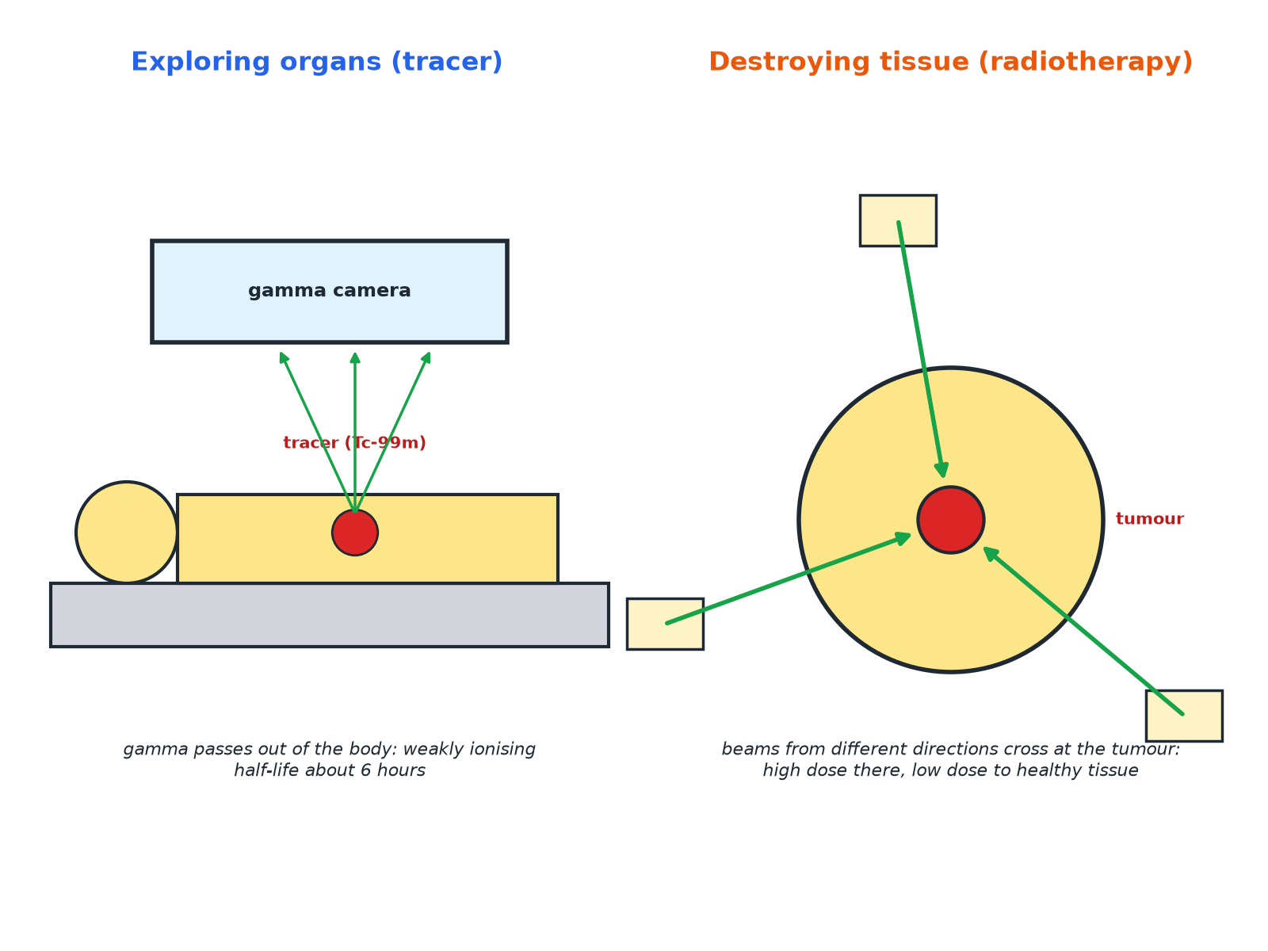

AQA GCSE PHYSICS · PAPER 1 · FOUNDATION & HIGHER
Nuclear Radiation in Medicine
The radiation is chosen for its penetration and half-life.
Atomic structure
openrevise.com
Lesson 9 of 10

Slide 7

AQA GCSE PHYSICS · PAPER 1 · FOUNDATION & HIGHER
Half-Life and Hazard
Data (approximate).
Isotope
Half-life
Comment
Technetium-99m
6 hours
Gamma emitter used as a medical tracer; gone from the body quickly
Iodine-131
8 days
Used to treat the thyroid; decays within weeks
Cobalt-60
5 years
Gamma source for radiotherapy
Uranium-238
4.5 × 10⁹ years
Stays radioactive for billions of years
Atomic structure
openrevise.com
Lesson 9 of 10

Slide 8

AQA GCSE PHYSICS · PAPER 1 · FOUNDATION & HIGHER
Why Half-Life Matters
Explain why a source with a very long half-life is a hazard for a long time, and why a source with a very short half-life is a hazard mainly at first.
Very long half-life
The activity falls extremely slowly, so it remains radioactive for a very long time
1
Very short half-life
It is very active at first but decays quickly, so it is a hazard for only a short time
2
ANSWER
Long half-life: long-term hazard, low activity. Short half-life: intense at first but soon gone.
Atomic structure
openrevise.com
Lesson 9 of 10

Slide 9
AQA GCSE PHYSICS · PAPER 1 · FOUNDATION & HIGHER
Choosing a Medical Tracer
Explain why technetium-99m is suitable as a tracer to explore organs in the body.
Gamma
Penetrating, so it passes out of the body to the detector, and weakly ionising, so it does little damage
1
Half-life 6 hours
Long enough to take the scan but decays quickly so the patient is not radioactive for long
2
ANSWER
It emits gamma rays, which pass out of the body and are weakly ionising, and its half-life is short.
Atomic structure
openrevise.com
Lesson 9 of 10

Slide 10

AQA GCSE PHYSICS · PAPER 1 · FOUNDATION & HIGHER
Evaluating Risk
Balance benefits and risks.
Benefits
Diagnose disease without surgery; destroy tumours.
Risks
Ionising radiation can damage healthy cells and cause cancer.
Reduce risk
Use small doses, short half-lives and beams from different directions.
Judging
Use the data on dose and consequences to say whether the risk is acceptable.
Atomic structure
openrevise.com
Lesson 9 of 10

Slide 11

AQA GCSE PHYSICS · PAPER 1 · FOUNDATION & HIGHER
Key Terms
Tracer
A radioactive substance used to follow a process in the body.
Radiotherapy
Treating cancer using nuclear radiation.
Half-life
The time for the activity to halve.
Gamma camera
A device that detects gamma rays from a tracer.
Unwanted tissue
Tissue such as a tumour.
Risk
The chance of harm.
Atomic structure
openrevise.com
Lesson 9 of 10

Slide 12

AQA GCSE PHYSICS · PAPER 1 · FOUNDATION & HIGHER
YOUR TASK
12 minutes
Evaluate the Scan
A doctor uses technetium-99m (half-life 6 hours, gamma) to scan a patient's kidneys. Give two reasons why it is suitable and one risk.
Consider penetration.
1
Consider half-life.
2
WHAT A GOOD ANSWER SHOWS
Reasons: gamma passes out of the body; short half-life. Risk: ionising radiation may damage cells (small).
Atomic structure
openrevise.com
Lesson 9 of 10

Slide 13
AQA GCSE PHYSICS · PAPER 1 · FOUNDATION & HIGHER
Can I...?
Explain hazard and half-life.
Explain beams from different directions.
Explain why gamma tracers are used.
Evaluate risks and benefits.
Explain why a short half-life suits a tracer.
Read standard form data.
Describe radiotherapy.
Use data in an answer.
Atomic structure
openrevise.com
Lesson 9 of 10

Slide 14
AQA GCSE PHYSICS · PAPER 1 · FOUNDATION & HIGHER
Summary & Exam Focus
Half-lives range from fractions of a second to billions of years.
Tracers: gamma, short half-life.
Radiotherapy: focus beams to destroy tumours.
Weigh benefits and risks.
EXAM FOCUS
Explain why a radioactive tracer used inside the body should emit gamma radiation and have a short half-life. (4 marks)
Gamma passes out of the body and short half-life means it does not remain long.
openrevise.com

