Slide 1

AQA GCSE PHYSICS · PAPER 1 · FOUNDATION & HIGHER
Nuclear fission and fusion
Atomic structure
Lesson 10 of 10
openrevise.com

Slide 2

AQA GCSE PHYSICS · PAPER 1 · FOUNDATION & HIGHER
Warm-up
Answer each one, then check.
1
What is a nucleus?
2
What is an isotope?
3
What is energy conserved?
4
What happens to mass in E = mc²?
5
What is a chain reaction?
Atomic structure
openrevise.com
Lesson 10 of 10

Slide 3
AQA GCSE PHYSICS · PAPER 1 · FOUNDATION & HIGHER
Warm-up - Answers
What is a nucleus?
The centre of an atom, made of protons and neutrons
1
What is an isotope?
An atom with the same protons but different neutrons
2
What is energy conserved?
Energy cannot be created or destroyed
3
What happens to mass in E = mc²?
It can be converted to energy
4
What is a chain reaction?
A reaction that keeps itself going
5
Atomic structure
openrevise.com
Lesson 10 of 10

Slide 4

AQA GCSE PHYSICS · PAPER 1 · FOUNDATION & HIGHER
Learning Objectives
Describe nuclear fission and how a chain reaction occurs.
1
Explain how the chain reaction is controlled in a nuclear reactor and uncontrolled in a nuclear weapon.
2
Draw and interpret diagrams of fission and chain reactions.
3
Describe nuclear fusion.
4
Atomic structure
openrevise.com
Lesson 10 of 10

Slide 5

AQA GCSE PHYSICS · PAPER 1 · FOUNDATION & HIGHER
FISSION AND FUSION
Nuclear fission is the splitting of a large and unstable nucleus, such as uranium or plutonium. Nuclear fusion is the joining of two light nuclei to form a heavier nucleus.
In both, energy is released. In fusion some of the mass is converted into the energy of radiation.
Atomic structure
openrevise.com
Lesson 10 of 10

Slide 6
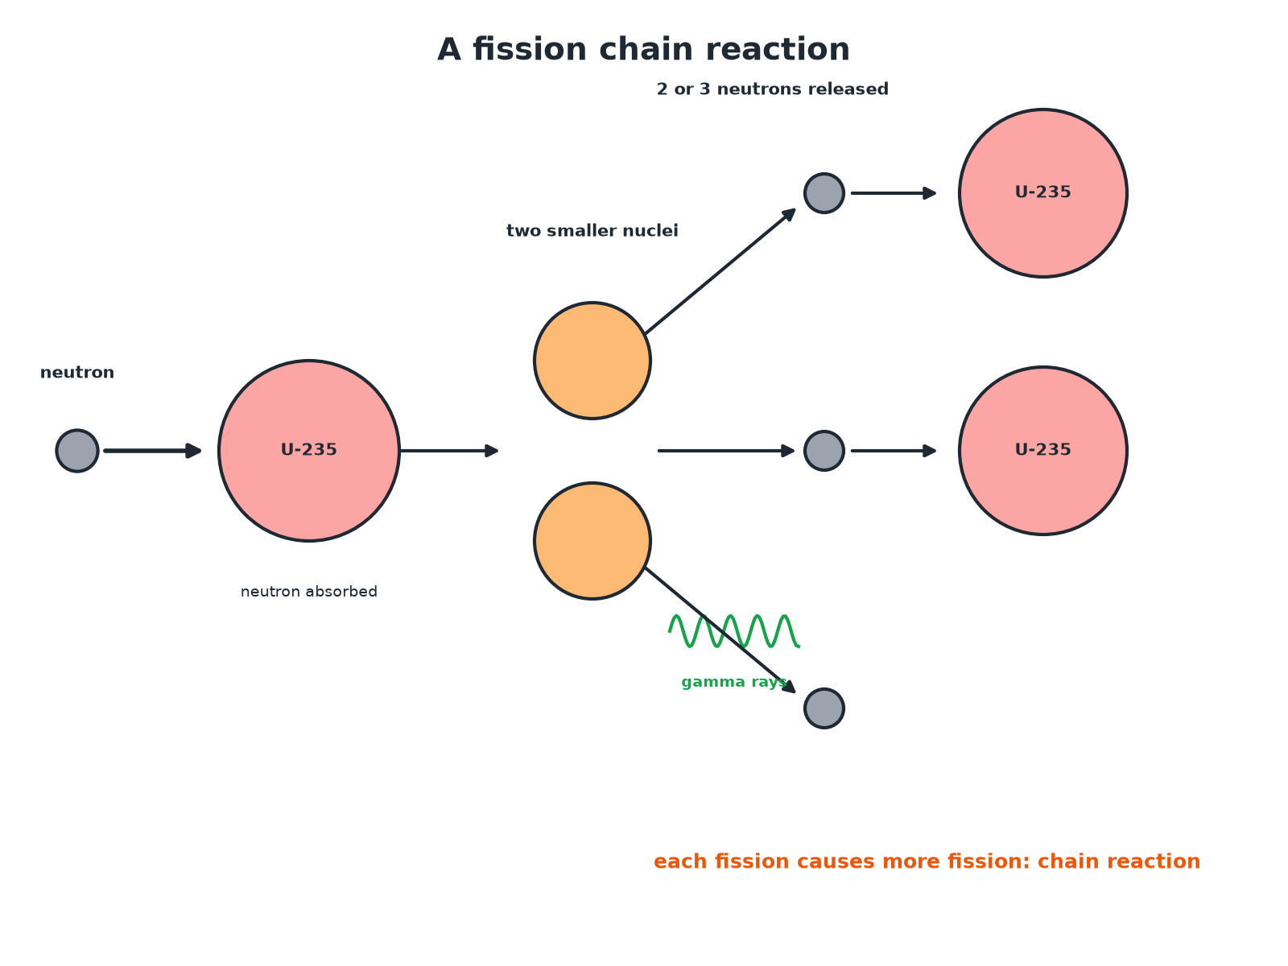

AQA GCSE PHYSICS · PAPER 1 · FOUNDATION & HIGHER
A Fission Chain Reaction
Each fission produces neutrons that cause more fission.
Atomic structure
openrevise.com
Lesson 10 of 10

Slide 7
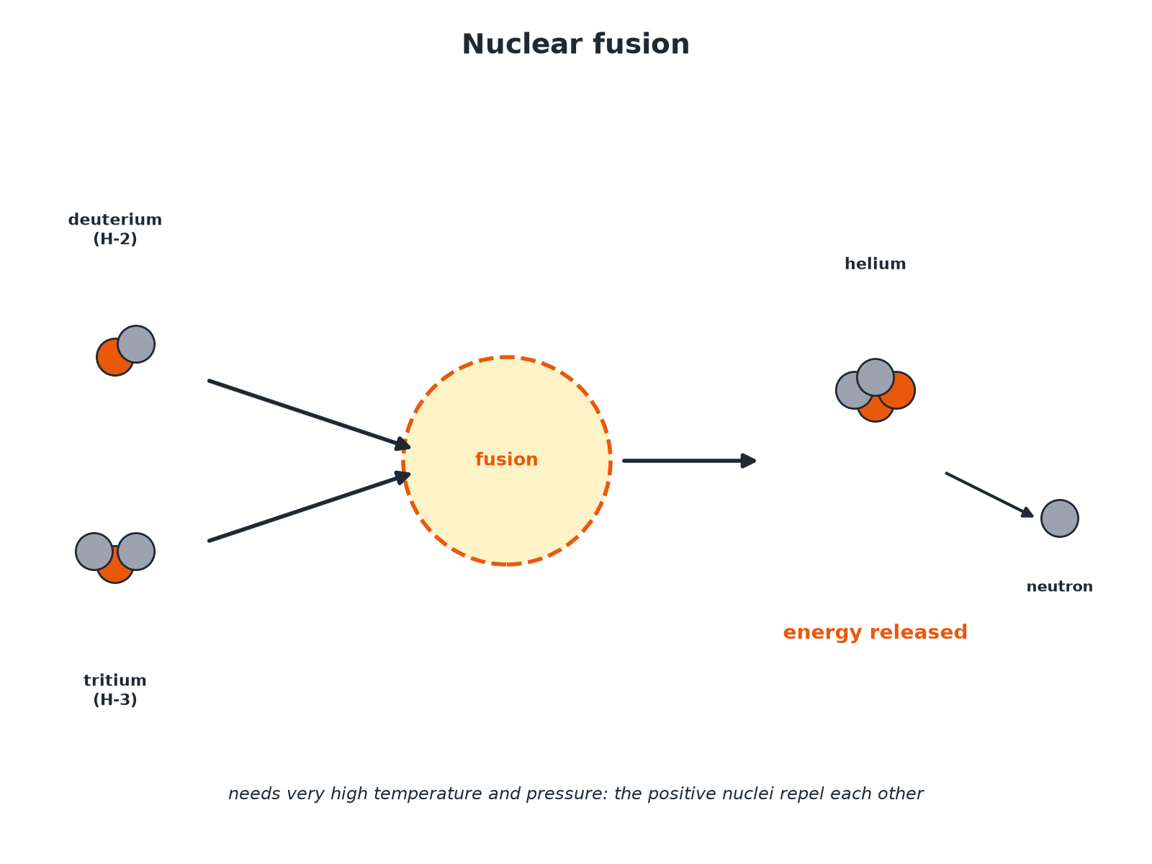
AQA GCSE PHYSICS · PAPER 1 · FOUNDATION & HIGHER
Nuclear Fusion
Two light nuclei join to make a heavier one.
Atomic structure
openrevise.com
Lesson 10 of 10

Slide 8

AQA GCSE PHYSICS · PAPER 1 · FOUNDATION & HIGHER
Nuclear Fission
Follow the steps.
1
2
3
4
5
A neutron is absorbed
An unstable nucleus such as uranium-235 absorbs a neutron.
The nucleus splits
Into two smaller nuclei, roughly equal in size.
Two or three neutrons are released
Also gamma rays.
Energy is released
All the fission products have kinetic energy.
Chain reaction
The neutrons go on to cause further fission.
Atomic structure
openrevise.com
Lesson 10 of 10

Slide 9

AQA GCSE PHYSICS · PAPER 1 · FOUNDATION & HIGHER
Controlled or Uncontrolled?
IN A NUCLEAR REACTOR
IN A NUCLEAR WEAPON
• The chain reaction is controlled.
• Control rods absorb excess neutrons so only one neutron from each fission causes another.
• Energy is released steadily to heat water.
• The chain reaction is uncontrolled.
• Neutrons cause many more fissions each time.
• A huge amount of energy is released in an instant: an explosion.
Atomic structure
openrevise.com
Lesson 10 of 10

Slide 10

AQA GCSE PHYSICS · PAPER 1 · FOUNDATION & HIGHER
Describing a Chain Reaction
Explain how a chain reaction occurs in a fission reactor.
Start
A neutron is absorbed by a uranium-235 nucleus which splits
1
Neutrons released
2 or 3 neutrons are released
2
Continues
These neutrons are absorbed by more nuclei, which also split, so the reaction keeps going
3
ANSWER
The neutrons released in each fission cause further fissions, so the reaction sustains itself.
Atomic structure
openrevise.com
Lesson 10 of 10

Slide 11
AQA GCSE PHYSICS · PAPER 1 · FOUNDATION & HIGHER
Fusion
Describe what happens in nuclear fusion.
Two light nuclei
Join together to form a heavier nucleus
1
Mass
Some of the mass is converted to energy released as radiation
2
Conditions
Very high temperature and pressure are needed to overcome the repulsion between the positive nuclei
3
ANSWER
Light nuclei join to form a heavier nucleus, releasing energy.
Atomic structure
openrevise.com
Lesson 10 of 10

Slide 12

AQA GCSE PHYSICS · PAPER 1 · FOUNDATION & HIGHER
Comparing Them
Points to remember.
Fission
A large nucleus splits into two smaller ones; releases neutrons; chain reaction.
Fusion
Two small nuclei join; needs very high temperature; powers the Sun.
Both
Release energy; fusion releases more per kilogram of fuel than fission.
Waste
Fission produces radioactive waste; fusion products are largely not radioactive for long.
Atomic structure
openrevise.com
Lesson 10 of 10

Slide 13

AQA GCSE PHYSICS · PAPER 1 · FOUNDATION & HIGHER
Key Terms
Nuclear fission
The splitting of a large, unstable nucleus.
Nuclear fusion
The joining of two light nuclei to form a heavier nucleus.
Chain reaction
A reaction in which the products cause more of the same reaction.
Control rods
Rods that absorb neutrons to control a reactor.
Fission products
The smaller nuclei produced by fission.
Nuclear reactor
A device in which fission is controlled.
Atomic structure
openrevise.com
Lesson 10 of 10

Slide 14

AQA GCSE PHYSICS · PAPER 1 · FOUNDATION & HIGHER
YOUR TASK
10 minutes
Fission or Fusion?
State whether each is fission or fusion: (a) uranium-235 absorbs a neutron and splits (b) hydrogen nuclei join to make helium (c) a chain reaction in a reactor (d) the process in the Sun.
Decide if a nucleus splits or joins.
1
WHAT A GOOD ANSWER SHOWS
(a) Fission (b) Fusion (c) Fission (d) Fusion.
Atomic structure
openrevise.com
Lesson 10 of 10
Notes:
Ask why fusion needs such a high temperature.

Slide 15
AQA GCSE PHYSICS · PAPER 1 · FOUNDATION & HIGHER
Can I...?
Define fission.
Describe uncontrolled fission.
Define fusion.
Draw and interpret a fission diagram.
Describe a chain reaction.
Describe fusion conditions.
Describe control in a reactor.
Compare fission and fusion.
Atomic structure
openrevise.com
Lesson 10 of 10

Slide 16
AQA GCSE PHYSICS · PAPER 1 · FOUNDATION & HIGHER
Summary & Exam Focus
Fission: large nucleus splits into two smaller nuclei plus 2 to 3 neutrons and gamma.
Chain reaction: neutrons cause further fission.
Controlled in a reactor, uncontrolled in a weapon.
Fusion: two light nuclei join, releasing energy.
EXAM FOCUS
Describe what happens in nuclear fission. (3 marks)
Neutron absorbed, nucleus splits, neutrons and energy released.
openrevise.com

Slide 17
AQA GCSE PHYSICS · PAPER 1 · FOUNDATION & HIGHER
Exam Practice: Nuclear fission and fusion
Answer all questions. Use the mark allocation as a guide to how much to write. · 16 minutes
Question 1 · 2 marks · State
What is meant by nuclear fission?
Question 2 · 3 marks · Complete the diagram
The diagram shows part of a fission chain reaction. (a) Name the particle labelled X. (b) Explain how the diagram shows that a chain…
Question 3 · 3 marks · Explain
Explain how the chain reaction is controlled in a nuclear reactor.
Atomic structure
openrevise.com
Lesson 10 of 10

Slide 18
AQA GCSE PHYSICS · PAPER 1 · FOUNDATION & HIGHER
Exam Practice: Nuclear fission and fusion (cont.)
Question 4 · 3 marks · Describe
Describe what happens in nuclear fusion, and state one condition needed for it to happen.
Question 5 · 4 marks · Compare
Compare nuclear fission and nuclear fusion.
Atomic structure
openrevise.com
Lesson 10 of 10

Slide 19
AQA GCSE PHYSICS · PAPER 1 · FOUNDATION & HIGHER
Question 1 · 2 marks · State
“
What is meant by nuclear fission?
HOW TO ANSWER IT
Command word: State. Worth 2 marks, so plan before writing.
Atomic structure
openrevise.com
Lesson 10 of 10

Slide 20
AQA GCSE PHYSICS · PAPER 1 · FOUNDATION & HIGHER
Question 1 · mark scheme
2 marks available. Award a mark for each point made.
Splitting of a large unstable nucleus
1 mark
Into two smaller nuclei
1 mark
Atomic structure
openrevise.com
Lesson 10 of 10

Slide 21
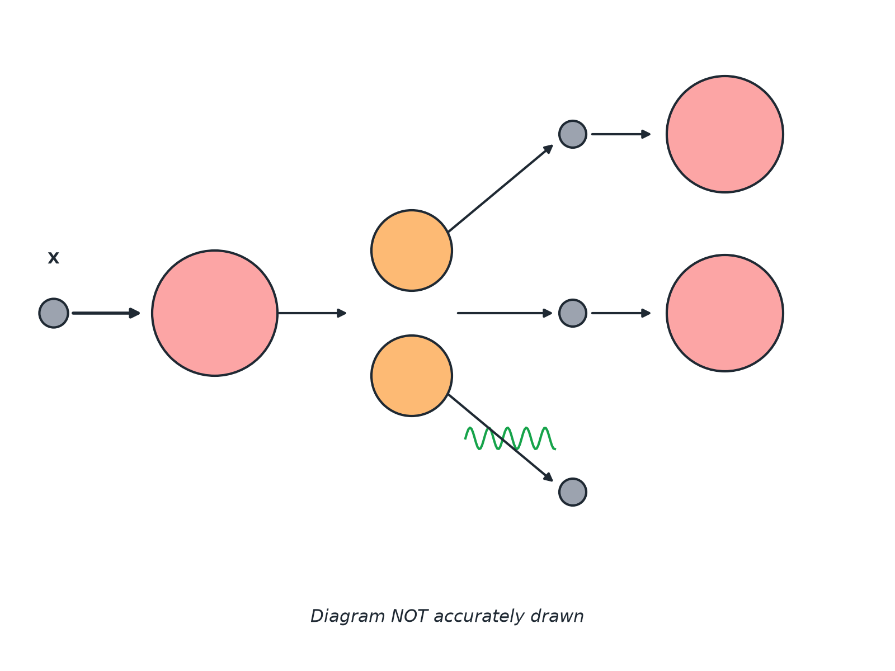
AQA GCSE PHYSICS · PAPER 1 · FOUNDATION & HIGHER
Question 2 · 3 marks · Complete the diagram
The diagram shows part of a fission chain reaction. (a) Name the particle labelled X. (b) Explain how the diagram shows that a chain reaction can happen. (3 marks)
Atomic structure
openrevise.com
Lesson 10 of 10

Slide 22
AQA GCSE PHYSICS · PAPER 1 · FOUNDATION & HIGHER
Question 2 · mark scheme
3 marks available. Award a mark for each point made.
X is a neutron
1 mark
Each fission releases more than one neutron
1 mark
These cause more nuclei to split
1 mark
Atomic structure
openrevise.com
Lesson 10 of 10

Slide 23
AQA GCSE PHYSICS · PAPER 1 · FOUNDATION & HIGHER
Question 3 · 3 marks · Explain
“
Explain how the chain reaction is controlled in a nuclear reactor.
HOW TO ANSWER IT
Command word: Explain. Worth 3 marks, so plan before writing.
Atomic structure
openrevise.com
Lesson 10 of 10

Slide 24
AQA GCSE PHYSICS · PAPER 1 · FOUNDATION & HIGHER
Question 3 · mark scheme
3 marks available. Award a mark for each point made.
Control rods absorb neutrons
1 mark
Only one neutron from each fission goes on to cause fission
1 mark
So the rate of energy release is steady
1 mark
Atomic structure
openrevise.com
Lesson 10 of 10

Slide 25
AQA GCSE PHYSICS · PAPER 1 · FOUNDATION & HIGHER
Question 4 · 3 marks · Describe
“
Describe what happens in nuclear fusion, and state one condition needed for it to happen.
HOW TO ANSWER IT
Command word: Describe. Worth 3 marks, so plan before writing.
Atomic structure
openrevise.com
Lesson 10 of 10

Slide 26
AQA GCSE PHYSICS · PAPER 1 · FOUNDATION & HIGHER
Question 4 · mark scheme
3 marks available. Award a mark for each point made.
Two light nuclei join
1 mark
Energy released
1 mark
Very high temperature or pressure needed
1 mark
Atomic structure
openrevise.com
Lesson 10 of 10

Slide 27
AQA GCSE PHYSICS · PAPER 1 · FOUNDATION & HIGHER
Question 5 · 4 marks · Compare
“
Compare nuclear fission and nuclear fusion.
HOW TO ANSWER IT
Command word: Compare. Worth 4 marks, so plan before writing.
Atomic structure
openrevise.com
Lesson 10 of 10

Slide 28
AQA GCSE PHYSICS · PAPER 1 · FOUNDATION & HIGHER
Question 5 · mark scheme
4 marks available. Award a mark for each point made.
Fission: splitting
1 mark
Fusion: joining
1 mark
Both release energy
1 mark
A difference in conditions or products
1 mark
Atomic structure
openrevise.com
Lesson 10 of 10

