Slide 1

AQA GCSE PHYSICS · PAPER 2 · FOUNDATION & HIGHER
Gravity, mass and weight
Forces
Lesson 2 of 20
openrevise.com

Slide 2

AQA GCSE PHYSICS · PAPER 2 · FOUNDATION & HIGHER
Warm-up
Answer each one, then check.
1
What is the unit of mass?
2
What is the unit of weight?
3
What does g stand for?
4
What is gravity?
5
What instrument measures force?
Forces
openrevise.com
Lesson 2 of 20

Slide 3
AQA GCSE PHYSICS · PAPER 2 · FOUNDATION & HIGHER
Warm-up - Answers
What is the unit of mass?
Kilogram
1
What is the unit of weight?
Newton
2
What does g stand for?
Gravitational field strength
3
What is gravity?
An attractive force between objects with mass
4
What instrument measures force?
A newtonmeter (spring balance)
5
Forces
openrevise.com
Lesson 2 of 20

Slide 4

AQA GCSE PHYSICS · PAPER 2 · FOUNDATION & HIGHER
Learning Objectives
Define weight and explain how it depends on gravitational field strength.
1
Recall and apply W = mg.
2
Explain that weight and mass are directly proportional.
3
Describe the centre of mass.
4
Forces
openrevise.com
Lesson 2 of 20

Slide 5

AQA GCSE PHYSICS · PAPER 2 · FOUNDATION & HIGHER
WEIGHT
weight = mass × gravitational field strength W = mg
Weight is the force on an object due to gravity. On Earth g is about 9.8 N/kg, but in any calculation the value of g will be given.
Forces
openrevise.com
Lesson 2 of 20

Slide 6
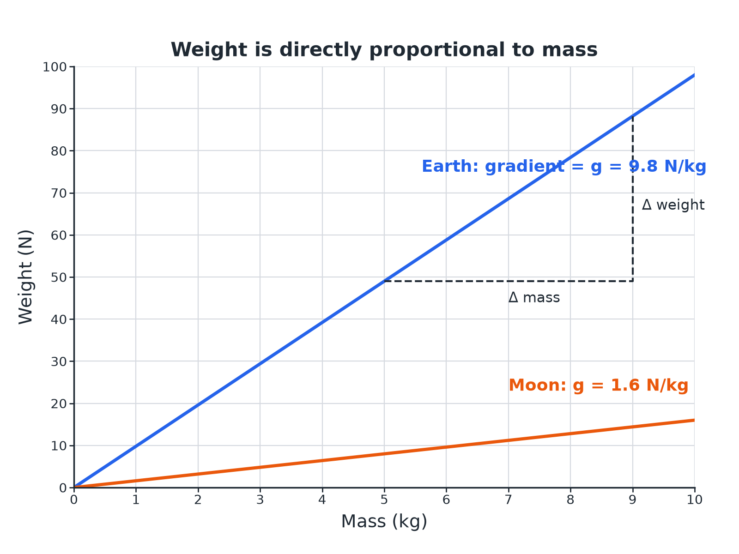

AQA GCSE PHYSICS · PAPER 2 · FOUNDATION & HIGHER
Weight Against Mass
Weight is directly proportional to mass.
Forces
openrevise.com
Lesson 2 of 20

Slide 7

AQA GCSE PHYSICS · PAPER 2 · FOUNDATION & HIGHER
Gravitational Field Strength
g varies from place to place.
Place
g (N/kg)
Earth
9.8
Moon
1.6
Mars
3.7
Jupiter
25
Forces
openrevise.com
Lesson 2 of 20

Slide 8

AQA GCSE PHYSICS · PAPER 2 · FOUNDATION & HIGHER
Weight on Earth
A person has a mass of 60 kg. Calculate their weight on Earth. g = 9.8 N/kg.
Write the equation
W = mg
1
Substitute
W = 60 × 9.8
2
Answer
W = 588 N
3
ANSWER
588 N
Forces
openrevise.com
Lesson 2 of 20

Slide 9
AQA GCSE PHYSICS · PAPER 2 · FOUNDATION & HIGHER
Weight on the Moon
The same person goes to the Moon, where g = 1.6 N/kg. Calculate their mass and weight.
Mass
Mass does not change: 60 kg
1
Weight
W = 60 × 1.6 = 96 N
2
ANSWER
Mass 60 kg; weight 96 N.
Forces
openrevise.com
Lesson 2 of 20

Slide 10
AQA GCSE PHYSICS · PAPER 2 · FOUNDATION & HIGHER
Finding g
An object of mass 3.0 kg has a weight of 12 N on a planet. Calculate g.
Rearrange
g = W ÷ m
1
Substitute
g = 12 ÷ 3.0
2
Answer
g = 4.0 N/kg
3
ANSWER
4.0 N/kg
Forces
openrevise.com
Lesson 2 of 20

Slide 11

AQA GCSE PHYSICS · PAPER 2 · FOUNDATION & HIGHER
Key Ideas
Mass and weight are different.
Mass
The amount of matter in an object; in kg; does not change with place.
Weight
A force in newtons; depends on g; measured with a newtonmeter.
Proportional
W ∝ m: doubling the mass doubles the weight.
Centre of mass
The single point at which the weight of an object may be considered to act.
Forces
openrevise.com
Lesson 2 of 20

Slide 12

AQA GCSE PHYSICS · PAPER 2 · FOUNDATION & HIGHER
Key Terms
Weight
The force acting on an object due to gravity.
Mass
The amount of matter in an object.
Gravitational field strength
The force per kilogram near a planet.
Newtonmeter
A calibrated spring balance for measuring force.
Centre of mass
The point where the weight of an object may be considered to act.
Directly proportional
Doubling one quantity doubles the other.
Forces
openrevise.com
Lesson 2 of 20

Slide 13

AQA GCSE PHYSICS · PAPER 2 · FOUNDATION & HIGHER
YOUR TASK
10 minutes
Weigh It
A rock has a mass of 5.0 kg. Calculate its weight on Earth (g = 9.8 N/kg), on the Moon (g = 1.6 N/kg) and on Jupiter (g = 25 N/kg).
Use W = mg.
1
Compare the answers.
2
WHAT A GOOD ANSWER SHOWS
Earth 49 N; Moon 8.0 N; Jupiter 125 N. The mass is 5.0 kg everywhere.
Forces
openrevise.com
Lesson 2 of 20
Notes:
Ask which quantity changes and which does not.

Slide 14
AQA GCSE PHYSICS · PAPER 2 · FOUNDATION & HIGHER
Can I...?
Define weight.
Recall the unit of weight.
Use W = mg.
Describe a newtonmeter.
Rearrange for g or m.
Explain proportionality.
Say why weight changes but mass does not.
Describe the centre of mass.
Forces
openrevise.com
Lesson 2 of 20

Slide 15
AQA GCSE PHYSICS · PAPER 2 · FOUNDATION & HIGHER
Summary & Exam Focus
W = mg.
Mass in kg; weight in N.
Weight is proportional to mass.
Mass is the same everywhere; weight depends on g.
EXAM FOCUS
A person has a mass of 60 kg. Calculate their weight. g = 9.8 N/kg. (2 marks)
Substitute into W = mg and include N.
openrevise.com

Slide 16
AQA GCSE PHYSICS · PAPER 2 · FOUNDATION & HIGHER
Exam Practice: Gravity, mass and weight
Answer all questions. Use the mark allocation as a guide to how much to write. · 15 minutes
Question 1 · 2 marks · Calculate
A person has a mass of 60 kg. Gravitational field strength = 9.8 N/kg. Calculate the weight of the person. Use the equation: weight = mass…
Question 2 · 3 marks · Explain
An astronaut travels from Earth to the Moon. Explain what happens to the astronaut's mass and weight.
Question 3 · 4 marks · Use the graph
The graph shows how the weight of objects on a planet depends on their mass. (a) Describe the relationship between weight and mass. (b) Use…
Forces
openrevise.com
Lesson 2 of 20

Slide 17
AQA GCSE PHYSICS · PAPER 2 · FOUNDATION & HIGHER
Exam Practice: Gravity, mass and weight (cont.)
Question 4 · 3 marks · Calculate
A rock has a weight of 12 N on a planet. Its mass is 3.0 kg. Calculate the gravitational field strength of the planet.
Question 5 · 2 marks · Explain
A newtonmeter is used to measure the weight of an object. State what the newtonmeter actually measures and the unit used.
Forces
openrevise.com
Lesson 2 of 20

Slide 18
AQA GCSE PHYSICS · PAPER 2 · FOUNDATION & HIGHER
Question 1 · 2 marks · Calculate
“
A person has a mass of 60 kg. Gravitational field strength = 9.8 N/kg. Calculate the weight of the person. Use the equation: weight = mass × gravitational field strength
HOW TO ANSWER IT
Command word: Calculate. Worth 2 marks, so plan before writing.
Forces
openrevise.com
Lesson 2 of 20

Slide 19
AQA GCSE PHYSICS · PAPER 2 · FOUNDATION & HIGHER
Question 1 · mark scheme
2 marks available. Award a mark for each point made.
Correct substitution
1 mark
588 N
1 mark
Forces
openrevise.com
Lesson 2 of 20

Slide 20
AQA GCSE PHYSICS · PAPER 2 · FOUNDATION & HIGHER
Question 2 · 3 marks · Explain
“
An astronaut travels from Earth to the Moon. Explain what happens to the astronaut's mass and weight.
HOW TO ANSWER IT
Command word: Explain. Worth 3 marks, so plan before writing.
Forces
openrevise.com
Lesson 2 of 20

Slide 21
AQA GCSE PHYSICS · PAPER 2 · FOUNDATION & HIGHER
Question 2 · mark scheme
3 marks available. Award a mark for each point made.
Mass unchanged
1 mark
Weight decreases
1 mark
Moon has a weaker gravitational field
1 mark
Forces
openrevise.com
Lesson 2 of 20

Slide 22
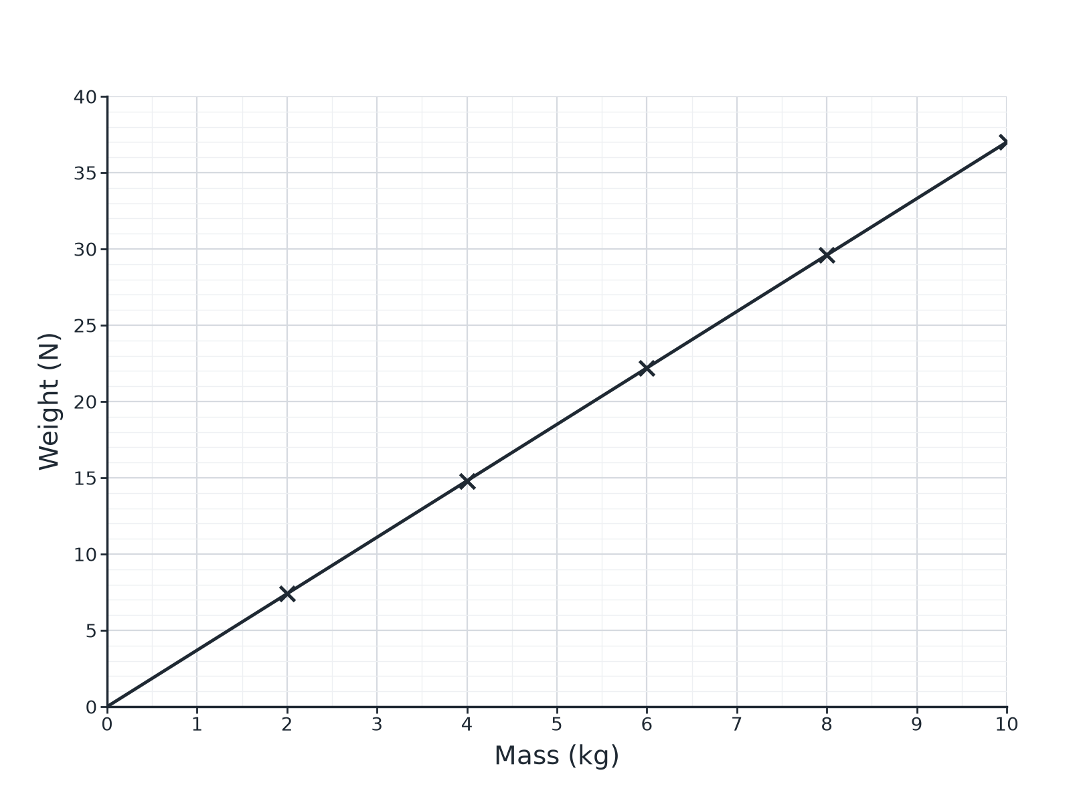
AQA GCSE PHYSICS · PAPER 2 · FOUNDATION & HIGHER
Question 3 · 4 marks · Use the graph
The graph shows how the weight of objects on a planet depends on their mass. (a) Describe the relationship between weight and mass. (b) Use the graph to calculate the gravitational field strength of the planet. (4 marks)
Forces
openrevise.com
Lesson 2 of 20

Slide 23
AQA GCSE PHYSICS · PAPER 2 · FOUNDATION & HIGHER
Question 3 · mark scheme
4 marks available. Award a mark for each point made.
Straight line through the origin
1 mark
Directly proportional
1 mark
Uses the gradient
1 mark
3.7 N/kg (accept 3.5 to 3.9)
1 mark
Forces
openrevise.com
Lesson 2 of 20

Slide 24
AQA GCSE PHYSICS · PAPER 2 · FOUNDATION & HIGHER
Question 4 · 3 marks · Calculate
“
A rock has a weight of 12 N on a planet. Its mass is 3.0 kg. Calculate the gravitational field strength of the planet.
HOW TO ANSWER IT
Command word: Calculate. Worth 3 marks, so plan before writing.
Forces
openrevise.com
Lesson 2 of 20

Slide 25
AQA GCSE PHYSICS · PAPER 2 · FOUNDATION & HIGHER
Question 4 · mark scheme
3 marks available. Award a mark for each point made.
Rearranges to g = W ÷ m
1 mark
Correct substitution
1 mark
4.0 N/kg
1 mark
Forces
openrevise.com
Lesson 2 of 20

Slide 26
AQA GCSE PHYSICS · PAPER 2 · FOUNDATION & HIGHER
Question 5 · 2 marks · Explain
“
A newtonmeter is used to measure the weight of an object. State what the newtonmeter actually measures and the unit used.
HOW TO ANSWER IT
Command word: Explain. Worth 2 marks, so plan before writing.
Forces
openrevise.com
Lesson 2 of 20

Slide 27
AQA GCSE PHYSICS · PAPER 2 · FOUNDATION & HIGHER
Question 5 · mark scheme
2 marks available. Award a mark for each point made.
Force or weight
1 mark
In newtons
1 mark
Forces
openrevise.com
Lesson 2 of 20

