Slide 1

AQA GCSE PHYSICS · PAPER 2 · FOUNDATION & HIGHER
Resultant forces
Forces
Lesson 3 of 20
openrevise.com

Slide 2

AQA GCSE PHYSICS · PAPER 2 · FOUNDATION & HIGHER
Warm-up
Answer each one, then check.
1
What is a force measured in?
2
What does balanced mean?
3
Is force a vector?
4
What does a resultant force of zero mean for motion?
5
Add 40 N and 15 N.
Forces
openrevise.com
Lesson 3 of 20

Slide 3
AQA GCSE PHYSICS · PAPER 2 · FOUNDATION & HIGHER
Warm-up - Answers
What is a force measured in?
Newtons
1
What does balanced mean?
Equal and opposite
2
Is force a vector?
Yes
3
What does a resultant force of zero mean for motion?
No change in velocity
4
Add 40 N and 15 N.
55 N
5
Forces
openrevise.com
Lesson 3 of 20

Slide 4

AQA GCSE PHYSICS · PAPER 2 · FOUNDATION & HIGHER
Learning Objectives
Define a resultant force.
1
Calculate the resultant of two forces acting in a straight line.
2
Describe the forces on an isolated object using a free body diagram (Higher tier).
3
Use scale drawings to find the resultant of two forces, and resolve a force into components (Higher tier).
4
Forces
openrevise.com
Lesson 3 of 20

Slide 5

AQA GCSE PHYSICS · PAPER 2 · FOUNDATION & HIGHER
RESULTANT FORCE
A number of forces acting on an object may be replaced by a single force that has the same effect: the resultant force.
Forces in the same direction are added. Forces in opposite directions are subtracted. If the resultant is zero the forces are balanced.
Forces
openrevise.com
Lesson 3 of 20

Slide 6
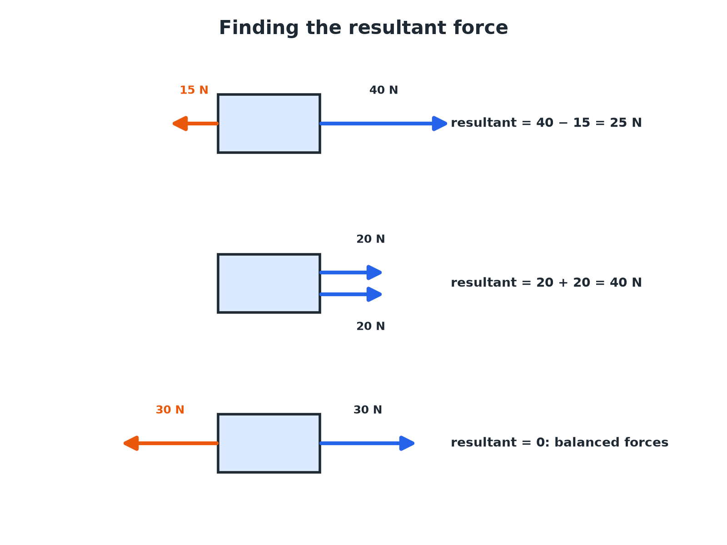

AQA GCSE PHYSICS · PAPER 2 · FOUNDATION & HIGHER
Finding the Resultant
Add same-direction forces; subtract opposite ones.
Forces
openrevise.com
Lesson 3 of 20

Slide 7

AQA GCSE PHYSICS · PAPER 2 · FOUNDATION & HIGHER
Forces in a Straight Line
A car's engine produces a driving force of 1800 N. Friction and air resistance give 1200 N in the opposite direction. Find the resultant force.
Opposite directions
Subtract
1
Calculate
1800 − 1200 = 600 N
2
ANSWER
600 N in the direction of the driving force.
Forces
openrevise.com
Lesson 3 of 20

Slide 8
AQA GCSE PHYSICS · PAPER 2 · FOUNDATION & HIGHER
Free Body Diagram (Higher)
Draw a free body diagram for a book at rest on a table.
Isolate the book
Draw the book as a box on its own
1
Weight
An arrow down from the centre of the box
2
Normal contact force
An arrow up of equal length
3
Resultant
Zero, so the forces are balanced
4
ANSWER
Equal arrows up and down: the resultant force is zero, so the book stays at rest.
Forces
openrevise.com
Lesson 3 of 20

Slide 9
AQA GCSE PHYSICS · PAPER 2 · FOUNDATION & HIGHER
Scale Drawing (Higher)
Two forces of 3.0 N (east) and 4.0 N (north) act on an object. Find the resultant using a scale drawing.
Scale
1 cm = 1 N
1
Draw
3 cm east, then 4 cm north from the end of the first arrow
2
Join start to finish
The arrow is 5.0 cm
3
Direction
Measure the angle: about 53° north of east
4
ANSWER
Resultant 5.0 N at about 53° north of east.
Forces
openrevise.com
Lesson 3 of 20

Slide 10
AQA GCSE PHYSICS · PAPER 2 · FOUNDATION & HIGHER
Resolving a Force (Higher)
A force of 10 N acts at 30° above the horizontal. Find the horizontal and vertical components using a scale drawing.
Scale
1 cm = 1 N
1
Draw
A 10 cm line at 30° to a horizontal line
2
Drop a perpendicular
Make a right-angled triangle
3
Measure
Horizontal about 8.7 cm and vertical 5.0 cm
4
ANSWER
Components: about 8.7 N horizontally and 5.0 N vertically.
Forces
openrevise.com
Lesson 3 of 20

Slide 11

AQA GCSE PHYSICS · PAPER 2 · FOUNDATION & HIGHER
Key Points
Remember in an exam.
Direction
Give the direction of the resultant.
Balanced
Zero resultant means constant velocity (Newton's first law).
Free body diagram
Show only the forces on the object, as arrows from its centre.
Units
Forces in newtons.
Forces
openrevise.com
Lesson 3 of 20

Slide 12

AQA GCSE PHYSICS · PAPER 2 · FOUNDATION & HIGHER
Key Terms
Resultant force
A single force with the same effect as all the forces on an object.
Balanced forces
Forces that are equal and opposite.
Free body diagram
A diagram showing all forces acting on an isolated object.
Component
One of two perpendicular forces that together have the same effect as one force.
Resolve
Split a force into two components at right angles.
Equilibrium
When the forces on an object are balanced.
Forces
openrevise.com
Lesson 3 of 20

Slide 13

AQA GCSE PHYSICS · PAPER 2 · FOUNDATION & HIGHER
YOUR TASK
10 minutes
Find the Resultant
Find the resultant force: (a) 50 N right and 20 N left (b) 30 N up and 30 N down (c) 12 N right and 8 N right.
Same direction: add.
1
Opposite: subtract.
2
WHAT A GOOD ANSWER SHOWS
(a) 30 N right (b) 0 N (c) 20 N right.
Forces
openrevise.com
Lesson 3 of 20
Notes:
Ask what each resultant means for motion.

Slide 14
AQA GCSE PHYSICS · PAPER 2 · FOUNDATION & HIGHER
Can I...?
Define a resultant.
Draw a free body diagram.
Add forces in the same direction.
Use a scale drawing.
Subtract opposite forces.
Resolve a force.
Recognise balanced forces.
Give direction.
Forces
openrevise.com
Lesson 3 of 20

Slide 15
AQA GCSE PHYSICS · PAPER 2 · FOUNDATION & HIGHER
Summary & Exam Focus
Resultant: same direction add, opposite subtract.
Zero resultant: balanced.
Higher: free body diagrams and scale drawings.
Resolve into perpendicular components.
EXAM FOCUS
A driving force of 1800 N and a resistive force of 1200 N act on a car. Calculate the resultant force. (2 marks)
Subtract the smaller from the larger and give the direction.
openrevise.com

Slide 16
AQA GCSE PHYSICS · PAPER 2 · FOUNDATION & HIGHER
Exam Practice: Resultant forces
Answer all questions. Use the mark allocation as a guide to how much to write. · 14 minutes
Question 1 · 2 marks · Calculate
A car engine produces a driving force of 1800 N. The total resistive force is 1200 N. Calculate the resultant force on the car and state…
Question 2 · 2 marks · Use the diagram
The diagram shows the forces acting on a box. Calculate the resultant force.
Question 3 · 2 marks · Explain
A skydiver has a weight of 800 N and air resistance of 500 N. Calculate the resultant force and state its direction.
Forces
openrevise.com
Lesson 3 of 20

Slide 17
AQA GCSE PHYSICS · PAPER 2 · FOUNDATION & HIGHER
Exam Practice: Resultant forces (cont.)
Question 4 · 3 marks · Draw
Draw a free body diagram for a stationary book on a table. Label the forces.
Question 5 · 4 marks · Determine
Two forces act on an object at right angles to each other: 3.0 N east and 4.0 N north. Use a scale drawing to find the magnitude and…
Forces
openrevise.com
Lesson 3 of 20

Slide 18
AQA GCSE PHYSICS · PAPER 2 · FOUNDATION & HIGHER
Question 1 · 2 marks · Calculate
“
A car engine produces a driving force of 1800 N. The total resistive force is 1200 N. Calculate the resultant force on the car and state its direction.
HOW TO ANSWER IT
Command word: Calculate. Worth 2 marks, so plan before writing.
Forces
openrevise.com
Lesson 3 of 20

Slide 19
AQA GCSE PHYSICS · PAPER 2 · FOUNDATION & HIGHER
Question 1 · mark scheme
2 marks available. Award a mark for each point made.
600 N
1 mark
In the direction of the driving force
1 mark
Forces
openrevise.com
Lesson 3 of 20

Slide 20
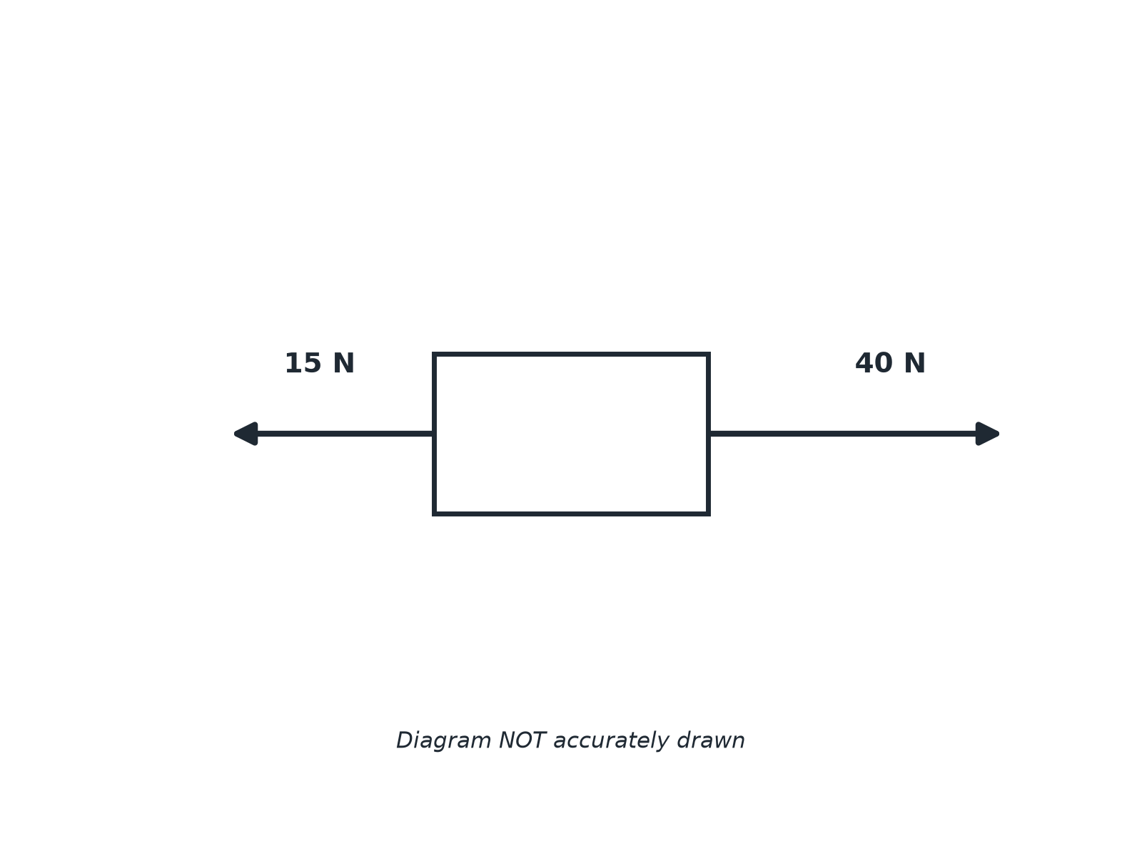
AQA GCSE PHYSICS · PAPER 2 · FOUNDATION & HIGHER
Question 2 · 2 marks · Use the diagram
The diagram shows the forces acting on a box. Calculate the resultant force. (2 marks)
Forces
openrevise.com
Lesson 3 of 20

Slide 21
AQA GCSE PHYSICS · PAPER 2 · FOUNDATION & HIGHER
Question 2 · mark scheme
2 marks available. Award a mark for each point made.
Subtracts 15 from 40
1 mark
25 N to the right
1 mark
Forces
openrevise.com
Lesson 3 of 20

Slide 22
AQA GCSE PHYSICS · PAPER 2 · FOUNDATION & HIGHER
Question 3 · 2 marks · Explain
“
A skydiver has a weight of 800 N and air resistance of 500 N. Calculate the resultant force and state its direction.
HOW TO ANSWER IT
Command word: Explain. Worth 2 marks, so plan before writing.
Forces
openrevise.com
Lesson 3 of 20

Slide 23
AQA GCSE PHYSICS · PAPER 2 · FOUNDATION & HIGHER
Question 3 · mark scheme
2 marks available. Award a mark for each point made.
300 N
1 mark
Downwards
1 mark
Forces
openrevise.com
Lesson 3 of 20

Slide 24
AQA GCSE PHYSICS · PAPER 2 · FOUNDATION & HIGHER
Question 4 · 3 marks · Draw
“
Draw a free body diagram for a stationary book on a table. Label the forces.
HOW TO ANSWER IT
Command word: Draw. Worth 3 marks, so plan before writing.
Forces
openrevise.com
Lesson 3 of 20

Slide 25
AQA GCSE PHYSICS · PAPER 2 · FOUNDATION & HIGHER
Question 4 · mark scheme
3 marks available. Award a mark for each point made.
Downward arrow labelled weight
1 mark
Upward arrow labelled normal contact force
1 mark
Arrows equal in length
1 mark
Forces
openrevise.com
Lesson 3 of 20

Slide 26
AQA GCSE PHYSICS · PAPER 2 · FOUNDATION & HIGHER
Question 5 · 4 marks · Determine
“
Two forces act on an object at right angles to each other: 3.0 N east and 4.0 N north. Use a scale drawing to find the magnitude and direction of the resultant force.
HOW TO ANSWER IT
Command word: Determine. Worth 4 marks, so plan before writing.
Forces
openrevise.com
Lesson 3 of 20

Slide 27
AQA GCSE PHYSICS · PAPER 2 · FOUNDATION & HIGHER
Question 5 · mark scheme
4 marks available. Award a mark for each point made.
Correct scale chosen
1 mark
Right-angled triangle drawn accurately
1 mark
5.0 N
1 mark
Direction about 53° north of east
1 mark
Forces
openrevise.com
Lesson 3 of 20

