Slide 1

AQA GCSE PHYSICS · PAPER 2 · FOUNDATION & HIGHER
Work done and energy transfer
Forces
Lesson 4 of 20
openrevise.com

Slide 2

AQA GCSE PHYSICS · PAPER 2 · FOUNDATION & HIGHER
Warm-up
Answer each one, then check.
1
What is energy measured in?
2
What is a force measured in?
3
What is distance measured in?
4
What is friction?
5
Name an energy store that increases when something warms up.
Forces
openrevise.com
Lesson 4 of 20

Slide 3
AQA GCSE PHYSICS · PAPER 2 · FOUNDATION & HIGHER
Warm-up - Answers
What is energy measured in?
Joules
1
What is a force measured in?
Newtons
2
What is distance measured in?
Metres
3
What is friction?
A force opposing motion
4
Name an energy store that increases when something warms up.
Thermal
5
Forces
openrevise.com
Lesson 4 of 20

Slide 4

AQA GCSE PHYSICS · PAPER 2 · FOUNDATION & HIGHER
Learning Objectives
Define work done.
1
Recall and apply W = Fs.
2
Convert between newton-metres and joules.
3
Describe the energy transfers when work is done, including against friction.
4
Forces
openrevise.com
Lesson 4 of 20

Slide 5

AQA GCSE PHYSICS · PAPER 2 · FOUNDATION & HIGHER
WORK DONE
work done = force × distance moved along the line of action of the force W = Fs
One joule of work is done when a force of one newton moves an object one metre. 1 J = 1 Nm.
Forces
openrevise.com
Lesson 4 of 20

Slide 6
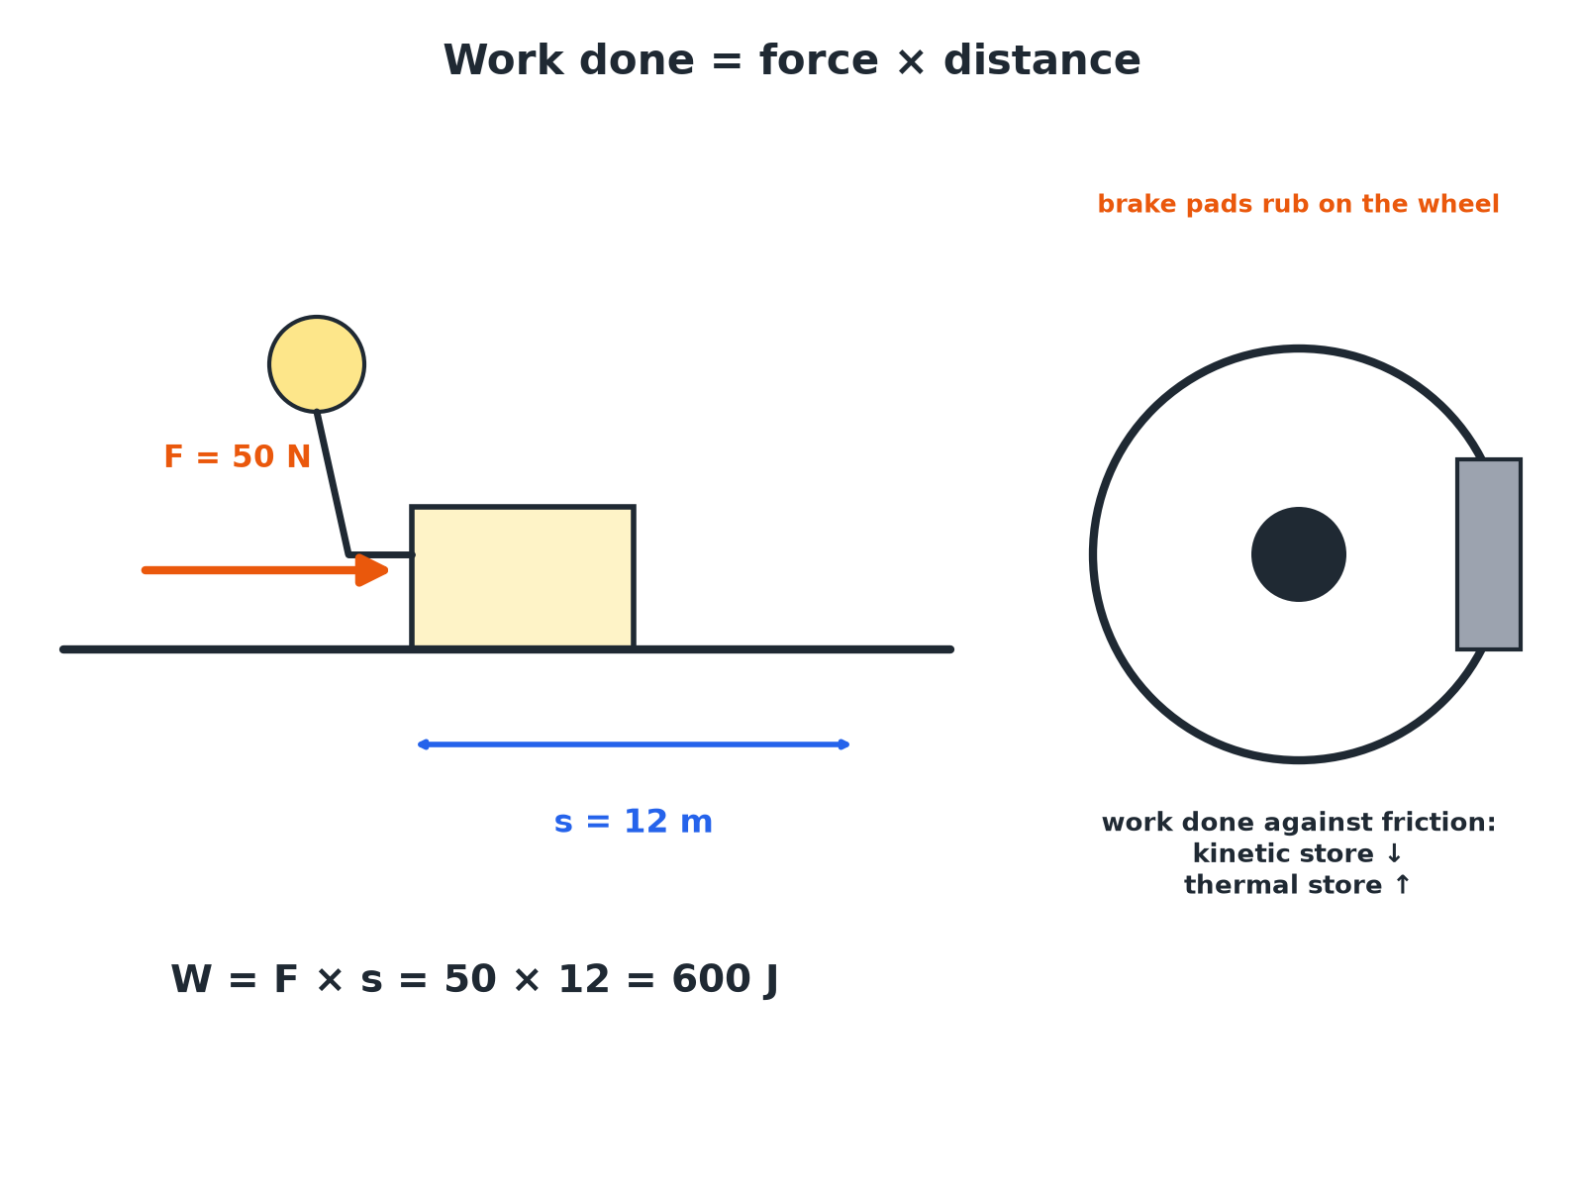

AQA GCSE PHYSICS · PAPER 2 · FOUNDATION & HIGHER
Work Done
Work done is energy transferred by a force.
Forces
openrevise.com
Lesson 4 of 20

Slide 7

AQA GCSE PHYSICS · PAPER 2 · FOUNDATION & HIGHER
Calculating Work Done
A force of 50 N pushes a box 12 m along the floor. Calculate the work done.
Write the equation
W = Fs
1
Substitute
W = 50 × 12
2
Answer
W = 600 J
3
ANSWER
600 J
Forces
openrevise.com
Lesson 4 of 20

Slide 8
AQA GCSE PHYSICS · PAPER 2 · FOUNDATION & HIGHER
Finding the Force
A crate is moved 8.0 m by a force. The work done is 1200 J. Find the force.
Rearrange
F = W ÷ s
1
Substitute
F = 1200 ÷ 8.0
2
Answer
F = 150 N
3
ANSWER
150 N
Forces
openrevise.com
Lesson 4 of 20

Slide 9
AQA GCSE PHYSICS · PAPER 2 · FOUNDATION & HIGHER
Work Against Friction
Explain why the brakes on a bicycle get warm when it slows down.
Friction force
The brake pads rub on the wheel
1
Work done
Work is done against the frictional force
2
Energy transfer
Energy is transferred from the kinetic store to the thermal store of the brakes
3
ANSWER
The kinetic energy of the bicycle is transferred to the thermal energy of the brakes and wheel.
Forces
openrevise.com
Lesson 4 of 20

Slide 10

AQA GCSE PHYSICS · PAPER 2 · FOUNDATION & HIGHER
Key Ideas
Learn these links.
Work is energy transferred
When a force moves an object, energy is transferred.
Distance
Measured in the direction of the force.
Friction
Work done against friction raises the temperature of the object.
Units
Convert kJ to J before calculating.
Forces
openrevise.com
Lesson 4 of 20

Slide 11

AQA GCSE PHYSICS · PAPER 2 · FOUNDATION & HIGHER
Key Terms
Work done
Energy transferred when a force moves an object.
Joule
The unit of work and energy.
Newton-metre
A joule: one newton moving an object one metre.
Friction
A force between surfaces that opposes motion.
Displacement
The distance moved in a particular direction.
Dissipated
Transferred to less useful stores.
Forces
openrevise.com
Lesson 4 of 20

Slide 12

AQA GCSE PHYSICS · PAPER 2 · FOUNDATION & HIGHER
YOUR TASK
10 minutes
Work It Out
A student pushes a trolley with a force of 40 N for 6.0 m. How much work is done? What happens to the energy if the trolley is moving at a steady speed on a rough floor?
Calculate the work.
1
Describe the energy transfer.
2
WHAT A GOOD ANSWER SHOWS
W = 40 × 6.0 = 240 J. The energy is transferred to the thermal store of the trolley and floor by friction.
Forces
openrevise.com
Lesson 4 of 20
Notes:
Ask what would be different on a smooth floor.

Slide 13
AQA GCSE PHYSICS · PAPER 2 · FOUNDATION & HIGHER
Can I...?
Define work done.
Describe energy transfer.
Use W = Fs.
Explain heating due to friction.
Rearrange for F or s.
Use the unit joule.
Convert Nm to J.
Show the working.
Forces
openrevise.com
Lesson 4 of 20

Slide 14
AQA GCSE PHYSICS · PAPER 2 · FOUNDATION & HIGHER
Summary & Exam Focus
W = Fs.
1 J = 1 Nm.
Work done against friction raises the temperature.
Work is energy transferred.
EXAM FOCUS
A force of 50 N moves a box 12 m. Calculate the work done. (2 marks)
Multiply force by distance and give J.
openrevise.com

Slide 15
AQA GCSE PHYSICS · PAPER 2 · FOUNDATION & HIGHER
Exam Practice: Work done and energy transfer
Answer all questions. Use the mark allocation as a guide to how much to write. · 14 minutes
Question 1 · 2 marks · Calculate
A person pushes a box with a force of 50 N. The box moves 12 m. Calculate the work done. Use the equation: work done = force × distance
Question 2 · 3 marks · Calculate
A force does 1200 J of work moving a crate 8.0 m. Calculate the force.
Question 3 · 2 marks · Explain
A bicycle rider brakes and the brake pads become warm. Explain why.
Forces
openrevise.com
Lesson 4 of 20

Slide 16
AQA GCSE PHYSICS · PAPER 2 · FOUNDATION & HIGHER
Exam Practice: Work done and energy transfer (cont.)
Question 4 · 2 marks · Describe
State what one joule of work means in terms of force and distance.
Question 5 · 4 marks · Calculate
A crane lifts a 200 kg load through 15 m at constant speed. Gravitational field strength = 9.8 N/kg. Calculate the work done on the load by…
Forces
openrevise.com
Lesson 4 of 20

Slide 17
AQA GCSE PHYSICS · PAPER 2 · FOUNDATION & HIGHER
Question 1 · 2 marks · Calculate
“
A person pushes a box with a force of 50 N. The box moves 12 m. Calculate the work done. Use the equation: work done = force × distance
HOW TO ANSWER IT
Command word: Calculate. Worth 2 marks, so plan before writing.
Forces
openrevise.com
Lesson 4 of 20

Slide 18
AQA GCSE PHYSICS · PAPER 2 · FOUNDATION & HIGHER
Question 1 · mark scheme
2 marks available. Award a mark for each point made.
Correct substitution
1 mark
600 J
1 mark
Forces
openrevise.com
Lesson 4 of 20

Slide 19
AQA GCSE PHYSICS · PAPER 2 · FOUNDATION & HIGHER
Question 2 · 3 marks · Calculate
“
A force does 1200 J of work moving a crate 8.0 m. Calculate the force.
HOW TO ANSWER IT
Command word: Calculate. Worth 3 marks, so plan before writing.
Forces
openrevise.com
Lesson 4 of 20

Slide 20
AQA GCSE PHYSICS · PAPER 2 · FOUNDATION & HIGHER
Question 2 · mark scheme
3 marks available. Award a mark for each point made.
Rearranges to F = W ÷ s
1 mark
Correct substitution
1 mark
150 N
1 mark
Forces
openrevise.com
Lesson 4 of 20

Slide 21
AQA GCSE PHYSICS · PAPER 2 · FOUNDATION & HIGHER
Question 3 · 2 marks · Explain
“
A bicycle rider brakes and the brake pads become warm. Explain why.
HOW TO ANSWER IT
Command word: Explain. Worth 2 marks, so plan before writing.
Forces
openrevise.com
Lesson 4 of 20

Slide 22
AQA GCSE PHYSICS · PAPER 2 · FOUNDATION & HIGHER
Question 3 · mark scheme
2 marks available. Award a mark for each point made.
Work done against friction
1 mark
Kinetic to thermal energy store
1 mark
Forces
openrevise.com
Lesson 4 of 20

Slide 23
AQA GCSE PHYSICS · PAPER 2 · FOUNDATION & HIGHER
Question 4 · 2 marks · Describe
“
State what one joule of work means in terms of force and distance.
HOW TO ANSWER IT
Command word: Describe. Worth 2 marks, so plan before writing.
Forces
openrevise.com
Lesson 4 of 20

Slide 24
AQA GCSE PHYSICS · PAPER 2 · FOUNDATION & HIGHER
Question 4 · mark scheme
2 marks available. Award a mark for each point made.
Force of 1 N
1 mark
Moves an object 1 m
1 mark
Forces
openrevise.com
Lesson 4 of 20

Slide 25
AQA GCSE PHYSICS · PAPER 2 · FOUNDATION & HIGHER
Question 5 · 4 marks · Calculate
“
A crane lifts a 200 kg load through 15 m at constant speed. Gravitational field strength = 9.8 N/kg. Calculate the work done on the load by the crane.
HOW TO ANSWER IT
Command word: Calculate. Worth 4 marks, so plan before writing.
Forces
openrevise.com
Lesson 4 of 20

Slide 26
AQA GCSE PHYSICS · PAPER 2 · FOUNDATION & HIGHER
Question 5 · mark scheme
4 marks available. Award a mark for each point made.
Force = weight = mg
1 mark
1960 N
1 mark
Correct substitution into W = Fs
1 mark
29 400 J
1 mark
Forces
openrevise.com
Lesson 4 of 20

