Slide 1

AQA GCSE PHYSICS · PAPER 2 · FOUNDATION & HIGHER
Moments, levers and gears
Forces
Lesson 6 of 20
openrevise.com

Slide 2

AQA GCSE PHYSICS · PAPER 2 · FOUNDATION & HIGHER
Warm-up
Answer each one, then check.
1
What is a pivot?
2
What is the unit of force?
3
What is clockwise?
4
What is the unit of distance?
5
Give an example of a lever.
Forces
openrevise.com
Lesson 6 of 20

Slide 3
AQA GCSE PHYSICS · PAPER 2 · FOUNDATION & HIGHER
Warm-up - Answers
What is a pivot?
The point about which something turns
1
What is the unit of force?
Newton
2
What is clockwise?
The direction the hands of a clock turn
3
What is the unit of distance?
Metre
4
Give an example of a lever.
A seesaw, crowbar or spanner
5
Forces
openrevise.com
Lesson 6 of 20

Slide 4

AQA GCSE PHYSICS · PAPER 2 · FOUNDATION & HIGHER
Learning Objectives
Describe examples in which forces cause rotation.
1
Recall and apply M = Fd.
2
Use the principle of moments to find an unknown force or distance.
3
Explain how levers and gears transmit the rotational effects of forces.
4
Forces
openrevise.com
Lesson 6 of 20

Slide 5

AQA GCSE PHYSICS · PAPER 2 · FOUNDATION & HIGHER
MOMENTS
moment of a force = force × perpendicular distance from the pivot M = Fd
The turning effect of a force is called its moment, in newton-metres (Nm). If an object is balanced, the total clockwise moment about a pivot equals the total anticlockwise moment.
Forces
openrevise.com
Lesson 6 of 20

Slide 6
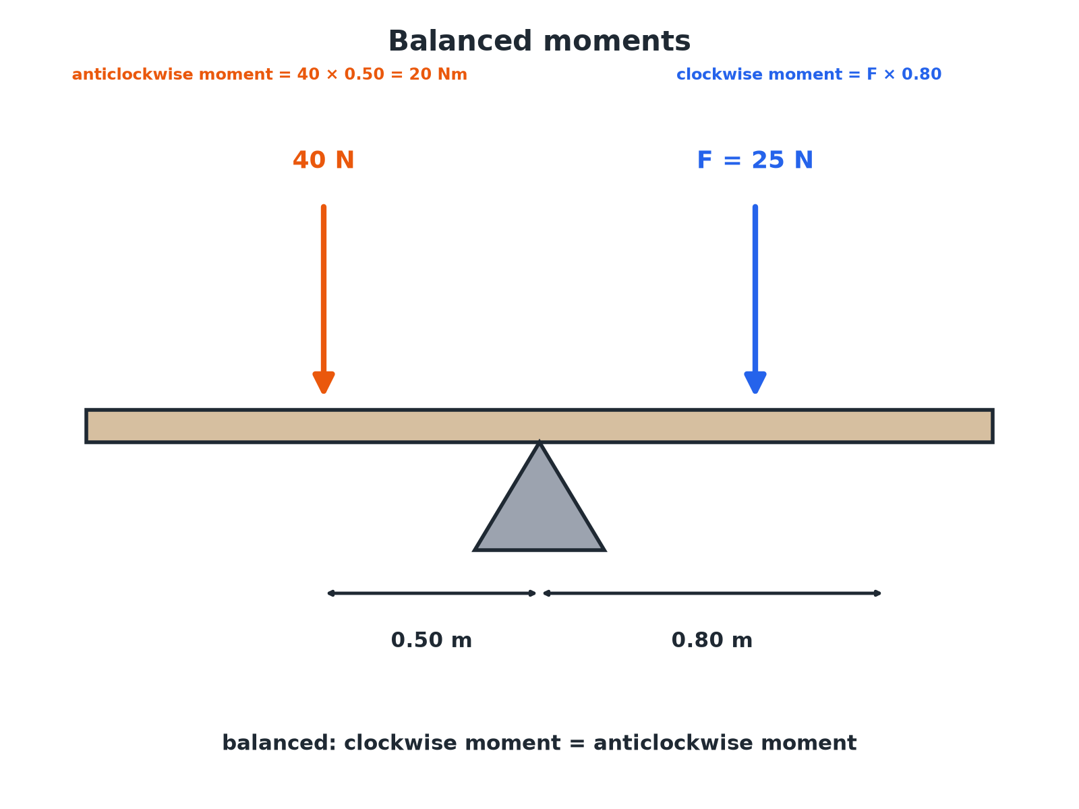

AQA GCSE PHYSICS · PAPER 2 · FOUNDATION & HIGHER
A Balanced Beam
Clockwise moments equal anticlockwise moments when balanced.
Forces
openrevise.com
Lesson 6 of 20

Slide 7

AQA GCSE PHYSICS · PAPER 2 · FOUNDATION & HIGHER
Calculating a Moment
A force of 30 N acts 1.5 m from a pivot at right angles. Calculate the moment.
Write the equation
M = Fd
1
Substitute
M = 30 × 1.5
2
Answer
M = 45 Nm
3
ANSWER
45 Nm
Forces
openrevise.com
Lesson 6 of 20

Slide 8
AQA GCSE PHYSICS · PAPER 2 · FOUNDATION & HIGHER
A Balanced Seesaw
A 40 N child sits 0.50 m from the pivot of a balanced beam. Another force F acts on the other side 0.80 m from the pivot. Calculate F.
Anticlockwise moment
40 × 0.50 = 20 Nm
1
Balanced
F × 0.80 = 20
2
Rearrange
F = 20 ÷ 0.80
3
Answer
F = 25 N
4
ANSWER
25 N
Forces
openrevise.com
Lesson 6 of 20

Slide 9
AQA GCSE PHYSICS · PAPER 2 · FOUNDATION & HIGHER
Gears
A gear with 20 teeth drives a gear with 40 teeth. Describe how the second gear turns compared with the first.
Direction
It turns in the opposite direction
1
Speed
The larger gear turns more slowly (half the speed)
2
Turning effect
The larger gear has a greater turning effect (moment)
3
ANSWER
It turns the opposite way at half the speed with a larger moment.
Forces
openrevise.com
Lesson 6 of 20

Slide 10

AQA GCSE PHYSICS · PAPER 2 · FOUNDATION & HIGHER
Levers and Gears
Transmitting turning effects.
Lever
A rigid bar that turns about a pivot; a longer distance from the pivot means a smaller force is needed.
Examples
A crowbar, spanner, wheelbarrow, scissors.
Gears
Toothed wheels that mesh to transfer rotation.
Gear ratio
A large gear driven by a small gear turns slower but with a greater moment.
Forces
openrevise.com
Lesson 6 of 20

Slide 11

AQA GCSE PHYSICS · PAPER 2 · FOUNDATION & HIGHER
Key Terms
Moment
The turning effect of a force, in newton-metres.
Pivot
The point about which an object turns.
Clockwise
In the direction of a clock's hands.
Anticlockwise
Opposite to the hands of a clock.
Lever
A bar that can turn about a pivot.
Gear
A toothed wheel that transmits rotation.
Forces
openrevise.com
Lesson 6 of 20

Slide 12

AQA GCSE PHYSICS · PAPER 2 · FOUNDATION & HIGHER
YOUR TASK
12 minutes
Balance the Beam
A beam is balanced. A 60 N weight is 0.40 m to the left of the pivot. Where must a 30 N weight be placed on the right?
Find the anticlockwise moment.
1
Equal the clockwise moment.
2
WHAT A GOOD ANSWER SHOWS
Clockwise = anticlockwise: 30 × d = 60 × 0.40 = 24, so d = 0.80 m.
Forces
openrevise.com
Lesson 6 of 20
Notes:
Ask what happens if d is larger.

Slide 13
AQA GCSE PHYSICS · PAPER 2 · FOUNDATION & HIGHER
Can I...?
Recall M = Fd.
Find an unknown distance.
Use perpendicular distance.
Explain levers.
State the principle of moments.
Explain gears.
Find an unknown force.
Use Nm.
Forces
openrevise.com
Lesson 6 of 20

Slide 14
AQA GCSE PHYSICS · PAPER 2 · FOUNDATION & HIGHER
Summary & Exam Focus
M = Fd.
Balanced: total clockwise moment = total anticlockwise moment.
Levers: a longer distance from the pivot gives a greater moment.
Gears: change direction, speed and turning effect.
EXAM FOCUS
A force of 30 N acts 1.5 m from a pivot. Calculate the moment. (2 marks)
Multiply force by distance and give Nm.
openrevise.com

Slide 15
AQA GCSE PHYSICS · PAPER 2 · FOUNDATION & HIGHER
Exam Practice: Moments, levers and gears
Answer all questions. Use the mark allocation as a guide to how much to write. · 15 minutes
Question 1 · 2 marks · Calculate
A force of 30 N is applied at a distance of 1.5 m from a pivot. The force acts at right angles. Calculate the moment of the force. Use the…
Question 2 · 3 marks · Calculate
The diagram shows a uniform beam balanced on a pivot. A 40 N force acts 0.50 m to the left of the pivot. Calculate the force F.
Question 3 · 2 marks · Explain
A spanner is used to undo a nut. Explain why a longer spanner makes it easier.
Forces
openrevise.com
Lesson 6 of 20

Slide 16
AQA GCSE PHYSICS · PAPER 2 · FOUNDATION & HIGHER
Exam Practice: Moments, levers and gears (cont.)
Question 4 · 3 marks · Explain
A gear with 20 teeth is driven by a motor. It meshes with a gear with 40 teeth. Explain how the larger gear turns compared with the smaller…
Question 5 · 4 marks · Calculate
A 60 N weight is 0.40 m to the left of a pivot on a balanced beam. A 30 N weight is on the right. Calculate its distance from the pivot.
Forces
openrevise.com
Lesson 6 of 20

Slide 17
AQA GCSE PHYSICS · PAPER 2 · FOUNDATION & HIGHER
Question 1 · 2 marks · Calculate
“
A force of 30 N is applied at a distance of 1.5 m from a pivot. The force acts at right angles. Calculate the moment of the force. Use the equation: moment = force × distance
HOW TO ANSWER IT
Command word: Calculate. Worth 2 marks, so plan before writing.
Forces
openrevise.com
Lesson 6 of 20

Slide 18
AQA GCSE PHYSICS · PAPER 2 · FOUNDATION & HIGHER
Question 1 · mark scheme
2 marks available. Award a mark for each point made.
Correct substitution
1 mark
45 Nm
1 mark
Forces
openrevise.com
Lesson 6 of 20

Slide 19
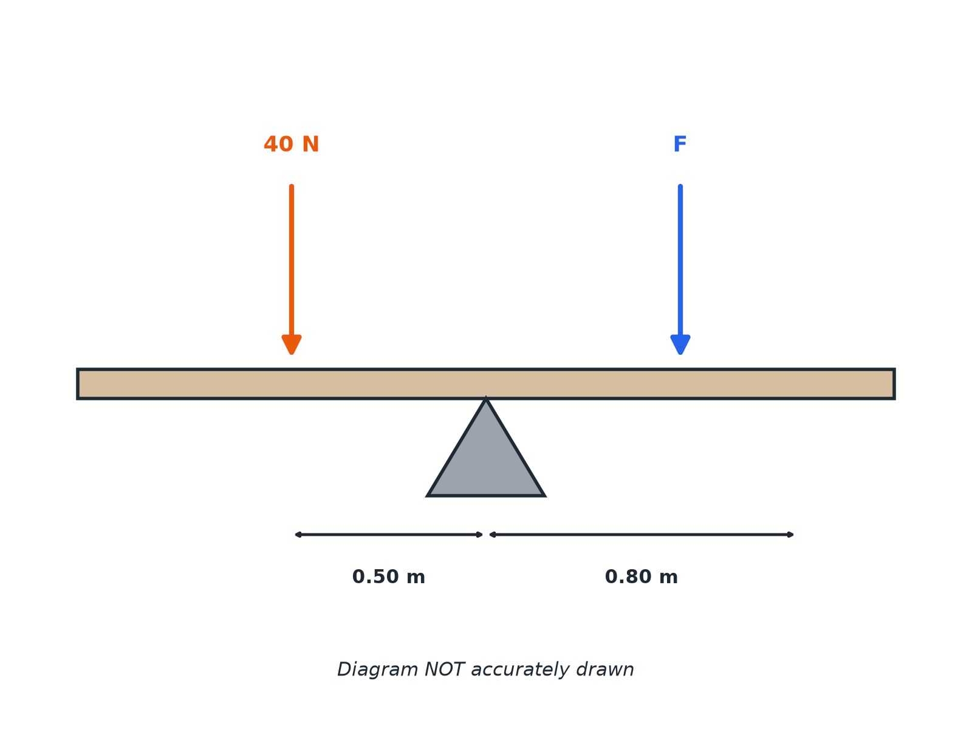
AQA GCSE PHYSICS · PAPER 2 · FOUNDATION & HIGHER
Question 2 · 3 marks · Calculate
The diagram shows a uniform beam balanced on a pivot. A 40 N force acts 0.50 m to the left of the pivot. Calculate the force F. (3 marks)
Forces
openrevise.com
Lesson 6 of 20

Slide 20
AQA GCSE PHYSICS · PAPER 2 · FOUNDATION & HIGHER
Question 2 · mark scheme
3 marks available. Award a mark for each point made.
Anticlockwise moment 20 Nm
1 mark
Equates moments
1 mark
25 N
1 mark
Forces
openrevise.com
Lesson 6 of 20

Slide 21
AQA GCSE PHYSICS · PAPER 2 · FOUNDATION & HIGHER
Question 3 · 2 marks · Explain
“
A spanner is used to undo a nut. Explain why a longer spanner makes it easier.
HOW TO ANSWER IT
Command word: Explain. Worth 2 marks, so plan before writing.
Forces
openrevise.com
Lesson 6 of 20

Slide 22
AQA GCSE PHYSICS · PAPER 2 · FOUNDATION & HIGHER
Question 3 · mark scheme
2 marks available. Award a mark for each point made.
Moment = force × distance
1 mark
Greater distance means smaller force needed
1 mark
Forces
openrevise.com
Lesson 6 of 20

Slide 23
AQA GCSE PHYSICS · PAPER 2 · FOUNDATION & HIGHER
Question 4 · 3 marks · Explain
“
A gear with 20 teeth is driven by a motor. It meshes with a gear with 40 teeth. Explain how the larger gear turns compared with the smaller gear.
HOW TO ANSWER IT
Command word: Explain. Worth 3 marks, so plan before writing.
Forces
openrevise.com
Lesson 6 of 20

Slide 24
AQA GCSE PHYSICS · PAPER 2 · FOUNDATION & HIGHER
Question 4 · mark scheme
3 marks available. Award a mark for each point made.
Opposite direction
1 mark
Slower (half the speed)
1 mark
Greater moment
1 mark
Forces
openrevise.com
Lesson 6 of 20

Slide 25
AQA GCSE PHYSICS · PAPER 2 · FOUNDATION & HIGHER
Question 5 · 4 marks · Calculate
“
A 60 N weight is 0.40 m to the left of a pivot on a balanced beam. A 30 N weight is on the right. Calculate its distance from the pivot.
HOW TO ANSWER IT
Command word: Calculate. Worth 4 marks, so plan before writing.
Forces
openrevise.com
Lesson 6 of 20

Slide 26
AQA GCSE PHYSICS · PAPER 2 · FOUNDATION & HIGHER
Question 5 · mark scheme
4 marks available. Award a mark for each point made.
Anticlockwise moment 24 Nm
1 mark
Balanced moments
1 mark
Correct rearrangement
1 mark
0.80 m
1 mark
Forces
openrevise.com
Lesson 6 of 20

