Slide 1

AQA GCSE PHYSICS · PAPER 2 · FOUNDATION & HIGHER
Pressure in a fluid
Forces
Lesson 7 of 20
openrevise.com

Slide 2

AQA GCSE PHYSICS · PAPER 2 · FOUNDATION & HIGHER
Warm-up
Answer each one, then check.
1
What is area?
2
What is the unit of area?
3
What is a fluid?
4
What is the unit of force?
5
What is the unit of pressure?
Forces
openrevise.com
Lesson 7 of 20

Slide 3
AQA GCSE PHYSICS · PAPER 2 · FOUNDATION & HIGHER
Warm-up - Answers
What is area?
The amount of surface
1
What is the unit of area?
Square metres (m²)
2
What is a fluid?
A liquid or a gas
3
What is the unit of force?
Newton
4
What is the unit of pressure?
Pascal (Pa)
5
Forces
openrevise.com
Lesson 7 of 20

Slide 4

AQA GCSE PHYSICS · PAPER 2 · FOUNDATION & HIGHER
Learning Objectives
Define pressure and recall that a fluid can be a liquid or a gas.
1
Recall and apply p = F ÷ A.
2
Explain that pressure in a fluid causes a force at right angles to any surface.
3
Explain examples where force is spread over a large or small area.
4
Forces
openrevise.com
Lesson 7 of 20

Slide 5

AQA GCSE PHYSICS · PAPER 2 · FOUNDATION & HIGHER
PRESSURE
pressure = force normal to a surface ÷ area of that surface p = F/A
Pressure is in pascals (Pa), force in newtons (N) and area in square metres (m²). 1 Pa = 1 N/m².
Forces
openrevise.com
Lesson 7 of 20

Slide 6
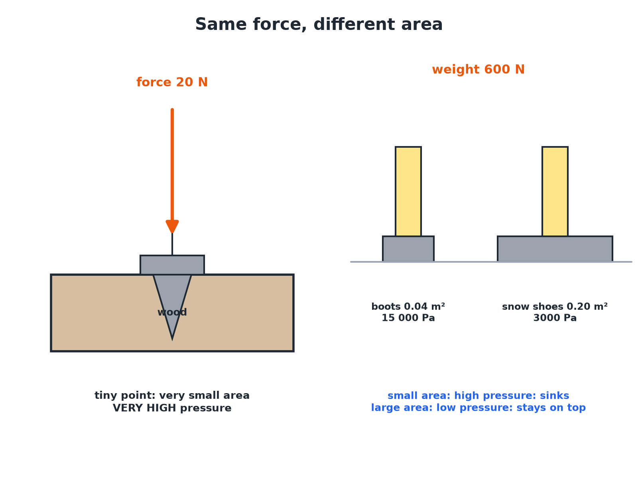

AQA GCSE PHYSICS · PAPER 2 · FOUNDATION & HIGHER
Same Force, Different Pressure
A smaller area gives a greater pressure for the same force.
Forces
openrevise.com
Lesson 7 of 20

Slide 7

AQA GCSE PHYSICS · PAPER 2 · FOUNDATION & HIGHER
Calculating Pressure
A person of weight 600 N stands on an area of 0.04 m². Calculate the pressure on the ground.
Write the equation
p = F ÷ A
1
Substitute
p = 600 ÷ 0.04
2
Answer
p = 15 000 Pa
3
ANSWER
15 000 Pa
Forces
openrevise.com
Lesson 7 of 20

Slide 8
AQA GCSE PHYSICS · PAPER 2 · FOUNDATION & HIGHER
Finding the Force
A pressure of 2000 Pa acts on a surface of area 0.50 m². Calculate the force.
Rearrange
F = pA
1
Substitute
F = 2000 × 0.50
2
Answer
F = 1000 N
3
ANSWER
1000 N
Forces
openrevise.com
Lesson 7 of 20

Slide 9
AQA GCSE PHYSICS · PAPER 2 · FOUNDATION & HIGHER
Explaining Everyday Examples
Explain why a sharp knife cuts better than a blunt one.
Same force
The same force is applied to both
1
Sharp edge
Has a very small area
2
Pressure
A small area gives a large pressure, so it cuts
3
ANSWER
The sharp knife has a smaller area, so for the same force it exerts a higher pressure.
Forces
openrevise.com
Lesson 7 of 20

Slide 10

AQA GCSE PHYSICS · PAPER 2 · FOUNDATION & HIGHER
Pressure in Fluids
Liquids and gases.
Direction
Pressure in a fluid causes a force normal (at right angles) to any surface.
Gases
Produced by collisions of particles with surfaces.
Liquids
Particles collide with the container walls in all directions.
Uses
Tyres, hydraulics and sealed containers use fluid pressure.
Forces
openrevise.com
Lesson 7 of 20

Slide 11

AQA GCSE PHYSICS · PAPER 2 · FOUNDATION & HIGHER
Key Terms
Pressure
Force per unit area.
Pascal
The unit of pressure; 1 N/m².
Fluid
A liquid or a gas.
Normal
At right angles to a surface.
Area
The size of a surface.
Force
A push or pull.
Forces
openrevise.com
Lesson 7 of 20

Slide 12

AQA GCSE PHYSICS · PAPER 2 · FOUNDATION & HIGHER
YOUR TASK
10 minutes
Shoe Pressure
A 500 N person wears stiletto heels of total area 0.0004 m² and then flat shoes of area 0.04 m². Calculate the pressure each exerts and explain which damages a floor.
Calculate each pressure.
1
Compare.
2
WHAT A GOOD ANSWER SHOWS
Heels: 500 ÷ 0.0004 = 1 250 000 Pa. Flat: 500 ÷ 0.04 = 12 500 Pa. The heels exert 100 times more pressure, so they damage the floor.
Forces
openrevise.com
Lesson 7 of 20

Slide 13
AQA GCSE PHYSICS · PAPER 2 · FOUNDATION & HIGHER
Can I...?
Define pressure.
Explain sharp and blunt objects.
Use p = F ÷ A.
Explain wide tyres.
Rearrange for force or area.
State the direction of fluid pressure.
Convert cm² to m².
Give the unit.
Forces
openrevise.com
Lesson 7 of 20

Slide 14
AQA GCSE PHYSICS · PAPER 2 · FOUNDATION & HIGHER
Summary & Exam Focus
p = F ÷ A.
Smaller area, larger pressure.
Fluid pressure acts at right angles to surfaces.
1 Pa = 1 N/m².
EXAM FOCUS
A person of weight 600 N stands on 0.04 m² of ground. Calculate the pressure. (2 marks)
Divide force by area.
openrevise.com

