Slide 1

AQA GCSE PHYSICS · PAPER 2 · HIGHER TIER ONLY
Pressure in a column of liquid and upthrust
Forces
Lesson 8 of 20
openrevise.com

Slide 2

AQA GCSE PHYSICS · PAPER 2 · HIGHER TIER ONLY
Warm-up
Answer each one, then check.
1
What is density?
2
Write the equation for pressure.
3
What unit is pressure in?
4
What is g?
5
What is a fluid?
Forces
openrevise.com
Lesson 8 of 20

Slide 3
AQA GCSE PHYSICS · PAPER 2 · HIGHER TIER ONLY
Warm-up - Answers
What is density?
Mass per unit volume
1
Write the equation for pressure.
p = F ÷ A
2
What unit is pressure in?
Pascal
3
What is g?
Gravitational field strength, 9.8 N/kg
4
What is a fluid?
A liquid or gas
5
Forces
openrevise.com
Lesson 8 of 20

Slide 4

AQA GCSE PHYSICS · PAPER 2 · HIGHER TIER ONLY
Learning Objectives
Explain why pressure at a point in a liquid increases with depth and with density.
1
Apply p = hρg and calculate pressure differences at different depths.
2
Explain why a submerged object experiences an upward force called upthrust.
3
Describe the factors that influence floating and sinking.
4
Forces
openrevise.com
Lesson 8 of 20

Slide 5

AQA GCSE PHYSICS · PAPER 2 · HIGHER TIER ONLY
PRESSURE IN A LIQUID
pressure = height of column × density × gravitational field strength p = hρg
The equation is given on the Physics equation sheet. In any calculation g will be given. Pressure is in pascals (Pa), h in metres, ρ in kg/m³ and g in N/kg.
Forces
openrevise.com
Lesson 8 of 20

Slide 6
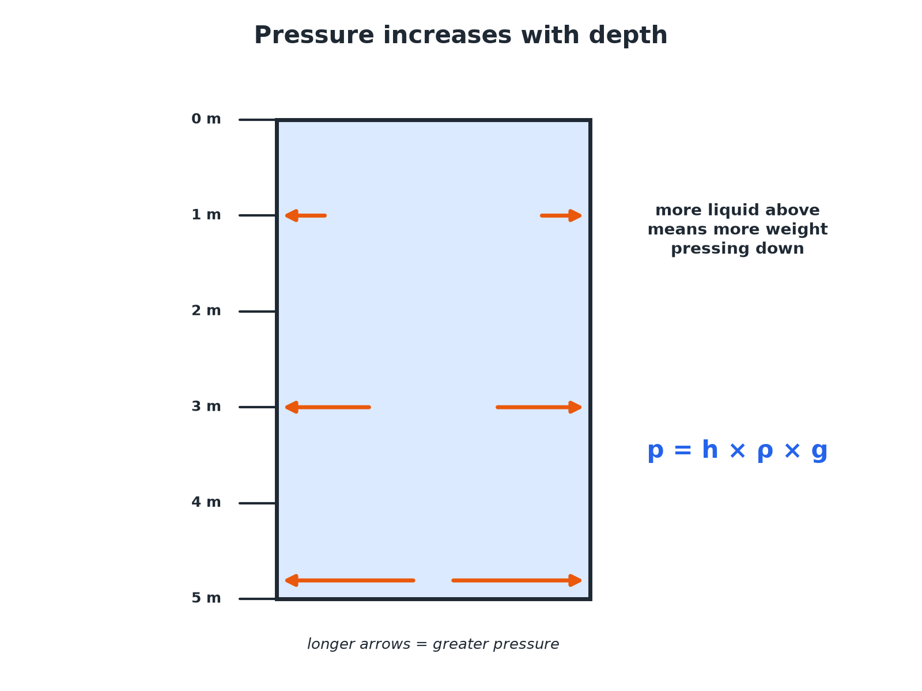

AQA GCSE PHYSICS · PAPER 2 · HIGHER TIER ONLY
Pressure Increases with Depth
More liquid above means more pressure.
Forces
openrevise.com
Lesson 8 of 20

Slide 7
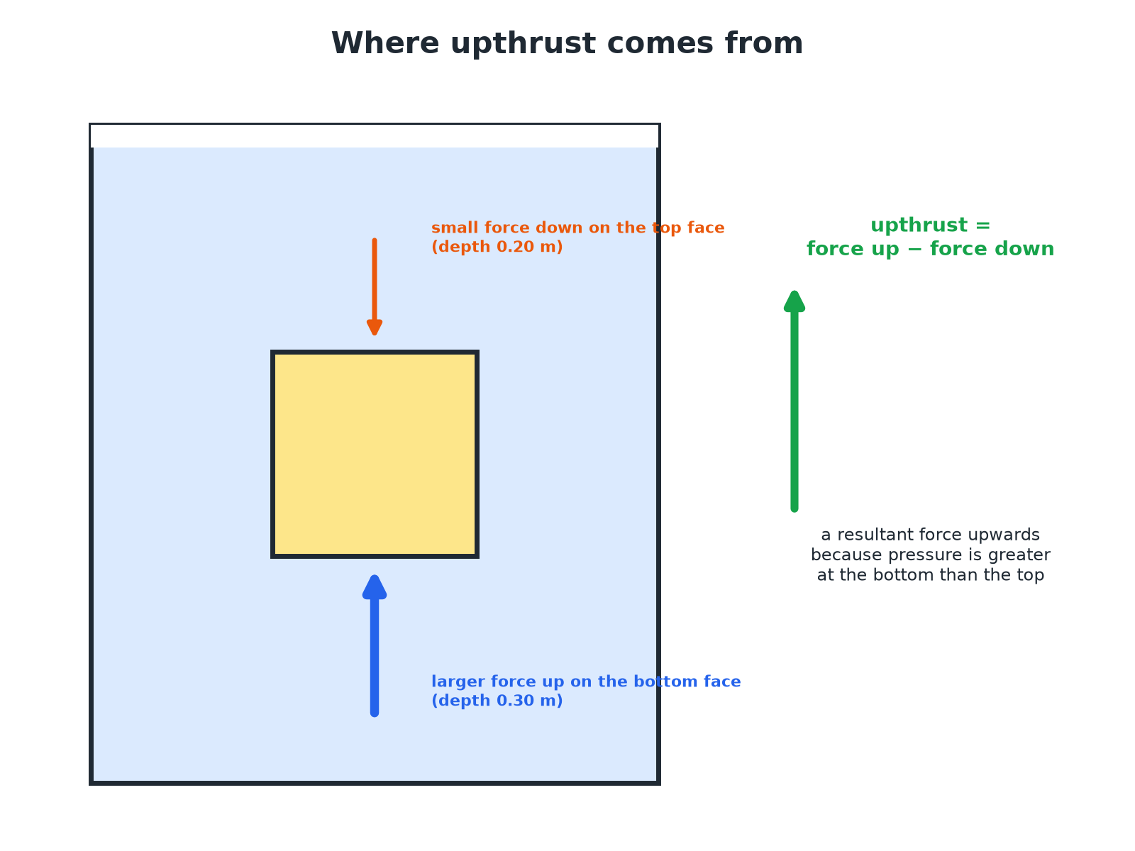
AQA GCSE PHYSICS · PAPER 2 · HIGHER TIER ONLY
Upthrust
Pressure is greater at the bottom than the top.
Forces
openrevise.com
Lesson 8 of 20

Slide 8

AQA GCSE PHYSICS · PAPER 2 · HIGHER TIER ONLY
Pressure at a Depth
Calculate the pressure due to the sea water at a depth of 20 m. Density of sea water = 1030 kg/m³; g = 9.8 N/kg.
Write the equation
p = hρg
1
Substitute
p = 20 × 1030 × 9.8
2
Answer
p = 201 880 Pa, about 2.0 × 10⁵ Pa
3
ANSWER
About 2.0 × 10⁵ Pa
Forces
openrevise.com
Lesson 8 of 20

Slide 9
AQA GCSE PHYSICS · PAPER 2 · HIGHER TIER ONLY
Pressure Difference
Calculate the difference in pressure between depths of 2.0 m and 5.0 m in fresh water (density 1000 kg/m³). g = 9.8 N/kg.
Difference in depth
5.0 − 2.0 = 3.0 m
1
Substitute
p = 3.0 × 1000 × 9.8
2
Answer
29 400 Pa
3
ANSWER
29 400 Pa
Forces
openrevise.com
Lesson 8 of 20

Slide 10
AQA GCSE PHYSICS · PAPER 2 · HIGHER TIER ONLY
Upthrust on a Cube
A cube of side 0.10 m is submerged with its top face at a depth of 0.20 m. Calculate the upthrust. Density of water = 1000 kg/m³; g = 9.8 N/kg.
Pressure difference between bottom and top
0.10 × 1000 × 9.8 = 980 Pa
1
Area of a face
0.10 × 0.10 = 0.010 m²
2
Force difference
F = pA = 980 × 0.010 = 9.8 N
3
ANSWER
Upthrust = 9.8 N, upwards.
Forces
openrevise.com
Lesson 8 of 20

Slide 11

AQA GCSE PHYSICS · PAPER 2 · HIGHER TIER ONLY
Floating and Sinking
Compare upthrust with weight.
Float
Upthrust equals weight when an object floats; its average density is less than the liquid's.
Sink
If the weight is greater than the maximum upthrust, the object sinks.
Ships
A steel ship floats because its shape displaces a lot of water, giving it a low average density.
Submarines
Change their average density by taking in or pushing out water.
Forces
openrevise.com
Lesson 8 of 20

Slide 12

AQA GCSE PHYSICS · PAPER 2 · HIGHER TIER ONLY
Key Terms
Upthrust
The resultant upward force on a submerged object due to pressure.
Column of liquid
The liquid above a point.
Density
Mass per unit volume.
Submerged
Completely under the surface.
Displaced
Pushed out of the way.
Average density
Total mass divided by total volume.
Forces
openrevise.com
Lesson 8 of 20

Slide 13

AQA GCSE PHYSICS · PAPER 2 · HIGHER TIER ONLY
YOUR TASK
12 minutes
Dive Down
A diver is 15 m deep in water (density 1000 kg/m³, g = 9.8 N/kg). Calculate the pressure due to the water. Explain why the pressure is greater than at 5 m.
Use p = hρg.
1
Explain with depth.
2
WHAT A GOOD ANSWER SHOWS
p = 15 × 1000 × 9.8 = 147 000 Pa. There is more water above the diver, so its weight produces a greater pressure.
Forces
openrevise.com
Lesson 8 of 20

Slide 14
AQA GCSE PHYSICS · PAPER 2 · HIGHER TIER ONLY
Can I...?
State p = hρg.
Explain why pressure increases with density.
Calculate pressure at a depth.
Explain upthrust.
Find a pressure difference.
Explain floating.
Explain why pressure increases with depth.
Explain sinking.
Forces
openrevise.com
Lesson 8 of 20

Slide 15
AQA GCSE PHYSICS · PAPER 2 · HIGHER TIER ONLY
Summary & Exam Focus
p = hρg.
Pressure increases with depth and density.
Upthrust = difference in force on bottom and top.
Floats if upthrust equals weight.
EXAM FOCUS
Calculate the pressure due to the sea at a depth of 20 m. Density = 1030 kg/m³; g = 9.8 N/kg. (2 marks)
Substitute into p = hρg.
openrevise.com

