Slide 1

AQA GCSE PHYSICS · PAPER 2 · HIGHER TIER ONLY
Pressure in a column of liquid and upthrust
Forces
Lesson 8 of 20
openrevise.com

Slide 2

AQA GCSE PHYSICS · PAPER 2 · HIGHER TIER ONLY
Warm-up
Answer each one, then check.
1
What is density?
2
Write the equation for pressure.
3
What unit is pressure in?
4
What is g?
5
What is a fluid?
Forces
openrevise.com
Lesson 8 of 20

Slide 3
AQA GCSE PHYSICS · PAPER 2 · HIGHER TIER ONLY
Warm-up - Answers
What is density?
Mass per unit volume
1
Write the equation for pressure.
p = F ÷ A
2
What unit is pressure in?
Pascal
3
What is g?
Gravitational field strength, 9.8 N/kg
4
What is a fluid?
A liquid or gas
5
Forces
openrevise.com
Lesson 8 of 20

Slide 4

AQA GCSE PHYSICS · PAPER 2 · HIGHER TIER ONLY
Learning Objectives
Explain why pressure at a point in a liquid increases with depth and with density.
1
Apply p = hρg and calculate pressure differences at different depths.
2
Explain why a submerged object experiences an upward force called upthrust.
3
Describe the factors that influence floating and sinking.
4
Forces
openrevise.com
Lesson 8 of 20

Slide 5

AQA GCSE PHYSICS · PAPER 2 · HIGHER TIER ONLY
PRESSURE IN A LIQUID
pressure = height of column × density × gravitational field strength p = hρg
The equation is given on the Physics equation sheet. In any calculation g will be given. Pressure is in pascals (Pa), h in metres, ρ in kg/m³ and g in N/kg.
Forces
openrevise.com
Lesson 8 of 20

Slide 6
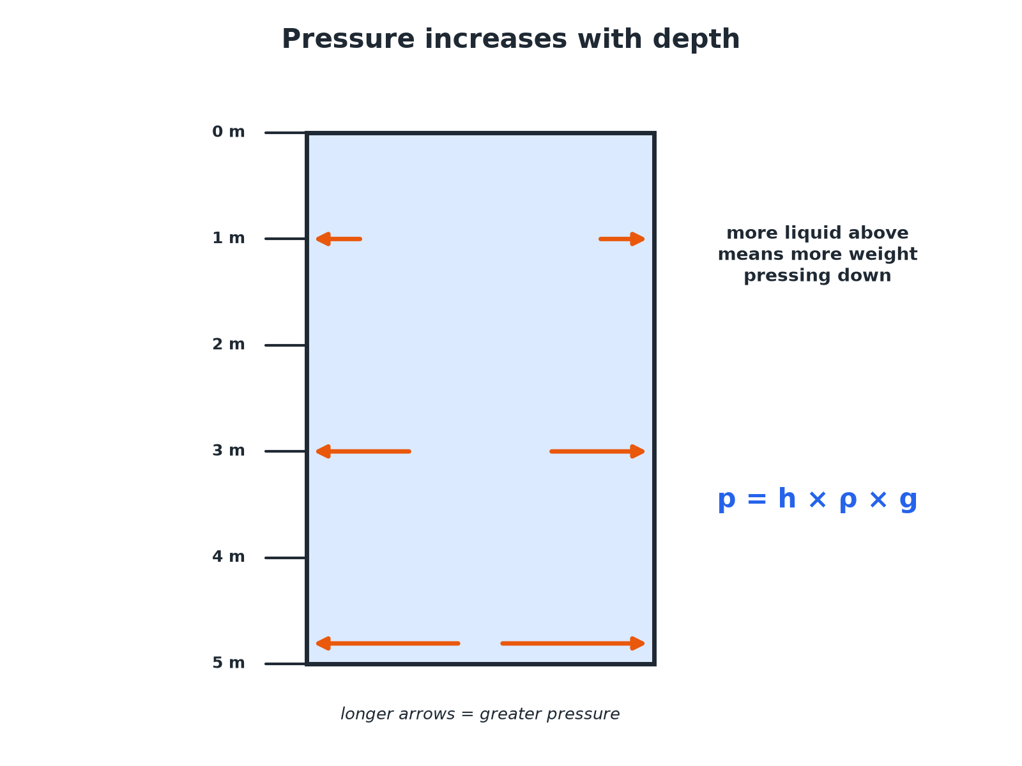

AQA GCSE PHYSICS · PAPER 2 · HIGHER TIER ONLY
Pressure Increases with Depth
More liquid above means more pressure.
Forces
openrevise.com
Lesson 8 of 20

Slide 7
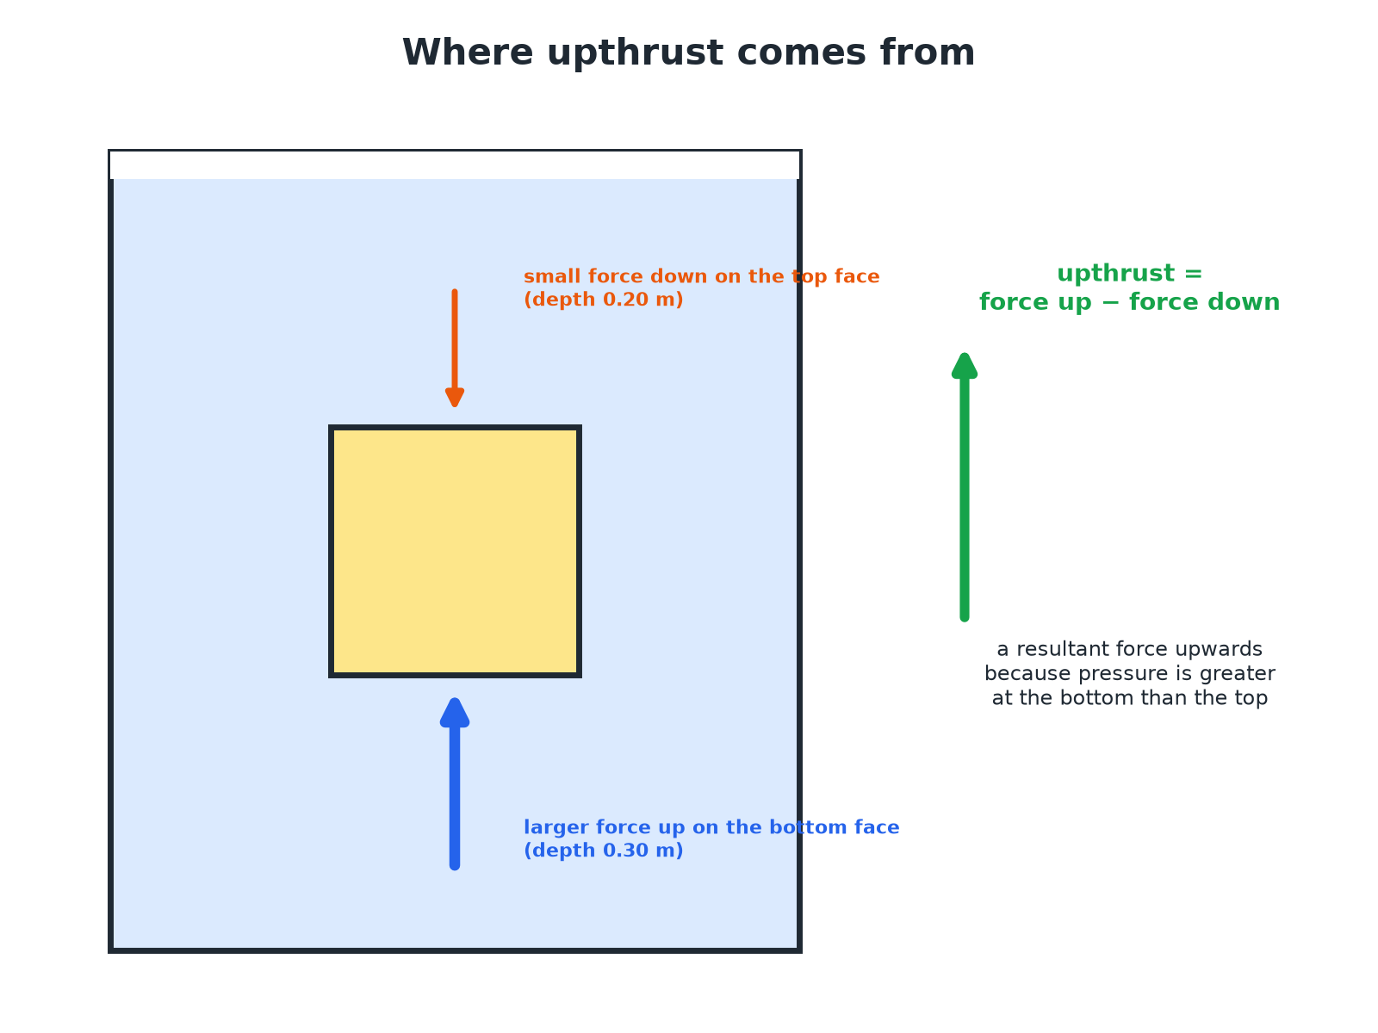
AQA GCSE PHYSICS · PAPER 2 · HIGHER TIER ONLY
Upthrust
Pressure is greater at the bottom than the top.
Forces
openrevise.com
Lesson 8 of 20

Slide 8

AQA GCSE PHYSICS · PAPER 2 · HIGHER TIER ONLY
Pressure at a Depth
Calculate the pressure due to the sea water at a depth of 20 m. Density of sea water = 1030 kg/m³; g = 9.8 N/kg.
Write the equation
p = hρg
1
Substitute
p = 20 × 1030 × 9.8
2
Answer
p = 201 880 Pa, about 2.0 × 10⁵ Pa
3
ANSWER
About 2.0 × 10⁵ Pa
Forces
openrevise.com
Lesson 8 of 20

Slide 9
AQA GCSE PHYSICS · PAPER 2 · HIGHER TIER ONLY
Pressure Difference
Calculate the difference in pressure between depths of 2.0 m and 5.0 m in fresh water (density 1000 kg/m³). g = 9.8 N/kg.
Difference in depth
5.0 − 2.0 = 3.0 m
1
Substitute
p = 3.0 × 1000 × 9.8
2
Answer
29 400 Pa
3
ANSWER
29 400 Pa
Forces
openrevise.com
Lesson 8 of 20

Slide 10
AQA GCSE PHYSICS · PAPER 2 · HIGHER TIER ONLY
Upthrust on a Cube
A cube of side 0.10 m is submerged with its top face at a depth of 0.20 m. Calculate the upthrust. Density of water = 1000 kg/m³; g = 9.8 N/kg.
Pressure difference between bottom and top
0.10 × 1000 × 9.8 = 980 Pa
1
Area of a face
0.10 × 0.10 = 0.010 m²
2
Force difference
F = pA = 980 × 0.010 = 9.8 N
3
ANSWER
Upthrust = 9.8 N, upwards.
Forces
openrevise.com
Lesson 8 of 20

Slide 11

AQA GCSE PHYSICS · PAPER 2 · HIGHER TIER ONLY
Floating and Sinking
Compare upthrust with weight.
Float
Upthrust equals weight when an object floats; its average density is less than the liquid's.
Sink
If the weight is greater than the maximum upthrust, the object sinks.
Ships
A steel ship floats because its shape displaces a lot of water, giving it a low average density.
Submarines
Change their average density by taking in or pushing out water.
Forces
openrevise.com
Lesson 8 of 20

Slide 12

AQA GCSE PHYSICS · PAPER 2 · HIGHER TIER ONLY
Why Pressure Increases with Depth
Two reasons, and an exam answer needs both.
Weight of liquid above
The deeper you go, the taller the column of liquid above you. A taller column has more weight pressing down on the same area, so the pressure is greater.
Density of the liquid
A denser liquid has more mass in each cubic metre, so the same column weighs more. Pressure at 10 m in sea water is greater than at 10 m in fresh water.
All directions
At any one depth, the pressure acts equally in all directions, at right angles to every surface. That is why water spurts sideways from holes in a tank.
Forces
openrevise.com
Lesson 8 of 20

Slide 13

AQA GCSE PHYSICS · PAPER 2 · HIGHER TIER ONLY
CASE STUDY
Why Dams Are Thicker at the Bottom
The water pressure on a dam increases with depth, so the force on the bottom of the dam wall is far greater than at the top. Engineers build dams much thicker at the base to withstand this. The same idea explains why divers must ascend slowly and why submarines need a thick hull.
10 m
2.0 × 10⁵ Pa
Depth of water that adds about 100 000 Pa of pressure
Pressure due to the sea at 20 m
Forces
openrevise.com
Lesson 8 of 20

Slide 14
AQA GCSE PHYSICS · PAPER 2 · HIGHER TIER ONLY
Will It Float?
Follow the forces as an object is lowered into water.
1
2
3
4
Enters the water
It displaces water, and upthrust starts to act.
Goes deeper
It displaces more water, so the upthrust grows.
Upthrust = weight
It stops sinking and floats, partly submerged.
Fully under, upthrust < weight
It cannot displace any more, so it sinks.
Forces
openrevise.com
Lesson 8 of 20

Slide 15

AQA GCSE PHYSICS · PAPER 2 · HIGHER TIER ONLY
Key Terms
Upthrust
The resultant upward force on a submerged object due to pressure.
Column of liquid
The liquid above a point.
Density
Mass per unit volume.
Submerged
Completely under the surface.
Displaced
Pushed out of the way.
Average density
Total mass divided by total volume.
Forces
openrevise.com
Lesson 8 of 20

Slide 16
AQA GCSE PHYSICS · PAPER 2 · HIGHER TIER ONLY
Key Terms (cont.)
Float
Stay at the surface because upthrust equals weight.
Depth
The distance below the surface of a liquid.
Forces
openrevise.com
Lesson 8 of 20

Slide 17

AQA GCSE PHYSICS · PAPER 2 · HIGHER TIER ONLY
YOUR TASK
12 minutes
Dive Down
A diver is 15 m deep in water (density 1000 kg/m³, g = 9.8 N/kg). Calculate the pressure due to the water. Explain why the pressure is greater than at 5 m.
Use p = hρg.
1
Explain with depth.
2
WHAT A GOOD ANSWER SHOWS
p = 15 × 1000 × 9.8 = 147 000 Pa. There is more water above the diver, so its weight produces a greater pressure.
Forces
openrevise.com
Lesson 8 of 20
Notes:
Ask how dense liquid changes the answer.

Slide 18
AQA GCSE PHYSICS · PAPER 2 · HIGHER TIER ONLY
Can I...?
State p = hρg.
Explain why pressure increases with density.
Calculate pressure at a depth.
Explain upthrust.
Find a pressure difference.
Explain floating.
Explain why pressure increases with depth.
Explain sinking.
Forces
openrevise.com
Lesson 8 of 20

Slide 19
AQA GCSE PHYSICS · PAPER 2 · HIGHER TIER ONLY
Summary & Exam Focus
p = hρg.
Pressure increases with depth and density.
Upthrust = difference in force on bottom and top.
Floats if upthrust equals weight.
An object floats if its average density is less than the liquid's.
At a given depth, pressure acts in all directions.
EXAM FOCUS
Calculate the pressure due to the sea at a depth of 20 m. Density = 1030 kg/m³; g = 9.8 N/kg. (2 marks)
Write p = hρg, substitute 20 × 1030 × 9.8 and give about 2.0 × 10⁵ Pa. Use the depth in metres and the density in kg/m³.
openrevise.com

Slide 20
AQA GCSE PHYSICS · PAPER 2 · HIGHER TIER ONLY
Exam Practice: Pressure in a column of liquid and upthrust
Answer all questions. Use the mark allocation as a guide to how much to write. · 17 minutes
Question 1 · 3 marks · Calculate
A submarine is at a depth of 20 m in sea water of density 1030 kg/m³. Gravitational field strength = 9.8 N/kg. Calculate the pressure on…
Question 2 · 3 marks · Explain
Explain why the pressure at the bottom of a swimming pool is greater than the pressure near the surface.
Question 3 · 3 marks · Calculate
Calculate the difference in pressure between depths of 2.0 m and 5.0 m in fresh water. Density of water = 1000 kg/m³; g = 9.8 N/kg.
Forces
openrevise.com
Lesson 8 of 20

Slide 21
AQA GCSE PHYSICS · PAPER 2 · HIGHER TIER ONLY
Exam Practice: Pressure in a column of liquid and upthrust (cont.)
Question 4 · 3 marks · Explain
A brick is completely submerged in water. Explain why it experiences an upward force called upthrust.
Question 5 · 4 marks · Explain
A steel ship floats but a steel ball of the same mass sinks. Explain why.
Forces
openrevise.com
Lesson 8 of 20

Slide 22
AQA GCSE PHYSICS · PAPER 2 · HIGHER TIER ONLY
Question 1 · 3 marks · Calculate
“
A submarine is at a depth of 20 m in sea water of density 1030 kg/m³. Gravitational field strength = 9.8 N/kg. Calculate the pressure on the submarine due to the water.
HOW TO ANSWER IT
Command word: Calculate. Worth 3 marks, so plan before writing.
Forces
openrevise.com
Lesson 8 of 20

Slide 23
AQA GCSE PHYSICS · PAPER 2 · HIGHER TIER ONLY
Question 1 · mark scheme
3 marks available. Award a mark for each point made.
Correct equation
1 mark
Correct substitution
1 mark
201 880 Pa
1 mark
Forces
openrevise.com
Lesson 8 of 20

Slide 24
AQA GCSE PHYSICS · PAPER 2 · HIGHER TIER ONLY
Question 2 · 3 marks · Explain
“
Explain why the pressure at the bottom of a swimming pool is greater than the pressure near the surface.
HOW TO ANSWER IT
Command word: Explain. Worth 3 marks, so plan before writing.
Forces
openrevise.com
Lesson 8 of 20

Slide 25
AQA GCSE PHYSICS · PAPER 2 · HIGHER TIER ONLY
Question 2 · mark scheme
3 marks available. Award a mark for each point made.
Pressure due to the weight of water above
1 mark
More water above at the bottom
1 mark
So greater pressure
1 mark
Forces
openrevise.com
Lesson 8 of 20

Slide 26
AQA GCSE PHYSICS · PAPER 2 · HIGHER TIER ONLY
Question 3 · 3 marks · Calculate
“
Calculate the difference in pressure between depths of 2.0 m and 5.0 m in fresh water. Density of water = 1000 kg/m³; g = 9.8 N/kg.
HOW TO ANSWER IT
Command word: Calculate. Worth 3 marks, so plan before writing.
Forces
openrevise.com
Lesson 8 of 20

Slide 27
AQA GCSE PHYSICS · PAPER 2 · HIGHER TIER ONLY
Question 3 · mark scheme
3 marks available. Award a mark for each point made.
Height difference 3.0 m
1 mark
Correct substitution
1 mark
29 400 Pa
1 mark
Forces
openrevise.com
Lesson 8 of 20

Slide 28
AQA GCSE PHYSICS · PAPER 2 · HIGHER TIER ONLY
Question 4 · 3 marks · Explain
“
A brick is completely submerged in water. Explain why it experiences an upward force called upthrust.
HOW TO ANSWER IT
Command word: Explain. Worth 3 marks, so plan before writing.
Forces
openrevise.com
Lesson 8 of 20

Slide 29
AQA GCSE PHYSICS · PAPER 2 · HIGHER TIER ONLY
Question 4 · mark scheme
3 marks available. Award a mark for each point made.
Pressure greater on the bottom
1 mark
Force greater on the bottom surface
1 mark
Resultant upward force
1 mark
Forces
openrevise.com
Lesson 8 of 20

Slide 30
AQA GCSE PHYSICS · PAPER 2 · HIGHER TIER ONLY
Question 5 · 4 marks · Explain
“
A steel ship floats but a steel ball of the same mass sinks. Explain why.
HOW TO ANSWER IT
Command word: Explain. Worth 4 marks, so plan before writing.
Forces
openrevise.com
Lesson 8 of 20

Slide 31
AQA GCSE PHYSICS · PAPER 2 · HIGHER TIER ONLY
Question 5 · mark scheme
4 marks available. Award a mark for each point made.
Ship displaces a large volume
1 mark
Upthrust equals weight for the ship
1 mark
Ball: upthrust less than weight
1 mark
Comparison of average density
1 mark
Forces
openrevise.com
Lesson 8 of 20

