Slide 1

AQA GCSE PHYSICS · PAPER 2 · FOUNDATION & HIGHER
Atmospheric pressure
Forces
Lesson 9 of 20
openrevise.com

Slide 2

AQA GCSE PHYSICS · PAPER 2 · FOUNDATION & HIGHER
Warm-up
Answer each one, then check.
1
What is air made of?
2
What causes gas pressure?
3
What is pressure?
4
What is density?
5
What is altitude?
Forces
openrevise.com
Lesson 9 of 20

Slide 3
AQA GCSE PHYSICS · PAPER 2 · FOUNDATION & HIGHER
Warm-up - Answers
What is air made of?
Gas molecules, mostly nitrogen and oxygen
1
What causes gas pressure?
Collisions of particles with surfaces
2
What is pressure?
Force per unit area
3
What is density?
Mass per unit volume
4
What is altitude?
Height above sea level
5
Forces
openrevise.com
Lesson 9 of 20

Slide 4

AQA GCSE PHYSICS · PAPER 2 · FOUNDATION & HIGHER
Learning Objectives
Describe a simple model of the atmosphere.
1
Explain how air molecules colliding with a surface create atmospheric pressure.
2
Explain why atmospheric pressure decreases with increasing height.
3
Forces
openrevise.com
Lesson 9 of 20

Slide 5

AQA GCSE PHYSICS · PAPER 2 · FOUNDATION & HIGHER
ATMOSPHERIC PRESSURE
The atmosphere is a thin layer of air round the Earth that gets less dense with altitude. Air molecules colliding with a surface create atmospheric pressure.
As height increases there is less air above a surface, so the weight of air above falls and the atmospheric pressure decreases.
Forces
openrevise.com
Lesson 9 of 20

Slide 6
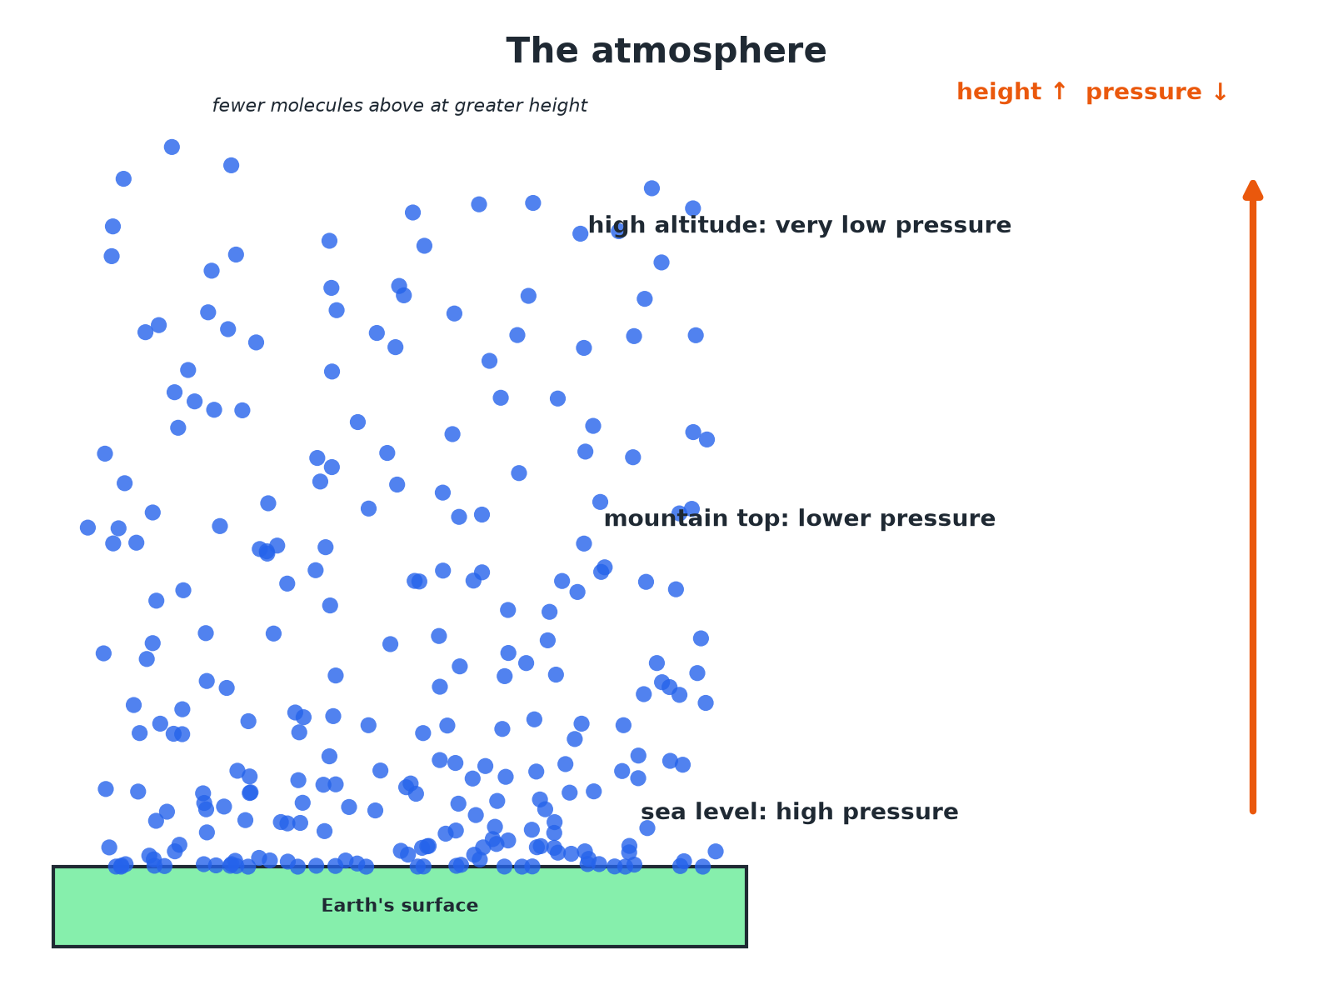

AQA GCSE PHYSICS · PAPER 2 · FOUNDATION & HIGHER
The Atmosphere
Less air above means lower pressure.
Forces
openrevise.com
Lesson 9 of 20

Slide 7

AQA GCSE PHYSICS · PAPER 2 · FOUNDATION & HIGHER
Why Pressure Falls with Height
Explain why atmospheric pressure is lower at the top of a mountain than at sea level.
Air above
At the top there is less air above the surface
1
Weight
So the weight of air pressing down is less
2
Molecules
There are fewer molecules, so fewer collisions with a surface each second
3
ANSWER
Fewer air molecules and less weight of air above lead to lower atmospheric pressure.
Forces
openrevise.com
Lesson 9 of 20

Slide 8
AQA GCSE PHYSICS · PAPER 2 · FOUNDATION & HIGHER
Using a Graph
At sea level the atmospheric pressure is about 101 kPa. At 5 km it is about 55 kPa. Describe the trend.
Height increases
5 km above sea level
1
Pressure
Falls from 101 kPa to 55 kPa
2
ANSWER
Atmospheric pressure decreases as height increases, at first quite quickly.
Forces
openrevise.com
Lesson 9 of 20

Slide 9

AQA GCSE PHYSICS · PAPER 2 · FOUNDATION & HIGHER
Key Points
Learn these.
Thin layer
The atmosphere is thin compared with the size of the Earth.
Density
The air gets less dense with altitude.
Collisions
Atmospheric pressure is caused by molecules colliding with surfaces.
No sharp edge
The pressure falls gradually to almost zero in space.
Forces
openrevise.com
Lesson 9 of 20

Slide 10

AQA GCSE PHYSICS · PAPER 2 · FOUNDATION & HIGHER
Key Terms
Atmosphere
The layer of air around the Earth.
Atmospheric pressure
The pressure caused by air molecules colliding with a surface.
Altitude
Height above the ground or sea level.
Air molecule
A particle of nitrogen, oxygen or another gas.
Less dense
Fewer particles in each cubic metre.
Collision
Particles hitting a surface.
Forces
openrevise.com
Lesson 9 of 20

Slide 11

AQA GCSE PHYSICS · PAPER 2 · FOUNDATION & HIGHER
YOUR TASK
10 minutes
Mountain Pressure
Explain why a sealed bag of crisps bulges when taken up a mountain.
Compare inside and outside pressure.
1
Explain the bulge.
2
WHAT A GOOD ANSWER SHOWS
The pressure outside falls with height, but the pressure inside the bag stays the same, so the bag expands.
Forces
openrevise.com
Lesson 9 of 20
Notes:
Ask what would happen at the top of a very high mountain.

Slide 12
AQA GCSE PHYSICS · PAPER 2 · FOUNDATION & HIGHER
Can I...?
Describe the atmosphere.
Read a graph of pressure.
Say air gets less dense with height.
Use the particle model.
Explain atmospheric pressure.
Describe collisions.
Explain the fall in pressure with height.
Explain a bulging bag.
Forces
openrevise.com
Lesson 9 of 20

Slide 13
AQA GCSE PHYSICS · PAPER 2 · FOUNDATION & HIGHER
Summary & Exam Focus
The atmosphere gets less dense with altitude.
Pressure: collisions of air molecules.
Less air above means a smaller weight of air.
Pressure decreases with height.
EXAM FOCUS
Explain why atmospheric pressure decreases as height above the ground increases. (3 marks)
Less air above, fewer collisions.
openrevise.com

Slide 14
AQA GCSE PHYSICS · PAPER 2 · FOUNDATION & HIGHER
Exam Practice: Atmospheric pressure
Answer all questions. Use the mark allocation as a guide to how much to write. · 14 minutes
Question 1 · 3 marks · Explain
Explain why atmospheric pressure decreases as the height above the ground increases.
Question 2 · 3 marks · Use the graph
The graph shows how atmospheric pressure changes with height above sea level. (a) Use the graph to find the atmospheric pressure at a…
Question 3 · 2 marks · Describe
Describe a simple model of the Earth's atmosphere.
Forces
openrevise.com
Lesson 9 of 20

Slide 15
AQA GCSE PHYSICS · PAPER 2 · FOUNDATION & HIGHER
Exam Practice: Atmospheric pressure (cont.)
Question 4 · 3 marks · Explain
A sealed bag of crisps is taken up a mountain and bulges. Explain why.
Question 5 · 2 marks · Explain
Explain what causes atmospheric pressure.
Forces
openrevise.com
Lesson 9 of 20

Slide 16
AQA GCSE PHYSICS · PAPER 2 · FOUNDATION & HIGHER
Question 1 · 3 marks · Explain
“
Explain why atmospheric pressure decreases as the height above the ground increases.
HOW TO ANSWER IT
Command word: Explain. Worth 3 marks, so plan before writing.
Forces
openrevise.com
Lesson 9 of 20

Slide 17
AQA GCSE PHYSICS · PAPER 2 · FOUNDATION & HIGHER
Question 1 · mark scheme
3 marks available. Award a mark for each point made.
Air less dense at greater height
1 mark
Fewer collisions with a surface
1 mark
Less weight of air above
1 mark
Forces
openrevise.com
Lesson 9 of 20

Slide 18
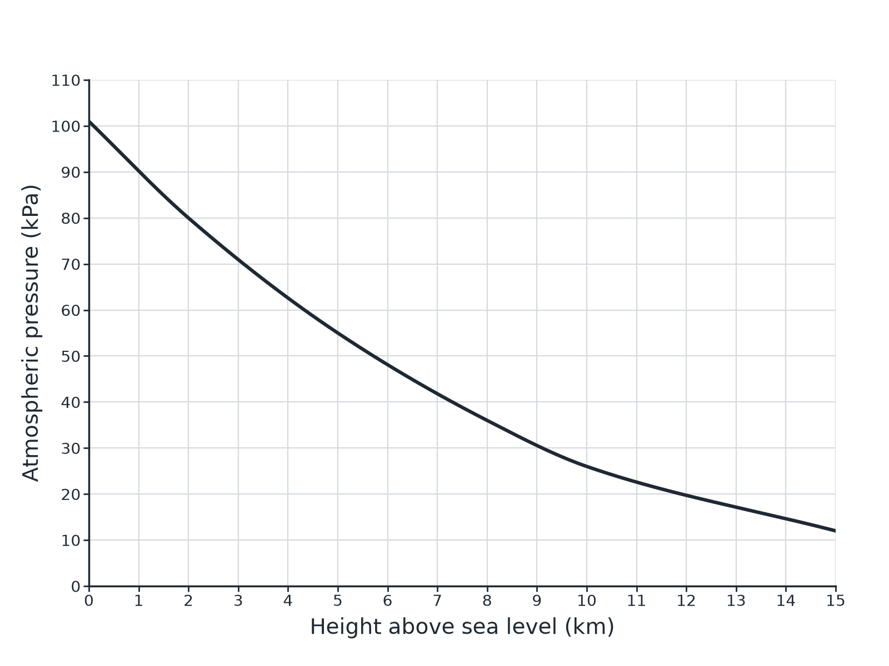
AQA GCSE PHYSICS · PAPER 2 · FOUNDATION & HIGHER
Question 2 · 3 marks · Use the graph
The graph shows how atmospheric pressure changes with height above sea level. (a) Use the graph to find the atmospheric pressure at a height of 5 km. (b) Describe how the pressure changes as the height increases. (3 marks)
Forces
openrevise.com
Lesson 9 of 20

Slide 19
AQA GCSE PHYSICS · PAPER 2 · FOUNDATION & HIGHER
Question 2 · mark scheme
3 marks available. Award a mark for each point made.
55 kPa
1 mark
Decreases
1 mark
Falls faster at first (curved)
1 mark
Forces
openrevise.com
Lesson 9 of 20

Slide 20
AQA GCSE PHYSICS · PAPER 2 · FOUNDATION & HIGHER
Question 3 · 2 marks · Describe
“
Describe a simple model of the Earth's atmosphere.
HOW TO ANSWER IT
Command word: Describe. Worth 2 marks, so plan before writing.
Forces
openrevise.com
Lesson 9 of 20

Slide 21
AQA GCSE PHYSICS · PAPER 2 · FOUNDATION & HIGHER
Question 3 · mark scheme
2 marks available. Award a mark for each point made.
Thin layer of air around the Earth
1 mark
Less dense with height
1 mark
Forces
openrevise.com
Lesson 9 of 20

Slide 22
AQA GCSE PHYSICS · PAPER 2 · FOUNDATION & HIGHER
Question 4 · 3 marks · Explain
“
A sealed bag of crisps is taken up a mountain and bulges. Explain why.
HOW TO ANSWER IT
Command word: Explain. Worth 3 marks, so plan before writing.
Forces
openrevise.com
Lesson 9 of 20

Slide 23
AQA GCSE PHYSICS · PAPER 2 · FOUNDATION & HIGHER
Question 4 · mark scheme
3 marks available. Award a mark for each point made.
Outside pressure is lower
1 mark
Pressure inside is greater than outside
1 mark
Bag expands
1 mark
Forces
openrevise.com
Lesson 9 of 20

Slide 24
AQA GCSE PHYSICS · PAPER 2 · FOUNDATION & HIGHER
Question 5 · 2 marks · Explain
“
Explain what causes atmospheric pressure.
HOW TO ANSWER IT
Command word: Explain. Worth 2 marks, so plan before writing.
Forces
openrevise.com
Lesson 9 of 20

Slide 25
AQA GCSE PHYSICS · PAPER 2 · FOUNDATION & HIGHER
Question 5 · mark scheme
2 marks available. Award a mark for each point made.
Collisions of air molecules with surfaces
1 mark
Force per unit area
1 mark
Forces
openrevise.com
Lesson 9 of 20

