Slide 1

AQA GCSE PHYSICS · PAPER 2 · FOUNDATION & HIGHER
Distance, displacement, speed and velocity
Forces
Lesson 10 of 20
openrevise.com

Slide 2

AQA GCSE PHYSICS · PAPER 2 · FOUNDATION & HIGHER
Warm-up
Answer each one, then check.
1
What is the unit of speed?
2
What is speed?
3
What is a vector?
4
What is a scalar?
5
Convert 2 minutes to seconds.
Forces
openrevise.com
Lesson 10 of 20

Slide 3
AQA GCSE PHYSICS · PAPER 2 · FOUNDATION & HIGHER
Warm-up - Answers
What is the unit of speed?
Metres per second (m/s)
1
What is speed?
How fast something moves
2
What is a vector?
A quantity with size and direction
3
What is a scalar?
A quantity with size only
4
Convert 2 minutes to seconds.
120 s
5
Forces
openrevise.com
Lesson 10 of 20

Slide 4

AQA GCSE PHYSICS · PAPER 2 · FOUNDATION & HIGHER
Learning Objectives
Distinguish distance (scalar) from displacement (vector).
1
Distinguish speed from velocity.
2
Recall typical speeds and use a speed = distance ÷ time.
3
Recall and apply s = vt and calculate average speed.
4
Explain qualitatively that circular motion has constant speed but changing velocity (Higher tier).
5
Forces
openrevise.com
Lesson 10 of 20

Slide 5

AQA GCSE PHYSICS · PAPER 2 · FOUNDATION & HIGHER
SPEED AND VELOCITY
distance travelled = speed × time s = vt
Distance and speed are scalars. Displacement and velocity are vectors: velocity is speed in a given direction.
Forces
openrevise.com
Lesson 10 of 20

Slide 6
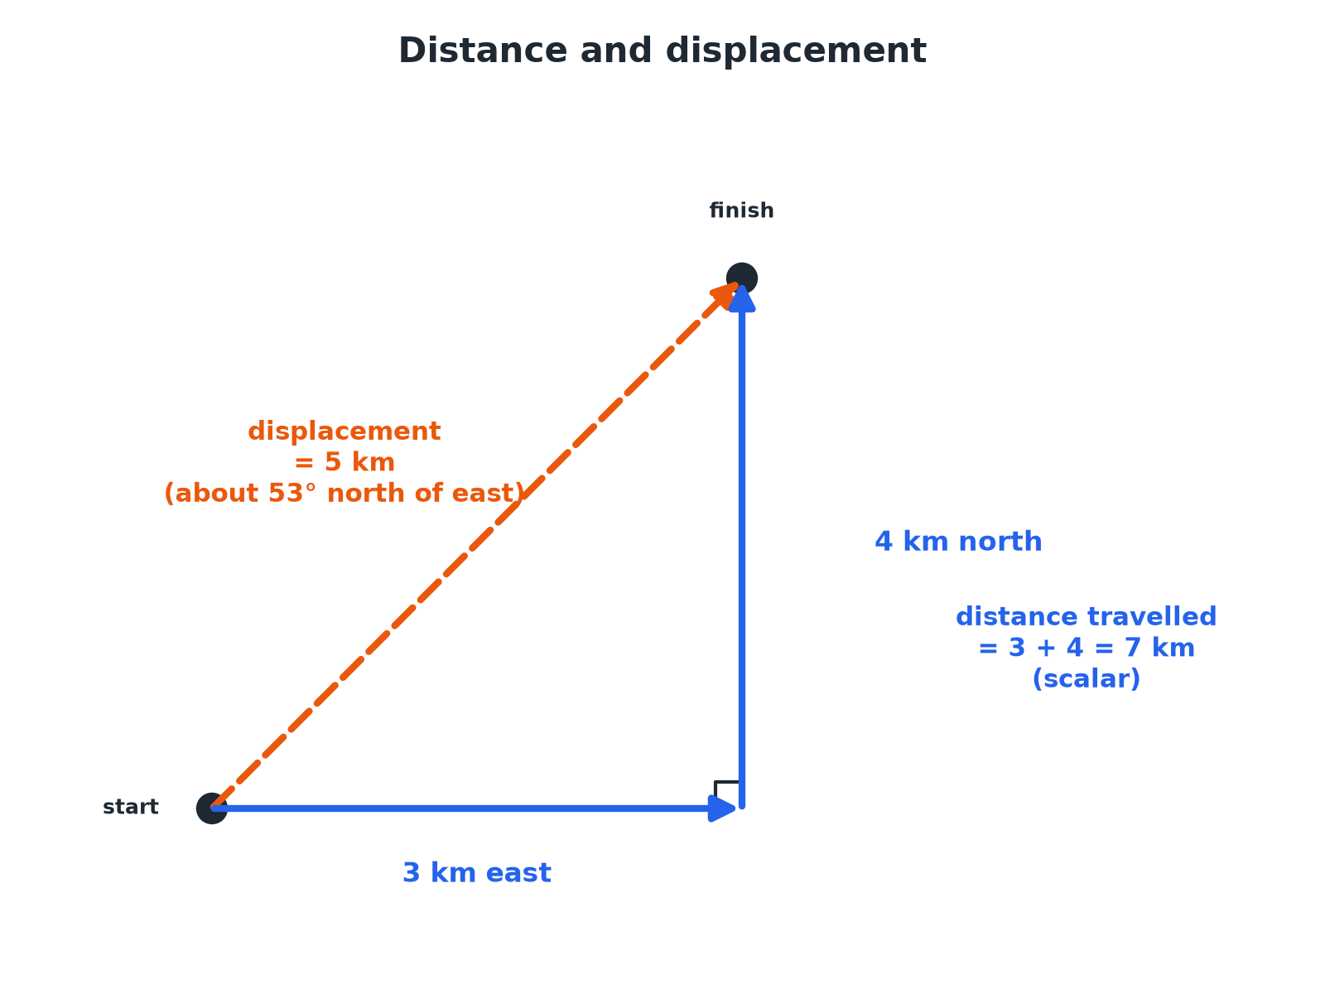

AQA GCSE PHYSICS · PAPER 2 · FOUNDATION & HIGHER
Distance and Displacement
Displacement is the straight-line distance with its direction.
Forces
openrevise.com
Lesson 10 of 20

Slide 7

AQA GCSE PHYSICS · PAPER 2 · FOUNDATION & HIGHER
Typical Speeds
Learn these values.
Motion
Typical speed (m/s)
Walking
1.5
Running
3
Cycling
6
Car
25
Train
55
Plane
250
Sound in air
330
Forces
openrevise.com
Lesson 10 of 20

Slide 8

AQA GCSE PHYSICS · PAPER 2 · FOUNDATION & HIGHER
Distance from Speed
A runner travels at 3.0 m/s for 2.0 minutes. How far do they run?
Convert time
2.0 min = 120 s
1
Substitute
s = vt = 3.0 × 120
2
Answer
s = 360 m
3
ANSWER
360 m
Forces
openrevise.com
Lesson 10 of 20

Slide 9
AQA GCSE PHYSICS · PAPER 2 · FOUNDATION & HIGHER
Average Speed
A cyclist travels 1500 m in 5.0 minutes. Calculate the average speed.
Convert time
5.0 min = 300 s
1
Rearrange
v = s ÷ t
2
Answer
v = 1500 ÷ 300 = 5.0 m/s
3
ANSWER
5.0 m/s
Forces
openrevise.com
Lesson 10 of 20

Slide 10
AQA GCSE PHYSICS · PAPER 2 · FOUNDATION & HIGHER
Distance and Displacement
A person walks 3 km east then 4 km north. Find the distance travelled and the displacement.
Distance
3 + 4 = 7 km
1
Displacement
√(3² + 4²) = 5 km
2
Direction
About 53° north of east
3
ANSWER
Distance 7 km; displacement 5 km at 53° north of east.
Forces
openrevise.com
Lesson 10 of 20

Slide 11
AQA GCSE PHYSICS · PAPER 2 · FOUNDATION & HIGHER
Circular Motion (Higher)
A car drives round a roundabout at a constant 10 m/s. Explain whether its velocity is constant.
Speed
Constant at 10 m/s
1
Direction
The direction of travel keeps changing
2
Velocity
A vector, so a change in direction is a change in velocity
3
ANSWER
The speed is constant but the velocity changes because the direction changes.
Forces
openrevise.com
Lesson 10 of 20

Slide 12

AQA GCSE PHYSICS · PAPER 2 · FOUNDATION & HIGHER
Practical Measurement
Measure speed.
Measure
Use a ruler or tape measure for distance and a stopwatch (or light gates) for time.
Average speed
Total distance divided by total time.
Non-uniform motion
Real motion rarely has constant speed, so calculate an average.
Variation
Speed depends on age, terrain, fitness and distance.
Forces
openrevise.com
Lesson 10 of 20

Slide 13

AQA GCSE PHYSICS · PAPER 2 · FOUNDATION & HIGHER
Key Terms
Distance
How far an object moves; a scalar.
Displacement
Distance in a straight line from start to finish with direction; a vector.
Speed
Distance travelled per unit time; a scalar.
Velocity
Speed in a given direction; a vector.
Average speed
Total distance divided by total time.
Uniform motion
Motion at constant speed in a straight line.
Forces
openrevise.com
Lesson 10 of 20

Slide 14

AQA GCSE PHYSICS · PAPER 2 · FOUNDATION & HIGHER
YOUR TASK
12 minutes
Journey Times
A car travels 120 km in 1.5 hours. Calculate its average speed in km/h and in m/s. How long would sound take to travel 660 m?
Convert units.
1
Use v = s ÷ t.
2
WHAT A GOOD ANSWER SHOWS
80 km/h; 80 ÷ 3.6 = 22 m/s. Sound: t = 660 ÷ 330 = 2.0 s.
Forces
openrevise.com
Lesson 10 of 20
Notes:
Ask how velocity would differ.

Slide 15
AQA GCSE PHYSICS · PAPER 2 · FOUNDATION & HIGHER
Can I...?
Define distance and displacement.
Recall typical speeds.
Define speed and velocity.
Convert units.
Use s = vt.
Explain circular motion.
Calculate average speed.
Give direction for a vector.
Forces
openrevise.com
Lesson 10 of 20

Slide 16
AQA GCSE PHYSICS · PAPER 2 · FOUNDATION & HIGHER
Summary & Exam Focus
s = vt.
Displacement and velocity are vectors.
Speed of sound in air about 330 m/s.
Circular motion: constant speed, changing velocity.
EXAM FOCUS
A runner travels at 3.0 m/s for 120 s. Calculate the distance. (2 marks)
Multiply speed by time.
openrevise.com

Slide 17
AQA GCSE PHYSICS · PAPER 2 · FOUNDATION & HIGHER
Exam Practice: Distance, displacement, speed and velocity
Answer all questions. Use the mark allocation as a guide to how much to write. · 14 minutes
Question 1 · 2 marks · Calculate
A runner travels at a steady speed of 3.0 m/s for 120 s. Calculate the distance travelled. Use the equation: distance travelled = speed ×…
Question 2 · 3 marks · Calculate
A cyclist travels 1500 m in 5.0 minutes. Calculate the average speed in m/s.
Question 3 · 2 marks · Explain
Explain the difference between distance and displacement.
Forces
openrevise.com
Lesson 10 of 20

Slide 18
AQA GCSE PHYSICS · PAPER 2 · FOUNDATION & HIGHER
Exam Practice: Distance, displacement, speed and velocity (cont.)
Question 4 · 3 marks · Calculate
A person walks 3 km east and then 4 km north. Calculate (a) the distance travelled (b) the magnitude of the displacement.
Question 5 · 3 marks · Explain
A car travels round a roundabout at a constant speed. Explain why its velocity is changing.
Forces
openrevise.com
Lesson 10 of 20

Slide 19
AQA GCSE PHYSICS · PAPER 2 · FOUNDATION & HIGHER
Question 1 · 2 marks · Calculate
“
A runner travels at a steady speed of 3.0 m/s for 120 s. Calculate the distance travelled. Use the equation: distance travelled = speed × time
HOW TO ANSWER IT
Command word: Calculate. Worth 2 marks, so plan before writing.
Forces
openrevise.com
Lesson 10 of 20

Slide 20
AQA GCSE PHYSICS · PAPER 2 · FOUNDATION & HIGHER
Question 1 · mark scheme
2 marks available. Award a mark for each point made.
Correct substitution
1 mark
360 m
1 mark
Forces
openrevise.com
Lesson 10 of 20

Slide 21
AQA GCSE PHYSICS · PAPER 2 · FOUNDATION & HIGHER
Question 2 · 3 marks · Calculate
“
A cyclist travels 1500 m in 5.0 minutes. Calculate the average speed in m/s.
HOW TO ANSWER IT
Command word: Calculate. Worth 3 marks, so plan before writing.
Forces
openrevise.com
Lesson 10 of 20

Slide 22
AQA GCSE PHYSICS · PAPER 2 · FOUNDATION & HIGHER
Question 2 · mark scheme
3 marks available. Award a mark for each point made.
Converts to 300 s
1 mark
Correct substitution
1 mark
5.0 m/s
1 mark
Forces
openrevise.com
Lesson 10 of 20

Slide 23
AQA GCSE PHYSICS · PAPER 2 · FOUNDATION & HIGHER
Question 3 · 2 marks · Explain
“
Explain the difference between distance and displacement.
HOW TO ANSWER IT
Command word: Explain. Worth 2 marks, so plan before writing.
Forces
openrevise.com
Lesson 10 of 20

Slide 24
AQA GCSE PHYSICS · PAPER 2 · FOUNDATION & HIGHER
Question 3 · mark scheme
2 marks available. Award a mark for each point made.
Distance: how far, no direction
1 mark
Displacement: straight line with direction
1 mark
Forces
openrevise.com
Lesson 10 of 20

Slide 25
AQA GCSE PHYSICS · PAPER 2 · FOUNDATION & HIGHER
Question 4 · 3 marks · Calculate
“
A person walks 3 km east and then 4 km north. Calculate (a) the distance travelled (b) the magnitude of the displacement.
HOW TO ANSWER IT
Command word: Calculate. Worth 3 marks, so plan before writing.
Forces
openrevise.com
Lesson 10 of 20

Slide 26
AQA GCSE PHYSICS · PAPER 2 · FOUNDATION & HIGHER
Question 4 · mark scheme
3 marks available. Award a mark for each point made.
7 km
1 mark
Pythagoras
1 mark
5 km
1 mark
Forces
openrevise.com
Lesson 10 of 20

Slide 27
AQA GCSE PHYSICS · PAPER 2 · FOUNDATION & HIGHER
Question 5 · 3 marks · Explain
“
A car travels round a roundabout at a constant speed. Explain why its velocity is changing.
HOW TO ANSWER IT
Command word: Explain. Worth 3 marks, so plan before writing.
Forces
openrevise.com
Lesson 10 of 20

Slide 28
AQA GCSE PHYSICS · PAPER 2 · FOUNDATION & HIGHER
Question 5 · mark scheme
3 marks available. Award a mark for each point made.
Velocity is a vector
1 mark
Direction changes
1 mark
So velocity changes with constant speed
1 mark
Forces
openrevise.com
Lesson 10 of 20

