Slide 1

AQA GCSE PHYSICS · PAPER 2 · FOUNDATION & HIGHER
Distance–time graphs
Forces
Lesson 11 of 20
openrevise.com

Slide 2

AQA GCSE PHYSICS · PAPER 2 · FOUNDATION & HIGHER
Warm-up
Answer each one, then check.
1
What is the gradient of a graph?
2
What does a horizontal line on a distance-time graph mean?
3
What is speed?
4
What is acceleration?
5
What does a steeper line mean?
Forces
openrevise.com
Lesson 11 of 20

Slide 3
AQA GCSE PHYSICS · PAPER 2 · FOUNDATION & HIGHER
Warm-up - Answers
What is the gradient of a graph?
Change in y divided by change in x
1
What does a horizontal line on a distance-time graph mean?
The object is stationary
2
What is speed?
Distance divided by time
3
What is acceleration?
Rate of change of velocity
4
What does a steeper line mean?
A faster speed
5
Forces
openrevise.com
Lesson 11 of 20

Slide 4

AQA GCSE PHYSICS · PAPER 2 · FOUNDATION & HIGHER
Learning Objectives
Draw distance–time graphs from measurements.
1
Interpret lines and slopes of distance–time graphs.
2
Calculate speed from the gradient of a distance–time graph.
3
Find the speed of an accelerating object at an instant using a tangent (Higher tier).
4
Forces
openrevise.com
Lesson 11 of 20

Slide 5

AQA GCSE PHYSICS · PAPER 2 · FOUNDATION & HIGHER
DISTANCE–TIME GRAPHS
The gradient of a distance–time graph is the speed of the object.
A straight line means constant speed, a horizontal line means stationary, and a curve means the speed is changing.
Forces
openrevise.com
Lesson 11 of 20

Slide 6
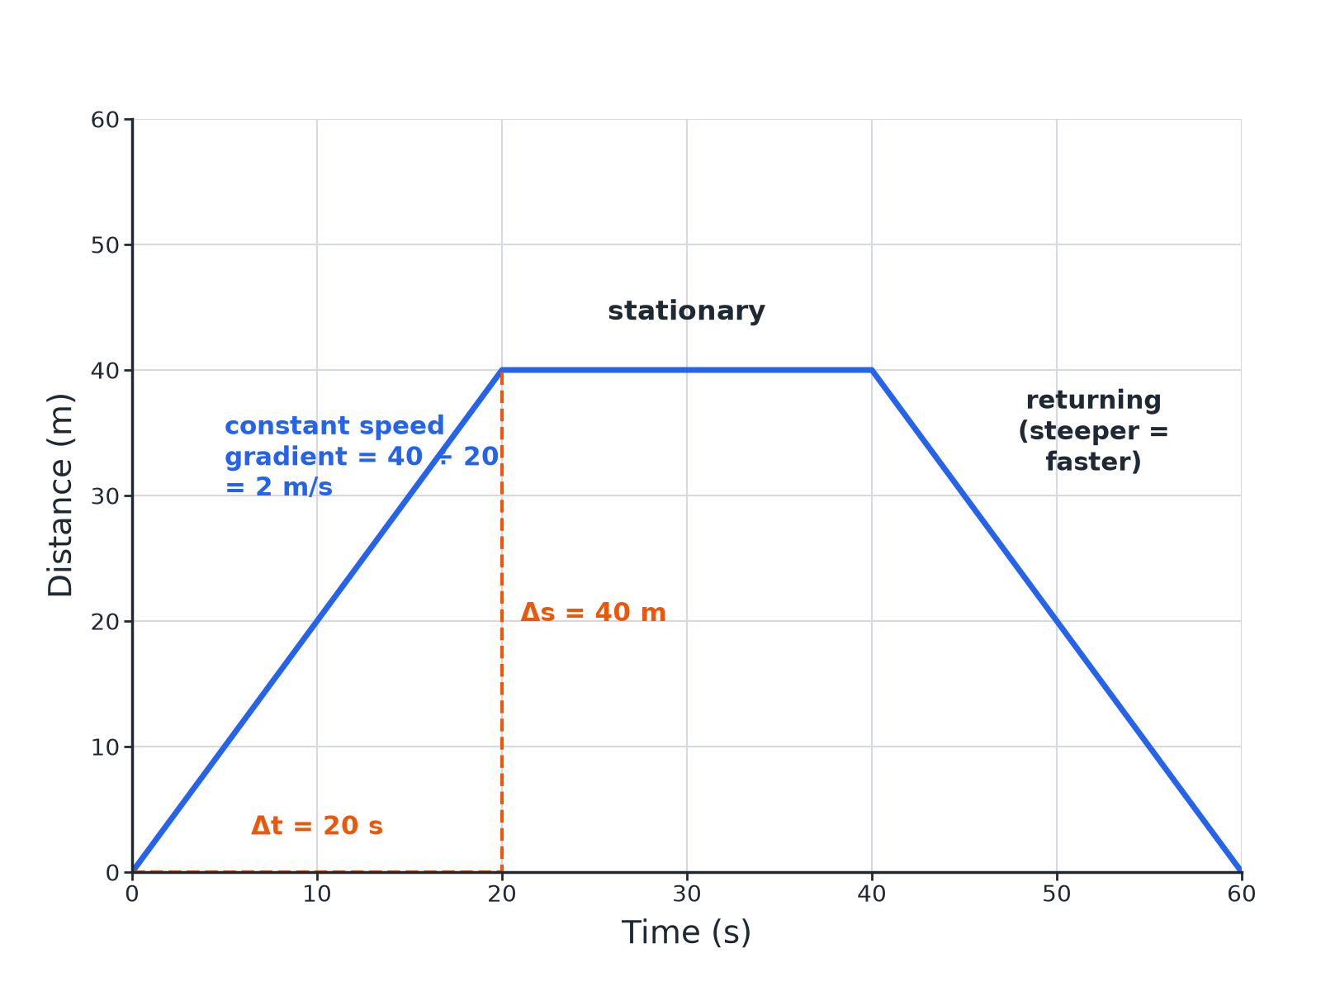

AQA GCSE PHYSICS · PAPER 2 · FOUNDATION & HIGHER
Reading a Distance–Time Graph
Gradient = change in distance ÷ change in time.
Forces
openrevise.com
Lesson 11 of 20

Slide 7

AQA GCSE PHYSICS · PAPER 2 · FOUNDATION & HIGHER
What the Graph Shows
Learn these.
Shape
Meaning
Straight line sloping up
Constant speed
Horizontal line
Stationary
Steeper line
Higher speed
Curve getting steeper
Accelerating
Curve getting shallower
Decelerating
Forces
openrevise.com
Lesson 11 of 20

Slide 8

AQA GCSE PHYSICS · PAPER 2 · FOUNDATION & HIGHER
Speed from a Gradient
An object travels 40 m in the first 20 s. Calculate its speed from the graph.
Gradient
(change in distance)/(change in time)
1
Substitute
40/20
2
Answer
2.0 m/s
3
ANSWER
2.0 m/s
Forces
openrevise.com
Lesson 11 of 20

Slide 9
AQA GCSE PHYSICS · PAPER 2 · FOUNDATION & HIGHER
Describing a Journey
Describe the motion shown from 20 s to 40 s where the line is horizontal.
Distance
Does not change
1
Speed
Zero
2
ANSWER
The object is stationary.
Forces
openrevise.com
Lesson 11 of 20

Slide 10
AQA GCSE PHYSICS · PAPER 2 · FOUNDATION & HIGHER
Tangent (Higher)
The distance is given by s = 0.5t² (in metres, t in seconds). Find the speed at t = 6 s using a tangent.
Draw a tangent
Touching the curve at t = 6 s
1
Gradient of the tangent
Δs/Δt from two points on the tangent: about 6 m/s
2
Check
The speed is t = 6 m/s from s = 0.5t²
3
ANSWER
About 6 m/s.
Forces
openrevise.com
Lesson 11 of 20

Slide 11

AQA GCSE PHYSICS · PAPER 2 · FOUNDATION & HIGHER
Drawing Graphs
Good practice.
Axes
Time on the x-axis, distance on the y-axis, with units.
Points
Plot from a table, then join with a ruler (or a smooth curve if the speed changes).
Gradient
Use a large triangle for accuracy.
Units
m/s if distance in m and time in s.
Forces
openrevise.com
Lesson 11 of 20

Slide 12

AQA GCSE PHYSICS · PAPER 2 · FOUNDATION & HIGHER
Key Terms
Distance–time graph
A graph of distance against time.
Gradient
How steep a line is.
Stationary
Not moving.
Tangent
A straight line that touches a curve at one point.
Constant speed
The same speed all the time.
Accelerating
Speeding up.
Forces
openrevise.com
Lesson 11 of 20

Slide 13

AQA GCSE PHYSICS · PAPER 2 · FOUNDATION & HIGHER
YOUR TASK
12 minutes
Story Graph
A cyclist travels 100 m in 20 s, stops for 20 s and then travels 60 m in 20 s. Sketch the graph and calculate the speed in each part.
Plot the three sections.
1
Gradient for each.
2
WHAT A GOOD ANSWER SHOWS
Part 1: 5.0 m/s. Part 2: 0 m/s. Part 3: 3.0 m/s.
Forces
openrevise.com
Lesson 11 of 20
Notes:
Ask about the average speed for the whole journey.

Slide 14
AQA GCSE PHYSICS · PAPER 2 · FOUNDATION & HIGHER
Can I...?
Draw a distance–time graph.
Describe a journey.
Say what a horizontal line means.
Describe a curve.
Calculate speed from a gradient.
Draw a tangent.
Compare speeds from slopes.
Use units.
Forces
openrevise.com
Lesson 11 of 20

Slide 15
AQA GCSE PHYSICS · PAPER 2 · FOUNDATION & HIGHER
Summary & Exam Focus
Gradient = speed.
Horizontal line = stationary.
Steeper = faster.
Higher: tangent to a curve gives instantaneous speed.
EXAM FOCUS
The graph shows 100 m in 20 s. Calculate the speed in the first 20 s. (2 marks)
Gradient = distance ÷ time.
openrevise.com

Slide 16
AQA GCSE PHYSICS · PAPER 2 · FOUNDATION & HIGHER
Exam Practice: Distance–time graphs
Answer all questions. Use the mark allocation as a guide to how much to write. · 15 minutes
Question 1 · 4 marks · Use the graph
The graph shows the distance travelled by a cyclist. (a) Calculate the speed in the first 20 s. (b) Describe the motion between 20 s and 40…
Question 2 · 2 marks · State
Describe what the gradient of a distance–time graph represents and what a horizontal line shows.
Question 3 · 3 marks · Calculate
A car travels 120 m in 10 s at constant speed. Sketch a distance–time graph for this and calculate the gradient.
Forces
openrevise.com
Lesson 11 of 20

Slide 17
AQA GCSE PHYSICS · PAPER 2 · FOUNDATION & HIGHER
Exam Practice: Distance–time graphs (cont.)
Question 4 · 2 marks · Explain
The distance–time graph for a runner is a curve that gets steeper. Describe the motion.
Question 5 · 3 marks · Determine
The graph shows the distance of a car from a starting point against time as a curve. Describe how to find the speed at a particular time.
Forces
openrevise.com
Lesson 11 of 20

Slide 18
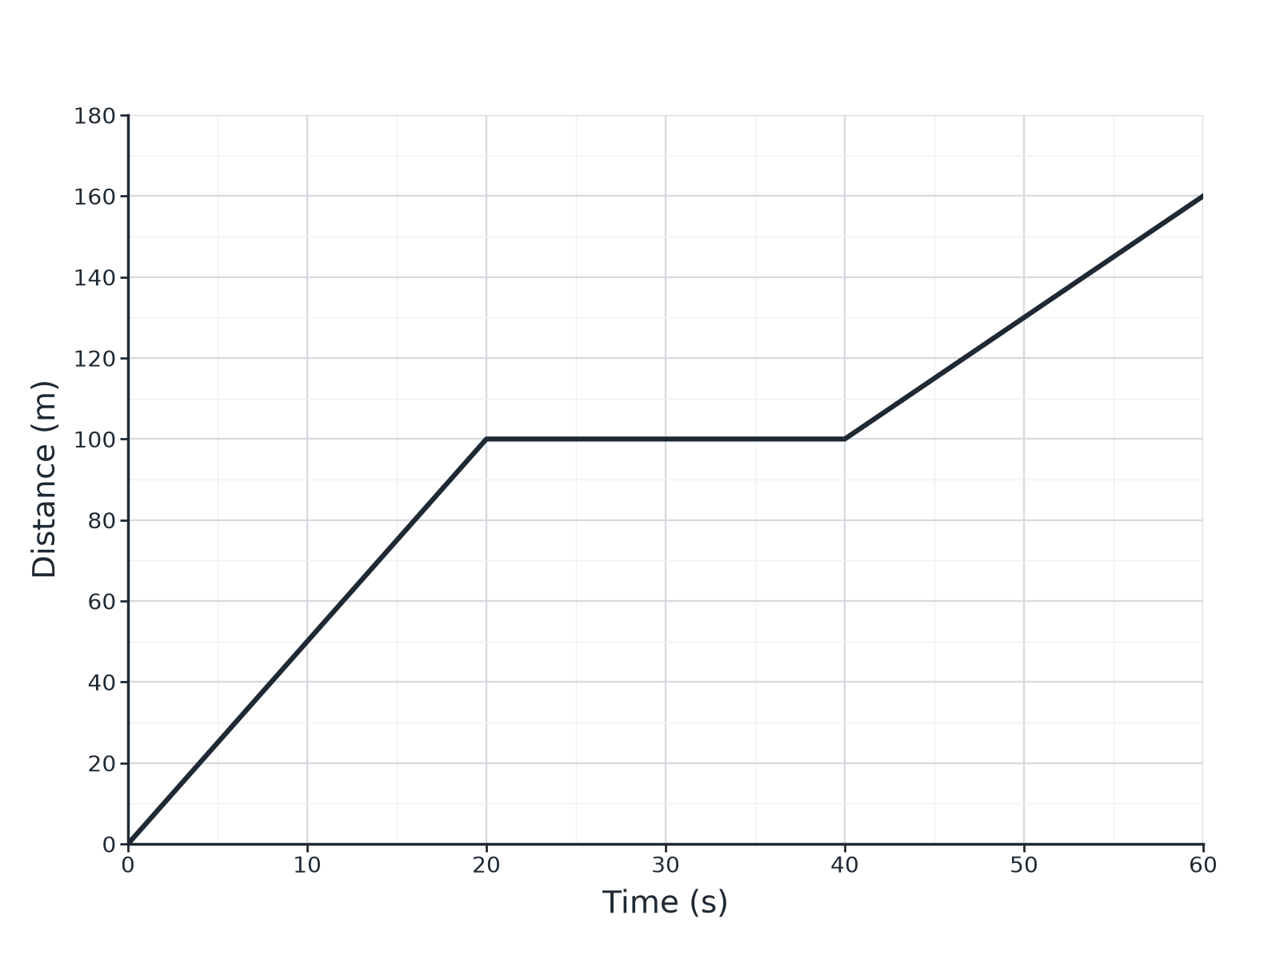
AQA GCSE PHYSICS · PAPER 2 · FOUNDATION & HIGHER
Question 1 · 4 marks · Use the graph
The graph shows the distance travelled by a cyclist. (a) Calculate the speed in the first 20 s. (b) Describe the motion between 20 s and 40 s. (c) Calculate the speed between 40 s and 60 s. (4 marks)
Forces
openrevise.com
Lesson 11 of 20

Slide 19
AQA GCSE PHYSICS · PAPER 2 · FOUNDATION & HIGHER
Question 1 · mark scheme
4 marks available. Award a mark for each point made.
5.0 m/s
1 mark
Stationary
1 mark
Correct distance and time
1 mark
3.0 m/s
1 mark
Forces
openrevise.com
Lesson 11 of 20

Slide 20
AQA GCSE PHYSICS · PAPER 2 · FOUNDATION & HIGHER
Question 2 · 2 marks · State
“
Describe what the gradient of a distance–time graph represents and what a horizontal line shows.
HOW TO ANSWER IT
Command word: State. Worth 2 marks, so plan before writing.
Forces
openrevise.com
Lesson 11 of 20

Slide 21
AQA GCSE PHYSICS · PAPER 2 · FOUNDATION & HIGHER
Question 2 · mark scheme
2 marks available. Award a mark for each point made.
Gradient is speed
1 mark
Horizontal line: stationary
1 mark
Forces
openrevise.com
Lesson 11 of 20

Slide 22
AQA GCSE PHYSICS · PAPER 2 · FOUNDATION & HIGHER
Question 3 · 3 marks · Calculate
“
A car travels 120 m in 10 s at constant speed. Sketch a distance–time graph for this and calculate the gradient.
HOW TO ANSWER IT
Command word: Calculate. Worth 3 marks, so plan before writing.
Forces
openrevise.com
Lesson 11 of 20

Slide 23
AQA GCSE PHYSICS · PAPER 2 · FOUNDATION & HIGHER
Question 3 · mark scheme
3 marks available. Award a mark for each point made.
Straight line from the origin
1 mark
Correct end point
1 mark
12 m/s
1 mark
Forces
openrevise.com
Lesson 11 of 20

Slide 24
AQA GCSE PHYSICS · PAPER 2 · FOUNDATION & HIGHER
Question 4 · 2 marks · Explain
“
The distance–time graph for a runner is a curve that gets steeper. Describe the motion.
HOW TO ANSWER IT
Command word: Explain. Worth 2 marks, so plan before writing.
Forces
openrevise.com
Lesson 11 of 20

Slide 25
AQA GCSE PHYSICS · PAPER 2 · FOUNDATION & HIGHER
Question 4 · mark scheme
2 marks available. Award a mark for each point made.
Accelerating
1 mark
Gradient or speed increases
1 mark
Forces
openrevise.com
Lesson 11 of 20

Slide 26
AQA GCSE PHYSICS · PAPER 2 · FOUNDATION & HIGHER
Question 5 · 3 marks · Determine
“
The graph shows the distance of a car from a starting point against time as a curve. Describe how to find the speed at a particular time.
HOW TO ANSWER IT
Command word: Determine. Worth 3 marks, so plan before writing.
Forces
openrevise.com
Lesson 11 of 20

Slide 27
AQA GCSE PHYSICS · PAPER 2 · FOUNDATION & HIGHER
Question 5 · mark scheme
3 marks available. Award a mark for each point made.
Draw a tangent
1 mark
Choose two points on the tangent
1 mark
Gradient = change in distance ÷ change in time
1 mark
Forces
openrevise.com
Lesson 11 of 20

