Slide 1

AQA GCSE PHYSICS · PAPER 2 · FOUNDATION & HIGHER
Terminal velocity
Forces
Lesson 13 of 20
openrevise.com

Slide 2

AQA GCSE PHYSICS · PAPER 2 · FOUNDATION & HIGHER
Warm-up
Answer each one, then check.
1
What is weight?
2
What is air resistance?
3
What does balanced mean?
4
What is acceleration?
5
What is the gradient of a v-t graph?
Forces
openrevise.com
Lesson 13 of 20

Slide 3
AQA GCSE PHYSICS · PAPER 2 · FOUNDATION & HIGHER
Warm-up - Answers
What is weight?
The force of gravity on an object
1
What is air resistance?
A force opposing motion through the air
2
What does balanced mean?
Forces equal and opposite
3
What is acceleration?
Rate of change of velocity
4
What is the gradient of a v-t graph?
Acceleration
5
Forces
openrevise.com
Lesson 13 of 20

Slide 4

AQA GCSE PHYSICS · PAPER 2 · FOUNDATION & HIGHER
Learning Objectives
Describe the forces on an object falling through a fluid.
1
Explain why the object reaches a terminal velocity.
2
Draw and interpret velocity–time graphs for terminal velocity.
3
Explain the effect of opening a parachute.
4
Forces
openrevise.com
Lesson 13 of 20

Slide 5

AQA GCSE PHYSICS · PAPER 2 · FOUNDATION & HIGHER
TERMINAL VELOCITY
An object falling through a fluid initially accelerates due to gravity. As its speed increases, the resistive force increases until the resultant force is zero and the object moves at its terminal velocity.
At terminal velocity the weight and the resistive force (air resistance or drag) are balanced, so there is no acceleration.
Forces
openrevise.com
Lesson 13 of 20

Slide 6
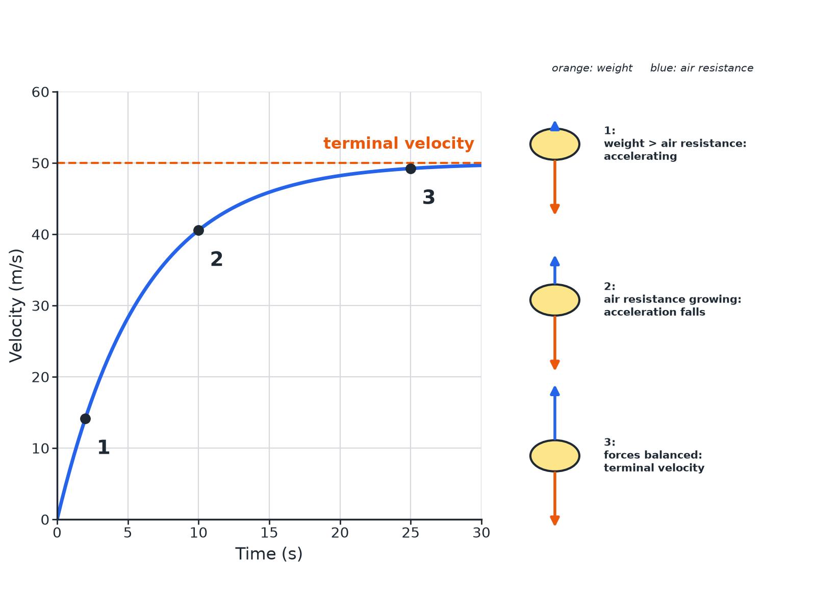

AQA GCSE PHYSICS · PAPER 2 · FOUNDATION & HIGHER
Falling to Terminal Velocity
As speed rises, air resistance rises until the forces balance.
Forces
openrevise.com
Lesson 13 of 20

Slide 7

AQA GCSE PHYSICS · PAPER 2 · FOUNDATION & HIGHER
What Happens to a Skydiver
Stage by stage.
1
2
3
4
5
Start
Only weight acts (almost no air resistance): large downward resultant, acceleration about 9.8 m/s².
Speeding up
Air resistance increases with speed, so the resultant force and acceleration decrease.
Terminal velocity
Air resistance equals weight: resultant zero, constant velocity.
Parachute opens
Large increase in air resistance: upward resultant, skydiver decelerates.
New terminal velocity
A lower speed where air resistance again equals weight.
Forces
openrevise.com
Lesson 13 of 20

Slide 8

AQA GCSE PHYSICS · PAPER 2 · FOUNDATION & HIGHER
Resultant Force
A skydiver weighs 700 N. At one instant the air resistance is 400 N. Find the resultant force. What is the air resistance at terminal velocity?
Resultant
700 − 400 = 300 N downwards
1
At terminal velocity
The resultant is zero, so air resistance = weight = 700 N
2
ANSWER
300 N downwards; 700 N at terminal velocity.
Forces
openrevise.com
Lesson 13 of 20

Slide 9
AQA GCSE PHYSICS · PAPER 2 · FOUNDATION & HIGHER
Why a Parachute Helps
Explain why opening a parachute reduces the terminal velocity.
Area
A large surface area is opened
1
Air resistance
It is much larger at the same speed
2
Forces balance
At a much lower speed, so the new terminal velocity is lower
3
ANSWER
The greater air resistance balances the weight at a lower speed.
Forces
openrevise.com
Lesson 13 of 20

Slide 10

AQA GCSE PHYSICS · PAPER 2 · FOUNDATION & HIGHER
Reading the Graph
Common exam features.
Gradient
Decreases as the object falls faster.
Flat section
Terminal velocity: zero acceleration.
Steep fall after parachute
Deceleration.
Shape
Explain each part with the forces.
Forces
openrevise.com
Lesson 13 of 20

Slide 11

AQA GCSE PHYSICS · PAPER 2 · FOUNDATION & HIGHER
Key Terms
Terminal velocity
The constant velocity reached when the resistive force equals the driving force.
Air resistance
A force opposing motion through air.
Drag
A resistive force in a fluid.
Resultant force
The single force equal to all the forces combined.
Surface area
The size of the surface.
Fluid
A liquid or gas.
Forces
openrevise.com
Lesson 13 of 20

Slide 12

AQA GCSE PHYSICS · PAPER 2 · FOUNDATION & HIGHER
YOUR TASK
10 minutes
Parachute Test
A parachutist reaches 50 m/s before opening a parachute. After opening, their speed falls to 5 m/s. Explain both terminal velocities.
Compare air resistance and weight.
1
Say when resultant is zero.
2
WHAT A GOOD ANSWER SHOWS
Before: air resistance on the body equals the weight at 50 m/s. After: the parachute gives much larger air resistance, so the speed falls until it equals the weight again at 5 m/s.
Forces
openrevise.com
Lesson 13 of 20
Notes:
Ask about the forces just after the parachute opens.

Slide 13
AQA GCSE PHYSICS · PAPER 2 · FOUNDATION & HIGHER
Can I...?
State the forces on a falling object.
Interpret a graph.
Explain acceleration at the start.
Explain a parachute.
Explain why acceleration falls.
Find the resultant.
Define terminal velocity.
Use force balance.
Forces
openrevise.com
Lesson 13 of 20

Slide 14
AQA GCSE PHYSICS · PAPER 2 · FOUNDATION & HIGHER
Summary & Exam Focus
At the start weight is greater than air resistance.
Air resistance increases with speed.
Terminal velocity: forces balanced, resultant zero.
Parachute: greater air resistance, lower terminal velocity.
EXAM FOCUS
Explain why a skydiver reaches a terminal velocity. (3 marks)
Air resistance rises until it equals the weight.
openrevise.com

Slide 15
AQA GCSE PHYSICS · PAPER 2 · FOUNDATION & HIGHER
Exam Practice: Terminal velocity
Answer all questions. Use the mark allocation as a guide to how much to write. · 16 minutes
Question 1 · 3 marks · Explain
A skydiver jumps from a plane. Explain why the skydiver reaches a terminal velocity.
Question 2 · 5 marks · Use the graph
The graph shows the velocity of a parachutist. (a) State what happens to the velocity between A and B. (b) Explain why the velocity is…
Question 3 · 2 marks · Calculate
A skydiver has a weight of 700 N. The air resistance is 400 N. Calculate the resultant force on the skydiver and state its direction.
Forces
openrevise.com
Lesson 13 of 20

Slide 16
AQA GCSE PHYSICS · PAPER 2 · FOUNDATION & HIGHER
Exam Practice: Terminal velocity (cont.)
Question 4 · 3 marks · Explain
A parachute increases the air resistance on a skydiver. Explain why the skydiver's terminal velocity is lower with the parachute open.
Question 5 · 2 marks · State
State the size of the resultant force on a skydiver falling at terminal velocity and what this means for the acceleration.
Forces
openrevise.com
Lesson 13 of 20

Slide 17
AQA GCSE PHYSICS · PAPER 2 · FOUNDATION & HIGHER
Question 1 · 3 marks · Explain
“
A skydiver jumps from a plane. Explain why the skydiver reaches a terminal velocity.
HOW TO ANSWER IT
Command word: Explain. Worth 3 marks, so plan before writing.
Forces
openrevise.com
Lesson 13 of 20

Slide 18
AQA GCSE PHYSICS · PAPER 2 · FOUNDATION & HIGHER
Question 1 · mark scheme
3 marks available. Award a mark for each point made.
Weight greater than air resistance at first
1 mark
Air resistance increases with speed
1 mark
Forces balance: constant speed
1 mark
Forces
openrevise.com
Lesson 13 of 20

Slide 19
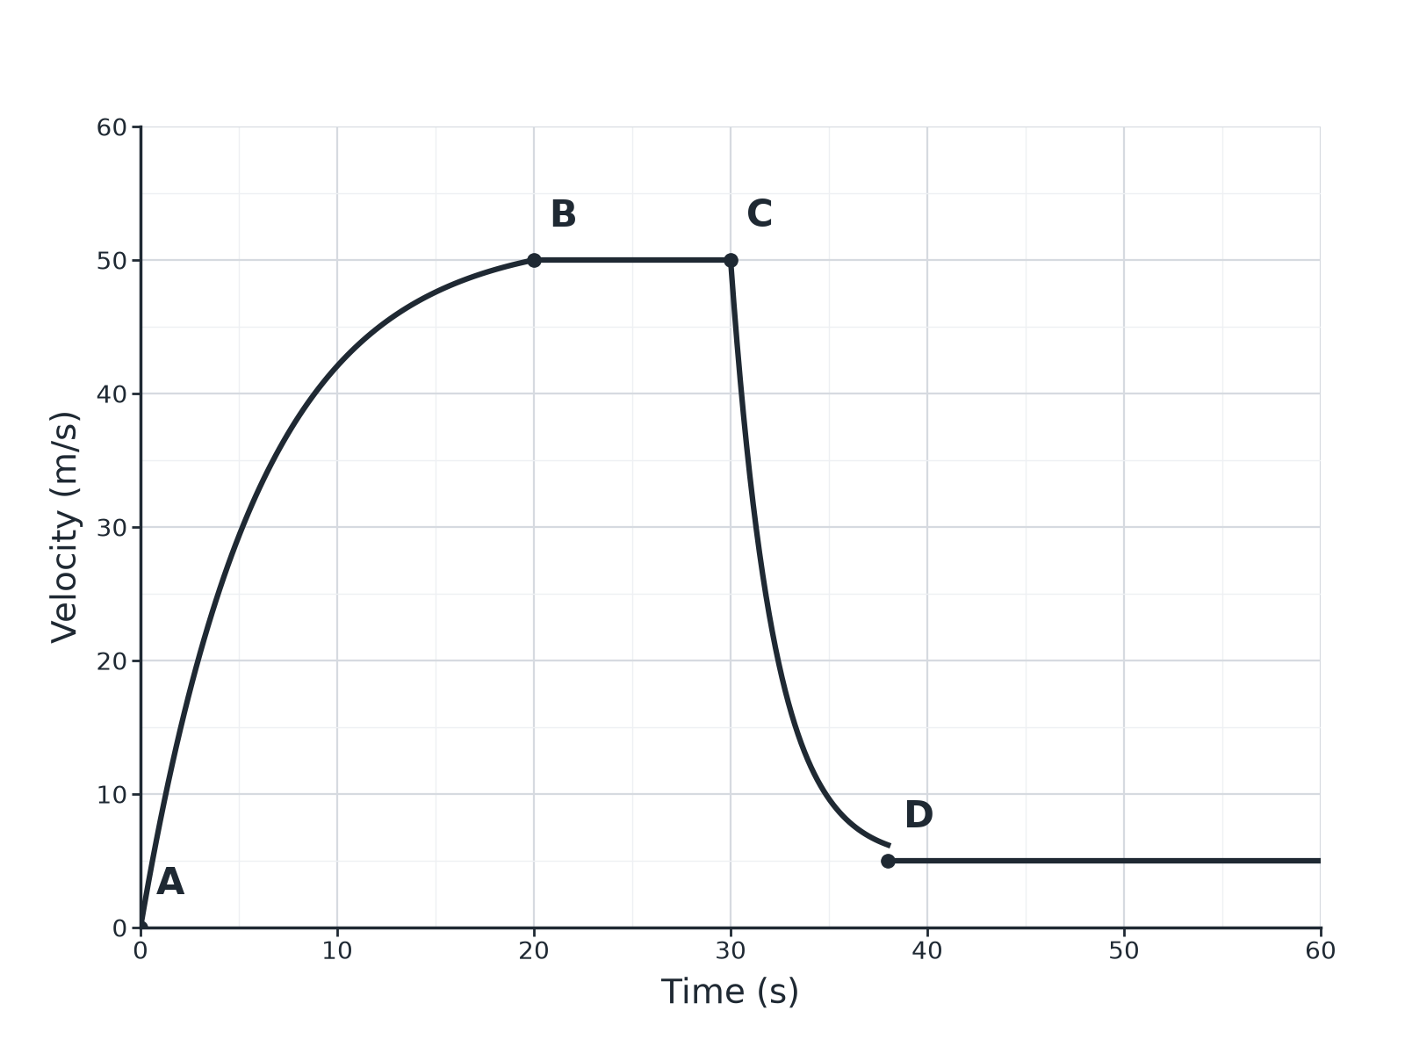
AQA GCSE PHYSICS · PAPER 2 · FOUNDATION & HIGHER
Question 2 · 5 marks · Use the graph
The graph shows the velocity of a parachutist. (a) State what happens to the velocity between A and B. (b) Explain why the velocity is constant between B and C. (c) At C the parachute opens. Explain what happens between C and D. (5 marks)
Forces
openrevise.com
Lesson 13 of 20

Slide 20
AQA GCSE PHYSICS · PAPER 2 · FOUNDATION & HIGHER
Question 2 · mark scheme
5 marks available. Award a mark for each point made.
A to B: accelerating, getting less
1 mark
B to C: air resistance equals weight
1 mark
Resultant force zero
1 mark
Forces
openrevise.com
Lesson 13 of 20

Slide 21
AQA GCSE PHYSICS · PAPER 2 · FOUNDATION & HIGHER
Question 2 · mark scheme (cont.)
C to D: air resistance greater than weight
1 mark
Decelerates to a lower terminal velocity
1 mark
Forces
openrevise.com
Lesson 13 of 20

Slide 22
AQA GCSE PHYSICS · PAPER 2 · FOUNDATION & HIGHER
Question 3 · 2 marks · Calculate
“
A skydiver has a weight of 700 N. The air resistance is 400 N. Calculate the resultant force on the skydiver and state its direction.
HOW TO ANSWER IT
Command word: Calculate. Worth 2 marks, so plan before writing.
Forces
openrevise.com
Lesson 13 of 20

Slide 23
AQA GCSE PHYSICS · PAPER 2 · FOUNDATION & HIGHER
Question 3 · mark scheme
2 marks available. Award a mark for each point made.
300 N
1 mark
Downwards
1 mark
Forces
openrevise.com
Lesson 13 of 20

Slide 24
AQA GCSE PHYSICS · PAPER 2 · FOUNDATION & HIGHER
Question 4 · 3 marks · Explain
“
A parachute increases the air resistance on a skydiver. Explain why the skydiver's terminal velocity is lower with the parachute open.
HOW TO ANSWER IT
Command word: Explain. Worth 3 marks, so plan before writing.
Forces
openrevise.com
Lesson 13 of 20

Slide 25
AQA GCSE PHYSICS · PAPER 2 · FOUNDATION & HIGHER
Question 4 · mark scheme
3 marks available. Award a mark for each point made.
Larger area means greater air resistance
1 mark
Forces balance at a lower speed
1 mark
So lower terminal velocity
1 mark
Forces
openrevise.com
Lesson 13 of 20

Slide 26
AQA GCSE PHYSICS · PAPER 2 · FOUNDATION & HIGHER
Question 5 · 2 marks · State
“
State the size of the resultant force on a skydiver falling at terminal velocity and what this means for the acceleration.
HOW TO ANSWER IT
Command word: State. Worth 2 marks, so plan before writing.
Forces
openrevise.com
Lesson 13 of 20

Slide 27
AQA GCSE PHYSICS · PAPER 2 · FOUNDATION & HIGHER
Question 5 · mark scheme
2 marks available. Award a mark for each point made.
Zero resultant force
1 mark
Zero acceleration
1 mark
Forces
openrevise.com
Lesson 13 of 20

