Slide 1

AQA GCSE PHYSICS · PAPER 2 · FOUNDATION & HIGHER
Newton's First Law
Forces
Lesson 14 of 20
openrevise.com

Slide 2

AQA GCSE PHYSICS · PAPER 2 · FOUNDATION & HIGHER
Warm-up
Answer each one, then check.
1
What is a resultant force?
2
What are balanced forces?
3
What is velocity?
4
What is friction?
5
What is constant velocity?
Forces
openrevise.com
Lesson 14 of 20

Slide 3
AQA GCSE PHYSICS · PAPER 2 · FOUNDATION & HIGHER
Warm-up - Answers
What is a resultant force?
A single force with the same effect as all the forces
1
What are balanced forces?
Equal and opposite forces
2
What is velocity?
Speed in a given direction
3
What is friction?
A force opposing motion
4
What is constant velocity?
Same speed in the same direction
5
Forces
openrevise.com
Lesson 14 of 20

Slide 4

AQA GCSE PHYSICS · PAPER 2 · FOUNDATION & HIGHER
Learning Objectives
State Newton's First Law.
1
Apply it to objects moving at constant velocity and to objects whose speed or direction changes.
2
Explain that when a vehicle travels at a steady speed the resistive forces balance the driving force.
3
Explain inertia (Higher tier).
4
Forces
openrevise.com
Lesson 14 of 20

Slide 5

AQA GCSE PHYSICS · PAPER 2 · FOUNDATION & HIGHER
NEWTON'S FIRST LAW
If the resultant force on an object is zero, a stationary object remains stationary and a moving object continues at the same speed in the same direction.
The velocity of an object will only change if a resultant force acts on it.
Forces
openrevise.com
Lesson 14 of 20

Slide 6
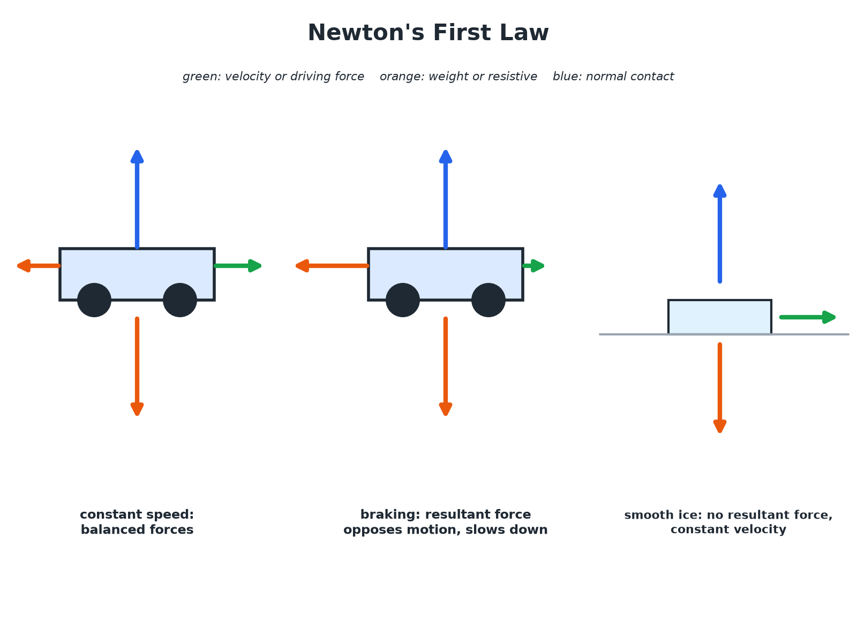

AQA GCSE PHYSICS · PAPER 2 · FOUNDATION & HIGHER
Balanced and Unbalanced Forces
No resultant force means no change in velocity.
Forces
openrevise.com
Lesson 14 of 20

Slide 7

AQA GCSE PHYSICS · PAPER 2 · FOUNDATION & HIGHER
Steady Speed
A car travels at a steady 20 m/s. The driving force is 1500 N. What is the resistive force?
Steady speed
Velocity is constant, so the resultant force is zero
1
Forces balance
Resistive force = driving force
2
ANSWER
1500 N, in the opposite direction.
Forces
openrevise.com
Lesson 14 of 20

Slide 8
AQA GCSE PHYSICS · PAPER 2 · FOUNDATION & HIGHER
Changing Velocity
A car brakes from 20 m/s to rest. Explain the motion using Newton's First Law.
Velocity changes
So there must be a resultant force
1
Braking force
Greater than the driving force, acting against the motion
2
ANSWER
A resultant force opposes the motion, so the car decelerates.
Forces
openrevise.com
Lesson 14 of 20

Slide 9
AQA GCSE PHYSICS · PAPER 2 · FOUNDATION & HIGHER
Inertia (Higher)
Explain why a passenger moves forwards when a car brakes suddenly.
Before braking
The passenger moves with the car at a constant velocity
1
Braking
The car slows, but no force acts on the passenger from the seat
2
Inertia
The passenger's body tends to continue at the same velocity, so moves forward relative to the car
3
ANSWER
Inertia: objects tend to keep their state of rest or uniform motion.
Forces
openrevise.com
Lesson 14 of 20

Slide 10

AQA GCSE PHYSICS · PAPER 2 · FOUNDATION & HIGHER
Key Ideas
Use the law in explanations.
Zero resultant
Stationary or constant velocity.
Non-zero resultant
The velocity (speed or direction) changes.
Direction matters
A circular motion needs a resultant force towards the centre.
Inertia (Higher)
The tendency of objects to continue in their state of rest or uniform motion.
Forces
openrevise.com
Lesson 14 of 20

Slide 11

AQA GCSE PHYSICS · PAPER 2 · FOUNDATION & HIGHER
Key Terms
Newton's First Law
An object keeps its velocity unless a resultant force acts on it.
Inertia
The tendency of an object to stay at rest or keep moving at constant velocity.
Balanced forces
Forces with a resultant of zero.
Uniform velocity
Constant speed in a straight line.
Resistive force
A force opposing motion.
Driving force
A force that makes a vehicle move.
Forces
openrevise.com
Lesson 14 of 20

Slide 12

AQA GCSE PHYSICS · PAPER 2 · FOUNDATION & HIGHER
YOUR TASK
10 minutes
Apply the Law
Explain each in terms of forces: (a) a cyclist coasts at constant speed on a flat road with no pedalling (hint: think of ideal conditions) (b) a book stays on a table (c) a ball rolls to a stop on grass.
Is there a resultant force?
1
Does velocity change?
2
WHAT A GOOD ANSWER SHOWS
(a) In ideal conditions with no resistive force the resultant is zero. (b) Weight and normal contact force are balanced. (c) Friction gives a resultant force opposing the motion.
Forces
openrevise.com
Lesson 14 of 20
Notes:
Ask what would happen on smooth ice.

Slide 13
AQA GCSE PHYSICS · PAPER 2 · FOUNDATION & HIGHER
Can I...?
State the first law.
Explain stopping in terms of forces.
Apply it to constant velocity.
Define inertia.
Apply it to changing velocity.
Explain passenger motion.
Explain balanced forces on a car.
Use resultant force.
Forces
openrevise.com
Lesson 14 of 20

Slide 14
AQA GCSE PHYSICS · PAPER 2 · FOUNDATION & HIGHER
Summary & Exam Focus
Resultant zero: stationary or constant velocity.
Resultant non-zero: velocity changes.
Steady speed: driving force equals resistive force.
Inertia: tendency to continue the same motion.
EXAM FOCUS
A car travels at a constant speed. Use Newton's First Law to explain what this tells you about the forces. (2 marks)
The resultant force is zero.
openrevise.com

Slide 15
AQA GCSE PHYSICS · PAPER 2 · FOUNDATION & HIGHER
Exam Practice: Newton's First Law
Answer all questions. Use the mark allocation as a guide to how much to write. · 13 minutes
Question 1 · 2 marks · State
State Newton's First Law of motion.
Question 2 · 2 marks · Explain
A car travels along a level road at a steady speed. The driving force is 1500 N. State the resistive force and explain your answer.
Question 3 · 3 marks · Explain
A lorry's driver takes his foot off the accelerator. The lorry slows down. Use Newton's First Law to explain why.
Forces
openrevise.com
Lesson 14 of 20

Slide 16
AQA GCSE PHYSICS · PAPER 2 · FOUNDATION & HIGHER
Exam Practice: Newton's First Law (cont.)
Question 4 · 3 marks · Explain
A passenger in a car moves forwards when the car brakes suddenly. Explain why, using the idea of inertia.
Question 5 · 2 marks · Explain
A puck slides at a constant velocity across very smooth ice. Explain why it does not slow down.
Forces
openrevise.com
Lesson 14 of 20

Slide 17
AQA GCSE PHYSICS · PAPER 2 · FOUNDATION & HIGHER
Question 1 · 2 marks · State
“
State Newton's First Law of motion.
HOW TO ANSWER IT
Command word: State. Worth 2 marks, so plan before writing.
Forces
openrevise.com
Lesson 14 of 20

Slide 18
AQA GCSE PHYSICS · PAPER 2 · FOUNDATION & HIGHER
Question 1 · mark scheme
2 marks available. Award a mark for each point made.
Zero resultant: stationary stays stationary
1 mark
Moving object keeps the same velocity
1 mark
Forces
openrevise.com
Lesson 14 of 20

Slide 19
AQA GCSE PHYSICS · PAPER 2 · FOUNDATION & HIGHER
Question 2 · 2 marks · Explain
“
A car travels along a level road at a steady speed. The driving force is 1500 N. State the resistive force and explain your answer.
HOW TO ANSWER IT
Command word: Explain. Worth 2 marks, so plan before writing.
Forces
openrevise.com
Lesson 14 of 20

Slide 20
AQA GCSE PHYSICS · PAPER 2 · FOUNDATION & HIGHER
Question 2 · mark scheme
2 marks available. Award a mark for each point made.
1500 N
1 mark
Resultant force zero
1 mark
Forces
openrevise.com
Lesson 14 of 20

Slide 21
AQA GCSE PHYSICS · PAPER 2 · FOUNDATION & HIGHER
Question 3 · 3 marks · Explain
“
A lorry's driver takes his foot off the accelerator. The lorry slows down. Use Newton's First Law to explain why.
HOW TO ANSWER IT
Command word: Explain. Worth 3 marks, so plan before writing.
Forces
openrevise.com
Lesson 14 of 20

Slide 22
AQA GCSE PHYSICS · PAPER 2 · FOUNDATION & HIGHER
Question 3 · mark scheme
3 marks available. Award a mark for each point made.
Resistive forces remain
1 mark
Resultant force acts against the motion
1 mark
Velocity changes so the lorry slows
1 mark
Forces
openrevise.com
Lesson 14 of 20

Slide 23
AQA GCSE PHYSICS · PAPER 2 · FOUNDATION & HIGHER
Question 4 · 3 marks · Explain
“
A passenger in a car moves forwards when the car brakes suddenly. Explain why, using the idea of inertia.
HOW TO ANSWER IT
Command word: Explain. Worth 3 marks, so plan before writing.
Forces
openrevise.com
Lesson 14 of 20

Slide 24
AQA GCSE PHYSICS · PAPER 2 · FOUNDATION & HIGHER
Question 4 · mark scheme
3 marks available. Award a mark for each point made.
Passenger moving with the car
1 mark
Inertia: tendency to keep the same velocity
1 mark
Keeps moving forwards as the car slows
1 mark
Forces
openrevise.com
Lesson 14 of 20

Slide 25
AQA GCSE PHYSICS · PAPER 2 · FOUNDATION & HIGHER
Question 5 · 2 marks · Explain
“
A puck slides at a constant velocity across very smooth ice. Explain why it does not slow down.
HOW TO ANSWER IT
Command word: Explain. Worth 2 marks, so plan before writing.
Forces
openrevise.com
Lesson 14 of 20

Slide 26
AQA GCSE PHYSICS · PAPER 2 · FOUNDATION & HIGHER
Question 5 · mark scheme
2 marks available. Award a mark for each point made.
Negligible friction
1 mark
Resultant force zero so velocity constant
1 mark
Forces
openrevise.com
Lesson 14 of 20

