Slide 1

AQA GCSE PHYSICS · PAPER 2 · FOUNDATION & HIGHER
Stopping distance and reaction time
Forces
Lesson 17 of 20
openrevise.com

Slide 2

AQA GCSE PHYSICS · PAPER 2 · FOUNDATION & HIGHER
Warm-up
Answer each one, then check.
1
What is speed?
2
What is distance = speed × time?
3
What is reaction time?
4
What does braking do?
5
What is a typical human reaction time?
Forces
openrevise.com
Lesson 17 of 20

Slide 3
AQA GCSE PHYSICS · PAPER 2 · FOUNDATION & HIGHER
Warm-up - Answers
What is speed?
Distance divided by time
1
What is distance = speed × time?
s = vt
2
What is reaction time?
The time between seeing something and reacting
3
What does braking do?
Reduces the vehicle's kinetic energy
4
What is a typical human reaction time?
0.2 s to 0.9 s
5
Forces
openrevise.com
Lesson 17 of 20

Slide 4

AQA GCSE PHYSICS · PAPER 2 · FOUNDATION & HIGHER
Learning Objectives
Define stopping distance, thinking distance and braking distance.
1
Explain how speed affects stopping distance.
2
Describe factors that affect reaction time, and methods used to measure it.
3
Interpret graphs relating speed to stopping distance.
4
Forces
openrevise.com
Lesson 17 of 20

Slide 5

AQA GCSE PHYSICS · PAPER 2 · FOUNDATION & HIGHER
STOPPING DISTANCE
stopping distance = thinking distance + braking distance
Thinking distance is the distance travelled during the driver's reaction time. Braking distance is the distance travelled under the braking force. For a given braking force, the greater the speed, the greater the stopping distance.
Forces
openrevise.com
Lesson 17 of 20

Slide 6
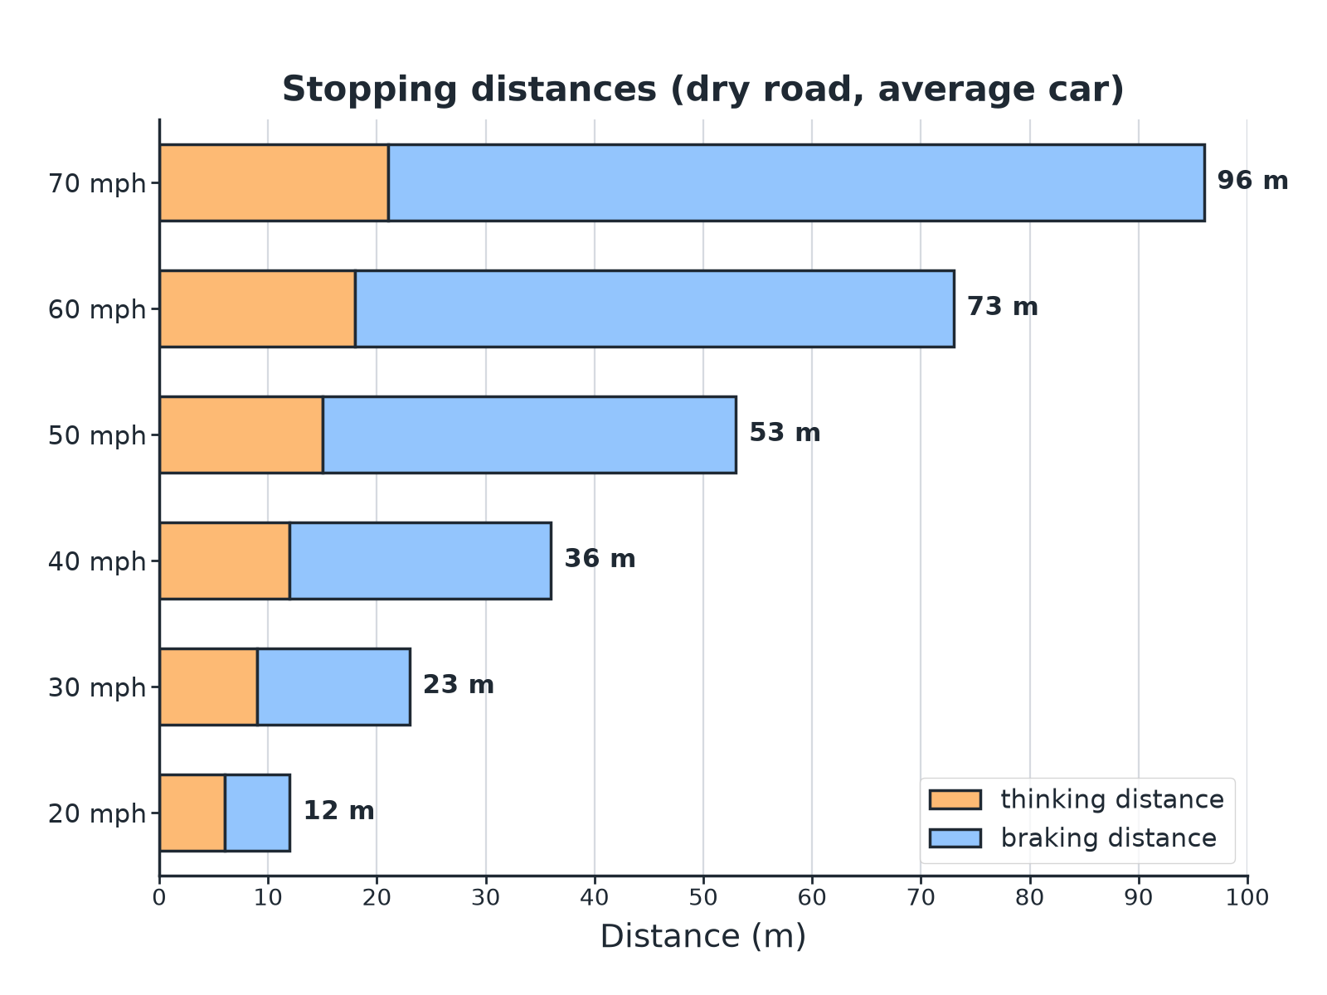

AQA GCSE PHYSICS · PAPER 2 · FOUNDATION & HIGHER
Stopping Distance
Thinking distance is proportional to speed; braking distance is not.
Forces
openrevise.com
Lesson 17 of 20

Slide 7

AQA GCSE PHYSICS · PAPER 2 · FOUNDATION & HIGHER
Reaction Time
Typical values and factors.
Idea
Detail
Typical reaction time
0.2 s to 0.9 s
Increases with
Tiredness, drugs, alcohol, distractions such as a mobile phone
Thinking distance
s = vt: reaction time × speed
Measuring it
Ruler drop test: the distance the ruler falls gives the reaction time
Forces
openrevise.com
Lesson 17 of 20

Slide 8

AQA GCSE PHYSICS · PAPER 2 · FOUNDATION & HIGHER
Thinking Distance
A driver travelling at 15 m/s has a reaction time of 0.60 s. Calculate the thinking distance.
Write the equation
s = vt
1
Substitute
s = 15 × 0.60
2
Answer
s = 9.0 m
3
ANSWER
9.0 m
Forces
openrevise.com
Lesson 17 of 20

Slide 9
AQA GCSE PHYSICS · PAPER 2 · FOUNDATION & HIGHER
Stopping Distance
A car has a thinking distance of 9.0 m and a braking distance of 14 m. Calculate the stopping distance.
Add
9.0 + 14 = 23 m
1
ANSWER
23 m
Forces
openrevise.com
Lesson 17 of 20

Slide 10
AQA GCSE PHYSICS · PAPER 2 · FOUNDATION & HIGHER
Measuring Reaction Time
Describe the ruler drop method.
Set up
A partner holds a ruler vertically with the zero between your thumb and finger
1
Drop
Without warning they drop it, and you catch it as fast as you can
2
Measure
The distance fallen is read from the ruler
3
Convert
Use a table of distance against time, then repeat and find a mean
4
ANSWER
The longer the distance the ruler falls, the longer the reaction time.
Forces
openrevise.com
Lesson 17 of 20

Slide 11
AQA GCSE PHYSICS · PAPER 2 · FOUNDATION & HIGHER
Distractions
Explain the effect of a driver texting on the stopping distance.
Reaction time
Increases
1
Thinking distance
s = vt is greater
2
Stopping distance
So the total stopping distance is greater
3
ANSWER
A longer reaction time gives a longer thinking distance and so a longer stopping distance.
Forces
openrevise.com
Lesson 17 of 20

Slide 12

AQA GCSE PHYSICS · PAPER 2 · FOUNDATION & HIGHER
Why It Matters
Safety.
Speed limits
Higher speed means a much greater stopping distance.
Driver factors
Tiredness, alcohol, drugs and distractions raise reaction time.
Estimates
Estimate how emergency stopping distance varies over typical speeds.
Graphs
Interpret graphs of speed against stopping distance for different vehicles.
Forces
openrevise.com
Lesson 17 of 20

Slide 13

AQA GCSE PHYSICS · PAPER 2 · FOUNDATION & HIGHER
Key Terms
Stopping distance
Thinking distance plus braking distance.
Thinking distance
Distance travelled in the driver's reaction time.
Braking distance
Distance travelled while the brakes slow the vehicle.
Reaction time
The time between a stimulus and a response.
Distraction
Something that takes a driver's attention away.
Mean
The average of repeated readings.
Forces
openrevise.com
Lesson 17 of 20

Slide 14

AQA GCSE PHYSICS · PAPER 2 · FOUNDATION & HIGHER
YOUR TASK
12 minutes
Reaction Test
In a ruler drop test a student's three results for the distance fallen are 14 cm, 16 cm and 15 cm. Calculate the mean. Explain why a tired driver would have a longer stopping distance.
Find the mean.
1
Link to s = vt.
2
WHAT A GOOD ANSWER SHOWS
Mean = 15 cm. Tiredness increases reaction time, so thinking distance increases, increasing the stopping distance.
Forces
openrevise.com
Lesson 17 of 20
Notes:
Ask how to make the test fair.

Slide 15
AQA GCSE PHYSICS · PAPER 2 · FOUNDATION & HIGHER
Can I...?
Define stopping distance.
Describe a reaction-time test.
Define thinking and braking distance.
Read a stopping distance chart.
Use s = vt.
Explain the effect of speed.
List factors affecting reaction time.
Estimate stopping distances.
Forces
openrevise.com
Lesson 17 of 20

Slide 16
AQA GCSE PHYSICS · PAPER 2 · FOUNDATION & HIGHER
Summary & Exam Focus
Stopping = thinking + braking.
Thinking distance: s = vt.
Reaction time 0.2 to 0.9 s; increased by tiredness, drugs, alcohol, distractions.
Higher speed gives a greater stopping distance.
EXAM FOCUS
A driver travels at 15 m/s with a reaction time of 0.60 s. Calculate the thinking distance. (2 marks)
Multiply speed by reaction time.
openrevise.com

Slide 17
AQA GCSE PHYSICS · PAPER 2 · FOUNDATION & HIGHER
Exam Practice: Stopping distance and reaction time
Answer all questions. Use the mark allocation as a guide to how much to write. · 16 minutes
Question 1 · 2 marks · Calculate
A car travels at 15 m/s. The driver's reaction time is 0.60 s. Calculate the thinking distance. Use the equation: distance = speed × time
Question 2 · 2 marks · State
Give two factors that can increase a driver's reaction time.
Question 3 · 4 marks · Use the chart
The chart shows the thinking distance and braking distance for a car at different speeds. (a) Use the chart to find the stopping distance…
Forces
openrevise.com
Lesson 17 of 20

Slide 18
AQA GCSE PHYSICS · PAPER 2 · FOUNDATION & HIGHER
Exam Practice: Stopping distance and reaction time (cont.)
Question 4 · 3 marks · Explain
A driver is sending a text message while driving. Explain how this affects the stopping distance of the car.
Question 5 · 4 marks · Describe
Describe an experiment to measure a person's reaction time using a ruler. Explain how the result is used.
Forces
openrevise.com
Lesson 17 of 20

Slide 19
AQA GCSE PHYSICS · PAPER 2 · FOUNDATION & HIGHER
Question 1 · 2 marks · Calculate
“
A car travels at 15 m/s. The driver's reaction time is 0.60 s. Calculate the thinking distance. Use the equation: distance = speed × time
HOW TO ANSWER IT
Command word: Calculate. Worth 2 marks, so plan before writing.
Forces
openrevise.com
Lesson 17 of 20

Slide 20
AQA GCSE PHYSICS · PAPER 2 · FOUNDATION & HIGHER
Question 1 · mark scheme
2 marks available. Award a mark for each point made.
Correct substitution
1 mark
9.0 m
1 mark
Forces
openrevise.com
Lesson 17 of 20

Slide 21
AQA GCSE PHYSICS · PAPER 2 · FOUNDATION & HIGHER
Question 2 · 2 marks · State
“
Give two factors that can increase a driver's reaction time.
HOW TO ANSWER IT
Command word: State. Worth 2 marks, so plan before writing.
Forces
openrevise.com
Lesson 17 of 20

Slide 22
AQA GCSE PHYSICS · PAPER 2 · FOUNDATION & HIGHER
Question 2 · mark scheme
2 marks available. Award a mark for each point made.
First factor
1 mark
Second factor
1 mark
Forces
openrevise.com
Lesson 17 of 20

Slide 23
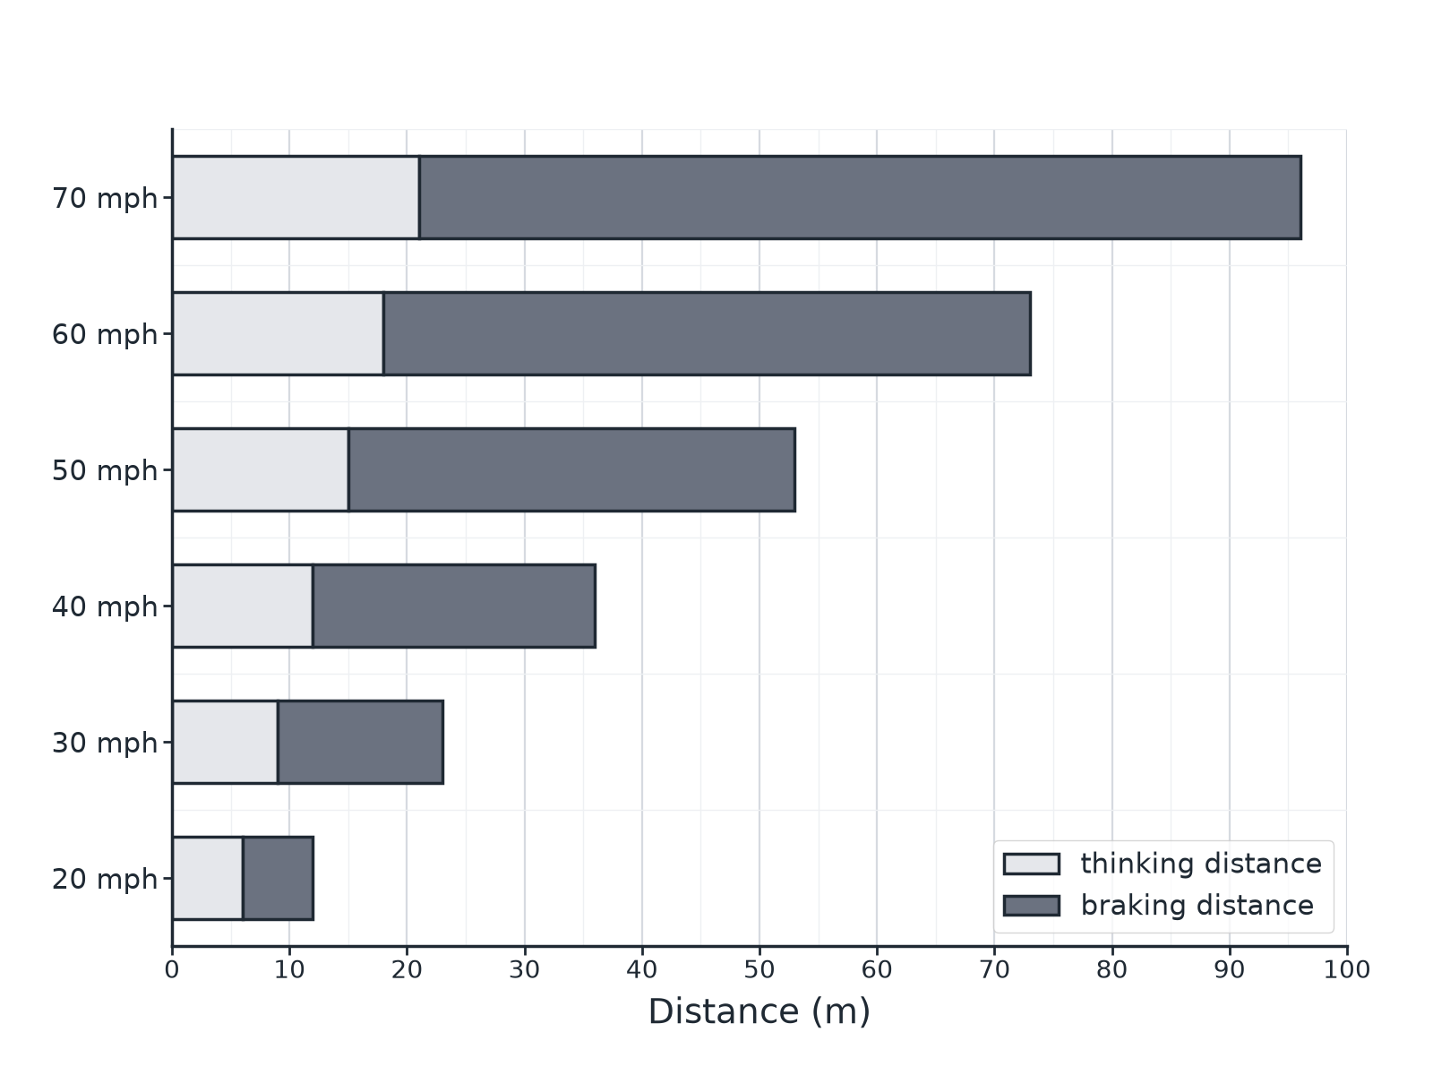
AQA GCSE PHYSICS · PAPER 2 · FOUNDATION & HIGHER
Question 3 · 4 marks · Use the chart
The chart shows the thinking distance and braking distance for a car at different speeds. (a) Use the chart to find the stopping distance at 50 mph. (b) Describe how the thinking distance changes with speed. (c) Explain why the braking distance increases more quickly than the thinking distance. (4 marks)
Forces
openrevise.com
Lesson 17 of 20

Slide 24
AQA GCSE PHYSICS · PAPER 2 · FOUNDATION & HIGHER
Question 3 · mark scheme
4 marks available. Award a mark for each point made.
53 m
1 mark
Thinking distance increases steadily or proportionally
1 mark
Braking distance depends on kinetic energy
1 mark
Kinetic energy ∝ speed²
1 mark
Forces
openrevise.com
Lesson 17 of 20

Slide 25
AQA GCSE PHYSICS · PAPER 2 · FOUNDATION & HIGHER
Question 4 · 3 marks · Explain
“
A driver is sending a text message while driving. Explain how this affects the stopping distance of the car.
HOW TO ANSWER IT
Command word: Explain. Worth 3 marks, so plan before writing.
Forces
openrevise.com
Lesson 17 of 20

Slide 26
AQA GCSE PHYSICS · PAPER 2 · FOUNDATION & HIGHER
Question 4 · mark scheme
3 marks available. Award a mark for each point made.
Reaction time increases
1 mark
Thinking distance increases
1 mark
Stopping distance greater
1 mark
Forces
openrevise.com
Lesson 17 of 20

Slide 27
AQA GCSE PHYSICS · PAPER 2 · FOUNDATION & HIGHER
Question 5 · 4 marks · Describe
“
Describe an experiment to measure a person's reaction time using a ruler. Explain how the result is used.
HOW TO ANSWER IT
Command word: Describe. Worth 4 marks, so plan before writing.
Forces
openrevise.com
Lesson 17 of 20

Slide 28
AQA GCSE PHYSICS · PAPER 2 · FOUNDATION & HIGHER
Question 5 · mark scheme
4 marks available. Award a mark for each point made.
Ruler held and dropped without warning
1 mark
Distance fallen measured
1 mark
Converted to a reaction time
1 mark
Repeat and mean, compare conditions
1 mark
Forces
openrevise.com
Lesson 17 of 20

