Slide 1

AQA GCSE PHYSICS · PAPER 2 · FOUNDATION & HIGHER
Braking distances and large decelerations
Forces
Lesson 18 of 20
openrevise.com

Slide 2

AQA GCSE PHYSICS · PAPER 2 · FOUNDATION & HIGHER
Warm-up
Answer each one, then check.
1
What is friction?
2
What is kinetic energy?
3
What is deceleration?
4
What is work done?
5
What does the brake do to the wheel?
Forces
openrevise.com
Lesson 18 of 20

Slide 3
AQA GCSE PHYSICS · PAPER 2 · FOUNDATION & HIGHER
Warm-up - Answers
What is friction?
A force opposing motion
1
What is kinetic energy?
Energy stored in a moving object
2
What is deceleration?
Slowing down
3
What is work done?
Energy transferred by a force
4
What does the brake do to the wheel?
Uses friction to slow it
5
Forces
openrevise.com
Lesson 18 of 20

Slide 4

AQA GCSE PHYSICS · PAPER 2 · FOUNDATION & HIGHER
Learning Objectives
Explain how road conditions and the condition of the vehicle affect braking distance.
1
Explain how the brakes reduce the kinetic energy of a vehicle by work done against friction.
2
Explain why greater speed needs a greater braking force to stop in the same distance.
3
Explain the dangers of large decelerations, and estimate the forces involved (Higher tier).
4
Forces
openrevise.com
Lesson 18 of 20

Slide 5

AQA GCSE PHYSICS · PAPER 2 · FOUNDATION & HIGHER
BRAKING
When a force is applied to the brakes, the work done by the friction force between the brakes and the wheel reduces the kinetic energy of the vehicle and increases the temperature of the brakes.
The greater the braking force, the greater the deceleration. Large decelerations may cause brakes to overheat or a loss of control.
Forces
openrevise.com
Lesson 18 of 20

Slide 6
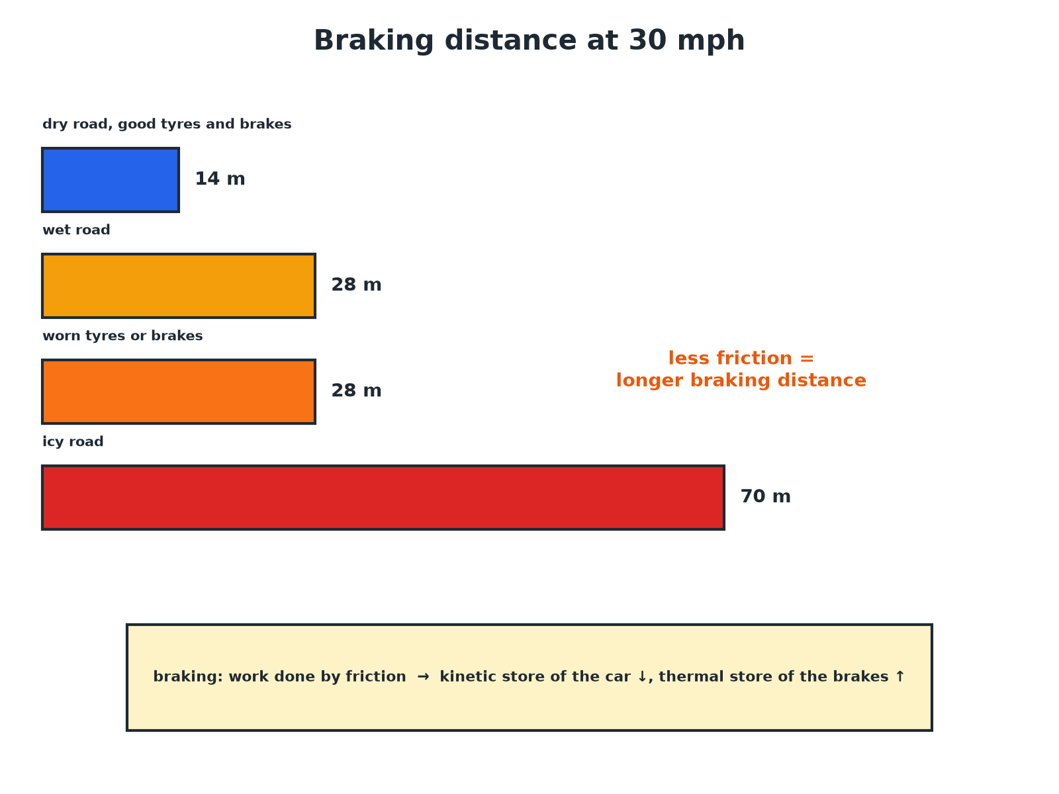

AQA GCSE PHYSICS · PAPER 2 · FOUNDATION & HIGHER
Braking Distance Depends on Conditions
Less friction means a longer braking distance.
Forces
openrevise.com
Lesson 18 of 20

Slide 7

AQA GCSE PHYSICS · PAPER 2 · FOUNDATION & HIGHER
What Affects Braking Distance
INCREASES BRAKING DISTANCE
REDUCES BRAKING DISTANCE
• Higher speed.
• Wet or icy roads (less friction).
• Worn tyres (less grip).
• Worn brakes (less braking force).
• A heavier vehicle (more kinetic energy).
• Lower speed.
• Dry road.
• Good tyres with deep treads.
• Well-maintained brakes.
Forces
openrevise.com
Lesson 18 of 20

Slide 8

AQA GCSE PHYSICS · PAPER 2 · FOUNDATION & HIGHER
Braking Force
A car of mass 1200 kg travelling at 25 m/s stops in 50 m. Estimate the average braking force.
Kinetic energy
E_k = ½mv² = 0.5 × 1200 × 25² = 375 000 J
1
Work done by the brakes
W = Fs, so F = 375 000 ÷ 50
2
Answer
F = 7500 N
3
ANSWER
About 7500 N.
Forces
openrevise.com
Lesson 18 of 20

Slide 9
AQA GCSE PHYSICS · PAPER 2 · FOUNDATION & HIGHER
Deceleration
For the same car, calculate the deceleration.
Use F = ma
a = F ÷ m = 7500 ÷ 1200
1
Answer
a = 6.25 m/s²
2
ANSWER
6.25 m/s² (deceleration).
Forces
openrevise.com
Lesson 18 of 20

Slide 10
AQA GCSE PHYSICS · PAPER 2 · FOUNDATION & HIGHER
Dangers of Large Decelerations
Explain the dangers of a very large deceleration.
Large force
A large braking force is needed
1
Overheating
Brakes can overheat and fade
2
Loss of control
Tyres may lose grip and the car may skid
3
Passengers
Occupants experience large forces that can cause injury
4
ANSWER
Brakes overheat, the car can skid, and people in the vehicle are harmed.
Forces
openrevise.com
Lesson 18 of 20

Slide 11

AQA GCSE PHYSICS · PAPER 2 · FOUNDATION & HIGHER
Energy
What happens to the energy.
Kinetic to thermal
Work done against friction transfers the car's kinetic energy to the thermal energy of the brakes and tyres.
Speed
Doubling speed quadruples kinetic energy, so the braking distance is about four times as long.
Braking force
A greater speed needs a greater braking force to stop in the same distance.
Estimate (Higher)
Use Fs = ½mv² to estimate forces.
Forces
openrevise.com
Lesson 18 of 20

Slide 12

AQA GCSE PHYSICS · PAPER 2 · FOUNDATION & HIGHER
Key Terms
Braking distance
The distance travelled while the brakes slow a vehicle.
Deceleration
A negative acceleration: slowing down.
Friction
A force between surfaces that opposes motion.
Kinetic energy
Energy of a moving object.
Brake fade
Loss of braking power when brakes overheat.
Skid
When tyres lose grip and slide.
Forces
openrevise.com
Lesson 18 of 20

Slide 13

AQA GCSE PHYSICS · PAPER 2 · FOUNDATION & HIGHER
YOUR TASK
10 minutes
Why Is Wet Worse?
A car's braking distance at 30 mph is 14 m on a dry road and 28 m on a wet road. Explain the difference. Estimate the braking distance on a wet road at 60 mph, where the dry distance is 55 m.
Link to friction.
1
Use the ratio.
2
WHAT A GOOD ANSWER SHOWS
Wet roads have less friction so the deceleration is less and the distance is longer. At 60 mph, wet braking distance is about double the dry: about 110 m.
Forces
openrevise.com
Lesson 18 of 20
Notes:
Ask about ice.

Slide 14
AQA GCSE PHYSICS · PAPER 2 · FOUNDATION & HIGHER
Can I...?
Explain braking distance factors.
Explain worn tyres and brakes.
Explain brakes and kinetic energy.
Explain brake overheating.
Explain why speed matters.
Estimate a braking force.
Explain wet and icy roads.
Explain dangers of deceleration.
Forces
openrevise.com
Lesson 18 of 20

Slide 15
AQA GCSE PHYSICS · PAPER 2 · FOUNDATION & HIGHER
Summary & Exam Focus
Braking: work done by friction reduces kinetic energy.
Wet or icy roads and worn tyres reduce friction.
Higher speed needs a larger braking force.
Large decelerations can overheat brakes and cause skids.
EXAM FOCUS
Explain why the braking distance of a car is greater on a wet road than on a dry road. (2 marks)
Less friction between the tyres and the road.
openrevise.com

Slide 16
AQA GCSE PHYSICS · PAPER 2 · FOUNDATION & HIGHER
Exam Practice: Braking distances and large decelerations
Answer all questions. Use the mark allocation as a guide to how much to write. · 16 minutes
Question 1 · 2 marks · Explain
Explain why the braking distance of a car is greater on a wet road than on a dry road.
Question 2 · 3 marks · Use the graph
The graph shows the braking distance of a car at different speeds on a dry road and on a wet road. (a) Use the graph to find the braking…
Question 3 · 3 marks · Explain
When a car brakes, the brakes become hot. Explain why in terms of energy and work.
Forces
openrevise.com
Lesson 18 of 20

Slide 17
AQA GCSE PHYSICS · PAPER 2 · FOUNDATION & HIGHER
Exam Practice: Braking distances and large decelerations (cont.)
Question 4 · 4 marks · Calculate
A car of mass 1000 kg travelling at 20 m/s is brought to rest in a distance of 40 m. Estimate the average braking force.
Question 5 · 3 marks · Explain
Explain the dangers of a very large deceleration of a car.
Forces
openrevise.com
Lesson 18 of 20

Slide 18
AQA GCSE PHYSICS · PAPER 2 · FOUNDATION & HIGHER
Question 1 · 2 marks · Explain
“
Explain why the braking distance of a car is greater on a wet road than on a dry road.
HOW TO ANSWER IT
Command word: Explain. Worth 2 marks, so plan before writing.
Forces
openrevise.com
Lesson 18 of 20

Slide 19
AQA GCSE PHYSICS · PAPER 2 · FOUNDATION & HIGHER
Question 1 · mark scheme
2 marks available. Award a mark for each point made.
Less friction on a wet road
1 mark
Smaller deceleration, so longer distance
1 mark
Forces
openrevise.com
Lesson 18 of 20

Slide 20
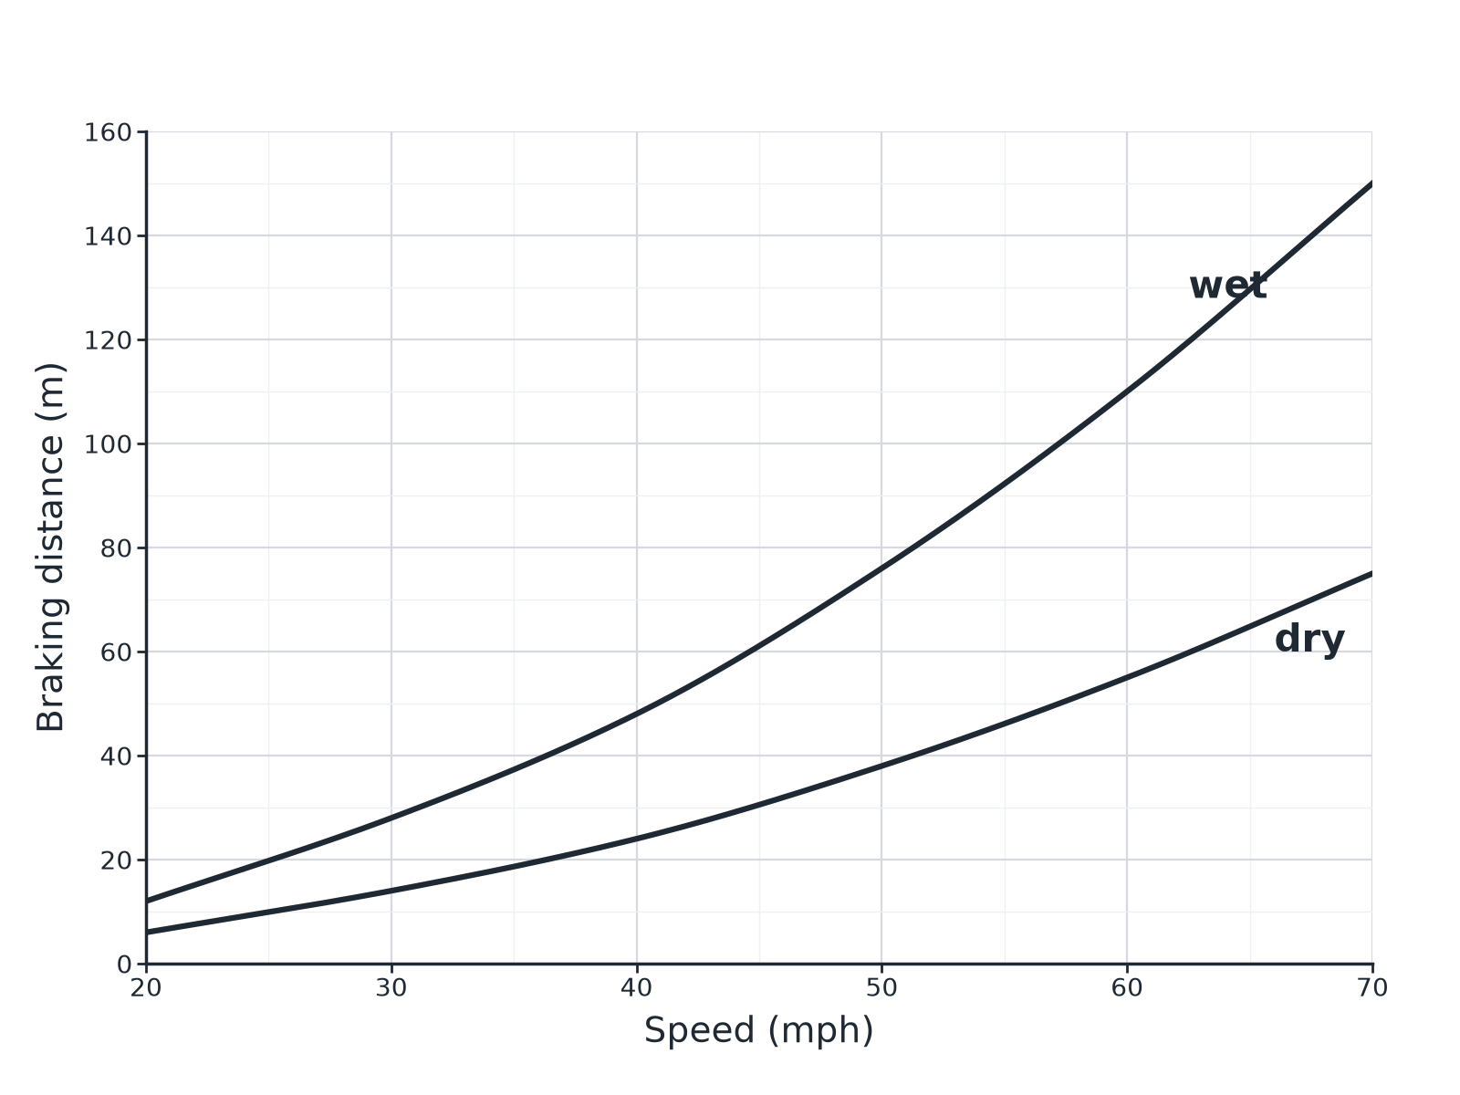
AQA GCSE PHYSICS · PAPER 2 · FOUNDATION & HIGHER
Question 2 · 3 marks · Use the graph
The graph shows the braking distance of a car at different speeds on a dry road and on a wet road. (a) Use the graph to find the braking distance at 50 mph on a wet road. (b) Explain the difference between the two lines. (3 marks)
Forces
openrevise.com
Lesson 18 of 20

Slide 21
AQA GCSE PHYSICS · PAPER 2 · FOUNDATION & HIGHER
Question 2 · mark scheme
3 marks available. Award a mark for each point made.
About 76 m (accept 72 to 80)
1 mark
Less friction on the wet road
1 mark
So greater braking distance
1 mark
Forces
openrevise.com
Lesson 18 of 20

Slide 22
AQA GCSE PHYSICS · PAPER 2 · FOUNDATION & HIGHER
Question 3 · 3 marks · Explain
“
When a car brakes, the brakes become hot. Explain why in terms of energy and work.
HOW TO ANSWER IT
Command word: Explain. Worth 3 marks, so plan before writing.
Forces
openrevise.com
Lesson 18 of 20

Slide 23
AQA GCSE PHYSICS · PAPER 2 · FOUNDATION & HIGHER
Question 3 · mark scheme
3 marks available. Award a mark for each point made.
Work done by the friction force
1 mark
Kinetic energy store decreases
1 mark
Thermal energy store of brakes increases
1 mark
Forces
openrevise.com
Lesson 18 of 20

Slide 24
AQA GCSE PHYSICS · PAPER 2 · FOUNDATION & HIGHER
Question 4 · 4 marks · Calculate
“
A car of mass 1000 kg travelling at 20 m/s is brought to rest in a distance of 40 m. Estimate the average braking force.
HOW TO ANSWER IT
Command word: Calculate. Worth 4 marks, so plan before writing.
Forces
openrevise.com
Lesson 18 of 20

Slide 25
AQA GCSE PHYSICS · PAPER 2 · FOUNDATION & HIGHER
Question 4 · mark scheme
4 marks available. Award a mark for each point made.
Kinetic energy 200 000 J
1 mark
Work done = Fs
1 mark
Correct substitution
1 mark
5000 N
1 mark
Forces
openrevise.com
Lesson 18 of 20

Slide 26
AQA GCSE PHYSICS · PAPER 2 · FOUNDATION & HIGHER
Question 5 · 3 marks · Explain
“
Explain the dangers of a very large deceleration of a car.
HOW TO ANSWER IT
Command word: Explain. Worth 3 marks, so plan before writing.
Forces
openrevise.com
Lesson 18 of 20

Slide 27
AQA GCSE PHYSICS · PAPER 2 · FOUNDATION & HIGHER
Question 5 · mark scheme
3 marks available. Award a mark for each point made.
Brakes overheat
1 mark
Loss of control or skidding
1 mark
Risk of injury
1 mark
Forces
openrevise.com
Lesson 18 of 20

