Slide 1

AQA GCSE PHYSICS · PAPER 2 · HIGHER TIER ONLY
Momentum and its conservation
Forces
Lesson 19 of 20
openrevise.com

Slide 2

AQA GCSE PHYSICS · PAPER 2 · HIGHER TIER ONLY
Warm-up
Answer each one, then check.
1
What is velocity?
2
What is mass?
3
What is a closed system?
4
What does conserved mean?
5
What is a collision?
Forces
openrevise.com
Lesson 19 of 20

Slide 3
AQA GCSE PHYSICS · PAPER 2 · HIGHER TIER ONLY
Warm-up - Answers
What is velocity?
Speed in a given direction
1
What is mass?
The amount of matter in an object
2
What is a closed system?
A system with no external forces or energy transfer
3
What does conserved mean?
Stays the same in total
4
What is a collision?
When two objects hit each other
5
Forces
openrevise.com
Lesson 19 of 20

Slide 4

AQA GCSE PHYSICS · PAPER 2 · HIGHER TIER ONLY
Learning Objectives
Define momentum and recall the equation.
1
State the principle of conservation of momentum.
2
Calculate momentum before and after collisions and explosions.
3
Explain examples such as collisions using momentum.
4
Forces
openrevise.com
Lesson 19 of 20

Slide 5

AQA GCSE PHYSICS · PAPER 2 · HIGHER TIER ONLY
MOMENTUM
momentum = mass × velocity p = mv
In a closed system the total momentum before an event is equal to the total momentum after the event. Momentum is a vector, measured in kg m/s.
Forces
openrevise.com
Lesson 19 of 20

Slide 6
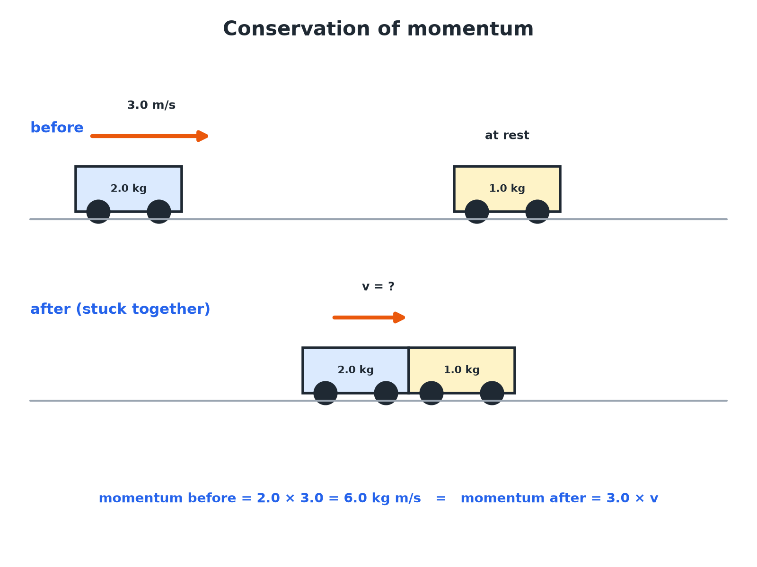

AQA GCSE PHYSICS · PAPER 2 · HIGHER TIER ONLY
A Collision
Momentum before = momentum after.
Forces
openrevise.com
Lesson 19 of 20

Slide 7

AQA GCSE PHYSICS · PAPER 2 · HIGHER TIER ONLY
Calculating Momentum
A car of mass 1500 kg moves at 20 m/s. Calculate its momentum.
Write the equation
p = mv
1
Substitute
p = 1500 × 20
2
Answer
p = 30 000 kg m/s
3
ANSWER
30 000 kg m/s
Forces
openrevise.com
Lesson 19 of 20

Slide 8
AQA GCSE PHYSICS · PAPER 2 · HIGHER TIER ONLY
Collision: Objects Stick Together
A 2.0 kg trolley moving at 3.0 m/s hits a stationary 1.0 kg trolley. They stick together. Calculate their velocity after the collision.
Momentum before
2.0 × 3.0 + 1.0 × 0 = 6.0 kg m/s
1
Momentum after
(2.0 + 1.0) × v = 3.0v
2
Conservation
3.0v = 6.0
3
Answer
v = 2.0 m/s
4
ANSWER
2.0 m/s in the original direction.
Forces
openrevise.com
Lesson 19 of 20

Slide 9
AQA GCSE PHYSICS · PAPER 2 · HIGHER TIER ONLY
Explosion
A 4.0 kg gun fires a 0.020 kg bullet at 200 m/s. Calculate the recoil velocity of the gun.
Momentum before
0 (both at rest)
1
Bullet
0.020 × 200 = 4.0 kg m/s forwards
2
Gun
4.0 × v = −4.0
3
Answer
v = −1.0 m/s
4
ANSWER
1.0 m/s backwards.
Forces
openrevise.com
Lesson 19 of 20

Slide 10

AQA GCSE PHYSICS · PAPER 2 · HIGHER TIER ONLY
Key Ideas
Use direction carefully.
Vector
Choose a positive direction; motion the other way is negative.
Closed system
No external forces (such as friction) act.
Kinetic energy
Not always conserved in collisions; momentum is.
Units
kg m/s.
Forces
openrevise.com
Lesson 19 of 20

Slide 11

AQA GCSE PHYSICS · PAPER 2 · HIGHER TIER ONLY
Key Terms
Momentum
Mass multiplied by velocity.
Conservation of momentum
Total momentum before an event equals total momentum after in a closed system.
Closed system
A system with no external forces.
Collision
Two objects hitting each other.
Recoil
The backward movement of a gun when fired.
Explosion
When objects push apart from rest.
Forces
openrevise.com
Lesson 19 of 20

Slide 12

AQA GCSE PHYSICS · PAPER 2 · HIGHER TIER ONLY
YOUR TASK
12 minutes
Stick Together
A 1.5 kg trolley moving at 2.0 m/s collides with a stationary 0.50 kg trolley and they stick together. Find the velocity after the collision.
Find the total momentum before.
1
Divide by the total mass.
2
WHAT A GOOD ANSWER SHOWS
Momentum before = 3.0; after (2.0 kg) v = 1.5 m/s.
Forces
openrevise.com
Lesson 19 of 20

Slide 13
AQA GCSE PHYSICS · PAPER 2 · HIGHER TIER ONLY
Can I...?
Define momentum.
Solve a recoil problem.
Use p = mv.
Use positive and negative directions.
State conservation of momentum.
Explain momentum in collisions.
Solve a sticking collision.
Give units.
Forces
openrevise.com
Lesson 19 of 20

Slide 14
AQA GCSE PHYSICS · PAPER 2 · HIGHER TIER ONLY
Summary & Exam Focus
p = mv.
Closed system: momentum before = momentum after.
Momentum is a vector.
Explosion from rest: total momentum zero.
EXAM FOCUS
A car of mass 1500 kg moves at 20 m/s. Calculate its momentum. (2 marks)
Multiply mass by velocity.
openrevise.com

