Slide 1

AQA GCSE PHYSICS · PAPER 2 · HIGHER TIER ONLY
Momentum and its conservation
Forces
Lesson 19 of 20
openrevise.com

Slide 2

AQA GCSE PHYSICS · PAPER 2 · HIGHER TIER ONLY
Warm-up
Answer each one, then check.
1
What is velocity?
2
What is mass?
3
What is a closed system?
4
What does conserved mean?
5
What is a collision?
Forces
openrevise.com
Lesson 19 of 20

Slide 3
AQA GCSE PHYSICS · PAPER 2 · HIGHER TIER ONLY
Warm-up - Answers
What is velocity?
Speed in a given direction
1
What is mass?
The amount of matter in an object
2
What is a closed system?
A system with no external forces or energy transfer
3
What does conserved mean?
Stays the same in total
4
What is a collision?
When two objects hit each other
5
Forces
openrevise.com
Lesson 19 of 20

Slide 4

AQA GCSE PHYSICS · PAPER 2 · HIGHER TIER ONLY
Learning Objectives
Define momentum and recall the equation.
1
State the principle of conservation of momentum.
2
Calculate momentum before and after collisions and explosions.
3
Explain examples such as collisions using momentum.
4
Forces
openrevise.com
Lesson 19 of 20

Slide 5

AQA GCSE PHYSICS · PAPER 2 · HIGHER TIER ONLY
MOMENTUM
momentum = mass × velocity p = mv
In a closed system the total momentum before an event is equal to the total momentum after the event. Momentum is a vector, measured in kg m/s.
Forces
openrevise.com
Lesson 19 of 20

Slide 6
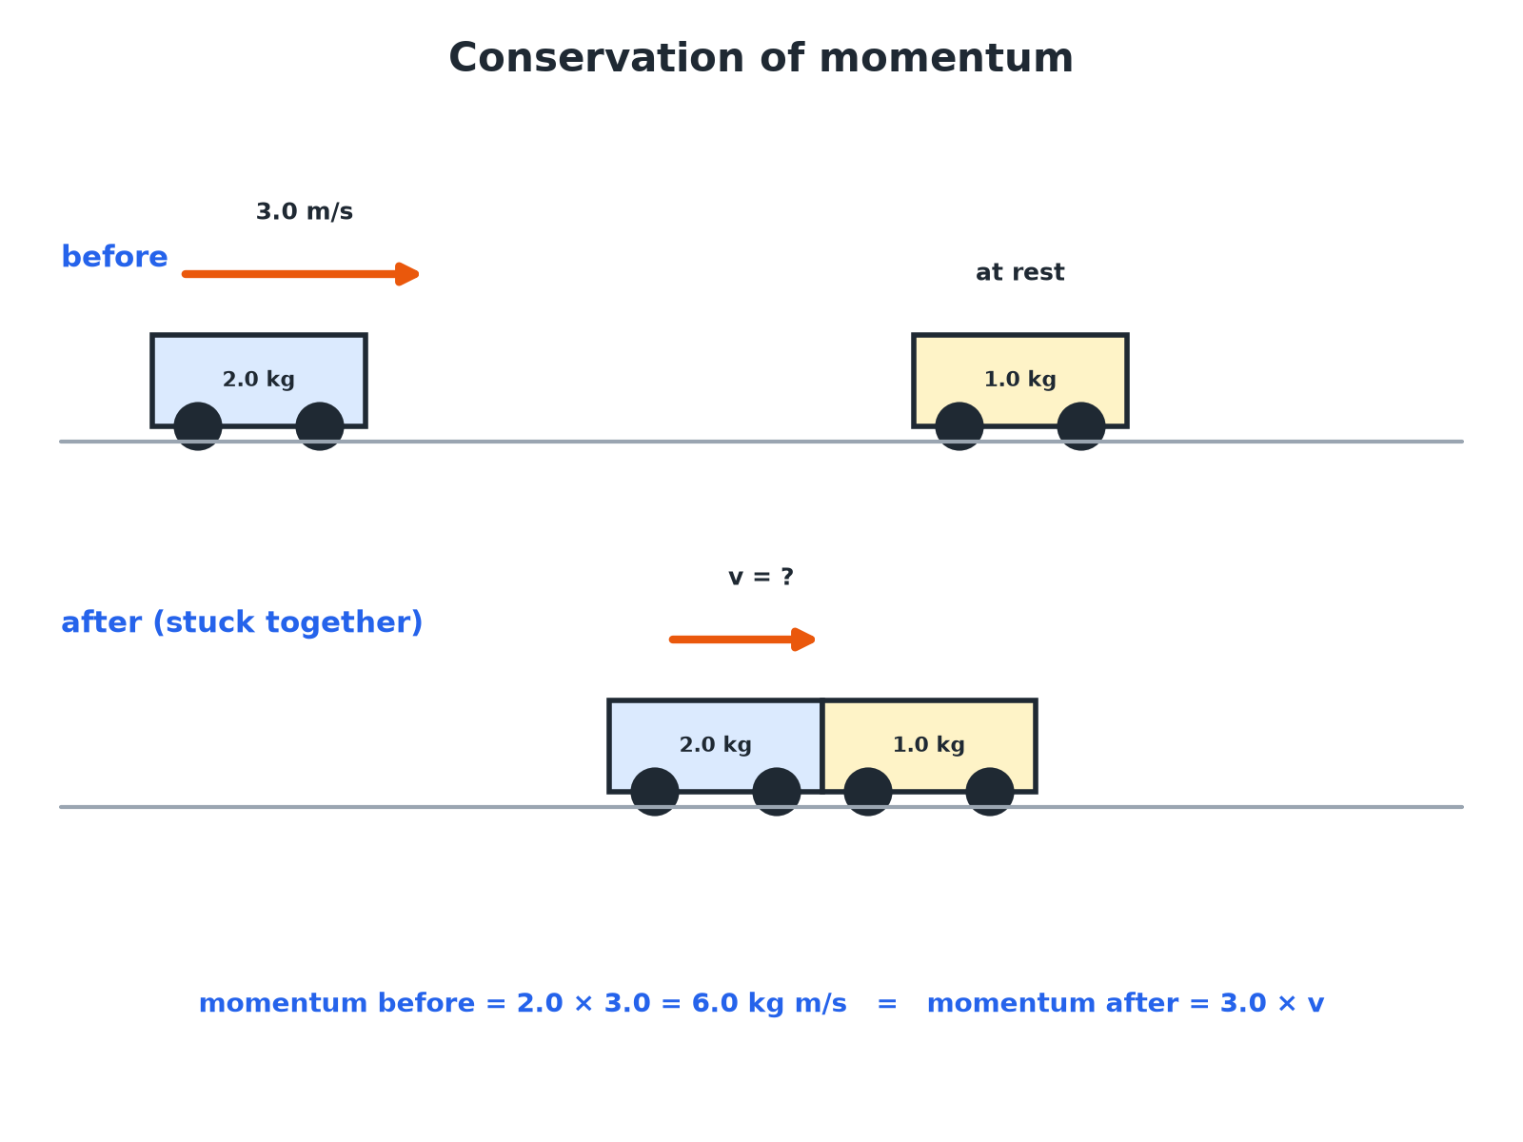

AQA GCSE PHYSICS · PAPER 2 · HIGHER TIER ONLY
A Collision
Momentum before = momentum after.
Forces
openrevise.com
Lesson 19 of 20

Slide 7

AQA GCSE PHYSICS · PAPER 2 · HIGHER TIER ONLY
Calculating Momentum
A car of mass 1500 kg moves at 20 m/s. Calculate its momentum.
Write the equation
p = mv
1
Substitute
p = 1500 × 20
2
Answer
p = 30 000 kg m/s
3
ANSWER
30 000 kg m/s
Forces
openrevise.com
Lesson 19 of 20

Slide 8
AQA GCSE PHYSICS · PAPER 2 · HIGHER TIER ONLY
Collision: Objects Stick Together
A 2.0 kg trolley moving at 3.0 m/s hits a stationary 1.0 kg trolley. They stick together. Calculate their velocity after the collision.
Momentum before
2.0 × 3.0 + 1.0 × 0 = 6.0 kg m/s
1
Momentum after
(2.0 + 1.0) × v = 3.0v
2
Conservation
3.0v = 6.0
3
Answer
v = 2.0 m/s
4
ANSWER
2.0 m/s in the original direction.
Forces
openrevise.com
Lesson 19 of 20

Slide 9
AQA GCSE PHYSICS · PAPER 2 · HIGHER TIER ONLY
Explosion
A 4.0 kg gun fires a 0.020 kg bullet at 200 m/s. Calculate the recoil velocity of the gun.
Momentum before
0 (both at rest)
1
Bullet
0.020 × 200 = 4.0 kg m/s forwards
2
Gun
4.0 × v = −4.0
3
Answer
v = −1.0 m/s
4
ANSWER
1.0 m/s backwards.
Forces
openrevise.com
Lesson 19 of 20

Slide 10

AQA GCSE PHYSICS · PAPER 2 · HIGHER TIER ONLY
Key Ideas
Use direction carefully.
Vector
Choose a positive direction; motion the other way is negative.
Closed system
No external forces (such as friction) act.
Kinetic energy
Not always conserved in collisions; momentum is.
Units
kg m/s.
Forces
openrevise.com
Lesson 19 of 20

Slide 11

AQA GCSE PHYSICS · PAPER 2 · HIGHER TIER ONLY
Key Terms
Momentum
Mass multiplied by velocity.
Conservation of momentum
Total momentum before an event equals total momentum after in a closed system.
Closed system
A system with no external forces.
Collision
Two objects hitting each other.
Recoil
The backward movement of a gun when fired.
Explosion
When objects push apart from rest.
Forces
openrevise.com
Lesson 19 of 20

Slide 12

AQA GCSE PHYSICS · PAPER 2 · HIGHER TIER ONLY
YOUR TASK
12 minutes
Stick Together
A 1.5 kg trolley moving at 2.0 m/s collides with a stationary 0.50 kg trolley and they stick together. Find the velocity after the collision.
Find the total momentum before.
1
Divide by the total mass.
2
WHAT A GOOD ANSWER SHOWS
Momentum before = 3.0; after (2.0 kg) v = 1.5 m/s.
Forces
openrevise.com
Lesson 19 of 20
Notes:
Ask about the kinetic energy before and after.

Slide 13
AQA GCSE PHYSICS · PAPER 2 · HIGHER TIER ONLY
Can I...?
Define momentum.
Solve a recoil problem.
Use p = mv.
Use positive and negative directions.
State conservation of momentum.
Explain momentum in collisions.
Solve a sticking collision.
Give units.
Forces
openrevise.com
Lesson 19 of 20

Slide 14
AQA GCSE PHYSICS · PAPER 2 · HIGHER TIER ONLY
Summary & Exam Focus
p = mv.
Closed system: momentum before = momentum after.
Momentum is a vector.
Explosion from rest: total momentum zero.
EXAM FOCUS
A car of mass 1500 kg moves at 20 m/s. Calculate its momentum. (2 marks)
Multiply mass by velocity.
openrevise.com

Slide 15
AQA GCSE PHYSICS · PAPER 2 · HIGHER TIER ONLY
Exam Practice: Momentum and its conservation
Answer all questions. Use the mark allocation as a guide to how much to write. · 16 minutes
Question 1 · 2 marks · Calculate
A car of mass 1500 kg travels at 20 m/s. Calculate the momentum of the car. Use the equation: momentum = mass × velocity
Question 2 · 4 marks · Calculate
The diagram shows a trolley A colliding with a stationary trolley B. After the collision they stick together. Calculate the velocity of the…
Question 3 · 3 marks · Explain
A moving ball hits a stationary ball and they move apart. Use the idea of conservation of momentum to explain what happens to the total…
Forces
openrevise.com
Lesson 19 of 20

Slide 16
AQA GCSE PHYSICS · PAPER 2 · HIGHER TIER ONLY
Exam Practice: Momentum and its conservation (cont.)
Question 4 · 4 marks · Calculate
A gun of mass 4.0 kg fires a bullet of mass 0.020 kg at a speed of 200 m/s. Calculate the recoil speed of the gun.
Question 5 · 2 marks · Explain
Explain why momentum is a vector quantity.
Forces
openrevise.com
Lesson 19 of 20

Slide 17
AQA GCSE PHYSICS · PAPER 2 · HIGHER TIER ONLY
Question 1 · 2 marks · Calculate
“
A car of mass 1500 kg travels at 20 m/s. Calculate the momentum of the car. Use the equation: momentum = mass × velocity
HOW TO ANSWER IT
Command word: Calculate. Worth 2 marks, so plan before writing.
Forces
openrevise.com
Lesson 19 of 20

Slide 18
AQA GCSE PHYSICS · PAPER 2 · HIGHER TIER ONLY
Question 1 · mark scheme
2 marks available. Award a mark for each point made.
Correct substitution
1 mark
30 000 kg m/s
1 mark
Forces
openrevise.com
Lesson 19 of 20

Slide 19
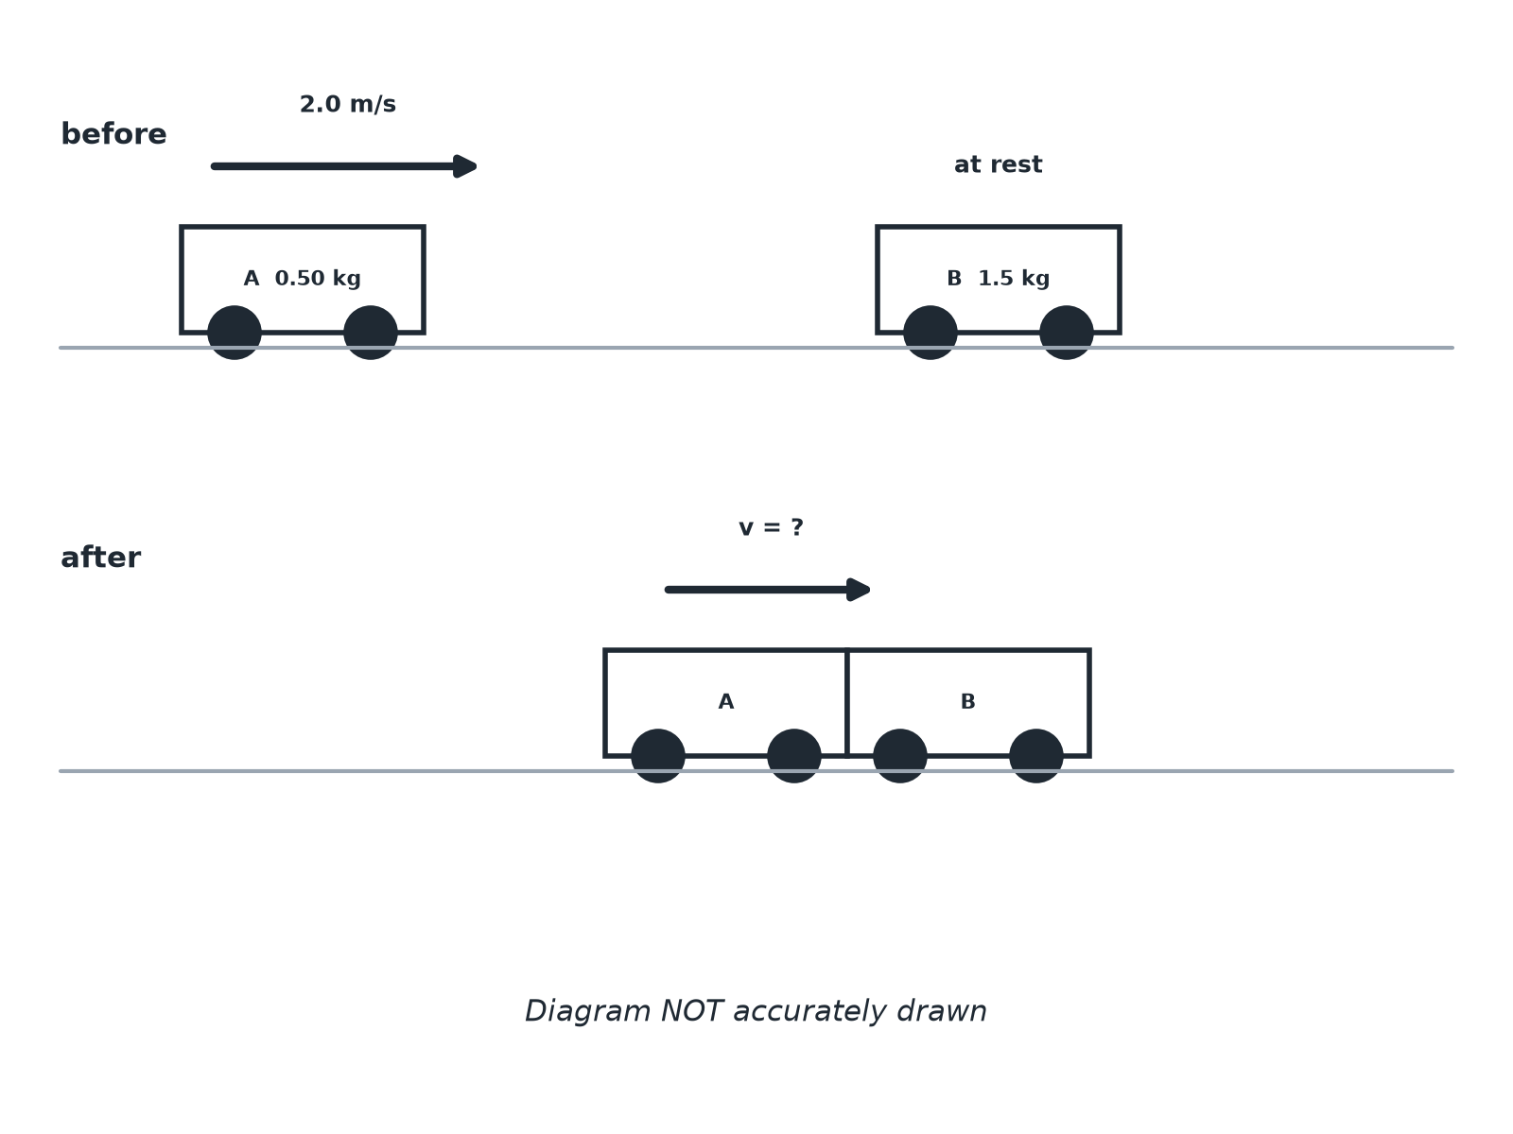
AQA GCSE PHYSICS · PAPER 2 · HIGHER TIER ONLY
Question 2 · 4 marks · Calculate
The diagram shows a trolley A colliding with a stationary trolley B. After the collision they stick together. Calculate the velocity of the trolleys after the collision. (4 marks)
Forces
openrevise.com
Lesson 19 of 20

Slide 20
AQA GCSE PHYSICS · PAPER 2 · HIGHER TIER ONLY
Question 2 · mark scheme
4 marks available. Award a mark for each point made.
Momentum before 1.0 kg m/s
1 mark
Total mass 2.0 kg
1 mark
Equates momentum
1 mark
0.50 m/s
1 mark
Forces
openrevise.com
Lesson 19 of 20

Slide 21
AQA GCSE PHYSICS · PAPER 2 · HIGHER TIER ONLY
Question 3 · 3 marks · Explain
“
A moving ball hits a stationary ball and they move apart. Use the idea of conservation of momentum to explain what happens to the total momentum.
HOW TO ANSWER IT
Command word: Explain. Worth 3 marks, so plan before writing.
Forces
openrevise.com
Lesson 19 of 20

Slide 22
AQA GCSE PHYSICS · PAPER 2 · HIGHER TIER ONLY
Question 3 · mark scheme
3 marks available. Award a mark for each point made.
Total momentum before equals after
1 mark
Closed system
1 mark
Momentum transferred between the balls
1 mark
Forces
openrevise.com
Lesson 19 of 20

Slide 23
AQA GCSE PHYSICS · PAPER 2 · HIGHER TIER ONLY
Question 4 · 4 marks · Calculate
“
A gun of mass 4.0 kg fires a bullet of mass 0.020 kg at a speed of 200 m/s. Calculate the recoil speed of the gun.
HOW TO ANSWER IT
Command word: Calculate. Worth 4 marks, so plan before writing.
Forces
openrevise.com
Lesson 19 of 20

Slide 24
AQA GCSE PHYSICS · PAPER 2 · HIGHER TIER ONLY
Question 4 · mark scheme
4 marks available. Award a mark for each point made.
Momentum of bullet 4.0 kg m/s
1 mark
Total momentum before is zero
1 mark
Equates momentum
1 mark
1.0 m/s backwards
1 mark
Forces
openrevise.com
Lesson 19 of 20

Slide 25
AQA GCSE PHYSICS · PAPER 2 · HIGHER TIER ONLY
Question 5 · 2 marks · Explain
“
Explain why momentum is a vector quantity.
HOW TO ANSWER IT
Command word: Explain. Worth 2 marks, so plan before writing.
Forces
openrevise.com
Lesson 19 of 20

Slide 26
AQA GCSE PHYSICS · PAPER 2 · HIGHER TIER ONLY
Question 5 · mark scheme
2 marks available. Award a mark for each point made.
Mass times velocity
1 mark
Has direction
1 mark
Forces
openrevise.com
Lesson 19 of 20

