Slide 1

AQA GCSE PHYSICS · PAPER 2 · HIGHER TIER ONLY
Changes in momentum
Forces
Lesson 20 of 20
openrevise.com

Slide 2

AQA GCSE PHYSICS · PAPER 2 · HIGHER TIER ONLY
Warm-up
Answer each one, then check.
1
What is momentum?
2
What is acceleration?
3
What is F = ma?
4
Give a safety device in a car.
5
What is a collision?
Forces
openrevise.com
Lesson 20 of 20

Slide 3
AQA GCSE PHYSICS · PAPER 2 · HIGHER TIER ONLY
Warm-up - Answers
What is momentum?
Mass times velocity
1
What is acceleration?
Change in velocity divided by time, a = Δv ÷ t
2
What is F = ma?
Resultant force equals mass times acceleration
3
Give a safety device in a car.
Seat belt, airbag or crumple zone
4
What is a collision?
Two objects hitting each other
5
Forces
openrevise.com
Lesson 20 of 20

Slide 4

AQA GCSE PHYSICS · PAPER 2 · HIGHER TIER ONLY
Learning Objectives
Explain that force equals the rate of change of momentum.
1
Apply F = mΔv ÷ Δt.
2
Explain safety features in terms of increasing the time of a collision.
3
Explain how changes in force, mass, velocity and time are related.
4
Forces
openrevise.com
Lesson 20 of 20

Slide 5

AQA GCSE PHYSICS · PAPER 2 · HIGHER TIER ONLY
RATE OF CHANGE OF MOMENTUM
force = change in momentum ÷ time taken F = mΔv/Δt
Combining F = ma and a = (v − u)/t gives F = mΔv/Δt, where mΔv is the change in momentum. This equation is given on the equation sheet.
Forces
openrevise.com
Lesson 20 of 20

Slide 6
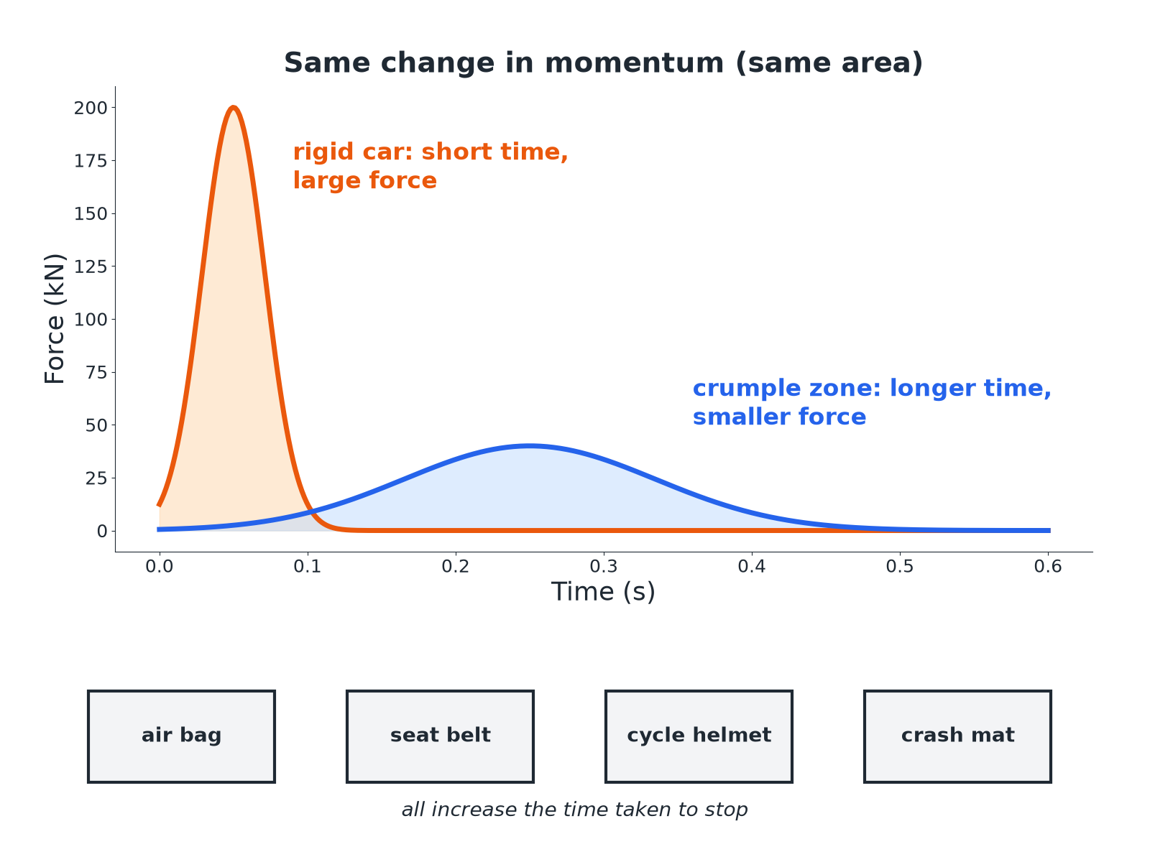

AQA GCSE PHYSICS · PAPER 2 · HIGHER TIER ONLY
Why Crumple Zones Help
A longer time means a smaller force for the same momentum change.
Forces
openrevise.com
Lesson 20 of 20

Slide 7

AQA GCSE PHYSICS · PAPER 2 · HIGHER TIER ONLY
Force in a Crash
A car of mass 1000 kg travelling at 20 m/s stops in 0.50 s. Calculate the average force.
Change in momentum
1000 × 20 = 20 000 kg m/s
1
Substitute
F = 20 000 ÷ 0.50
2
Answer
F = 40 000 N
3
ANSWER
40 000 N
Forces
openrevise.com
Lesson 20 of 20

Slide 8
AQA GCSE PHYSICS · PAPER 2 · HIGHER TIER ONLY
Increasing the Time
The same car is stopped in 0.10 s by hitting a wall. Calculate the average force and compare with the answer above.
Substitute
F = 20 000 ÷ 0.10 = 200 000 N
1
Compare
Five times greater
2
ANSWER
200 000 N: a much shorter time gives a much greater force.
Forces
openrevise.com
Lesson 20 of 20

Slide 9
AQA GCSE PHYSICS · PAPER 2 · HIGHER TIER ONLY
Safety Features
Explain how an air bag reduces injury in a collision.
Momentum
The change in the person's momentum is the same
1
Time
The air bag increases the time for the person to stop
2
Force
F = mΔv ÷ Δt: longer time gives a smaller force
3
ANSWER
It increases the collision time so the average force on the person is smaller.
Forces
openrevise.com
Lesson 20 of 20

Slide 10

AQA GCSE PHYSICS · PAPER 2 · HIGHER TIER ONLY
Other Safety Features
Seat belts
Stretch slightly, increasing the stopping time.
Crumple zones
Deform on impact, increasing the stopping time.
Cycle helmets
The foam compresses, increasing the stopping time.
Crash mats and playground surfaces
Cushion the landing, increasing the time.
Forces
openrevise.com
Lesson 20 of 20

Slide 11

AQA GCSE PHYSICS · PAPER 2 · HIGHER TIER ONLY
Key Points
For exam answers.
Same momentum change
The change in momentum is the same, whatever the time.
Force depends on time
Smaller rate of change of momentum means smaller force.
Say it clearly
'Increases the time of the collision, so decreases the force.'
Units
Force in N, momentum in kg m/s, time in s.
Forces
openrevise.com
Lesson 20 of 20

Slide 12

AQA GCSE PHYSICS · PAPER 2 · HIGHER TIER ONLY
Key Terms
Rate of change of momentum
Change in momentum divided by time.
Air bag
A cushion that inflates in a collision.
Crumple zone
Part of a vehicle designed to deform in a crash.
Seat belt
A strap that holds a passenger and stretches slightly.
Impact time
The time a collision lasts.
Average force
The mean force over the collision time.
Forces
openrevise.com
Lesson 20 of 20

Slide 13

AQA GCSE PHYSICS · PAPER 2 · HIGHER TIER ONLY
YOUR TASK
10 minutes
Ball Catch
A 0.40 kg ball moving at 15 m/s is stopped by a catcher in 0.020 s. A second catcher uses a glove that stops it in 0.10 s. Calculate the force in each case.
Find the momentum change.
1
Divide by time.
2
WHAT A GOOD ANSWER SHOWS
Change in momentum = 6.0 kg m/s. First: 300 N. Second: 60 N.
Forces
openrevise.com
Lesson 20 of 20
Notes:
Ask why a cricketer pulls their hands back when catching.

Slide 14
AQA GCSE PHYSICS · PAPER 2 · HIGHER TIER ONLY
Can I...?
State F = mΔv ÷ Δt.
Explain a seat belt.
Calculate a change in momentum.
Explain a crumple zone.
Calculate a force.
Explain a cycle helmet.
Explain an air bag.
Explain a crash mat.
Forces
openrevise.com
Lesson 20 of 20

Slide 15
AQA GCSE PHYSICS · PAPER 2 · HIGHER TIER ONLY
Summary & Exam Focus
F = mΔv ÷ Δt.
Longer collision time means a smaller force.
Air bags, seat belts, crumple zones, helmets, crash mats.
Change in momentum is the same.
EXAM FOCUS
Explain how a crumple zone reduces the force on the passengers. (3 marks)
Increases the time of the collision.
openrevise.com

Slide 16
AQA GCSE PHYSICS · PAPER 2 · HIGHER TIER ONLY
Exam Practice: Changes in momentum
Answer all questions. Use the mark allocation as a guide to how much to write. · 17 minutes
Question 1 · 3 marks · Calculate
A car of mass 1000 kg travelling at 20 m/s stops in 0.50 s. Calculate the average force on the car. Use the equation: force = mass × change…
Question 2 · 3 marks · Explain
Explain how an air bag reduces the force on a driver in a collision.
Question 3 · 3 marks · Explain
A cyclist wears a helmet containing soft foam. Explain how the helmet reduces the risk of head injury in a fall.
Forces
openrevise.com
Lesson 20 of 20

Slide 17
AQA GCSE PHYSICS · PAPER 2 · HIGHER TIER ONLY
Exam Practice: Changes in momentum (cont.)
Question 4 · 4 marks · Calculate
A ball of mass 0.40 kg moving at 15 m/s is caught and stopped in 0.020 s. Calculate the average force on the ball. Then state the force if…
Question 5 · 3 marks · Explain
A gymnast lands on a thick crash mat rather than a hard floor. Use the idea of rate of change of momentum to explain why the mat reduces…
Forces
openrevise.com
Lesson 20 of 20

Slide 18
AQA GCSE PHYSICS · PAPER 2 · HIGHER TIER ONLY
Question 1 · 3 marks · Calculate
“
A car of mass 1000 kg travelling at 20 m/s stops in 0.50 s. Calculate the average force on the car. Use the equation: force = mass × change in velocity ÷ time
HOW TO ANSWER IT
Command word: Calculate. Worth 3 marks, so plan before writing.
Forces
openrevise.com
Lesson 20 of 20

Slide 19
AQA GCSE PHYSICS · PAPER 2 · HIGHER TIER ONLY
Question 1 · mark scheme
3 marks available. Award a mark for each point made.
Change in momentum 20 000 kg m/s
1 mark
Correct substitution
1 mark
40 000 N
1 mark
Forces
openrevise.com
Lesson 20 of 20

Slide 20
AQA GCSE PHYSICS · PAPER 2 · HIGHER TIER ONLY
Question 2 · 3 marks · Explain
“
Explain how an air bag reduces the force on a driver in a collision.
HOW TO ANSWER IT
Command word: Explain. Worth 3 marks, so plan before writing.
Forces
openrevise.com
Lesson 20 of 20

Slide 21
AQA GCSE PHYSICS · PAPER 2 · HIGHER TIER ONLY
Question 2 · mark scheme
3 marks available. Award a mark for each point made.
Increases the time to stop
1 mark
Same change in momentum
1 mark
Force = change in momentum ÷ time, so smaller force
1 mark
Forces
openrevise.com
Lesson 20 of 20

Slide 22
AQA GCSE PHYSICS · PAPER 2 · HIGHER TIER ONLY
Question 3 · 3 marks · Explain
“
A cyclist wears a helmet containing soft foam. Explain how the helmet reduces the risk of head injury in a fall.
HOW TO ANSWER IT
Command word: Explain. Worth 3 marks, so plan before writing.
Forces
openrevise.com
Lesson 20 of 20

Slide 23
AQA GCSE PHYSICS · PAPER 2 · HIGHER TIER ONLY
Question 3 · mark scheme
3 marks available. Award a mark for each point made.
Foam compresses
1 mark
Increases the stopping time
1 mark
Reduces the force
1 mark
Forces
openrevise.com
Lesson 20 of 20

Slide 24
AQA GCSE PHYSICS · PAPER 2 · HIGHER TIER ONLY
Question 4 · 4 marks · Calculate
“
A ball of mass 0.40 kg moving at 15 m/s is caught and stopped in 0.020 s. Calculate the average force on the ball. Then state the force if a soft glove makes the stopping time 0.10 s.
HOW TO ANSWER IT
Command word: Calculate. Worth 4 marks, so plan before writing.
Forces
openrevise.com
Lesson 20 of 20

Slide 25
AQA GCSE PHYSICS · PAPER 2 · HIGHER TIER ONLY
Question 4 · mark scheme
4 marks available. Award a mark for each point made.
6.0 kg m/s
1 mark
300 N
1 mark
60 N
1 mark
Comparison: longer time, smaller force
1 mark
Forces
openrevise.com
Lesson 20 of 20

Slide 26
AQA GCSE PHYSICS · PAPER 2 · HIGHER TIER ONLY
Question 5 · 3 marks · Explain
“
A gymnast lands on a thick crash mat rather than a hard floor. Use the idea of rate of change of momentum to explain why the mat reduces the risk of injury.
HOW TO ANSWER IT
Command word: Explain. Worth 3 marks, so plan before writing.
Forces
openrevise.com
Lesson 20 of 20

Slide 27
AQA GCSE PHYSICS · PAPER 2 · HIGHER TIER ONLY
Question 5 · mark scheme
3 marks available. Award a mark for each point made.
Mat increases the stopping time
1 mark
Same change in momentum
1 mark
Smaller rate of change of momentum, smaller force
1 mark
Forces
openrevise.com
Lesson 20 of 20

