Slide 1
AQA GCSE PHYSICS · PAPER 2 · FOUNDATION & HIGHER
Transverse and longitudinal waves
Waves
Lesson 1 of 12
openrevise.com

Slide 2

AQA GCSE PHYSICS · PAPER 2 · FOUNDATION & HIGHER
Warm-up
Answer each one, then check.
1
What do waves transfer?
2
Give an example of a wave.
3
What is a medium?
4
What is a vibration?
5
What do sound waves travel through?
Waves
openrevise.com
Lesson 1 of 12

Slide 3
AQA GCSE PHYSICS · PAPER 2 · FOUNDATION & HIGHER
Warm-up - Answers
What do waves transfer?
Energy
1
Give an example of a wave.
Sound, light or water ripples
2
What is a medium?
The material a wave travels through
3
What is a vibration?
A repeated back-and-forth movement
4
What do sound waves travel through?
Solids, liquids and gases
5
Waves
openrevise.com
Lesson 1 of 12

Slide 4

AQA GCSE PHYSICS · PAPER 2 · FOUNDATION & HIGHER
Learning Objectives
Describe the difference between transverse and longitudinal waves.
1
Give examples of each.
2
Describe compressions and rarefactions.
3
Describe evidence that in ripples and sound it is the wave, not the water or air, that travels.
4
Waves
openrevise.com
Lesson 1 of 12

Slide 5

AQA GCSE PHYSICS · PAPER 2 · FOUNDATION & HIGHER
TWO TYPES OF WAVE
In a transverse wave the vibrations are at right angles to the direction the wave travels. In a longitudinal wave the vibrations are parallel to the direction of travel.
Waves transfer energy (and information) from one place to another without transferring matter.
Waves
openrevise.com
Lesson 1 of 12

Slide 6
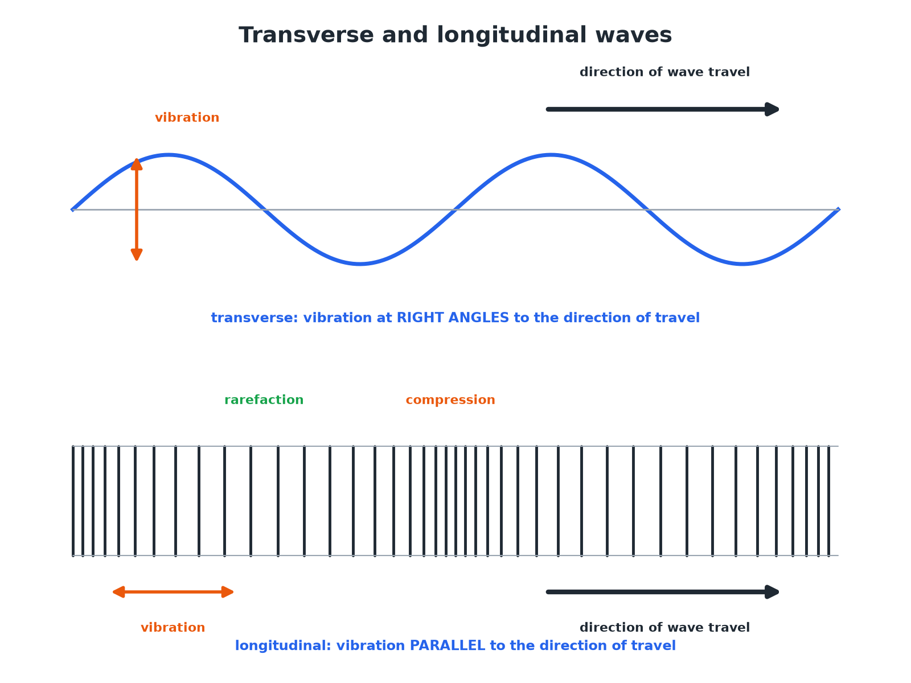

AQA GCSE PHYSICS · PAPER 2 · FOUNDATION & HIGHER
Transverse and Longitudinal Waves
The direction of vibration compared with travel is the key difference.
Waves
openrevise.com
Lesson 1 of 12

Slide 7

AQA GCSE PHYSICS · PAPER 2 · FOUNDATION & HIGHER
Transverse or Longitudinal?
TRANSVERSE
LONGITUDINAL
• Vibrations are at right angles to the direction of travel.
• Examples: ripples on water, electromagnetic waves, waves on a rope.
• Have crests and troughs.
• Vibrations are parallel to the direction of travel.
• Examples: sound waves, P-waves.
• Have compressions and rarefactions.
Waves
openrevise.com
Lesson 1 of 12

Slide 8

AQA GCSE PHYSICS · PAPER 2 · FOUNDATION & HIGHER
Evidence That the Wave Travels
Describe evidence that in water ripples it is the wave, and not the water, that moves.
Float a cork on a pond
As ripples pass, the cork bobs up and down
1
Observe
The cork does not travel along with the wave
2
Conclusion
The water vibrates but does not move with the wave
3
ANSWER
The cork moves up and down in the same place, so the water itself does not travel.
Waves
openrevise.com
Lesson 1 of 12

Slide 9
AQA GCSE PHYSICS · PAPER 2 · FOUNDATION & HIGHER
Sound in Air
Explain why sound waves are longitudinal.
Air particles
Vibrate backwards and forwards in the direction the wave travels
1
Compressions
Regions where the particles are pushed close together
2
Rarefactions
Regions where the particles are spread out
3
ANSWER
Sound is a longitudinal wave with compressions and rarefactions.
Waves
openrevise.com
Lesson 1 of 12

Slide 10

AQA GCSE PHYSICS · PAPER 2 · FOUNDATION & HIGHER
Key Points
Learn these.
Energy, not matter
Waves transfer energy without transferring matter.
Medium
Mechanical waves need a medium; electromagnetic waves do not.
Sound evidence
Particles in air vibrate about fixed positions; smoke in a tube just vibrates back and forth.
Don't say
'The water moves along'. The water just moves up and down.
Waves
openrevise.com
Lesson 1 of 12

Slide 11

AQA GCSE PHYSICS · PAPER 2 · FOUNDATION & HIGHER
Key Terms
Transverse wave
A wave with vibrations at right angles to the direction of travel.
Longitudinal wave
A wave with vibrations parallel to the direction of travel.
Compression
A region where particles are close together.
Rarefaction
A region where particles are spread out.
Medium
The material a wave travels through.
Oscillation
A back-and-forth movement.
Waves
openrevise.com
Lesson 1 of 12

Slide 12

AQA GCSE PHYSICS · PAPER 2 · FOUNDATION & HIGHER
YOUR TASK
8 minutes
Wave Types
Classify each wave as transverse or longitudinal: (a) light (b) sound in air (c) ripples on a pond (d) a wave on a rope shaken up and down.
Is vibration at right angles?
1
Or parallel?
2
WHAT A GOOD ANSWER SHOWS
(a) Transverse (b) Longitudinal (c) Transverse (d) Transverse.
Waves
openrevise.com
Lesson 1 of 12
Notes:
Ask learners to describe the direction of vibration for each.

Slide 13
AQA GCSE PHYSICS · PAPER 2 · FOUNDATION & HIGHER
Can I...?
Define transverse.
Describe the cork evidence.
Define longitudinal.
Say waves transfer energy.
Give examples.
Explain sound in air.
Name compressions and rarefactions.
Draw both wave types.
Waves
openrevise.com
Lesson 1 of 12

Slide 14
AQA GCSE PHYSICS · PAPER 2 · FOUNDATION & HIGHER
Summary & Exam Focus
Transverse: vibrations at right angles; longitudinal: parallel.
Sound is longitudinal; ripples are transverse.
Compressions and rarefactions in longitudinal waves.
The wave, not the medium, travels.
EXAM FOCUS
Describe the difference between a transverse wave and a longitudinal wave. (2 marks)
Direction of vibration relative to the direction of travel.
openrevise.com

Slide 15
AQA GCSE PHYSICS · PAPER 2 · FOUNDATION & HIGHER
Exam Practice: Transverse and longitudinal waves
Answer all questions. Use the mark allocation as a guide to how much to write. · 14 minutes
Question 1 · 2 marks · Describe
Describe the difference between a transverse wave and a longitudinal wave.
Question 2 · 2 marks · State
Give one example of a transverse wave and one example of a longitudinal wave.
Question 3 · 3 marks · Describe
Describe how a longitudinal wave, such as a sound wave, travels through air. Use the words compression and rarefaction.
Waves
openrevise.com
Lesson 1 of 12

Slide 16
AQA GCSE PHYSICS · PAPER 2 · FOUNDATION & HIGHER
Exam Practice: Transverse and longitudinal waves (cont.)
Question 4 · 3 marks · Describe
A cork floats on water. Ripples pass it. Describe what happens to the cork and explain what this shows about the wave.
Question 5 · 3 marks · Explain
Explain why sound cannot travel through a vacuum but light can.
Waves
openrevise.com
Lesson 1 of 12

Slide 17
AQA GCSE PHYSICS · PAPER 2 · FOUNDATION & HIGHER
Question 1 · 2 marks · Describe
“
Describe the difference between a transverse wave and a longitudinal wave.
HOW TO ANSWER IT
Command word: Describe. Worth 2 marks, so plan before writing.
Waves
openrevise.com
Lesson 1 of 12

Slide 18
AQA GCSE PHYSICS · PAPER 2 · FOUNDATION & HIGHER
Question 1 · mark scheme
2 marks available. Award a mark for each point made.
Transverse: at right angles
1 mark
Longitudinal: parallel
1 mark
Waves
openrevise.com
Lesson 1 of 12

Slide 19
AQA GCSE PHYSICS · PAPER 2 · FOUNDATION & HIGHER
Question 2 · 2 marks · State
“
Give one example of a transverse wave and one example of a longitudinal wave.
HOW TO ANSWER IT
Command word: State. Worth 2 marks, so plan before writing.
Waves
openrevise.com
Lesson 1 of 12

Slide 20
AQA GCSE PHYSICS · PAPER 2 · FOUNDATION & HIGHER
Question 2 · mark scheme
2 marks available. Award a mark for each point made.
A transverse wave
1 mark
A longitudinal wave
1 mark
Waves
openrevise.com
Lesson 1 of 12

Slide 21
AQA GCSE PHYSICS · PAPER 2 · FOUNDATION & HIGHER
Question 3 · 3 marks · Describe
“
Describe how a longitudinal wave, such as a sound wave, travels through air. Use the words compression and rarefaction.
HOW TO ANSWER IT
Command word: Describe. Worth 3 marks, so plan before writing.
Waves
openrevise.com
Lesson 1 of 12

Slide 22
AQA GCSE PHYSICS · PAPER 2 · FOUNDATION & HIGHER
Question 3 · mark scheme
3 marks available. Award a mark for each point made.
Particles vibrate parallel to travel
1 mark
Compressions: particles close together
1 mark
Rarefactions: particles spread out
1 mark
Waves
openrevise.com
Lesson 1 of 12

Slide 23
AQA GCSE PHYSICS · PAPER 2 · FOUNDATION & HIGHER
Question 4 · 3 marks · Describe
“
A cork floats on water. Ripples pass it. Describe what happens to the cork and explain what this shows about the wave.
HOW TO ANSWER IT
Command word: Describe. Worth 3 marks, so plan before writing.
Waves
openrevise.com
Lesson 1 of 12

Slide 24
AQA GCSE PHYSICS · PAPER 2 · FOUNDATION & HIGHER
Question 4 · mark scheme
3 marks available. Award a mark for each point made.
Cork moves up and down
1 mark
Cork does not move along with the wave
1 mark
The wave, not the water, travels (energy transferred)
1 mark
Waves
openrevise.com
Lesson 1 of 12

Slide 25
AQA GCSE PHYSICS · PAPER 2 · FOUNDATION & HIGHER
Question 5 · 3 marks · Explain
“
Explain why sound cannot travel through a vacuum but light can.
HOW TO ANSWER IT
Command word: Explain. Worth 3 marks, so plan before writing.
Waves
openrevise.com
Lesson 1 of 12

Slide 26
AQA GCSE PHYSICS · PAPER 2 · FOUNDATION & HIGHER
Question 5 · mark scheme
3 marks available. Award a mark for each point made.
Sound needs a medium or particles
1 mark
No particles in a vacuum
1 mark
Light does not need a medium
1 mark
Waves
openrevise.com
Lesson 1 of 12

