Slide 1
AQA GCSE PHYSICS · PAPER 2 · HIGHER TIER ONLY
Sound waves and hearing
Waves
Lesson 5 of 12
openrevise.com

Slide 2

AQA GCSE PHYSICS · PAPER 2 · HIGHER TIER ONLY
Warm-up
Answer each one, then check.
1
What type of wave is sound?
2
What is frequency?
3
What does a vibration do?
4
Name part of the ear.
5
What is ultrasound?
Waves
openrevise.com
Lesson 5 of 12

Slide 3
AQA GCSE PHYSICS · PAPER 2 · HIGHER TIER ONLY
Warm-up - Answers
What type of wave is sound?
Longitudinal
1
What is frequency?
Waves per second
2
What does a vibration do?
Moves back and forth
3
Name part of the ear.
Ear drum
4
What is ultrasound?
Sound above 20 kHz
5
Waves
openrevise.com
Lesson 5 of 12

Slide 4

AQA GCSE PHYSICS · PAPER 2 · HIGHER TIER ONLY
Learning Objectives
Describe how sound waves can be converted to vibrations in solids, and vice versa.
1
Describe how the ear drum and other parts of the ear convert sound into the sensation of sound.
2
Explain why the conversion only works over a limited frequency range.
3
State the range of normal human hearing: 20 Hz to 20 kHz.
4
Waves
openrevise.com
Lesson 5 of 12

Slide 5

AQA GCSE PHYSICS · PAPER 2 · HIGHER TIER ONLY
SOUND AND HEARING
Sound waves can travel through solids causing vibrations in the solid. In the ear, sound waves make the ear drum and other parts vibrate, giving the sensation of sound.
The range of normal human hearing is from 20 Hz to 20 kHz.
Waves
openrevise.com
Lesson 5 of 12

Slide 6
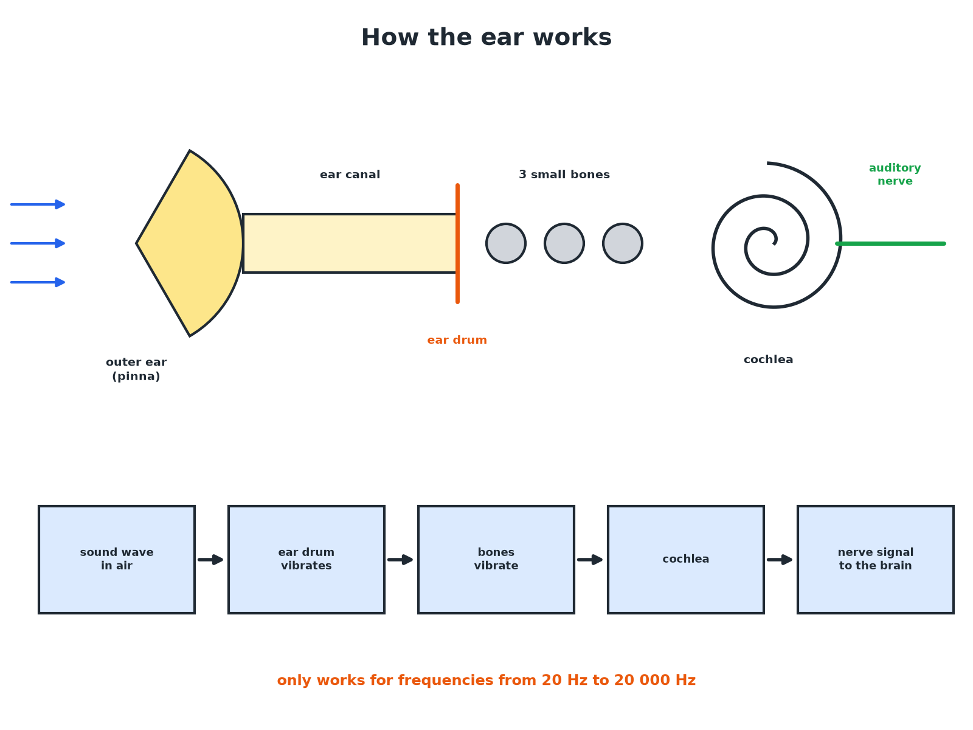

AQA GCSE PHYSICS · PAPER 2 · HIGHER TIER ONLY
How the Ear Works
Each part transfers the vibrations.
Waves
openrevise.com
Lesson 5 of 12

Slide 7

AQA GCSE PHYSICS · PAPER 2 · HIGHER TIER ONLY
Sound to Vibration
Describe how sound waves cause the sensation of hearing.
Sound wave
Compressions and rarefactions reach the ear drum
1
Ear drum
Vibrates at the same frequency as the wave
2
Small bones
Pass the vibrations to the cochlea
3
Cochlea
Converts the vibrations to electrical signals sent to the brain
4
ANSWER
Sound waves make the ear drum vibrate; the vibrations are passed on and converted to nerve impulses.
Waves
openrevise.com
Lesson 5 of 12

Slide 8
AQA GCSE PHYSICS · PAPER 2 · HIGHER TIER ONLY
Limited Range
Explain why humans cannot hear sounds above 20 kHz.
Structure
The ear drum and bones can only vibrate at limited frequencies
1
High frequency
Too fast for them to follow
2
Result
No sensation of sound
3
ANSWER
The parts of the ear cannot vibrate fast enough; the range of hearing is limited.
Waves
openrevise.com
Lesson 5 of 12

Slide 9
AQA GCSE PHYSICS · PAPER 2 · HIGHER TIER ONLY
Other Conversions
Give an example of sound waves being converted to vibrations in a solid.
Sound hits a surface
A wall or window vibrates slightly
1
Microphone
The diaphragm vibrates
2
Loudspeaker
A cone vibrates to make sound waves
3
ANSWER
A sound wave makes a solid vibrate; a vibrating solid makes sound waves.
Waves
openrevise.com
Lesson 5 of 12

Slide 10

AQA GCSE PHYSICS · PAPER 2 · HIGHER TIER ONLY
Key Facts
Learn these numbers.
Hearing range
About 20 Hz to 20 kHz for humans (20 000 Hz).
Infrasound
Below 20 Hz.
Ultrasound
Above 20 kHz.
Age
The upper limit falls with age.
Waves
openrevise.com
Lesson 5 of 12

Slide 11

AQA GCSE PHYSICS · PAPER 2 · HIGHER TIER ONLY
Key Terms
Ear drum
A thin membrane in the ear that vibrates with sound.
Cochlea
A coiled part of the inner ear that turns vibrations into signals.
Frequency range
The span of frequencies a device or ear can respond to.
Infrasound
Sound below 20 Hz.
Ultrasound
Sound above 20 kHz.
Vibration
A repeated back-and-forth movement.
Waves
openrevise.com
Lesson 5 of 12

Slide 12

AQA GCSE PHYSICS · PAPER 2 · HIGHER TIER ONLY
YOUR TASK
8 minutes
Hearing Range
Convert 20 kHz to Hz. A dog whistle produces a sound of 25 kHz. Can a human hear it? Explain.
Compare with 20 Hz to 20 kHz.
1
WHAT A GOOD ANSWER SHOWS
20 kHz = 20 000 Hz. 25 kHz is above the upper limit, so a human cannot hear it (but a dog can).
Waves
openrevise.com
Lesson 5 of 12
Notes:
Ask why old people cannot hear high notes.

Slide 13
AQA GCSE PHYSICS · PAPER 2 · HIGHER TIER ONLY
Can I...?
Describe the ear drum.
Give examples of conversion.
Describe the route in the ear.
Define ultrasound.
State the hearing range.
Define infrasound.
Explain the limited range.
Convert kHz to Hz.
Waves
openrevise.com
Lesson 5 of 12

Slide 14
AQA GCSE PHYSICS · PAPER 2 · HIGHER TIER ONLY
Summary & Exam Focus
Hearing range 20 Hz to 20 kHz.
Ear drum vibrates, then bones, then cochlea.
Only works over a limited frequency range.
Ultrasound is above 20 kHz.
EXAM FOCUS
State the range of normal human hearing. (1 mark)
20 Hz to 20 kHz.
openrevise.com

Slide 15
AQA GCSE PHYSICS · PAPER 2 · HIGHER TIER ONLY
Exam Practice: Sound waves and hearing
Answer all questions. Use the mark allocation as a guide to how much to write. · 12 minutes
Question 1 · 1 mark · State
State the range of frequencies of normal human hearing.
Question 2 · 3 marks · Describe
Describe how sound waves in air are converted into the sensation of sound in the ear.
Question 3 · 3 marks · Explain
Explain why humans cannot hear sounds with a frequency of 30 kHz.
Waves
openrevise.com
Lesson 5 of 12

Slide 16
AQA GCSE PHYSICS · PAPER 2 · HIGHER TIER ONLY
Exam Practice: Sound waves and hearing (cont.)
Question 4 · 2 marks · Describe
A loudspeaker converts electrical signals to sound waves. Describe what happens to the cone.
Question 5 · 2 marks · Calculate
A dog can hear a sound of 40 kHz. Convert 40 kHz to hertz and state whether a human could hear it.
Waves
openrevise.com
Lesson 5 of 12

Slide 17
AQA GCSE PHYSICS · PAPER 2 · HIGHER TIER ONLY
Question 1 · 1 mark · State
“
State the range of frequencies of normal human hearing.
HOW TO ANSWER IT
Command word: State. Worth 1 mark, so plan before writing.
Waves
openrevise.com
Lesson 5 of 12

Slide 18
AQA GCSE PHYSICS · PAPER 2 · HIGHER TIER ONLY
Question 1 · mark scheme
1 mark available. Award a mark for each point made.
20 Hz to 20 kHz
1 mark
Waves
openrevise.com
Lesson 5 of 12

Slide 19
AQA GCSE PHYSICS · PAPER 2 · HIGHER TIER ONLY
Question 2 · 3 marks · Describe
“
Describe how sound waves in air are converted into the sensation of sound in the ear.
HOW TO ANSWER IT
Command word: Describe. Worth 3 marks, so plan before writing.
Waves
openrevise.com
Lesson 5 of 12

Slide 20
AQA GCSE PHYSICS · PAPER 2 · HIGHER TIER ONLY
Question 2 · mark scheme
3 marks available. Award a mark for each point made.
Ear drum vibrates
1 mark
Vibrations passed on through the bones
1 mark
Converted to signals to the brain
1 mark
Waves
openrevise.com
Lesson 5 of 12

Slide 21
AQA GCSE PHYSICS · PAPER 2 · HIGHER TIER ONLY
Question 3 · 3 marks · Explain
“
Explain why humans cannot hear sounds with a frequency of 30 kHz.
HOW TO ANSWER IT
Command word: Explain. Worth 3 marks, so plan before writing.
Waves
openrevise.com
Lesson 5 of 12

Slide 22
AQA GCSE PHYSICS · PAPER 2 · HIGHER TIER ONLY
Question 3 · mark scheme
3 marks available. Award a mark for each point made.
Ear parts vibrate only over a limited range
1 mark
30 kHz is above 20 kHz
1 mark
So no sensation of sound
1 mark
Waves
openrevise.com
Lesson 5 of 12

Slide 23
AQA GCSE PHYSICS · PAPER 2 · HIGHER TIER ONLY
Question 4 · 2 marks · Describe
“
A loudspeaker converts electrical signals to sound waves. Describe what happens to the cone.
HOW TO ANSWER IT
Command word: Describe. Worth 2 marks, so plan before writing.
Waves
openrevise.com
Lesson 5 of 12

Slide 24
AQA GCSE PHYSICS · PAPER 2 · HIGHER TIER ONLY
Question 4 · mark scheme
2 marks available. Award a mark for each point made.
Cone vibrates
1 mark
Produces sound waves in the air
1 mark
Waves
openrevise.com
Lesson 5 of 12

Slide 25
AQA GCSE PHYSICS · PAPER 2 · HIGHER TIER ONLY
Question 5 · 2 marks · Calculate
“
A dog can hear a sound of 40 kHz. Convert 40 kHz to hertz and state whether a human could hear it.
HOW TO ANSWER IT
Command word: Calculate. Worth 2 marks, so plan before writing.
Waves
openrevise.com
Lesson 5 of 12

Slide 26
AQA GCSE PHYSICS · PAPER 2 · HIGHER TIER ONLY
Question 5 · mark scheme
2 marks available. Award a mark for each point made.
40 000 Hz
1 mark
No, above the human limit
1 mark
Waves
openrevise.com
Lesson 5 of 12

