Slide 1
AQA GCSE PHYSICS · PAPER 2 · HIGHER TIER ONLY
Ultrasound and seismic waves
Waves
Lesson 6 of 12
openrevise.com

Slide 2

AQA GCSE PHYSICS · PAPER 2 · HIGHER TIER ONLY
Warm-up
Answer each one, then check.
1
What is an echo?
2
What is the speed equation?
3
What is ultrasound?
4
What causes an earthquake?
5
Is a P-wave longitudinal or transverse?
Waves
openrevise.com
Lesson 6 of 12

Slide 3
AQA GCSE PHYSICS · PAPER 2 · HIGHER TIER ONLY
Warm-up - Answers
What is an echo?
A reflected sound
1
What is the speed equation?
v = s ÷ t
2
What is ultrasound?
Sound with frequency above 20 kHz
3
What causes an earthquake?
Movement of the Earth's tectonic plates
4
Is a P-wave longitudinal or transverse?
Longitudinal
5
Waves
openrevise.com
Lesson 6 of 12

Slide 4

AQA GCSE PHYSICS · PAPER 2 · HIGHER TIER ONLY
Learning Objectives
Explain how ultrasound is partially reflected at boundaries and used for imaging.
1
Use the time taken for an echo to calculate a distance.
2
Describe P-waves and S-waves and how they provide evidence about the Earth's structure.
3
Describe echo sounding.
4
Waves
openrevise.com
Lesson 6 of 12

Slide 5

AQA GCSE PHYSICS · PAPER 2 · HIGHER TIER ONLY
DETECTION AND EXPLORATION
Ultrasound waves are partially reflected when they meet a boundary between two media. The time taken for the echo to return can be used to work out how far away the boundary is.
Seismic waves from earthquakes (P-waves and S-waves) give evidence of the structure of the Earth.
Waves
openrevise.com
Lesson 6 of 12

Slide 6
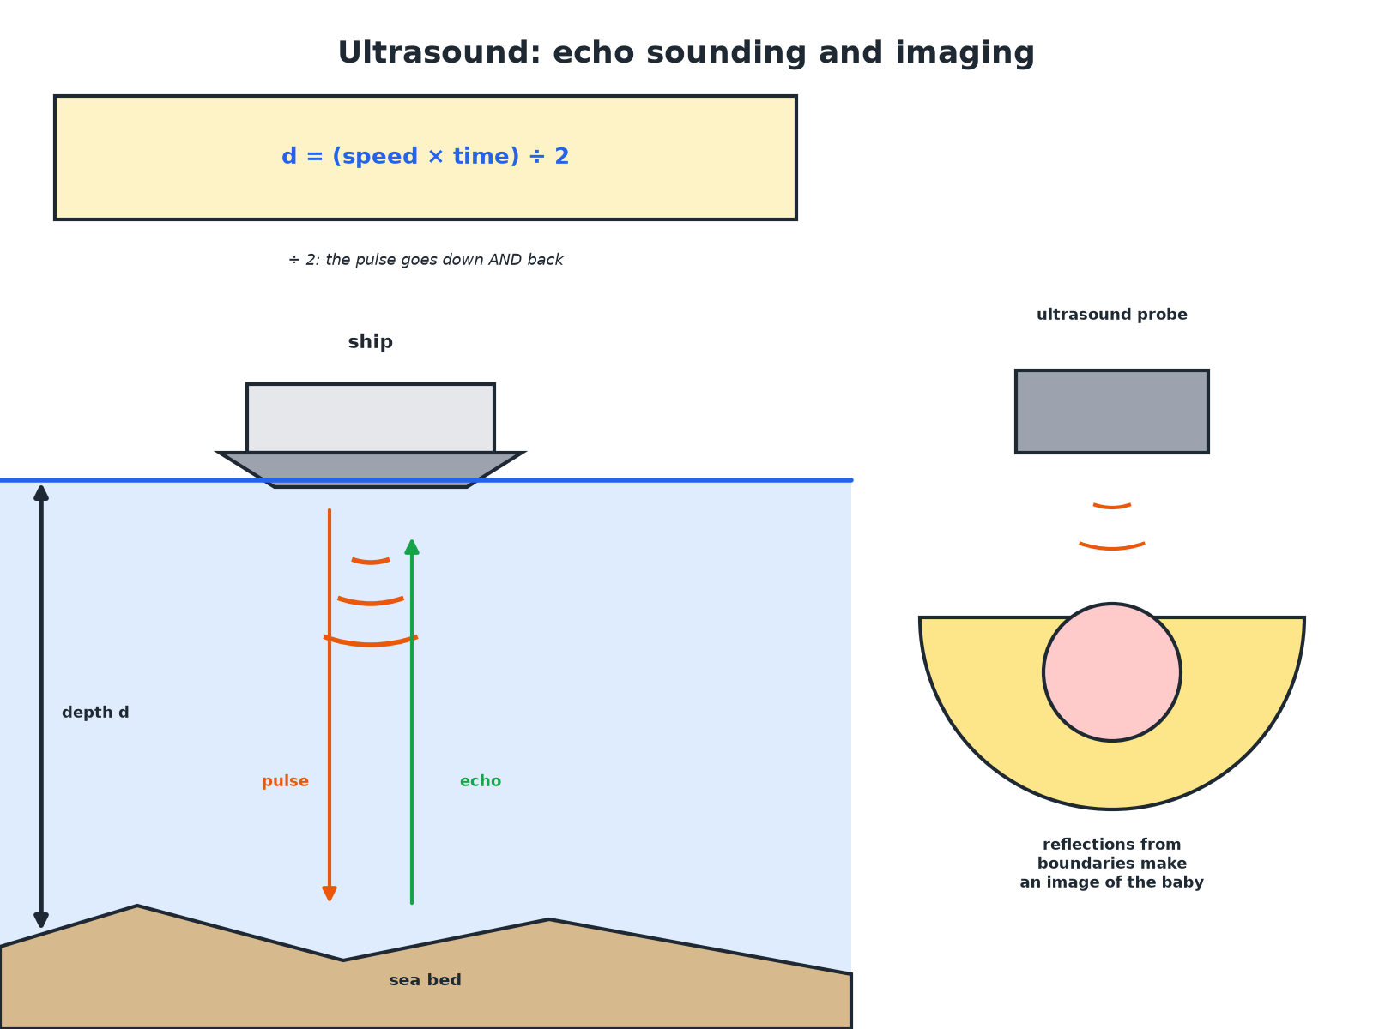

AQA GCSE PHYSICS · PAPER 2 · HIGHER TIER ONLY
Echo Sounding
The pulse travels to the boundary and back.
Waves
openrevise.com
Lesson 6 of 12

Slide 7
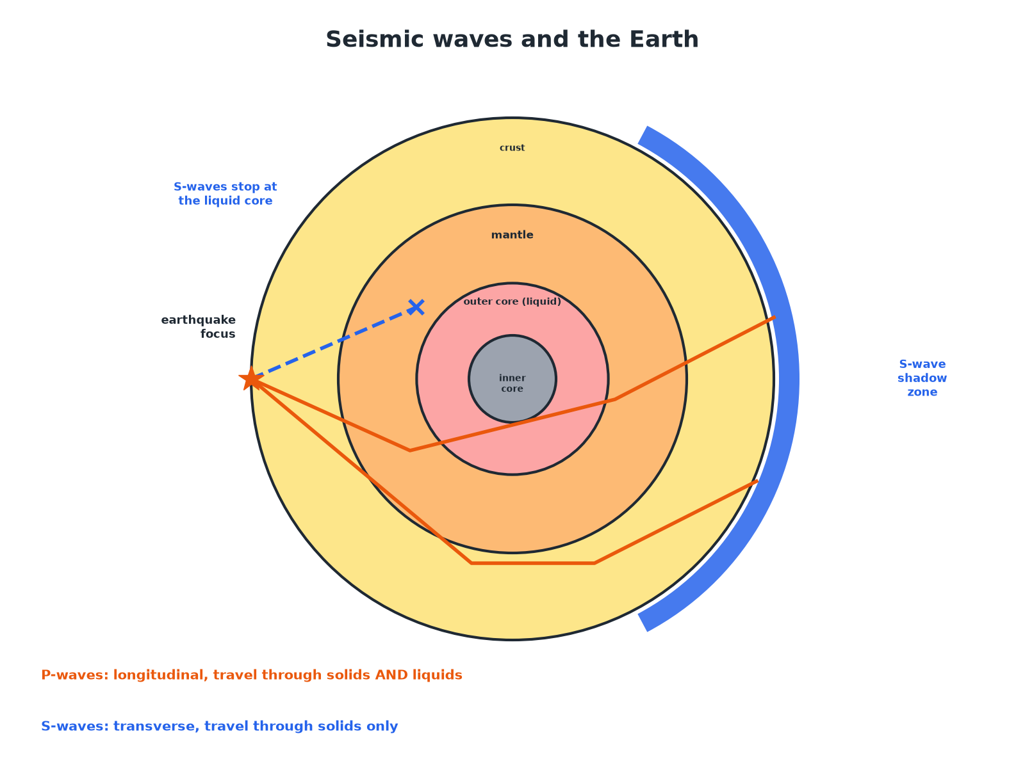
AQA GCSE PHYSICS · PAPER 2 · HIGHER TIER ONLY
Seismic Waves and the Earth
S-waves cannot pass through the liquid outer core.
Waves
openrevise.com
Lesson 6 of 12

Slide 8

AQA GCSE PHYSICS · PAPER 2 · HIGHER TIER ONLY
P-waves and S-waves
P-WAVES
S-WAVES
• Longitudinal seismic waves.
• Travel through solids and liquids.
• Travel faster than S-waves.
• Speed changes between solids and liquids.
• Transverse seismic waves.
• Cannot travel through liquids.
• Travel more slowly.
• Stopped by the liquid outer core.
Waves
openrevise.com
Lesson 6 of 12

Slide 9

AQA GCSE PHYSICS · PAPER 2 · HIGHER TIER ONLY
Echo Sounding
A ship sends an ultrasound pulse down and receives the echo 0.40 s later. The speed of sound in sea water is 1500 m/s. Calculate the depth.
Distance there and back
1500 × 0.40 = 600 m
1
Depth is half of this
600 ÷ 2 = 300 m
2
ANSWER
300 m
Waves
openrevise.com
Lesson 6 of 12

Slide 10
AQA GCSE PHYSICS · PAPER 2 · HIGHER TIER ONLY
Medical Ultrasound
An ultrasound pulse is reflected from a boundary inside the body after 0.000060 s. The speed in tissue is 1500 m/s. Calculate the depth of the boundary.
Total distance
1500 × 0.000060 = 0.090 m
1
Depth
0.090 ÷ 2 = 0.045 m = 4.5 cm
2
ANSWER
4.5 cm
Waves
openrevise.com
Lesson 6 of 12

Slide 11
AQA GCSE PHYSICS · PAPER 2 · HIGHER TIER ONLY
Evidence for the Core
Explain how S-waves give evidence that part of the Earth's core is liquid.
S-waves
Cannot travel through liquids
1
Observation
They are not detected on the far side of the Earth
2
Conclusion
Part of the core (the outer core) must be liquid
3
ANSWER
S-waves are blocked by the outer core, so it must be liquid.
Waves
openrevise.com
Lesson 6 of 12

Slide 12

AQA GCSE PHYSICS · PAPER 2 · HIGHER TIER ONLY
Uses
Other examples.
Medical imaging
Ultrasound scans of foetuses and organs are safe (non-ionising).
Industrial imaging
Ultrasound detects cracks in metal.
Echo sounding
Used for water depth and to detect fish or shipwrecks.
Seismology
New evidence from seismic waves led to discoveries about parts of the Earth that cannot be observed directly.
Waves
openrevise.com
Lesson 6 of 12

Slide 13

AQA GCSE PHYSICS · PAPER 2 · HIGHER TIER ONLY
Key Terms
Ultrasound
Sound with frequency above 20 kHz.
Echo
A reflection of a sound wave.
Seismic wave
A wave produced by an earthquake.
P-wave
A longitudinal seismic wave.
S-wave
A transverse seismic wave that cannot travel through liquids.
Echo sounding
Using reflected sound to find depth.
Waves
openrevise.com
Lesson 6 of 12

Slide 14

AQA GCSE PHYSICS · PAPER 2 · HIGHER TIER ONLY
YOUR TASK
10 minutes
Depth Finder
A boat sends out ultrasound and hears the echo after 0.20 s (speed 1500 m/s). Calculate the depth of the water. Explain why the time must be halved.
Use s = vt.
1
Halve the distance.
2
WHAT A GOOD ANSWER SHOWS
Distance there and back = 1500 × 0.20 = 300 m; depth = 150 m. The pulse travels to the bottom and back.
Waves
openrevise.com
Lesson 6 of 12
Notes:
Ask what would happen if the speed were different.

Slide 15
AQA GCSE PHYSICS · PAPER 2 · HIGHER TIER ONLY
Can I...?
Define ultrasound.
Describe S-waves.
Explain echo timing.
Explain the liquid core.
Calculate depth by echo.
Give uses of ultrasound.
Describe P-waves.
Explain why the time is halved.
Waves
openrevise.com
Lesson 6 of 12

Slide 16
AQA GCSE PHYSICS · PAPER 2 · HIGHER TIER ONLY
Summary & Exam Focus
Ultrasound is partially reflected at boundaries.
Depth = speed × time ÷ 2.
P-waves: longitudinal; S-waves: transverse, not through liquids.
Seismic evidence shows a liquid outer core.
EXAM FOCUS
A ship sends out ultrasound and receives the echo 0.40 s later. The speed is 1500 m/s. Calculate the depth of the sea. (3 marks)
Distance there and back, then halve.
openrevise.com

Slide 17
AQA GCSE PHYSICS · PAPER 2 · HIGHER TIER ONLY
Exam Practice: Ultrasound and seismic waves
Answer all questions. Use the mark allocation as a guide to how much to write. · 16 minutes
Question 1 · 3 marks · Calculate
A ship sends a pulse of ultrasound towards the sea bed and detects the echo 0.40 s later. The speed of sound in sea water is 1500 m/s…
Question 2 · 3 marks · Explain
Explain how ultrasound waves can be used to produce an image of an organ in the body.
Question 3 · 4 marks · Explain
S-waves cannot travel through the Earth's outer core. Explain what this tells scientists about the outer core, and how the properties of…
Waves
openrevise.com
Lesson 6 of 12

Slide 18
AQA GCSE PHYSICS · PAPER 2 · HIGHER TIER ONLY
Exam Practice: Ultrasound and seismic waves (cont.)
Question 4 · 2 marks · State
State two differences between P-waves and S-waves.
Question 5 · 3 marks · Explain
Suggest why ultrasound is used rather than X-rays to scan an unborn baby.
Waves
openrevise.com
Lesson 6 of 12

Slide 19
AQA GCSE PHYSICS · PAPER 2 · HIGHER TIER ONLY
Question 1 · 3 marks · Calculate
“
A ship sends a pulse of ultrasound towards the sea bed and detects the echo 0.40 s later. The speed of sound in sea water is 1500 m/s. Calculate the depth of the sea at this point.
HOW TO ANSWER IT
Command word: Calculate. Worth 3 marks, so plan before writing.
Waves
openrevise.com
Lesson 6 of 12

Slide 20
AQA GCSE PHYSICS · PAPER 2 · HIGHER TIER ONLY
Question 1 · mark scheme
3 marks available. Award a mark for each point made.
Correct substitution
1 mark
600 m
1 mark
300 m (halved)
1 mark
Waves
openrevise.com
Lesson 6 of 12

Slide 21
AQA GCSE PHYSICS · PAPER 2 · HIGHER TIER ONLY
Question 2 · 3 marks · Explain
“
Explain how ultrasound waves can be used to produce an image of an organ in the body.
HOW TO ANSWER IT
Command word: Explain. Worth 3 marks, so plan before writing.
Waves
openrevise.com
Lesson 6 of 12

Slide 22
AQA GCSE PHYSICS · PAPER 2 · HIGHER TIER ONLY
Question 2 · mark scheme
3 marks available. Award a mark for each point made.
Partially reflected at boundaries
1 mark
Time taken for echoes measured
1 mark
Distance calculated and used to form an image
1 mark
Waves
openrevise.com
Lesson 6 of 12

Slide 23
AQA GCSE PHYSICS · PAPER 2 · HIGHER TIER ONLY
Question 3 · 4 marks · Explain
“
S-waves cannot travel through the Earth's outer core. Explain what this tells scientists about the outer core, and how the properties of P-waves give further evidence about the Earth's structure.
HOW TO ANSWER IT
Command word: Explain. Worth 4 marks, so plan before writing.
Waves
openrevise.com
Lesson 6 of 12

Slide 24
AQA GCSE PHYSICS · PAPER 2 · HIGHER TIER ONLY
Question 3 · mark scheme
4 marks available. Award a mark for each point made.
S-waves cannot travel through liquids
1 mark
So the outer core is liquid
1 mark
P-waves travel through solids and liquids at different speeds
1 mark
Changes show boundaries between layers
1 mark
Waves
openrevise.com
Lesson 6 of 12

Slide 25
AQA GCSE PHYSICS · PAPER 2 · HIGHER TIER ONLY
Question 4 · 2 marks · State
“
State two differences between P-waves and S-waves.
HOW TO ANSWER IT
Command word: State. Worth 2 marks, so plan before writing.
Waves
openrevise.com
Lesson 6 of 12

Slide 26
AQA GCSE PHYSICS · PAPER 2 · HIGHER TIER ONLY
Question 4 · mark scheme
2 marks available. Award a mark for each point made.
Longitudinal and transverse
1 mark
A second difference
1 mark
Waves
openrevise.com
Lesson 6 of 12

Slide 27
AQA GCSE PHYSICS · PAPER 2 · HIGHER TIER ONLY
Question 5 · 3 marks · Explain
“
Suggest why ultrasound is used rather than X-rays to scan an unborn baby.
HOW TO ANSWER IT
Command word: Explain. Worth 3 marks, so plan before writing.
Waves
openrevise.com
Lesson 6 of 12

Slide 28
AQA GCSE PHYSICS · PAPER 2 · HIGHER TIER ONLY
Question 5 · mark scheme
3 marks available. Award a mark for each point made.
Ultrasound non-ionising
1 mark
X-rays ionising
1 mark
Could damage cells of the baby
1 mark
Waves
openrevise.com
Lesson 6 of 12

