Slide 1
AQA GCSE PHYSICS · PAPER 2 · FOUNDATION & HIGHER
The electromagnetic spectrum
Waves
Lesson 7 of 12
openrevise.com

Slide 2

AQA GCSE PHYSICS · PAPER 2 · FOUNDATION & HIGHER
Warm-up
Answer each one, then check.
1
What is a wave?
2
What is frequency?
3
Name a colour of the rainbow.
4
What is the speed of light in a vacuum?
5
What type of wave is light?
Waves
openrevise.com
Lesson 7 of 12

Slide 3
AQA GCSE PHYSICS · PAPER 2 · FOUNDATION & HIGHER
Warm-up - Answers
What is a wave?
A way of transferring energy
1
What is frequency?
Number of waves per second
2
Name a colour of the rainbow.
Red, orange, yellow, green, blue, indigo or violet
3
What is the speed of light in a vacuum?
3.0 × 10⁸ m/s
4
What type of wave is light?
Transverse
5
Waves
openrevise.com
Lesson 7 of 12

Slide 4

AQA GCSE PHYSICS · PAPER 2 · FOUNDATION & HIGHER
Learning Objectives
List the seven types of electromagnetic wave in order.
1
State that all EM waves are transverse and travel at the same speed in a vacuum or air.
2
Relate wavelength to frequency across the spectrum.
3
Give examples of energy transfer by EM waves.
4
Waves
openrevise.com
Lesson 7 of 12

Slide 5

AQA GCSE PHYSICS · PAPER 2 · FOUNDATION & HIGHER
THE EM SPECTRUM
Electromagnetic waves are transverse waves that transfer energy from a source to an absorber. They form a continuous spectrum and all travel at the same speed through a vacuum or air.
From long to short wavelength (or low to high frequency): radio, microwave, infrared, visible light (red to violet), ultraviolet, X-rays, gamma rays.
Waves
openrevise.com
Lesson 7 of 12

Slide 6
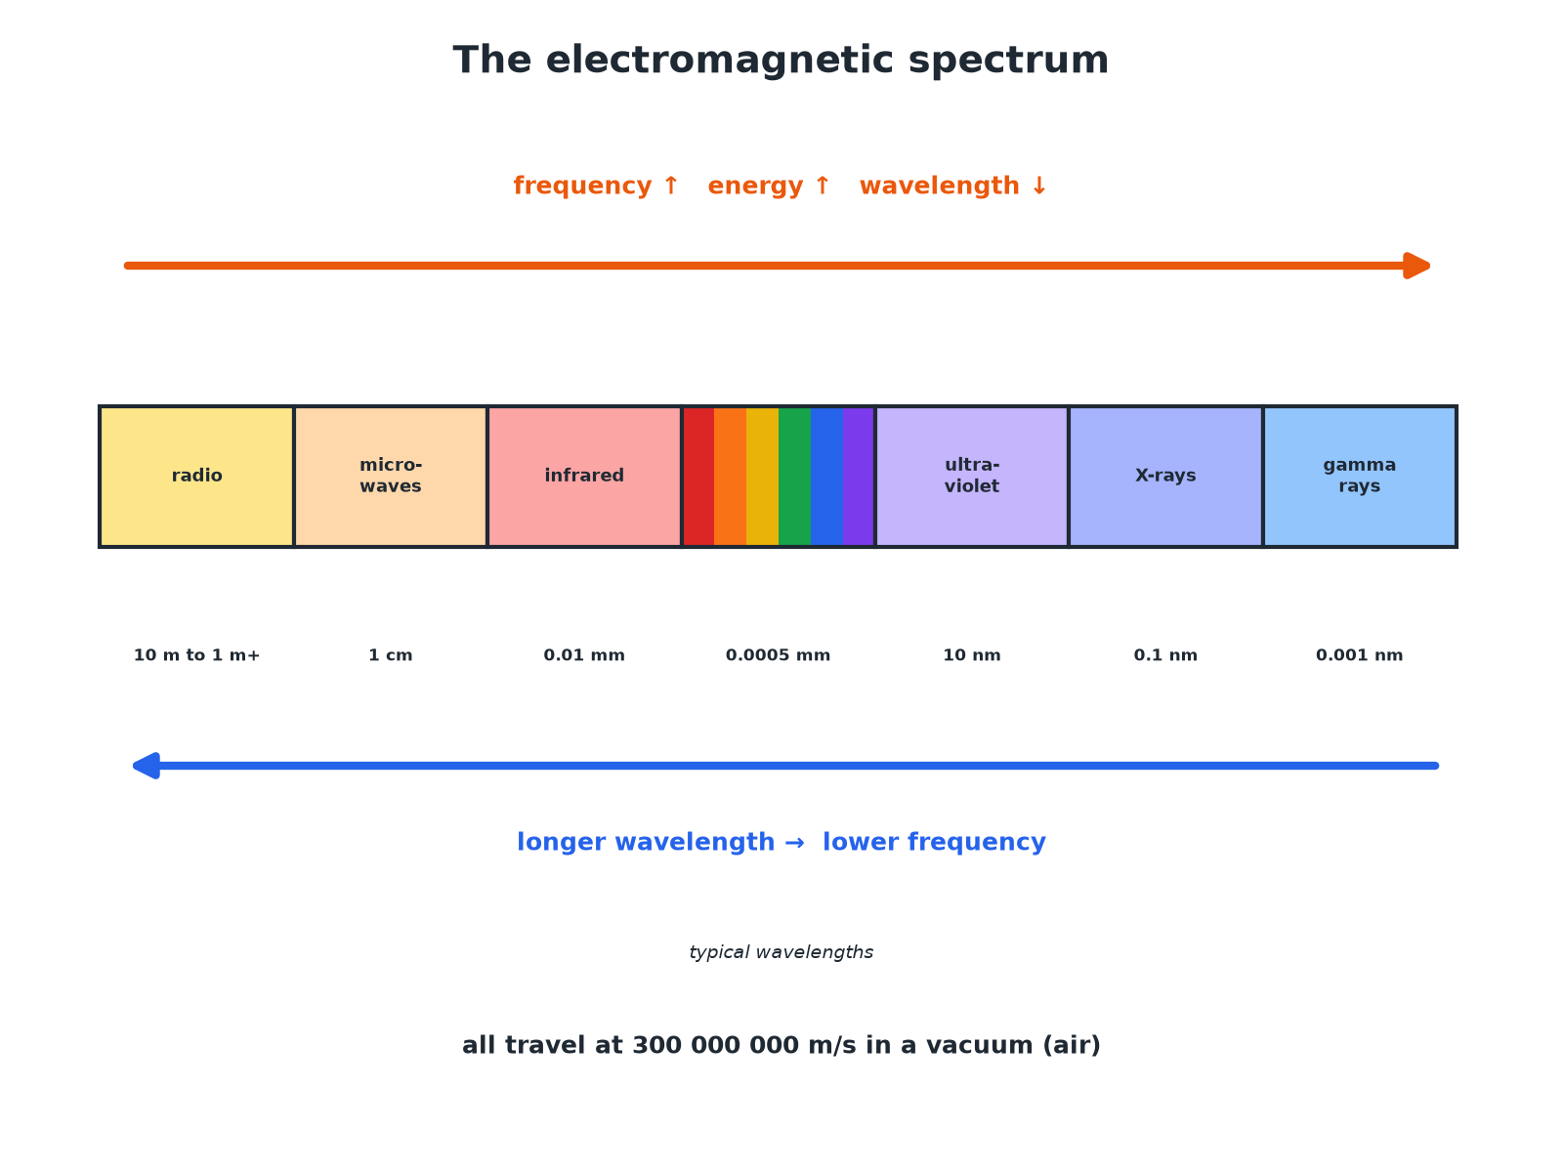

AQA GCSE PHYSICS · PAPER 2 · FOUNDATION & HIGHER
The Electromagnetic Spectrum
Longer wavelength means lower frequency.
Waves
openrevise.com
Lesson 7 of 12

Slide 7

AQA GCSE PHYSICS · PAPER 2 · FOUNDATION & HIGHER
The Seven Groups
Learn the order.
Group
Wavelength
Frequency
Radio waves
Longest
Lowest
Microwaves
Infrared
Visible light (red to violet)
Ultraviolet
X-rays
Gamma rays
Shortest
Highest
Waves
openrevise.com
Lesson 7 of 12

Slide 8

AQA GCSE PHYSICS · PAPER 2 · FOUNDATION & HIGHER
Using the Wave Equation
A radio wave has a frequency of 100 MHz. Calculate its wavelength. Speed of EM waves = 3.0 × 10⁸ m/s.
Convert
100 MHz = 1.0 × 10⁸ Hz
1
Rearrange
λ= v ÷ f
2
Substitute
λ= 3.0 × 10⁸ ÷ 1.0 × 10⁸
3
Answer
λ= 3.0 m
4
ANSWER
3.0 m
Waves
openrevise.com
Lesson 7 of 12

Slide 9
AQA GCSE PHYSICS · PAPER 2 · FOUNDATION & HIGHER
Memory Aid
Give a way to remember the order of the EM spectrum.
Initials
Radio, Microwave, Infrared, Visible, Ultraviolet, X-ray, Gamma
1
Sentence
Rabbits Mate In Very Unusual eXpensive Gardens
2
ANSWER
Use a mnemonic such as 'Rabbits Mate In Very Unusual eXpensive Gardens'.
Waves
openrevise.com
Lesson 7 of 12

Slide 10
AQA GCSE PHYSICS · PAPER 2 · FOUNDATION & HIGHER
Energy Transfer
Give examples that show EM waves transfer energy from a source to an absorber.
Microwaves
Heat food
1
Infrared
Warm your skin from a fire
2
Light
Provides energy to plants and to solar cells
3
Gamma rays
Transfer energy to cells
4
ANSWER
Each wave carries energy from its source to an absorber, where it increases a thermal or other energy store.
Waves
openrevise.com
Lesson 7 of 12

Slide 11

AQA GCSE PHYSICS · PAPER 2 · FOUNDATION & HIGHER
Key Facts
Remember these.
Transverse
All EM waves are transverse.
Same speed
They all travel at 3.0 × 10⁸ m/s in a vacuum.
Continuous
There are no gaps between the groups.
Our eyes
Detect only visible light, a limited range of the spectrum.
Waves
openrevise.com
Lesson 7 of 12

Slide 12

AQA GCSE PHYSICS · PAPER 2 · FOUNDATION & HIGHER
Key Terms
Electromagnetic wave
A transverse wave that can travel through a vacuum.
Spectrum
A continuous range of wavelengths or frequencies.
Radio wave
The electromagnetic wave with the longest wavelength.
Gamma ray
The electromagnetic wave with the shortest wavelength.
Visible light
The part of the spectrum our eyes detect.
Absorber
An object that takes in the energy of a wave.
Waves
openrevise.com
Lesson 7 of 12

Slide 13

AQA GCSE PHYSICS · PAPER 2 · FOUNDATION & HIGHER
YOUR TASK
8 minutes
Order the Waves
Put these in order of increasing frequency: X-rays, radio waves, visible light, microwaves, gamma rays, infrared, ultraviolet.
Use the mnemonic.
1
WHAT A GOOD ANSWER SHOWS
Radio waves, microwaves, infrared, visible light, ultraviolet, X-rays, gamma rays.
Waves
openrevise.com
Lesson 7 of 12
Notes:
Ask which has the highest energy.

Slide 14
AQA GCSE PHYSICS · PAPER 2 · FOUNDATION & HIGHER
Can I...?
List the EM spectrum in order.
Use v = fλ for EM waves.
Say they are transverse.
Name the visible colours.
State the common speed.
Say eyes detect only visible light.
Link wavelength and frequency.
Give an example of energy transfer.
Waves
openrevise.com
Lesson 7 of 12

Slide 15
AQA GCSE PHYSICS · PAPER 2 · FOUNDATION & HIGHER
Summary & Exam Focus
Order: radio, microwave, infrared, visible, ultraviolet, X-rays, gamma.
All are transverse and travel at the same speed in a vacuum.
Wavelength decreases as frequency increases.
Eyes detect only visible light.
EXAM FOCUS
List the electromagnetic waves in order of increasing frequency, starting with radio waves. (2 marks)
Radio, microwave, infrared, visible, ultraviolet, X-ray, gamma.
openrevise.com

Slide 16
AQA GCSE PHYSICS · PAPER 2 · FOUNDATION & HIGHER
Exam Practice: The electromagnetic spectrum
Answer all questions. Use the mark allocation as a guide to how much to write. · 14 minutes
Question 1 · 2 marks · Complete
The electromagnetic spectrum is shown in order of increasing frequency. Radio waves, microwaves, infrared, visible light, ___, X-rays…
Question 2 · 3 marks · Use the diagram
The diagram shows the electromagnetic spectrum with some waves missing. (a) Name the waves labelled A and B. (b) State one property that…
Question 3 · 3 marks · Calculate
A radio wave has a frequency of 100 MHz. The speed of electromagnetic waves in air is 3.0 × 10⁸ m/s. Calculate the wavelength. (1 MHz = 10⁶…
Waves
openrevise.com
Lesson 7 of 12

Slide 17
AQA GCSE PHYSICS · PAPER 2 · FOUNDATION & HIGHER
Exam Practice: The electromagnetic spectrum (cont.)
Question 4 · 2 marks · State
State two properties that are the same for all electromagnetic waves.
Question 5 · 3 marks · Explain
Gamma rays have a much higher frequency than radio waves. Explain why their wavelength is much shorter.
Waves
openrevise.com
Lesson 7 of 12

Slide 18
AQA GCSE PHYSICS · PAPER 2 · FOUNDATION & HIGHER
Question 1 · 2 marks · Complete
“
The electromagnetic spectrum is shown in order of increasing frequency. Radio waves, microwaves, infrared, visible light, ___, X-rays, gamma rays. Name the missing wave.
HOW TO ANSWER IT
Command word: Complete. Worth 2 marks, so plan before writing.
Waves
openrevise.com
Lesson 7 of 12

Slide 19
AQA GCSE PHYSICS · PAPER 2 · FOUNDATION & HIGHER
Question 1 · mark scheme
2 marks available. Award a mark for each point made.
Ultraviolet
1 mark
Correct position in order
1 mark
Waves
openrevise.com
Lesson 7 of 12

Slide 20
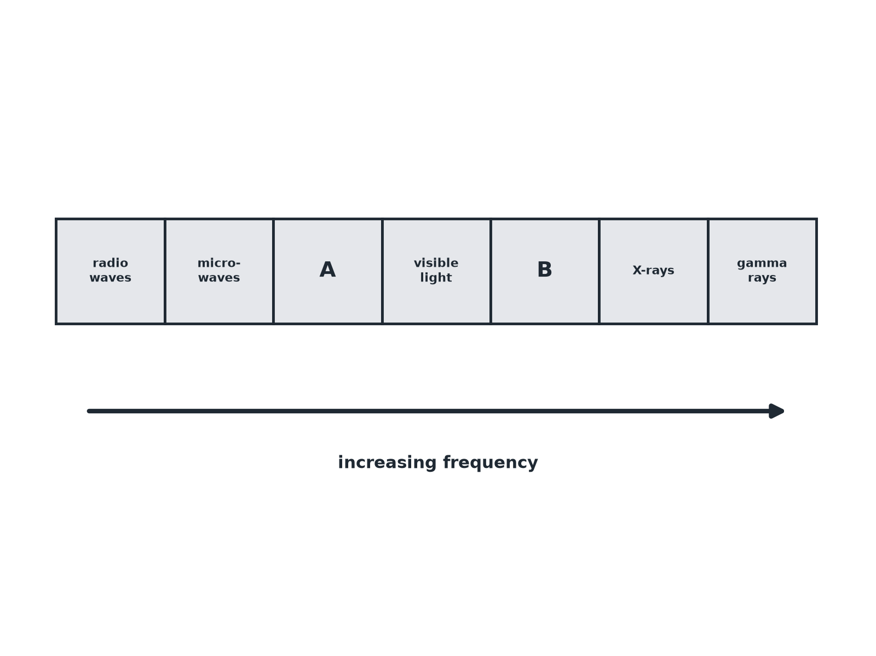
AQA GCSE PHYSICS · PAPER 2 · FOUNDATION & HIGHER
Question 2 · 3 marks · Use the diagram
The diagram shows the electromagnetic spectrum with some waves missing. (a) Name the waves labelled A and B. (b) State one property that all electromagnetic waves have. (3 marks)
Waves
openrevise.com
Lesson 7 of 12

Slide 21
AQA GCSE PHYSICS · PAPER 2 · FOUNDATION & HIGHER
Question 2 · mark scheme
3 marks available. Award a mark for each point made.
A: infrared
1 mark
B: ultraviolet
1 mark
A common property
1 mark
Waves
openrevise.com
Lesson 7 of 12

Slide 22
AQA GCSE PHYSICS · PAPER 2 · FOUNDATION & HIGHER
Question 3 · 3 marks · Calculate
“
A radio wave has a frequency of 100 MHz. The speed of electromagnetic waves in air is 3.0 × 10⁸ m/s. Calculate the wavelength. (1 MHz = 10⁶ Hz)
HOW TO ANSWER IT
Command word: Calculate. Worth 3 marks, so plan before writing.
Waves
openrevise.com
Lesson 7 of 12

Slide 23
AQA GCSE PHYSICS · PAPER 2 · FOUNDATION & HIGHER
Question 3 · mark scheme
3 marks available. Award a mark for each point made.
Converts to 1.0 × 10⁸ Hz
1 mark
Correct substitution
1 mark
3.0 m
1 mark
Waves
openrevise.com
Lesson 7 of 12

Slide 24
AQA GCSE PHYSICS · PAPER 2 · FOUNDATION & HIGHER
Question 4 · 2 marks · State
“
State two properties that are the same for all electromagnetic waves.
HOW TO ANSWER IT
Command word: State. Worth 2 marks, so plan before writing.
Waves
openrevise.com
Lesson 7 of 12

Slide 25
AQA GCSE PHYSICS · PAPER 2 · FOUNDATION & HIGHER
Question 4 · mark scheme
2 marks available. Award a mark for each point made.
Transverse waves
1 mark
Same speed in a vacuum
1 mark
Waves
openrevise.com
Lesson 7 of 12

Slide 26
AQA GCSE PHYSICS · PAPER 2 · FOUNDATION & HIGHER
Question 5 · 3 marks · Explain
“
Gamma rays have a much higher frequency than radio waves. Explain why their wavelength is much shorter.
HOW TO ANSWER IT
Command word: Explain. Worth 3 marks, so plan before writing.
Waves
openrevise.com
Lesson 7 of 12

Slide 27
AQA GCSE PHYSICS · PAPER 2 · FOUNDATION & HIGHER
Question 5 · mark scheme
3 marks available. Award a mark for each point made.
Same speed
1 mark
v = fλ
1 mark
Higher frequency means shorter wavelength
1 mark
Waves
openrevise.com
Lesson 7 of 12

