Slide 1
AQA GCSE PHYSICS · PAPER 2 · FOUNDATION & HIGHER
Properties and hazards of electromagnetic waves
Waves
Lesson 8 of 12
openrevise.com

Slide 2

AQA GCSE PHYSICS · PAPER 2 · FOUNDATION & HIGHER
Warm-up
Answer each one, then check.
1
What is ionising radiation?
2
What is an alternating current?
3
Where do gamma rays come from?
4
What is a mutation?
5
What is radiation dose measured in?
Waves
openrevise.com
Lesson 8 of 12

Slide 3
AQA GCSE PHYSICS · PAPER 2 · FOUNDATION & HIGHER
Warm-up - Answers
What is ionising radiation?
Radiation that can remove electrons from atoms
1
What is an alternating current?
A current that changes direction repeatedly
2
Where do gamma rays come from?
The nucleus of an atom
3
What is a mutation?
A change in the DNA of a cell
4
What is radiation dose measured in?
Sieverts (Sv)
5
Waves
openrevise.com
Lesson 8 of 12

Slide 4

AQA GCSE PHYSICS · PAPER 2 · FOUNDATION & HIGHER
Learning Objectives
Explain that changes in atoms and nuclei can produce and absorb electromagnetic waves.
1
Explain how radio waves are produced and detected (Higher tier).
2
Describe the hazardous effects of ultraviolet, X-rays and gamma rays.
3
Use data on radiation dose to draw conclusions about risk.
4
Waves
openrevise.com
Lesson 8 of 12

Slide 5

AQA GCSE PHYSICS · PAPER 2 · FOUNDATION & HIGHER
PRODUCTION AND HAZARDS
Changes in atoms and in the nuclei of atoms can result in electromagnetic waves being generated or absorbed over a wide frequency range. Gamma rays originate from changes in the nucleus.
Ultraviolet, X-rays and gamma rays can have hazardous effects on body tissue. The effects depend on the type of radiation and the size of the dose.
Waves
openrevise.com
Lesson 8 of 12

Slide 6
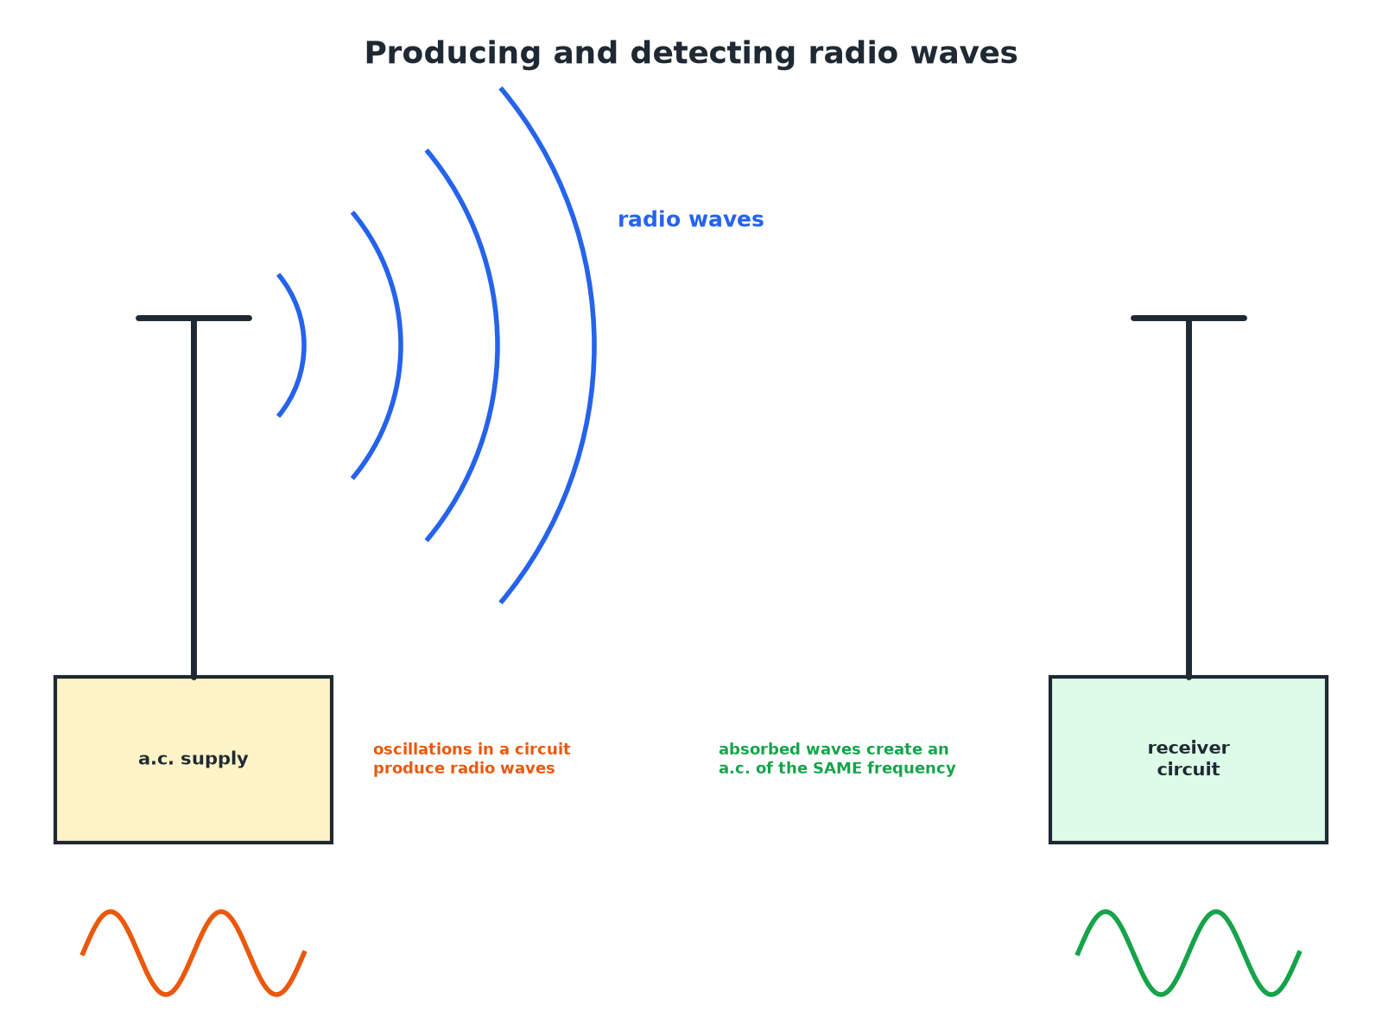

AQA GCSE PHYSICS · PAPER 2 · FOUNDATION & HIGHER
Radio Waves: Producing and Detecting (Higher)
The received current has the same frequency as the wave.
Waves
openrevise.com
Lesson 8 of 12

Slide 7
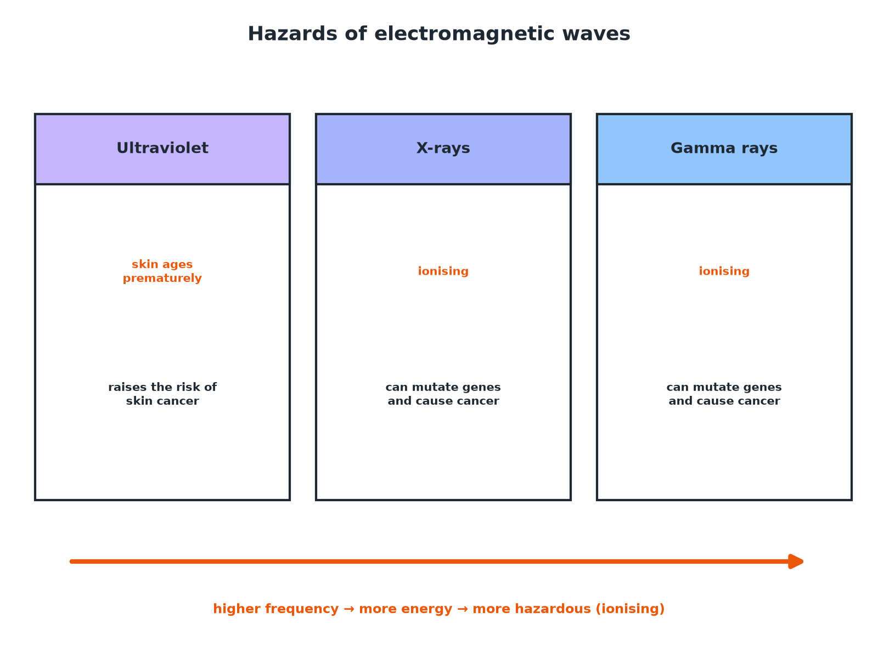
AQA GCSE PHYSICS · PAPER 2 · FOUNDATION & HIGHER
Hazards of Electromagnetic Waves
Higher frequency waves carry more energy and can ionise.
Waves
openrevise.com
Lesson 8 of 12

Slide 8

AQA GCSE PHYSICS · PAPER 2 · FOUNDATION & HIGHER
Hazards
Learn the effects.
Radiation
Hazardous effect
Ultraviolet
Premature skin ageing; increased risk of skin cancer; eye damage
X-rays
Ionising: can mutate genes and cause cancer
Gamma rays
Ionising: can mutate genes and cause cancer
Waves
openrevise.com
Lesson 8 of 12

Slide 9

AQA GCSE PHYSICS · PAPER 2 · FOUNDATION & HIGHER
Producing Radio Waves (Higher)
Explain how radio waves are produced and how they can be detected.
Transmitter
Oscillations (an alternating current) in an electrical circuit produce radio waves
1
Receiver
When radio waves are absorbed by an aerial, they create an alternating current in the circuit
2
Frequency
The current has the same frequency as the radio wave
3
ANSWER
An alternating current produces radio waves; absorbed waves produce an alternating current of the same frequency.
Waves
openrevise.com
Lesson 8 of 12

Slide 10
AQA GCSE PHYSICS · PAPER 2 · FOUNDATION & HIGHER
Risk and Dose
A chest X-ray gives a dose of 0.02 mSv and a CT scan of the chest gives 7 mSv. Compare the doses.
Ratio
7 ÷ 0.02 = 350
1
Comparison
The CT scan gives 350 times the dose
2
ANSWER
The CT scan gives a dose 350 times greater, so a greater risk.
Waves
openrevise.com
Lesson 8 of 12

Slide 11
AQA GCSE PHYSICS · PAPER 2 · FOUNDATION & HIGHER
Sources of EM Waves
Explain where gamma rays come from.
Nucleus
An unstable nucleus changes to become more stable
1
Emission
It emits gamma radiation
2
Atoms
Changes in electron energy levels produce other parts of the spectrum
3
ANSWER
Gamma rays are emitted by changes in the nucleus of an atom.
Waves
openrevise.com
Lesson 8 of 12

Slide 12

AQA GCSE PHYSICS · PAPER 2 · FOUNDATION & HIGHER
Dose
Radiation dose units.
Sievert
Dose is measured in sieverts (Sv); 1000 mSv = 1 Sv.
What it shows
A measure of the risk of harm from exposure.
Depends on
The type of radiation and the size of the dose.
No need to recall
You do not need to recall the unit of dose.
Waves
openrevise.com
Lesson 8 of 12

Slide 13

AQA GCSE PHYSICS · PAPER 2 · FOUNDATION & HIGHER
Key Terms
Ionising radiation
Radiation that can remove electrons from atoms.
Radiation dose
A measure of the risk of harm from exposure to radiation.
Sievert
The unit of radiation dose.
Millisievert
One thousandth of a sievert.
Mutation
A change in the genes of a cell.
Aerial
A device that transmits or receives radio waves.
Waves
openrevise.com
Lesson 8 of 12

Slide 14

AQA GCSE PHYSICS · PAPER 2 · FOUNDATION & HIGHER
YOUR TASK
10 minutes
Compare the Doses
A dental X-ray gives 0.005 mSv and a flight from London to New York gives about 0.08 mSv. Calculate how many dental X-rays have the same dose as the flight. Do you think the risk is large?
Divide the doses.
1
Comment on the size.
2
WHAT A GOOD ANSWER SHOWS
0.08 ÷ 0.005 = 16 dental X-rays. Both doses are very small, so the risk is small.
Waves
openrevise.com
Lesson 8 of 12
Notes:
Discuss benefit versus risk.

Slide 15
AQA GCSE PHYSICS · PAPER 2 · FOUNDATION & HIGHER
Can I...?
Explain how gamma rays are produced.
Name hazards of X-rays.
Explain how radio waves are produced.
Define radiation dose.
Explain how radio waves are detected.
Compare doses.
Name hazards of UV.
Draw conclusions from data.
Waves
openrevise.com
Lesson 8 of 12

Slide 16
AQA GCSE PHYSICS · PAPER 2 · FOUNDATION & HIGHER
Summary & Exam Focus
UV: premature ageing and skin cancer.
X-rays and gamma rays: ionising; can mutate genes and cause cancer.
Radio waves produced by oscillations in circuits (Higher).
Dose measured in sieverts.
EXAM FOCUS
State one hazard of exposure to ultraviolet radiation. (1 mark)
Skin cancer or premature skin ageing.
openrevise.com

Slide 17
AQA GCSE PHYSICS · PAPER 2 · FOUNDATION & HIGHER
Exam Practice: Properties and hazards of electromagnetic waves
Answer all questions. Use the mark allocation as a guide to how much to write. · 14 minutes
Question 1 · 2 marks · State
Give two hazards of exposure to ultraviolet radiation.
Question 2 · 3 marks · Explain
X-rays and gamma rays are described as ionising radiation. Explain why they are a hazard to human health.
Question 3 · 4 marks · Use the chart
The chart shows the radiation dose a patient receives from different medical procedures. (a) Which procedure gives the greatest dose? (b)…
Waves
openrevise.com
Lesson 8 of 12

Slide 18
AQA GCSE PHYSICS · PAPER 2 · FOUNDATION & HIGHER
Exam Practice: Properties and hazards of electromagnetic waves (cont.)
Question 4 · 3 marks · Explain
Explain how radio waves are produced in a transmitter and how they can be detected by a receiver.
Question 5 · 1 mark · State
State where gamma rays originate.
Waves
openrevise.com
Lesson 8 of 12

Slide 19
AQA GCSE PHYSICS · PAPER 2 · FOUNDATION & HIGHER
Question 1 · 2 marks · State
“
Give two hazards of exposure to ultraviolet radiation.
HOW TO ANSWER IT
Command word: State. Worth 2 marks, so plan before writing.
Waves
openrevise.com
Lesson 8 of 12

Slide 20
AQA GCSE PHYSICS · PAPER 2 · FOUNDATION & HIGHER
Question 1 · mark scheme
2 marks available. Award a mark for each point made.
First hazard
1 mark
Second hazard
1 mark
Waves
openrevise.com
Lesson 8 of 12

Slide 21
AQA GCSE PHYSICS · PAPER 2 · FOUNDATION & HIGHER
Question 2 · 3 marks · Explain
“
X-rays and gamma rays are described as ionising radiation. Explain why they are a hazard to human health.
HOW TO ANSWER IT
Command word: Explain. Worth 3 marks, so plan before writing.
Waves
openrevise.com
Lesson 8 of 12

Slide 22
AQA GCSE PHYSICS · PAPER 2 · FOUNDATION & HIGHER
Question 2 · mark scheme
3 marks available. Award a mark for each point made.
Ionising: remove electrons
1 mark
Damage or mutate genes or cells
1 mark
Can cause cancer
1 mark
Waves
openrevise.com
Lesson 8 of 12

Slide 23
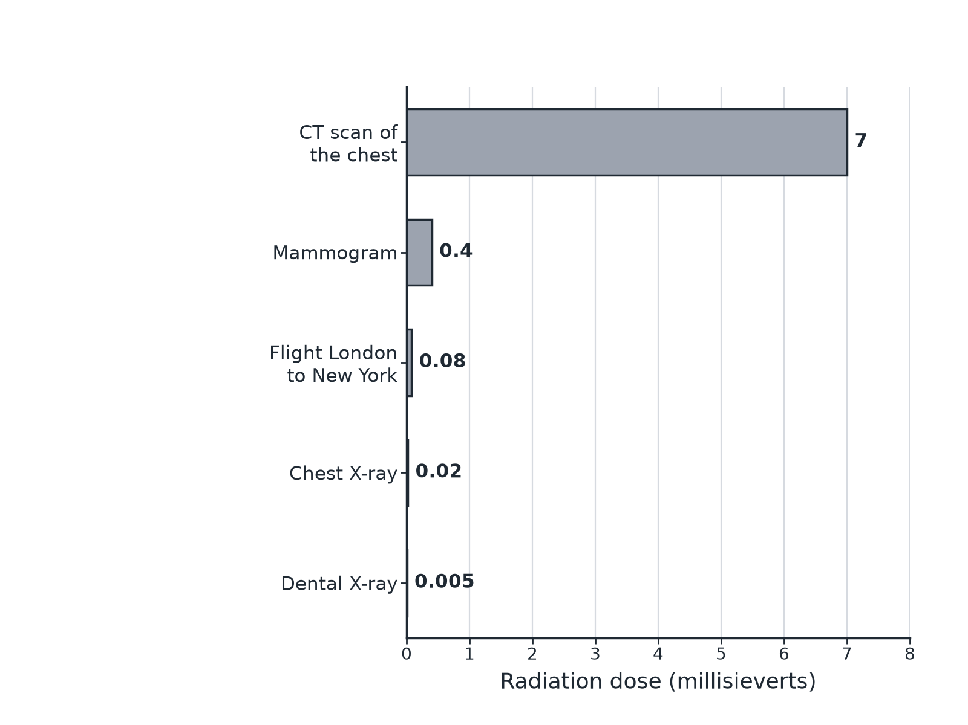
AQA GCSE PHYSICS · PAPER 2 · FOUNDATION & HIGHER
Question 3 · 4 marks · Use the chart
The chart shows the radiation dose a patient receives from different medical procedures. (a) Which procedure gives the greatest dose? (b) Calculate how many times greater the dose from a chest CT scan is than from a chest X-ray. (c) Suggest why a doctor might still use a CT scan. (4 marks)
Waves
openrevise.com
Lesson 8 of 12

Slide 24
AQA GCSE PHYSICS · PAPER 2 · FOUNDATION & HIGHER
Question 3 · mark scheme
4 marks available. Award a mark for each point made.
Chest CT scan
1 mark
7 ÷ 0.02
1 mark
350 times
1 mark
Benefit outweighs risk or more information
1 mark
Waves
openrevise.com
Lesson 8 of 12

Slide 25
AQA GCSE PHYSICS · PAPER 2 · FOUNDATION & HIGHER
Question 4 · 3 marks · Explain
“
Explain how radio waves are produced in a transmitter and how they can be detected by a receiver.
HOW TO ANSWER IT
Command word: Explain. Worth 3 marks, so plan before writing.
Waves
openrevise.com
Lesson 8 of 12

Slide 26
AQA GCSE PHYSICS · PAPER 2 · FOUNDATION & HIGHER
Question 4 · mark scheme
3 marks available. Award a mark for each point made.
Oscillations in a circuit produce radio waves
1 mark
Waves absorbed by the aerial
1 mark
Produces an alternating current of the same frequency
1 mark
Waves
openrevise.com
Lesson 8 of 12

Slide 27
AQA GCSE PHYSICS · PAPER 2 · FOUNDATION & HIGHER
Question 5 · 1 mark · State
“
State where gamma rays originate.
HOW TO ANSWER IT
Command word: State. Worth 1 mark, so plan before writing.
Waves
openrevise.com
Lesson 8 of 12

Slide 28
AQA GCSE PHYSICS · PAPER 2 · FOUNDATION & HIGHER
Question 5 · mark scheme
1 mark available. Award a mark for each point made.
The nucleus
1 mark
Waves
openrevise.com
Lesson 8 of 12

