Slide 1
AQA GCSE PHYSICS · PAPER 2 · FOUNDATION & HIGHER
Uses of electromagnetic waves
Waves
Lesson 9 of 12
openrevise.com

Slide 2

AQA GCSE PHYSICS · PAPER 2 · FOUNDATION & HIGHER
Warm-up
Answer each one, then check.
1
Name a type of EM wave.
2
Which EM waves are ionising?
3
What is a satellite?
4
What is fibre optics?
5
What does a remote control use?
Waves
openrevise.com
Lesson 9 of 12

Slide 3
AQA GCSE PHYSICS · PAPER 2 · FOUNDATION & HIGHER
Warm-up - Answers
Name a type of EM wave.
Radio, microwave, infrared, visible, ultraviolet, X-ray or gamma
1
Which EM waves are ionising?
X-rays and gamma rays (and some UV)
2
What is a satellite?
An object that orbits a planet
3
What is fibre optics?
Thin glass fibres that carry light signals
4
What does a remote control use?
Infrared
5
Waves
openrevise.com
Lesson 9 of 12

Slide 4

AQA GCSE PHYSICS · PAPER 2 · FOUNDATION & HIGHER
Learning Objectives
Give uses of radio waves, microwaves, infrared, visible light, ultraviolet, X-rays and gamma rays.
1
Give brief explanations of why each wave is suitable for its use (Higher tier).
2
Waves
openrevise.com
Lesson 9 of 12

Slide 5

AQA GCSE PHYSICS · PAPER 2 · FOUNDATION & HIGHER
USES OF EM WAVES
Electromagnetic waves have many practical applications. Each type is suited to its use by its wavelength and how it interacts with matter.
Radio: TV and radio. Microwaves: satellite communications, cooking. Infrared: heaters, cooking, cameras. Visible: fibre optics. Ultraviolet: lamps, tanning. X-rays and gamma rays: medical imaging and treatment.
Waves
openrevise.com
Lesson 9 of 12

Slide 6
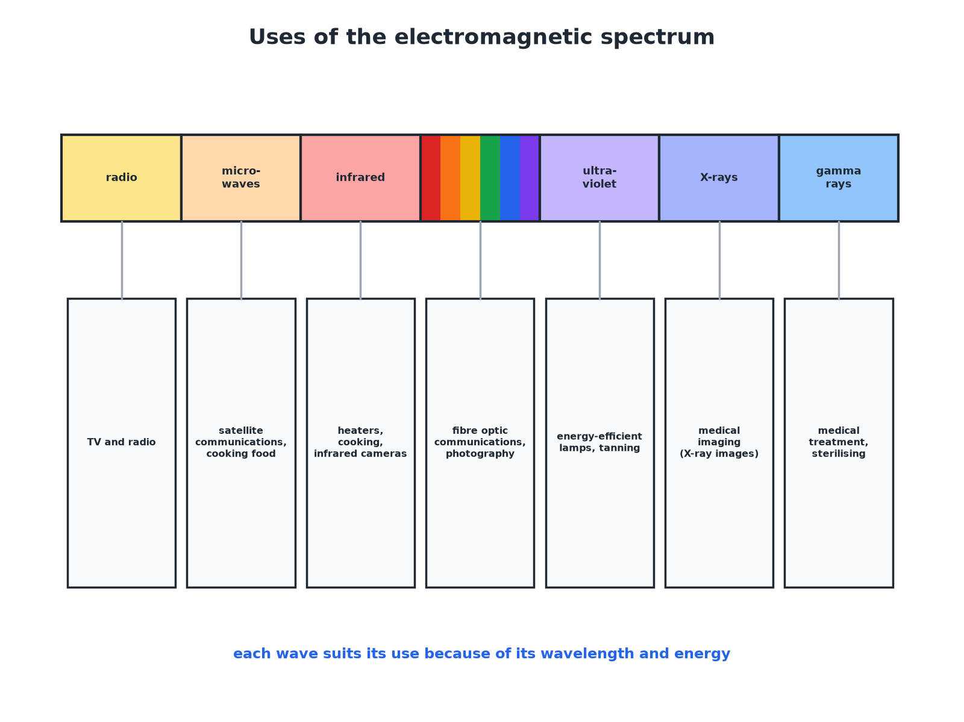

AQA GCSE PHYSICS · PAPER 2 · FOUNDATION & HIGHER
Uses of the Electromagnetic Spectrum
Each wave suits its use because of its wavelength and energy.
Waves
openrevise.com
Lesson 9 of 12

Slide 7

AQA GCSE PHYSICS · PAPER 2 · FOUNDATION & HIGHER
Uses and Why They Suit
Higher tier explanations in the last column.
Wave
Uses
Why suitable
Radio waves
Television and radio
Long wavelength, so they can travel long distances and diffract round obstacles
Microwaves
Satellite communications; cooking
Pass through the atmosphere; absorbed by water molecules to heat food
Infrared
Heaters, cooking, infrared cameras
Absorbed by surfaces, warming them; emitted by warm objects
Visible light
Fibre optic communications
Reflects along glass fibres by total internal reflection; is not absorbed much
Ultraviolet
Energy-efficient lamps; sun tanning
Makes a coating glow with visible light; causes skin to darken
X-rays
Medical imaging
Pass through soft tissue but are absorbed by bone
Gamma rays
Medical treatments and sterilising
Penetrating; ionising so they kill cells or bacteria
Waves
openrevise.com
Lesson 9 of 12

Slide 8

AQA GCSE PHYSICS · PAPER 2 · FOUNDATION & HIGHER
Why Microwaves for Satellites
Explain why microwaves are used for satellite communication.
Penetration
They pass through the atmosphere without being absorbed or reflected much
1
Direction
They can be sent in a narrow beam
2
Result
Signals reach satellites and come back to Earth
3
ANSWER
Microwaves can pass through the atmosphere to a satellite and back.
Waves
openrevise.com
Lesson 9 of 12

Slide 9
AQA GCSE PHYSICS · PAPER 2 · FOUNDATION & HIGHER
Why X-rays for Bones
Explain why X-rays are used to image broken bones.
Soft tissue
Transmits X-rays, so they pass through to the detector
1
Bone
Absorbs X-rays, leaving a shadow
2
Image
The bone shows white or dark on the image
3
ANSWER
Bone absorbs more X-rays than soft tissue, so it shows on the image.
Waves
openrevise.com
Lesson 9 of 12

Slide 10
AQA GCSE PHYSICS · PAPER 2 · FOUNDATION & HIGHER
Why Gamma Rays for Treatment
Explain why gamma rays can be used to treat cancer.
Penetrating
They reach tumours inside the body
1
Ionising
They damage or kill cancer cells
2
Beams
Focused from several directions to limit damage to healthy cells
3
ANSWER
Gamma rays penetrate and ionise, killing cancer cells.
Waves
openrevise.com
Lesson 9 of 12

Slide 11

AQA GCSE PHYSICS · PAPER 2 · FOUNDATION & HIGHER
Key Ideas
For exam answers.
Match
Link the property of the wave to the use.
Hazard
X-rays and gamma rays must be used carefully.
Energy transfer
Microwave ovens and infrared heaters transfer energy to food or surfaces.
Communication
Radio, microwaves, light carry information.
Waves
openrevise.com
Lesson 9 of 12

Slide 12

AQA GCSE PHYSICS · PAPER 2 · FOUNDATION & HIGHER
Key Terms
Satellite communication
Sending signals to and from satellites, using microwaves.
Fibre optics
Glass fibres that carry light signals.
Medical imaging
Making pictures of the inside of the body.
Radiotherapy
Using radiation to treat cancer.
Thermal camera
A camera that detects infrared.
Sterilise
Kill bacteria, e.g. using gamma rays.
Waves
openrevise.com
Lesson 9 of 12

Slide 13

AQA GCSE PHYSICS · PAPER 2 · FOUNDATION & HIGHER
YOUR TASK
10 minutes
Match the Wave
Match the use to the wave: (a) cooking food quickly (b) remote control (c) checking for broken bones (d) broadcasting TV programmes (e) treating cancer (f) tanning.
Name the wave.
1
Say why it suits the job.
2
WHAT A GOOD ANSWER SHOWS
(a) Microwaves (b) Infrared (c) X-rays (d) Radio waves (e) Gamma rays (f) Ultraviolet.
Waves
openrevise.com
Lesson 9 of 12
Notes:
Ask why bone shows on an X-ray image.

Slide 14
AQA GCSE PHYSICS · PAPER 2 · FOUNDATION & HIGHER
Can I...?
Give uses of radio waves.
Give uses of ultraviolet.
Give uses of microwaves.
Give uses of X-rays.
Give uses of infrared.
Give uses of gamma rays.
Give uses of visible light.
Explain why each is suitable.
Waves
openrevise.com
Lesson 9 of 12

Slide 15
AQA GCSE PHYSICS · PAPER 2 · FOUNDATION & HIGHER
Summary & Exam Focus
Radio: TV and radio.
Microwaves: satellites, cooking.
Infrared: heaters, cameras. Visible: fibre optics. UV: lamps, tanning.
X-rays and gamma: medical imaging and treatments.
EXAM FOCUS
State one use of infrared radiation. (1 mark)
Electrical heaters, cooking or infrared cameras.
openrevise.com

Slide 16
AQA GCSE PHYSICS · PAPER 2 · FOUNDATION & HIGHER
Exam Practice: Uses of electromagnetic waves
Answer all questions. Use the mark allocation as a guide to how much to write. · 16 minutes
Question 1 · 3 marks · State
Give one use for each of the following types of electromagnetic wave: (a) radio waves (b) microwaves (c) X-rays.
Question 2 · 3 marks · Explain
Explain why microwaves are used for satellite communications.
Question 3 · 3 marks · Explain
X-rays are used to produce images of broken bones. Explain why X-rays are suitable for this use.
Waves
openrevise.com
Lesson 9 of 12

Slide 17
AQA GCSE PHYSICS · PAPER 2 · FOUNDATION & HIGHER
Exam Practice: Uses of electromagnetic waves (cont.)
Question 4 · 4 marks · Explain
Explain why gamma rays can be used both to treat cancer and to sterilise medical equipment, and why care is needed when they are used.
Question 5 · 2 marks · State
Give two uses of infrared radiation.
Waves
openrevise.com
Lesson 9 of 12

Slide 18
AQA GCSE PHYSICS · PAPER 2 · FOUNDATION & HIGHER
Question 1 · 3 marks · State
“
Give one use for each of the following types of electromagnetic wave: (a) radio waves (b) microwaves (c) X-rays.
HOW TO ANSWER IT
Command word: State. Worth 3 marks, so plan before writing.
Waves
openrevise.com
Lesson 9 of 12

Slide 19
AQA GCSE PHYSICS · PAPER 2 · FOUNDATION & HIGHER
Question 1 · mark scheme
3 marks available. Award a mark for each point made.
Radio waves use
1 mark
Microwaves use
1 mark
X-rays use
1 mark
Waves
openrevise.com
Lesson 9 of 12

Slide 20
AQA GCSE PHYSICS · PAPER 2 · FOUNDATION & HIGHER
Question 2 · 3 marks · Explain
“
Explain why microwaves are used for satellite communications.
HOW TO ANSWER IT
Command word: Explain. Worth 3 marks, so plan before writing.
Waves
openrevise.com
Lesson 9 of 12

Slide 21
AQA GCSE PHYSICS · PAPER 2 · FOUNDATION & HIGHER
Question 2 · mark scheme
3 marks available. Award a mark for each point made.
Pass through the atmosphere
1 mark
Not absorbed or reflected much
1 mark
Reach the satellite and return
1 mark
Waves
openrevise.com
Lesson 9 of 12

Slide 22
AQA GCSE PHYSICS · PAPER 2 · FOUNDATION & HIGHER
Question 3 · 3 marks · Explain
“
X-rays are used to produce images of broken bones. Explain why X-rays are suitable for this use.
HOW TO ANSWER IT
Command word: Explain. Worth 3 marks, so plan before writing.
Waves
openrevise.com
Lesson 9 of 12

Slide 23
AQA GCSE PHYSICS · PAPER 2 · FOUNDATION & HIGHER
Question 3 · mark scheme
3 marks available. Award a mark for each point made.
Transmitted by soft tissue
1 mark
Absorbed by bone
1 mark
Image shows bone
1 mark
Waves
openrevise.com
Lesson 9 of 12

Slide 24
AQA GCSE PHYSICS · PAPER 2 · FOUNDATION & HIGHER
Question 4 · 4 marks · Explain
“
Explain why gamma rays can be used both to treat cancer and to sterilise medical equipment, and why care is needed when they are used.
HOW TO ANSWER IT
Command word: Explain. Worth 4 marks, so plan before writing.
Waves
openrevise.com
Lesson 9 of 12

Slide 25
AQA GCSE PHYSICS · PAPER 2 · FOUNDATION & HIGHER
Question 4 · mark scheme
4 marks available. Award a mark for each point made.
Penetrating or high energy
1 mark
Ionising: kills cells or bacteria
1 mark
Also damages healthy cells
1 mark
So precautions needed
1 mark
Waves
openrevise.com
Lesson 9 of 12

Slide 26
AQA GCSE PHYSICS · PAPER 2 · FOUNDATION & HIGHER
Question 5 · 2 marks · State
“
Give two uses of infrared radiation.
HOW TO ANSWER IT
Command word: State. Worth 2 marks, so plan before writing.
Waves
openrevise.com
Lesson 9 of 12

Slide 27
AQA GCSE PHYSICS · PAPER 2 · FOUNDATION & HIGHER
Question 5 · mark scheme
2 marks available. Award a mark for each point made.
First use
1 mark
Second use
1 mark
Waves
openrevise.com
Lesson 9 of 12

