Slide 1
AQA GCSE PHYSICS · PAPER 2 · FOUNDATION & HIGHER
Lenses
Waves
Lesson 10 of 12
openrevise.com

Slide 2

AQA GCSE PHYSICS · PAPER 2 · FOUNDATION & HIGHER
Warm-up
Answer each one, then check.
1
What is refraction?
2
What is a ray?
3
What is an image?
4
What is magnification?
5
Give an example of a lens use.
Waves
openrevise.com
Lesson 10 of 12

Slide 3
AQA GCSE PHYSICS · PAPER 2 · FOUNDATION & HIGHER
Warm-up - Answers
What is refraction?
A change of direction caused by a change in speed
1
What is a ray?
A line showing the path of light
2
What is an image?
What you see when light from an object is focused
3
What is magnification?
How many times bigger an image is than the object
4
Give an example of a lens use.
Glasses, cameras or magnifying glasses
5
Waves
openrevise.com
Lesson 10 of 12

Slide 4

AQA GCSE PHYSICS · PAPER 2 · FOUNDATION & HIGHER
Learning Objectives
Describe how a lens forms an image by refracting light.
1
Define principal focus and focal length for a convex lens.
2
Construct ray diagrams for convex and concave lenses.
3
Distinguish real and virtual images and calculate magnification.
4
Waves
openrevise.com
Lesson 10 of 12

Slide 5

AQA GCSE PHYSICS · PAPER 2 · FOUNDATION & HIGHER
LENSES
A lens forms an image by refracting light. A convex lens brings parallel rays together at the principal focus; a concave lens spreads them out.
Magnification has no units: image height and object height must be in the same units (mm or cm). The magnification equation is given on the Physics equation sheet.
Waves
openrevise.com
Lesson 10 of 12

Slide 6
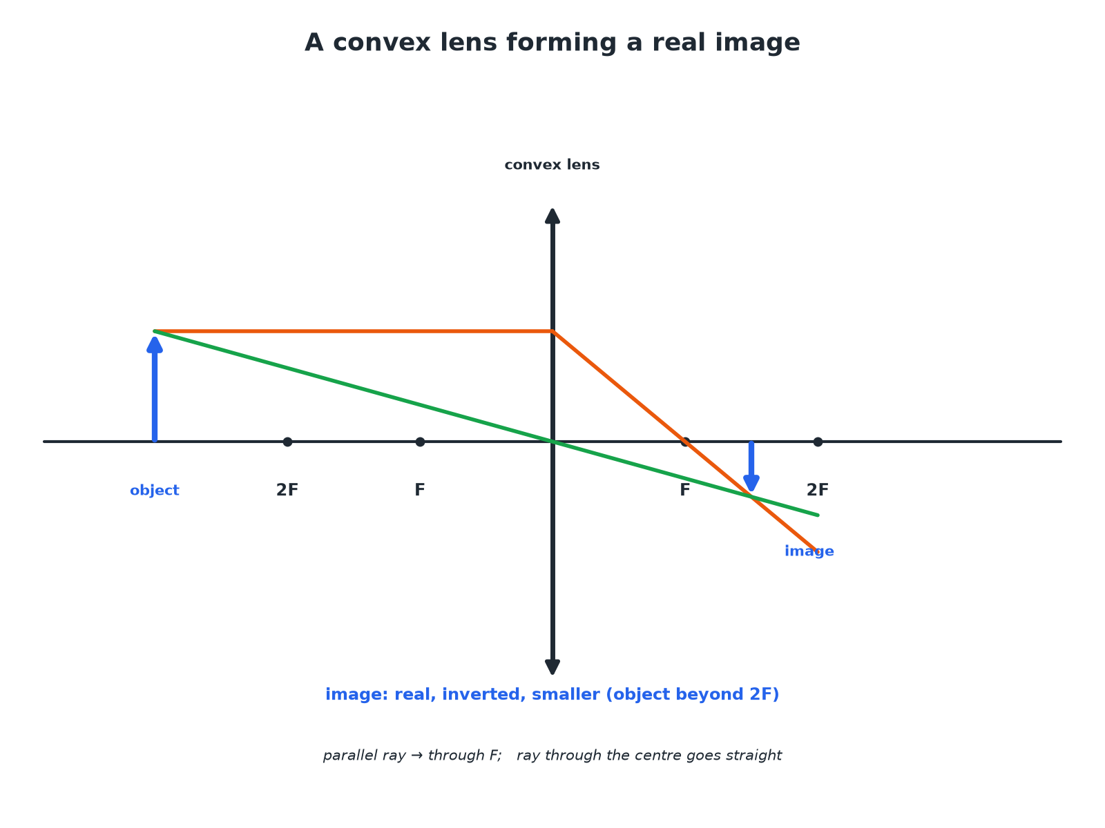

AQA GCSE PHYSICS · PAPER 2 · FOUNDATION & HIGHER
A Convex Lens
Two rays are enough to find the image position.
Waves
openrevise.com
Lesson 10 of 12

Slide 7
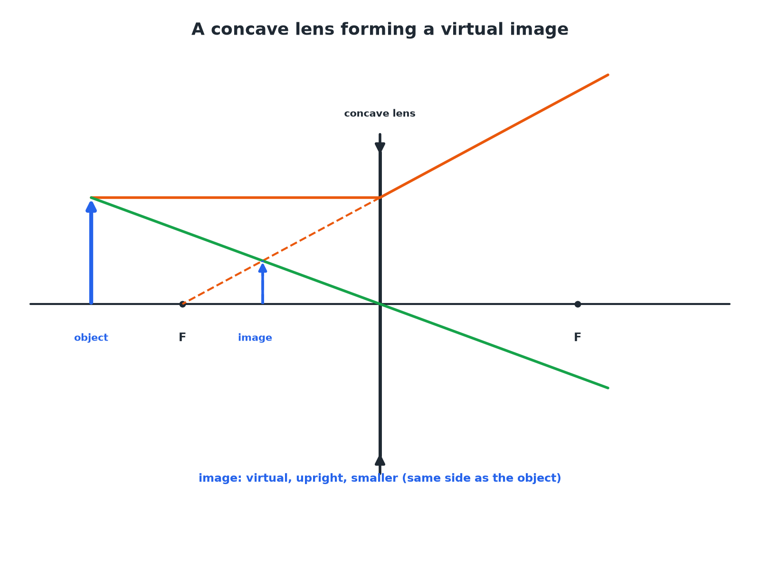
AQA GCSE PHYSICS · PAPER 2 · FOUNDATION & HIGHER
A Concave Lens
Rays spread out, so the image is virtual.
Waves
openrevise.com
Lesson 10 of 12

Slide 8

AQA GCSE PHYSICS · PAPER 2 · FOUNDATION & HIGHER
Convex and Concave Lenses
Compare them.
Feature
Convex (converging)
Concave (diverging)
Effect on parallel rays
Brings them together at the principal focus
Spreads them out
Image
Real or virtual
Always virtual
Symbol
Vertical line with outward arrowheads
Vertical line with inward arrowheads
Uses
Magnifying glass, camera, projector
Correcting short sight
Waves
openrevise.com
Lesson 10 of 12

Slide 9

AQA GCSE PHYSICS · PAPER 2 · FOUNDATION & HIGHER
Magnification
An object is 2.0 cm high. The image formed by a lens is 6.0 cm high. Calculate the magnification.
Write the equation
magnification = (image height)/(object height)
1
Substitute
6.0/2.0
2
Answer
3.0 (no units)
3
ANSWER
Magnification = 3.0
Waves
openrevise.com
Lesson 10 of 12

Slide 10
AQA GCSE PHYSICS · PAPER 2 · FOUNDATION & HIGHER
Finding the Image Height
A lens has a magnification of 5. The object is 4 mm high. Calculate the image height.
Rearrange
image height = magnification × object height
1
Substitute
5 × 4
2
Answer
20 mm
3
ANSWER
20 mm
Waves
openrevise.com
Lesson 10 of 12

Slide 11
AQA GCSE PHYSICS · PAPER 2 · FOUNDATION & HIGHER
Real or Virtual?
Explain the difference between a real image and a virtual image.
Real
Light rays actually meet at the image; it can be shown on a screen
1
Virtual
Rays only appear to come from the image; it cannot be shown on a screen
2
ANSWER
A real image can be projected onto a screen; a virtual image cannot.
Waves
openrevise.com
Lesson 10 of 12

Slide 12

AQA GCSE PHYSICS · PAPER 2 · FOUNDATION & HIGHER
Drawing Tips
Get full marks.
Use a ruler
Draw straight rays with arrowheads.
Two rays
One parallel to the axis (through F after a convex lens), one through the centre (undeviated).
Mark F
Mark the principal focus on both sides.
Virtual images
Draw the rays as dashed lines behind the lens.
Waves
openrevise.com
Lesson 10 of 12

Slide 13
AQA GCSE PHYSICS · PAPER 2 · FOUNDATION & HIGHER
Convex Lens Images and Object Distance
Where the object sits decides what kind of image forms.
Object position
Image
Use
Further than 2F
Real, inverted, smaller
Camera, eye
Between F and 2F
Real, inverted, larger
Projector
Closer than F
Virtual, upright, larger
Magnifying glass
Waves
openrevise.com
Lesson 10 of 12

Slide 14

AQA GCSE PHYSICS · PAPER 2 · FOUNDATION & HIGHER
Drawing a Convex Lens Ray Diagram
Two rays from the top of the object are enough.
1
2
3
4
5
Draw the set-up
Principal axis, lens symbol, F marked on both sides, and the object as an upright arrow.
Ray 1
From the top of the object parallel to the axis, then through F on the far side.
Ray 2
From the top of the object straight through the centre of the lens, undeviated.
Find the image
Where the rays cross is the top of the image; draw it down to the axis.
Describe it
State whether it is real or virtual, upright or inverted, magnified or diminished.
Waves
openrevise.com
Lesson 10 of 12

Slide 15

AQA GCSE PHYSICS · PAPER 2 · FOUNDATION & HIGHER
Lenses in Everyday Life
Each device uses the image a lens can make.
Camera
A convex lens forms a small, real, inverted image on the sensor. Moving the lens focuses objects at different distances.
Magnifying glass
Holding a convex lens close to an object, inside the focal length, gives a large, upright, virtual image.
Glasses for short sight
A short-sighted eye focuses distant light in front of the retina; a concave lens spreads the rays slightly so they focus on the retina.
Waves
openrevise.com
Lesson 10 of 12

Slide 16

AQA GCSE PHYSICS · PAPER 2 · FOUNDATION & HIGHER
Key Terms
Convex lens
A lens that brings parallel rays to a focus.
Concave lens
A lens that spreads parallel rays out.
Principal focus
The point where parallel rays meet after a convex lens.
Focal length
The distance from the lens to the principal focus.
Real image
An image formed where light rays actually meet.
Virtual image
An image formed where rays appear to come from.
Waves
openrevise.com
Lesson 10 of 12

Slide 17
AQA GCSE PHYSICS · PAPER 2 · FOUNDATION & HIGHER
Key Terms (cont.)
Magnification
Image height divided by object height; it has no units.
Principal axis
The line through the centre of a lens at right angles to it.
Inverted
Upside down compared with the object.
Waves
openrevise.com
Lesson 10 of 12

Slide 18

AQA GCSE PHYSICS · PAPER 2 · FOUNDATION & HIGHER
YOUR TASK
10 minutes
Lens Sums
An object of height 3.0 cm gives an image of height 1.2 cm. Calculate the magnification. Is the image bigger or smaller than the object?
Use image ÷ object.
1
Compare with 1.
2
WHAT A GOOD ANSWER SHOWS
Magnification = 1.2 ÷ 3.0 = 0.40. The image is smaller (diminished).
Waves
openrevise.com
Lesson 10 of 12
Notes:
Ask how a magnifying glass is different.

Slide 19
AQA GCSE PHYSICS · PAPER 2 · FOUNDATION & HIGHER
Can I...?
Define convex and concave.
Draw a concave lens ray diagram.
Define principal focus.
Define real and virtual images.
Define focal length.
Calculate magnification.
Draw a convex lens ray diagram.
Give a use of each lens.
Waves
openrevise.com
Lesson 10 of 12

Slide 20
AQA GCSE PHYSICS · PAPER 2 · FOUNDATION & HIGHER
Summary & Exam Focus
Convex: converging; concave: diverging.
Convex images can be real or virtual; concave always virtual.
Magnification = image height ÷ object height (no units).
Two rays to locate the image.
Object inside F gives a virtual, upright, magnified image.
EXAM FOCUS
An object is 2.0 cm high. The image is 6.0 cm high. Calculate the magnification. (2 marks)
Magnification = image height ÷ object height = 6.0 ÷ 2.0 = 3.0. Both heights must be in the same unit, and the answer has no unit, so do not write cm.
openrevise.com

Slide 21
AQA GCSE PHYSICS · PAPER 2 · FOUNDATION & HIGHER
Exam Practice: Lenses
Answer all questions. Use the mark allocation as a guide to how much to write. · 15 minutes
Question 1 · 2 marks · Calculate
An object is 2.0 cm high. A lens produces an image that is 6.0 cm high. Calculate the magnification. Use the equation: magnification =…
Question 2 · 4 marks · Complete the diagram
The diagram shows an object in front of a convex lens. Two rays have been drawn. Complete the ray diagram to find the position of the image…
Question 3 · 2 marks · Explain
Explain the difference between a real image and a virtual image.
Waves
openrevise.com
Lesson 10 of 12

Slide 22
AQA GCSE PHYSICS · PAPER 2 · FOUNDATION & HIGHER
Exam Practice: Lenses (cont.)
Question 4 · 3 marks · Describe
State what happens to parallel rays of light when they pass through (a) a convex lens (b) a concave lens.
Question 5 · 3 marks · Calculate
A lens forms an image 20 mm high. The magnification is 5. Calculate the height of the object.
Waves
openrevise.com
Lesson 10 of 12

Slide 23
AQA GCSE PHYSICS · PAPER 2 · FOUNDATION & HIGHER
Question 1 · 2 marks · Calculate
“
An object is 2.0 cm high. A lens produces an image that is 6.0 cm high. Calculate the magnification. Use the equation: magnification = image height ÷ object height
HOW TO ANSWER IT
Command word: Calculate. Worth 2 marks, so plan before writing.
Waves
openrevise.com
Lesson 10 of 12

Slide 24
AQA GCSE PHYSICS · PAPER 2 · FOUNDATION & HIGHER
Question 1 · mark scheme
2 marks available. Award a mark for each point made.
Correct substitution
1 mark
3.0 (no units)
1 mark
Waves
openrevise.com
Lesson 10 of 12

Slide 25
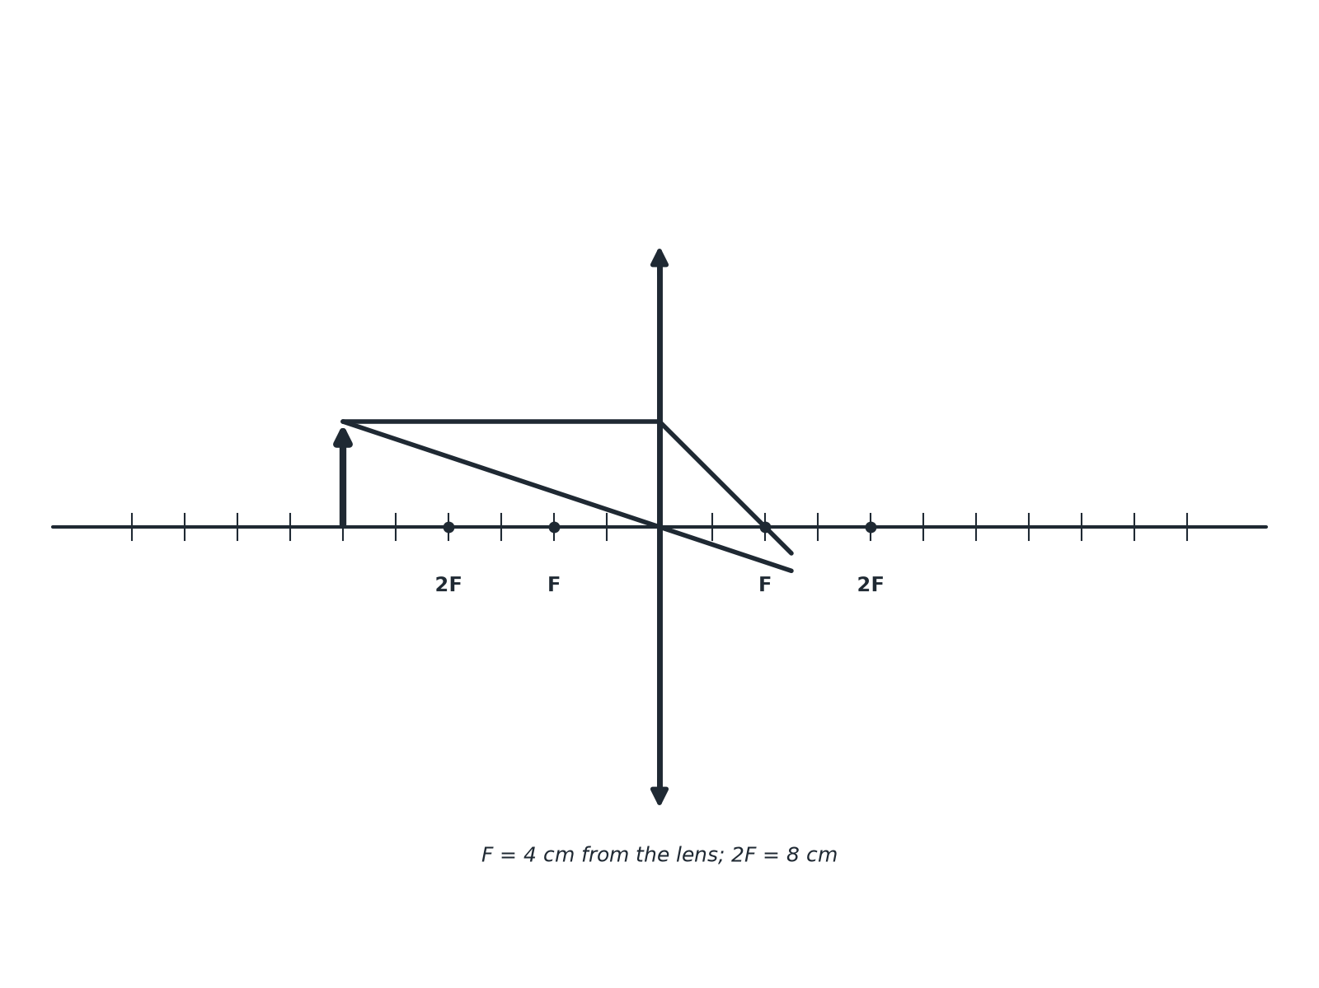
AQA GCSE PHYSICS · PAPER 2 · FOUNDATION & HIGHER
Question 2 · 4 marks · Complete the diagram
The diagram shows an object in front of a convex lens. Two rays have been drawn. Complete the ray diagram to find the position of the image and draw the image. Describe the image. (4 marks)
Waves
openrevise.com
Lesson 10 of 12

Slide 26
AQA GCSE PHYSICS · PAPER 2 · FOUNDATION & HIGHER
Question 2 · mark scheme
4 marks available. Award a mark for each point made.
Rays continue to cross
1 mark
Image drawn from the axis to the intersection
1 mark
Real and inverted
1 mark
Smaller than the object
1 mark
Waves
openrevise.com
Lesson 10 of 12

Slide 27
AQA GCSE PHYSICS · PAPER 2 · FOUNDATION & HIGHER
Question 3 · 2 marks · Explain
“
Explain the difference between a real image and a virtual image.
HOW TO ANSWER IT
Command word: Explain. Worth 2 marks, so plan before writing.
Waves
openrevise.com
Lesson 10 of 12

Slide 28
AQA GCSE PHYSICS · PAPER 2 · FOUNDATION & HIGHER
Question 3 · mark scheme
2 marks available. Award a mark for each point made.
Real: rays meet, on a screen
1 mark
Virtual: rays appear to come from, not on a screen
1 mark
Waves
openrevise.com
Lesson 10 of 12

Slide 29
AQA GCSE PHYSICS · PAPER 2 · FOUNDATION & HIGHER
Question 4 · 3 marks · Describe
“
State what happens to parallel rays of light when they pass through (a) a convex lens (b) a concave lens.
HOW TO ANSWER IT
Command word: Describe. Worth 3 marks, so plan before writing.
Waves
openrevise.com
Lesson 10 of 12

Slide 30
AQA GCSE PHYSICS · PAPER 2 · FOUNDATION & HIGHER
Question 4 · mark scheme
3 marks available. Award a mark for each point made.
Convex: converge at a point
1 mark
Concave: diverge
1 mark
Principal focus mentioned
1 mark
Waves
openrevise.com
Lesson 10 of 12

Slide 31
AQA GCSE PHYSICS · PAPER 2 · FOUNDATION & HIGHER
Question 5 · 3 marks · Calculate
“
A lens forms an image 20 mm high. The magnification is 5. Calculate the height of the object.
HOW TO ANSWER IT
Command word: Calculate. Worth 3 marks, so plan before writing.
Waves
openrevise.com
Lesson 10 of 12

Slide 32
AQA GCSE PHYSICS · PAPER 2 · FOUNDATION & HIGHER
Question 5 · mark scheme
3 marks available. Award a mark for each point made.
Rearranges the equation
1 mark
Correct substitution
1 mark
4.0 mm
1 mark
Waves
openrevise.com
Lesson 10 of 12

