Slide 1
AQA GCSE PHYSICS · PAPER 2 · FOUNDATION & HIGHER
Visible light and colour
Waves
Lesson 11 of 12
openrevise.com

Slide 2

AQA GCSE PHYSICS · PAPER 2 · FOUNDATION & HIGHER
Warm-up
Answer each one, then check.
1
What colours make up white light?
2
What is reflection?
3
What is absorption?
4
What is transparent?
5
What is opaque?
Waves
openrevise.com
Lesson 11 of 12

Slide 3
AQA GCSE PHYSICS · PAPER 2 · FOUNDATION & HIGHER
Warm-up - Answers
What colours make up white light?
The colours of the rainbow
1
What is reflection?
A wave bouncing off a surface
2
What is absorption?
A wave's energy being taken in by a material
3
What is transparent?
Lets light pass through with no scattering
4
What is opaque?
Does not let light through
5
Waves
openrevise.com
Lesson 11 of 12

Slide 4

AQA GCSE PHYSICS · PAPER 2 · FOUNDATION & HIGHER
Learning Objectives
State that each colour of visible light has its own narrow band of wavelength and frequency.
1
Distinguish specular reflection from diffuse reflection.
2
Explain how colour filters work.
3
Explain why an opaque object has a particular colour.
4
Waves
openrevise.com
Lesson 11 of 12

Slide 5

AQA GCSE PHYSICS · PAPER 2 · FOUNDATION & HIGHER
COLOUR
Each colour within the visible spectrum has its own narrow band of wavelength and frequency. The colour of an opaque object depends on which wavelengths it reflects most strongly.
Wavelengths that are not reflected are absorbed. If all wavelengths are reflected equally the object looks white; if all are absorbed it looks black.
Waves
openrevise.com
Lesson 11 of 12

Slide 6
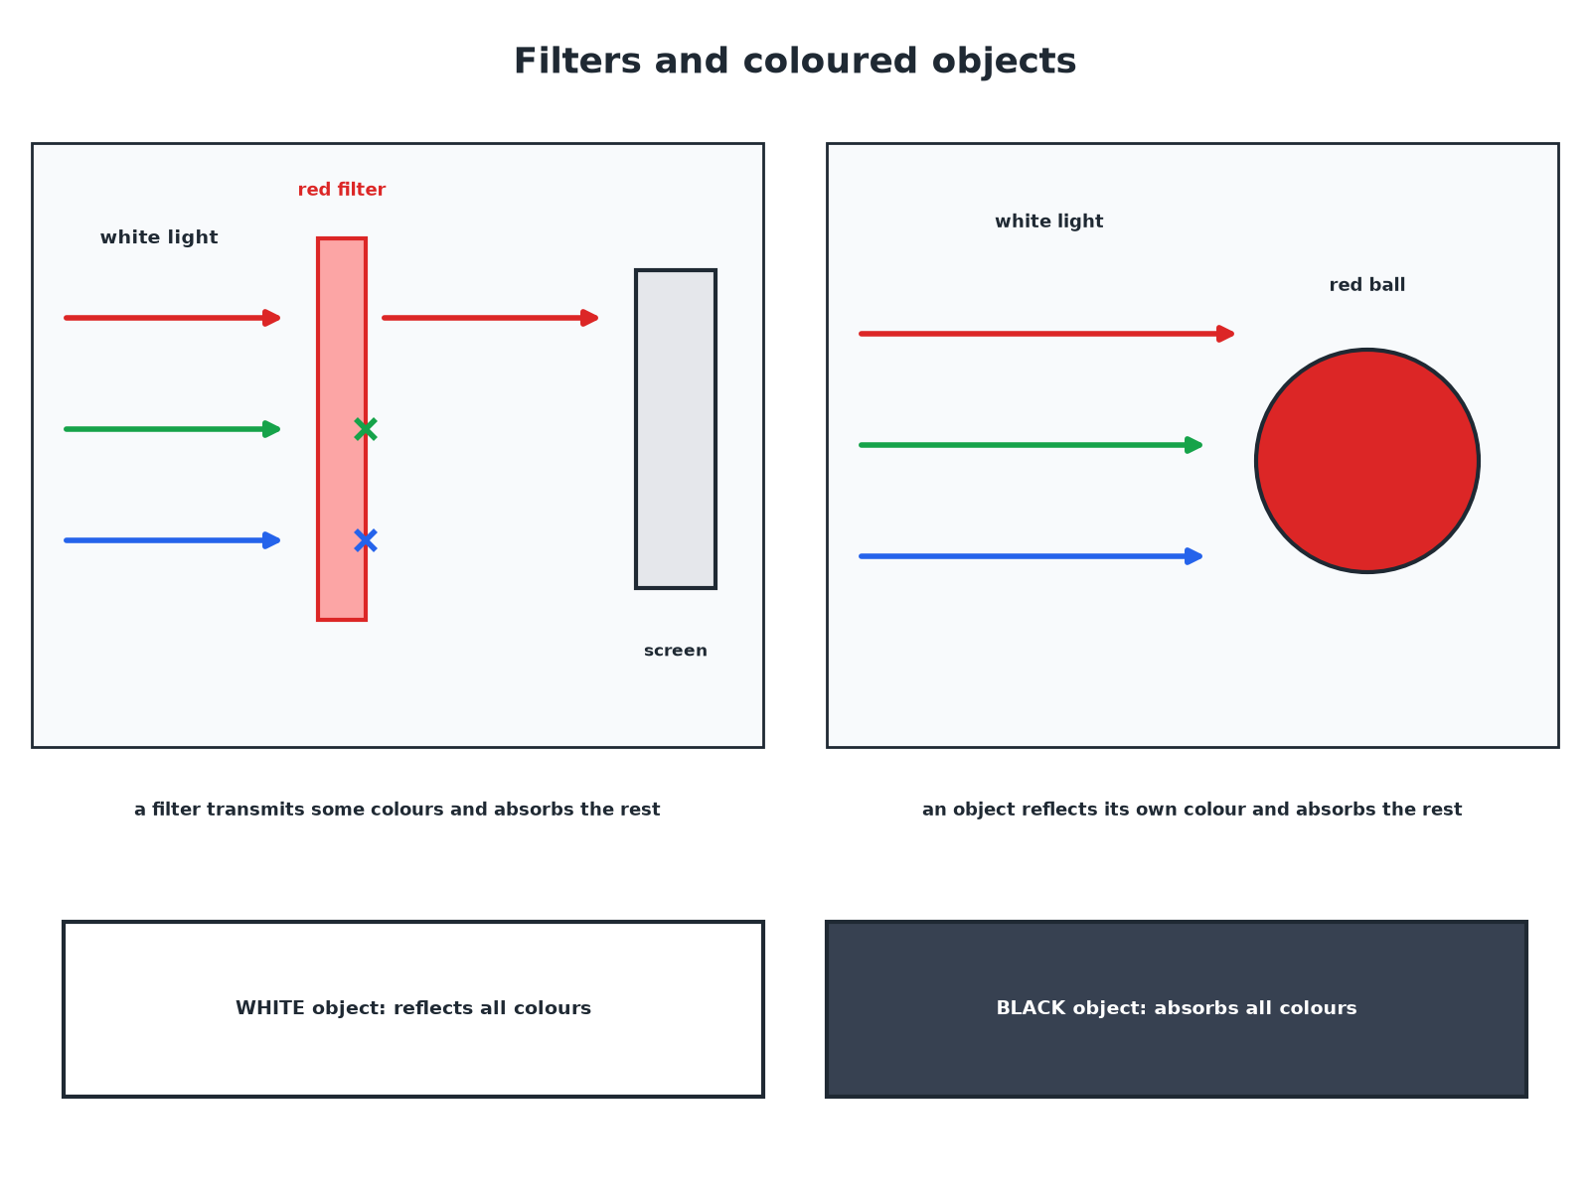

AQA GCSE PHYSICS · PAPER 2 · FOUNDATION & HIGHER
Filters and Coloured Objects
Colour comes from which wavelengths are reflected or transmitted.
Waves
openrevise.com
Lesson 11 of 12

Slide 7

AQA GCSE PHYSICS · PAPER 2 · FOUNDATION & HIGHER
Specular or Diffuse Reflection?
SPECULAR REFLECTION
DIFFUSE REFLECTION
• From a smooth surface such as a mirror.
• Reflected in a single direction.
• Forms a clear image.
• From a rough surface such as paper.
• Scattered in many directions.
• No clear image.
Waves
openrevise.com
Lesson 11 of 12

Slide 8

AQA GCSE PHYSICS · PAPER 2 · FOUNDATION & HIGHER
Objects and Colours
What you see.
Object
In white light
Why
Red shirt
Red
Reflects red, absorbs other colours
Green leaf
Green
Reflects green, absorbs the rest
White paper
White
Reflects all colours equally
Black cloth
Black
Absorbs all colours
Waves
openrevise.com
Lesson 11 of 12

Slide 9

AQA GCSE PHYSICS · PAPER 2 · FOUNDATION & HIGHER
A Colour Filter
White light passes through a green filter. What colour emerges?
Filter
Transmits green and absorbs the other wavelengths
1
Light that emerges
Green
2
ANSWER
Green light.
Waves
openrevise.com
Lesson 11 of 12

Slide 10
AQA GCSE PHYSICS · PAPER 2 · FOUNDATION & HIGHER
Two Filters
White light passes through a red filter and then a blue filter. What emerges?
Red filter
Transmits only red
1
Blue filter
Absorbs red and transmits blue
2
Result
No light
3
ANSWER
No light emerges (black).
Waves
openrevise.com
Lesson 11 of 12

Slide 11
AQA GCSE PHYSICS · PAPER 2 · FOUNDATION & HIGHER
Coloured Light on an Object
A red shirt is illuminated with green light only. What colour does it look?
Red shirt
Reflects red but absorbs green
1
Green light
There is no red light to reflect
2
Result
The shirt looks black
3
ANSWER
Black.
Waves
openrevise.com
Lesson 11 of 12

Slide 12

AQA GCSE PHYSICS · PAPER 2 · FOUNDATION & HIGHER
Key Terms
Transparent, translucent and opaque.
Transparent
Transmits light; you can see clearly through it.
Translucent
Transmits light but scatters it; you cannot see a clear image.
Opaque
Does not transmit light.
Filters
Absorb certain wavelengths and transmit others.
Waves
openrevise.com
Lesson 11 of 12

Slide 13

AQA GCSE PHYSICS · PAPER 2 · FOUNDATION & HIGHER
Key Terms
Specular reflection
Reflection from a smooth surface in a single direction.
Diffuse reflection
Reflection from a rough surface in many directions.
Colour filter
Material that transmits some wavelengths and absorbs others.
Transparent
Lets light pass through with no scattering.
Translucent
Lets light through but scatters it.
Opaque
Does not let light through.
Waves
openrevise.com
Lesson 11 of 12

Slide 14

AQA GCSE PHYSICS · PAPER 2 · FOUNDATION & HIGHER
YOUR TASK
10 minutes
Predict the Colour
What colour does a blue book look in (a) white light (b) red light? What does a white page look in blue light?
What wavelengths does it reflect?
1
What light is available?
2
WHAT A GOOD ANSWER SHOWS
(a) Blue. (b) Black, because it absorbs red. A white page in blue light looks blue.
Waves
openrevise.com
Lesson 11 of 12
Notes:
Ask why a white shirt looks different under coloured lights.

Slide 15
AQA GCSE PHYSICS · PAPER 2 · FOUNDATION & HIGHER
Can I...?
State that colours have wavelength bands.
Explain object colour.
Explain specular reflection.
Explain black and white.
Explain diffuse reflection.
Define transparent, translucent, opaque.
Explain filters.
Predict colours under filters.
Waves
openrevise.com
Lesson 11 of 12

Slide 16
AQA GCSE PHYSICS · PAPER 2 · FOUNDATION & HIGHER
Summary & Exam Focus
Colours: narrow bands of wavelength and frequency.
Smooth: specular; rough: diffuse.
Filters transmit some wavelengths and absorb others.
Object colour from the wavelengths it reflects.
EXAM FOCUS
Explain why a red book looks red in white light. (2 marks)
Reflects red, absorbs other colours.
openrevise.com

Slide 17
AQA GCSE PHYSICS · PAPER 2 · FOUNDATION & HIGHER
Exam Practice: Visible light and colour
Answer all questions. Use the mark allocation as a guide to how much to write. · 13 minutes
Question 1 · 2 marks · Explain
A red book looks red in white light. Explain why.
Question 2 · 2 marks · Describe
Describe the difference between specular reflection and diffuse reflection.
Question 3 · 3 marks · Explain
White light passes through a green filter onto a white screen. Explain what colour the screen looks. Then explain what happens if the light…
Waves
openrevise.com
Lesson 11 of 12

Slide 18
AQA GCSE PHYSICS · PAPER 2 · FOUNDATION & HIGHER
Exam Practice: Visible light and colour (cont.)
Question 4 · 3 marks · Explain
A blue shirt is seen in red light. Explain why it looks black.
Question 5 · 2 marks · State
Explain the difference between a transparent and a translucent material.
Waves
openrevise.com
Lesson 11 of 12

Slide 19
AQA GCSE PHYSICS · PAPER 2 · FOUNDATION & HIGHER
Question 1 · 2 marks · Explain
“
A red book looks red in white light. Explain why.
HOW TO ANSWER IT
Command word: Explain. Worth 2 marks, so plan before writing.
Waves
openrevise.com
Lesson 11 of 12

Slide 20
AQA GCSE PHYSICS · PAPER 2 · FOUNDATION & HIGHER
Question 1 · mark scheme
2 marks available. Award a mark for each point made.
Reflects red
1 mark
Absorbs other colours
1 mark
Waves
openrevise.com
Lesson 11 of 12

Slide 21
AQA GCSE PHYSICS · PAPER 2 · FOUNDATION & HIGHER
Question 2 · 2 marks · Describe
“
Describe the difference between specular reflection and diffuse reflection.
HOW TO ANSWER IT
Command word: Describe. Worth 2 marks, so plan before writing.
Waves
openrevise.com
Lesson 11 of 12

Slide 22
AQA GCSE PHYSICS · PAPER 2 · FOUNDATION & HIGHER
Question 2 · mark scheme
2 marks available. Award a mark for each point made.
Specular: smooth surface, one direction
1 mark
Diffuse: rough surface, scattered
1 mark
Waves
openrevise.com
Lesson 11 of 12

Slide 23
AQA GCSE PHYSICS · PAPER 2 · FOUNDATION & HIGHER
Question 3 · 3 marks · Explain
“
White light passes through a green filter onto a white screen. Explain what colour the screen looks. Then explain what happens if the light from the green filter goes through a red filter.
HOW TO ANSWER IT
Command word: Explain. Worth 3 marks, so plan before writing.
Waves
openrevise.com
Lesson 11 of 12

Slide 24
AQA GCSE PHYSICS · PAPER 2 · FOUNDATION & HIGHER
Question 3 · mark scheme
3 marks available. Award a mark for each point made.
Green filter transmits green
1 mark
Screen looks green
1 mark
Red filter absorbs green: no light
1 mark
Waves
openrevise.com
Lesson 11 of 12

Slide 25
AQA GCSE PHYSICS · PAPER 2 · FOUNDATION & HIGHER
Question 4 · 3 marks · Explain
“
A blue shirt is seen in red light. Explain why it looks black.
HOW TO ANSWER IT
Command word: Explain. Worth 3 marks, so plan before writing.
Waves
openrevise.com
Lesson 11 of 12

Slide 26
AQA GCSE PHYSICS · PAPER 2 · FOUNDATION & HIGHER
Question 4 · mark scheme
3 marks available. Award a mark for each point made.
Shirt reflects blue
1 mark
Absorbs red light
1 mark
So no light reflected: looks black
1 mark
Waves
openrevise.com
Lesson 11 of 12

Slide 27
AQA GCSE PHYSICS · PAPER 2 · FOUNDATION & HIGHER
Question 5 · 2 marks · State
“
Explain the difference between a transparent and a translucent material.
HOW TO ANSWER IT
Command word: State. Worth 2 marks, so plan before writing.
Waves
openrevise.com
Lesson 11 of 12

Slide 28
AQA GCSE PHYSICS · PAPER 2 · FOUNDATION & HIGHER
Question 5 · mark scheme
2 marks available. Award a mark for each point made.
Transparent: clear view
1 mark
Translucent: light scattered
1 mark
Waves
openrevise.com
Lesson 11 of 12

