Slide 1

AQA GCSE PHYSICS · PAPER 2 · FOUNDATION & HIGHER
Electromagnetism
Magnetism and electromagnetism
Lesson 2 of 8
openrevise.com

Slide 2

AQA GCSE PHYSICS · PAPER 2 · FOUNDATION & HIGHER
Warm-up
Answer each one, then check.
1
What is an electric current?
2
What is a circuit?
3
What is a coil of wire called?
4
Name a magnetic material.
5
What does a battery do?
Magnetism and electromagnetism
openrevise.com
Lesson 2 of 8

Slide 3
AQA GCSE PHYSICS · PAPER 2 · FOUNDATION & HIGHER
Warm-up - Answers
What is an electric current?
A flow of charge
1
What is a circuit?
A complete loop for current to flow round
2
What is a coil of wire called?
A solenoid
3
Name a magnetic material.
Iron
4
What does a battery do?
Provides a potential difference
5
Magnetism and electromagnetism
openrevise.com
Lesson 2 of 8

Slide 4

AQA GCSE PHYSICS · PAPER 2 · FOUNDATION & HIGHER
Learning Objectives
Describe the magnetic field around a straight wire carrying a current.
1
Explain how the field changes with current and distance.
2
Describe the field of a solenoid and compare it with a bar magnet.
3
Explain how to increase the strength of a solenoid's field and how an iron core affects it.
4
Describe an electromagnet.
5
Magnetism and electromagnetism
openrevise.com
Lesson 2 of 8

Slide 5

AQA GCSE PHYSICS · PAPER 2 · FOUNDATION & HIGHER
CURRENT AND MAGNETISM
When a current flows in a wire it produces a magnetic field around the wire. The field is stronger with a bigger current and closer to the wire.
The field lines around a straight wire are concentric circles. Reversing the current reverses the direction of the field.
Magnetism and electromagnetism
openrevise.com
Lesson 2 of 8

Slide 6
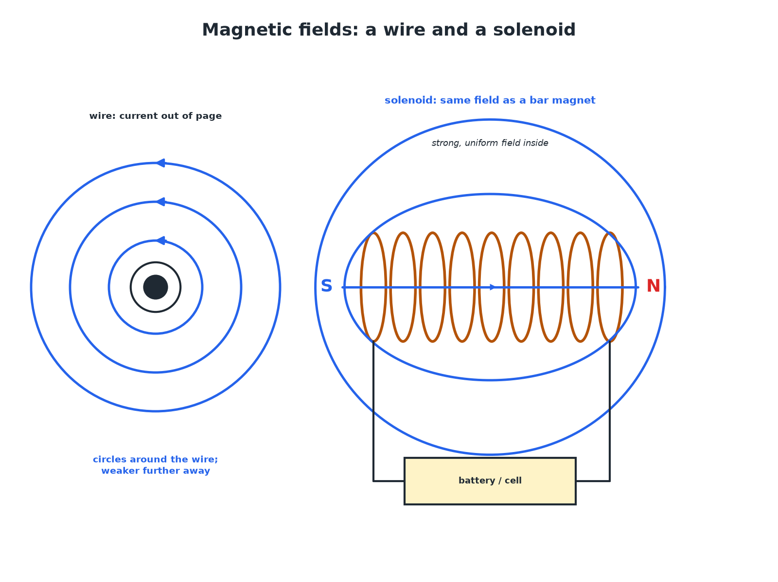

AQA GCSE PHYSICS · PAPER 2 · FOUNDATION & HIGHER
Fields Around a Wire and a Solenoid
A solenoid's field looks like a bar magnet's field.
Magnetism and electromagnetism
openrevise.com
Lesson 2 of 8

Slide 7

AQA GCSE PHYSICS · PAPER 2 · FOUNDATION & HIGHER
Changing the Strength
Learn what makes a stronger field.
Change
Effect
Bigger current
Stronger field
More turns of wire in the coil
Stronger field
Iron core inside the solenoid
Much stronger field
Reverse the current
Field direction reverses
Move further from the wire
Weaker field
Magnetism and electromagnetism
openrevise.com
Lesson 2 of 8

Slide 8

AQA GCSE PHYSICS · PAPER 2 · FOUNDATION & HIGHER
Making an Electromagnet
Describe how to make a strong electromagnet.
Wind a coil
Many turns of insulated wire round an iron core (nail)
1
Connect to a cell
Current in the coil magnetises the core
2
Increase the strength
More turns, larger current, or an iron core
3
ANSWER
Coil with an iron core and a large current.
Magnetism and electromagnetism
openrevise.com
Lesson 2 of 8

Slide 9
AQA GCSE PHYSICS · PAPER 2 · FOUNDATION & HIGHER
Why Use an Electromagnet?
Give two advantages of an electromagnet over a permanent magnet.
Switch on and off
The field disappears when the current is turned off
1
Change the strength
Change the current to change the field
2
ANSWER
It can be switched off and its strength controlled.
Magnetism and electromagnetism
openrevise.com
Lesson 2 of 8

Slide 10

AQA GCSE PHYSICS · PAPER 2 · FOUNDATION & HIGHER
Uses
Where are electromagnets used?
Scrapyards
Lift and drop scrap iron.
Electric bells
Current magnetises an iron core that attracts a hammer.
Relays
A small current switches a large current.
Maglev trains
Strong electromagnets lift and move the train.
Magnetism and electromagnetism
openrevise.com
Lesson 2 of 8

Slide 11

AQA GCSE PHYSICS · PAPER 2 · FOUNDATION & HIGHER
Key Terms
Electromagnet
A solenoid with an iron core that is magnetic only when a current flows.
Solenoid
A coil of wire.
Magnetic field
The region around a magnet or current where a force acts on magnetic materials.
Current
The rate of flow of charge.
Core
A piece of iron inside a solenoid.
Turns
Loops of wire in a coil.
Magnetism and electromagnetism
openrevise.com
Lesson 2 of 8

Slide 12

AQA GCSE PHYSICS · PAPER 2 · FOUNDATION & HIGHER
YOUR TASK
15 minutes
Build One
Wrap insulated wire round a nail and connect it to a cell. Count how many paper clips it picks up with 10, 20 and 30 turns.
Keep the current the same.
1
Do not leave it connected: the wire gets hot.
2
WHAT A GOOD ANSWER SHOWS
More turns pick up more paper clips. Stop current flowing and the clips drop.
Magnetism and electromagnetism
openrevise.com
Lesson 2 of 8
Notes:
Ask what else would increase the field.

Slide 13
AQA GCSE PHYSICS · PAPER 2 · FOUNDATION & HIGHER
Can I...?
Describe the field round a wire.
List ways to strengthen the field.
State that the field circles the wire.
Say what an iron core does.
Say what a solenoid is.
Describe an electromagnet.
Compare with a bar magnet.
Give uses.
Magnetism and electromagnetism
openrevise.com
Lesson 2 of 8

Slide 14
AQA GCSE PHYSICS · PAPER 2 · FOUNDATION & HIGHER
Summary & Exam Focus
Current produces a magnetic field.
More turns, more current or an iron core gives a stronger field.
A solenoid field is like a bar magnet's field.
Reversing the current reverses the field.
EXAM FOCUS
State two ways to increase the strength of an electromagnet. (2 marks)
Number of turns, current, iron core.
openrevise.com

Slide 15
AQA GCSE PHYSICS · PAPER 2 · FOUNDATION & HIGHER
Exam Practice: Electromagnetism
Answer all questions. Use the mark allocation as a guide to how much to write. · 14 minutes
Question 1 · 2 marks · State
State two ways of increasing the strength of the magnetic field of a solenoid.
Question 2 · 2 marks · Describe
Describe the magnetic field around a straight wire carrying a current.
Question 3 · 3 marks · Explain
Explain why a solenoid with an iron core is used in a scrapyard to lift cars and then drop them.
Magnetism and electromagnetism
openrevise.com
Lesson 2 of 8

Slide 16
AQA GCSE PHYSICS · PAPER 2 · FOUNDATION & HIGHER
Exam Practice: Electromagnetism (cont.)
Question 4 · 3 marks · Describe
Describe the magnetic field of a solenoid and explain how it is similar to the field of a bar magnet.
Question 5 · 3 marks · Explain
A student increases the current in a solenoid. Explain what happens to the field and to the number of paper clips the solenoid can lift.
Magnetism and electromagnetism
openrevise.com
Lesson 2 of 8

Slide 17
AQA GCSE PHYSICS · PAPER 2 · FOUNDATION & HIGHER
Question 1 · 2 marks · State
“
State two ways of increasing the strength of the magnetic field of a solenoid.
HOW TO ANSWER IT
Command word: State. Worth 2 marks, so plan before writing.
Magnetism and electromagnetism
openrevise.com
Lesson 2 of 8

Slide 18
AQA GCSE PHYSICS · PAPER 2 · FOUNDATION & HIGHER
Question 1 · mark scheme
2 marks available. Award a mark for each point made.
One way
1 mark
A second way
1 mark
Magnetism and electromagnetism
openrevise.com
Lesson 2 of 8

Slide 19
AQA GCSE PHYSICS · PAPER 2 · FOUNDATION & HIGHER
Question 2 · 2 marks · Describe
“
Describe the magnetic field around a straight wire carrying a current.
HOW TO ANSWER IT
Command word: Describe. Worth 2 marks, so plan before writing.
Magnetism and electromagnetism
openrevise.com
Lesson 2 of 8

Slide 20
AQA GCSE PHYSICS · PAPER 2 · FOUNDATION & HIGHER
Question 2 · mark scheme
2 marks available. Award a mark for each point made.
Circles around the wire
1 mark
Weaker with distance
1 mark
Magnetism and electromagnetism
openrevise.com
Lesson 2 of 8

Slide 21
AQA GCSE PHYSICS · PAPER 2 · FOUNDATION & HIGHER
Question 3 · 3 marks · Explain
“
Explain why a solenoid with an iron core is used in a scrapyard to lift cars and then drop them.
HOW TO ANSWER IT
Command word: Explain. Worth 3 marks, so plan before writing.
Magnetism and electromagnetism
openrevise.com
Lesson 2 of 8

Slide 22
AQA GCSE PHYSICS · PAPER 2 · FOUNDATION & HIGHER
Question 3 · mark scheme
3 marks available. Award a mark for each point made.
Iron core strengthens the field
1 mark
Electromagnet only works when a current flows
1 mark
Switching off releases the car
1 mark
Magnetism and electromagnetism
openrevise.com
Lesson 2 of 8

Slide 23
AQA GCSE PHYSICS · PAPER 2 · FOUNDATION & HIGHER
Question 4 · 3 marks · Describe
“
Describe the magnetic field of a solenoid and explain how it is similar to the field of a bar magnet.
HOW TO ANSWER IT
Command word: Describe. Worth 3 marks, so plan before writing.
Magnetism and electromagnetism
openrevise.com
Lesson 2 of 8

Slide 24
AQA GCSE PHYSICS · PAPER 2 · FOUNDATION & HIGHER
Question 4 · mark scheme
3 marks available. Award a mark for each point made.
Lines pass through and loop round outside
1 mark
Same shape as a bar magnet with two poles
1 mark
Strong and uniform inside the coil
1 mark
Magnetism and electromagnetism
openrevise.com
Lesson 2 of 8

Slide 25
AQA GCSE PHYSICS · PAPER 2 · FOUNDATION & HIGHER
Question 5 · 3 marks · Explain
“
A student increases the current in a solenoid. Explain what happens to the field and to the number of paper clips the solenoid can lift.
HOW TO ANSWER IT
Command word: Explain. Worth 3 marks, so plan before writing.
Magnetism and electromagnetism
openrevise.com
Lesson 2 of 8

Slide 26
AQA GCSE PHYSICS · PAPER 2 · FOUNDATION & HIGHER
Question 5 · mark scheme
3 marks available. Award a mark for each point made.
Field is stronger
1 mark
Greater force on the paper clips
1 mark
More clips lifted
1 mark
Magnetism and electromagnetism
openrevise.com
Lesson 2 of 8

