Slide 1

AQA GCSE PHYSICS · PAPER 2 · HIGHER TIER ONLY
The motor effect
Magnetism and electromagnetism
Lesson 3 of 8
openrevise.com

Slide 2

AQA GCSE PHYSICS · PAPER 2 · HIGHER TIER ONLY
Warm-up
Answer each one, then check.
1
What is a force?
2
What is the unit of force?
3
What is a magnetic field?
4
What is current?
5
What is a conductor?
Magnetism and electromagnetism
openrevise.com
Lesson 3 of 8

Slide 3
AQA GCSE PHYSICS · PAPER 2 · HIGHER TIER ONLY
Warm-up - Answers
What is a force?
A push or a pull
1
What is the unit of force?
Newton (N)
2
What is a magnetic field?
A region where a force acts on a magnet
3
What is current?
A flow of charge
4
What is a conductor?
A material that lets current flow
5
Magnetism and electromagnetism
openrevise.com
Lesson 3 of 8

Slide 4

AQA GCSE PHYSICS · PAPER 2 · HIGHER TIER ONLY
Learning Objectives
Explain why a current-carrying wire in a magnetic field experiences a force.
1
Use Fleming's left-hand rule to find the direction of the force.
2
Recall and use F = BIl.
3
State when the force is greatest and when it is zero.
4
Explain how the force can be reversed.
5
Magnetism and electromagnetism
openrevise.com
Lesson 3 of 8

Slide 5

AQA GCSE PHYSICS · PAPER 2 · HIGHER TIER ONLY
THE MOTOR EFFECT
force = magnetic flux density × current × length F = BIl
F in newtons (N), B in tesla (T), I in amperes (A) and l in metres (m). The conductor must be at right angles to the field. F = BIl is on the equation sheet.
Magnetism and electromagnetism
openrevise.com
Lesson 3 of 8

Slide 6
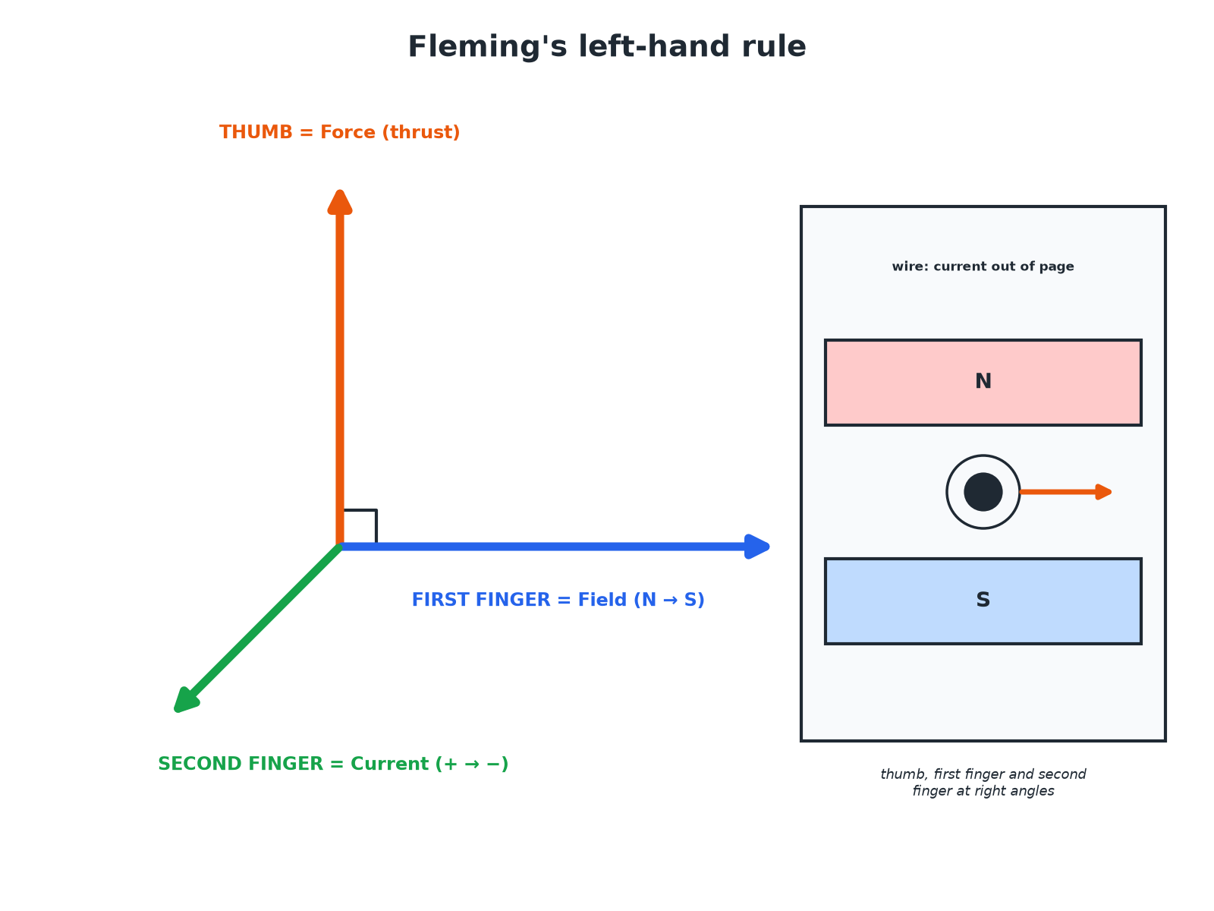

AQA GCSE PHYSICS · PAPER 2 · HIGHER TIER ONLY
Fleming's Left-Hand Rule
Thumb: force. First finger: field. Second finger: current.
Magnetism and electromagnetism
openrevise.com
Lesson 3 of 8

Slide 7

AQA GCSE PHYSICS · PAPER 2 · HIGHER TIER ONLY
Calculating the Force
A wire of length 0.20 m carries a current of 3.0 A at right angles to a magnetic field of flux density 0.40 T. Calculate the force.
Write the equation
F = BIl
1
Substitute
F = 0.40 × 3.0 × 0.20
2
Answer
F = 0.24 N
3
ANSWER
0.24 N
Magnetism and electromagnetism
openrevise.com
Lesson 3 of 8

Slide 8
AQA GCSE PHYSICS · PAPER 2 · HIGHER TIER ONLY
Finding the Current
A force of 0.60 N acts on a 0.30 m wire in a field of 0.50 T. Calculate the current.
Rearrange
I = F ÷ (Bl)
1
Substitute
I = 0.60 ÷ (0.50 × 0.30)
2
Answer
I = 4.0 A
3
ANSWER
4.0 A
Magnetism and electromagnetism
openrevise.com
Lesson 3 of 8

Slide 9

AQA GCSE PHYSICS · PAPER 2 · HIGHER TIER ONLY
Reversing and Changing the Force
Learn what happens.
Change
Effect on the force
Reverse the current
Force reverses
Reverse the magnetic field
Force reverses
Increase the current
Force increases
Stronger magnets (larger B)
Force increases
Wire parallel to the field
No force
Magnetism and electromagnetism
openrevise.com
Lesson 3 of 8

Slide 10

AQA GCSE PHYSICS · PAPER 2 · HIGHER TIER ONLY
Why Does It Happen?
Two magnetic fields.
Two fields
The magnet's field and the field round the wire interact.
Result
The two fields push on each other and the wire feels a force.
Right angles
The force is greatest when the wire is at 90° to the field.
Parallel
No force when the wire is parallel to the field.
Magnetism and electromagnetism
openrevise.com
Lesson 3 of 8

Slide 11

AQA GCSE PHYSICS · PAPER 2 · HIGHER TIER ONLY
Key Terms
Motor effect
The force on a current-carrying conductor in a magnetic field.
Magnetic flux density
A measure of the strength of a magnetic field, in tesla (T).
Tesla
The unit of magnetic flux density.
Fleming's left-hand rule
A rule for finding the direction of the force on a current-carrying wire in a magnetic field.
Conductor
A material that allows a current to flow.
Thumb
Gives the direction of the force in Fleming's left-hand rule.
Magnetism and electromagnetism
openrevise.com
Lesson 3 of 8

Slide 12

AQA GCSE PHYSICS · PAPER 2 · HIGHER TIER ONLY
YOUR TASK
10 minutes
Hand Rule
A current flows left to right through a wire between a north pole (above) and a south pole (below). Use Fleming's left-hand rule. Which way is the force? Then calculate F for B = 0.30 T, I = 5.0 A, l = 0.10 m.
1
Thumb = force.
2
First finger = field.
3
Second finger = current.
WHAT A GOOD ANSWER SHOWS
The field points downwards (north to south), the current points to the right, so the force is into the page. F = 0.30 × 5.0 × 0.10 = 0.15 N.
Magnetism and electromagnetism
openrevise.com
Lesson 3 of 8
Notes:
Ask learners to rehearse the rule with their left hand.

Slide 13
AQA GCSE PHYSICS · PAPER 2 · HIGHER TIER ONLY
Can I...?
State the motor effect.
Use right angles.
Use the left-hand rule.
Reverse the force.
Write F = BIl.
Change the force.
Give units.
Calculate F, I, B or l.
Magnetism and electromagnetism
openrevise.com
Lesson 3 of 8

Slide 14
AQA GCSE PHYSICS · PAPER 2 · HIGHER TIER ONLY
Summary & Exam Focus
F = BIl (tesla, amperes, metres).
Left-hand rule: thumb force, first finger field, second finger current.
Reversing current or field reverses the force.
No force if parallel to the field.
EXAM FOCUS
A 0.20 m wire carries 3.0 A at right angles to a 0.40 T field. Calculate the force. (2 marks)
F = BIl.
openrevise.com

Slide 15
AQA GCSE PHYSICS · PAPER 2 · HIGHER TIER ONLY
Exam Practice: The motor effect
Answer all questions. Use the mark allocation as a guide to how much to write. · 14 minutes
Question 1 · 2 marks · Calculate
A wire of length 0.20 m carries a current of 3.0 A at right angles to a magnetic field of flux density 0.40 T. Calculate the force on the…
Question 2 · 2 marks · State
State two ways of reversing the direction of the force on a current-carrying wire in a magnetic field.
Question 3 · 3 marks · Calculate
A force of 0.60 N acts on a wire of length 0.30 m in a magnetic field of 0.50 T. The wire is at right angles to the field. Calculate the…
Magnetism and electromagnetism
openrevise.com
Lesson 3 of 8

Slide 16
AQA GCSE PHYSICS · PAPER 2 · HIGHER TIER ONLY
Exam Practice: The motor effect (cont.)
Question 4 · 3 marks · Explain
Explain why a wire carrying a current experiences a force when it is placed between the poles of a magnet.
Question 5 · 3 marks · Explain
Explain what happens to the force on the wire in a magnetic field when the wire is turned so that it is parallel to the field lines. Give a…
Magnetism and electromagnetism
openrevise.com
Lesson 3 of 8

Slide 17
AQA GCSE PHYSICS · PAPER 2 · HIGHER TIER ONLY
Question 1 · 2 marks · Calculate
“
A wire of length 0.20 m carries a current of 3.0 A at right angles to a magnetic field of flux density 0.40 T. Calculate the force on the wire. Use the equation: force = magnetic flux density × current × length
HOW TO ANSWER IT
Command word: Calculate. Worth 2 marks, so plan before writing.
Magnetism and electromagnetism
openrevise.com
Lesson 3 of 8

Slide 18
AQA GCSE PHYSICS · PAPER 2 · HIGHER TIER ONLY
Question 1 · mark scheme
2 marks available. Award a mark for each point made.
Correct substitution
1 mark
0.24 N
1 mark
Magnetism and electromagnetism
openrevise.com
Lesson 3 of 8

Slide 19
AQA GCSE PHYSICS · PAPER 2 · HIGHER TIER ONLY
Question 2 · 2 marks · State
“
State two ways of reversing the direction of the force on a current-carrying wire in a magnetic field.
HOW TO ANSWER IT
Command word: State. Worth 2 marks, so plan before writing.
Magnetism and electromagnetism
openrevise.com
Lesson 3 of 8

Slide 20
AQA GCSE PHYSICS · PAPER 2 · HIGHER TIER ONLY
Question 2 · mark scheme
2 marks available. Award a mark for each point made.
Reverse the current
1 mark
Reverse the field
1 mark
Magnetism and electromagnetism
openrevise.com
Lesson 3 of 8

Slide 21
AQA GCSE PHYSICS · PAPER 2 · HIGHER TIER ONLY
Question 3 · 3 marks · Calculate
“
A force of 0.60 N acts on a wire of length 0.30 m in a magnetic field of 0.50 T. The wire is at right angles to the field. Calculate the current in the wire.
HOW TO ANSWER IT
Command word: Calculate. Worth 3 marks, so plan before writing.
Magnetism and electromagnetism
openrevise.com
Lesson 3 of 8

Slide 22
AQA GCSE PHYSICS · PAPER 2 · HIGHER TIER ONLY
Question 3 · mark scheme
3 marks available. Award a mark for each point made.
Rearranges to I = F ÷ (B l)
1 mark
Substitution
1 mark
4.0 A
1 mark
Magnetism and electromagnetism
openrevise.com
Lesson 3 of 8

Slide 23
AQA GCSE PHYSICS · PAPER 2 · HIGHER TIER ONLY
Question 4 · 3 marks · Explain
“
Explain why a wire carrying a current experiences a force when it is placed between the poles of a magnet.
HOW TO ANSWER IT
Command word: Explain. Worth 3 marks, so plan before writing.
Magnetism and electromagnetism
openrevise.com
Lesson 3 of 8

Slide 24
AQA GCSE PHYSICS · PAPER 2 · HIGHER TIER ONLY
Question 4 · mark scheme
3 marks available. Award a mark for each point made.
Current produces a magnetic field
1 mark
Interacts with the magnet's field
1 mark
Resulting force on the wire
1 mark
Magnetism and electromagnetism
openrevise.com
Lesson 3 of 8

Slide 25
AQA GCSE PHYSICS · PAPER 2 · HIGHER TIER ONLY
Question 5 · 3 marks · Explain
“
Explain what happens to the force on the wire in a magnetic field when the wire is turned so that it is parallel to the field lines. Give a reason.
HOW TO ANSWER IT
Command word: Explain. Worth 3 marks, so plan before writing.
Magnetism and electromagnetism
openrevise.com
Lesson 3 of 8

Slide 26
AQA GCSE PHYSICS · PAPER 2 · HIGHER TIER ONLY
Question 5 · mark scheme
3 marks available. Award a mark for each point made.
Force decreases to zero
1 mark
Force is greatest at right angles
1 mark
Fields no longer interact / no component at right angles
1 mark
Magnetism and electromagnetism
openrevise.com
Lesson 3 of 8

