Slide 1

AQA GCSE PHYSICS · PAPER 2 · HIGHER TIER ONLY
Electric motors
Magnetism and electromagnetism
Lesson 4 of 8
openrevise.com

Slide 2

AQA GCSE PHYSICS · PAPER 2 · HIGHER TIER ONLY
Warm-up
Answer each one, then check.
1
What is the motor effect?
2
What does a motor transfer energy to?
3
What does the left-hand rule give?
4
What is a commutator?
5
What are brushes?
Magnetism and electromagnetism
openrevise.com
Lesson 4 of 8

Slide 3
AQA GCSE PHYSICS · PAPER 2 · HIGHER TIER ONLY
Warm-up - Answers
What is the motor effect?
The force on a current-carrying wire in a magnetic field
1
What does a motor transfer energy to?
Kinetic energy store
2
What does the left-hand rule give?
The direction of the force
3
What is a commutator?
A part that reverses the current each half turn
4
What are brushes?
Carbon contacts touching the commutator
5
Magnetism and electromagnetism
openrevise.com
Lesson 4 of 8

Slide 4

AQA GCSE PHYSICS · PAPER 2 · HIGHER TIER ONLY
Learning Objectives
Describe how a coil of wire in a magnetic field rotates.
1
Explain the role of the split-ring commutator.
2
Explain how to increase the speed of a motor.
3
Explain why the forces on the two sides of the coil are in opposite directions.
4
Magnetism and electromagnetism
openrevise.com
Lesson 4 of 8

Slide 5

AQA GCSE PHYSICS · PAPER 2 · HIGHER TIER ONLY
THE D.C. MOTOR
A current-carrying coil in a magnetic field experiences forces on its two long sides that act in opposite directions, so it rotates. The split-ring commutator reverses the current every half turn to keep it turning in the same direction.
The forces are opposite because the current flows in opposite directions along the two sides of the coil.
Magnetism and electromagnetism
openrevise.com
Lesson 4 of 8

Slide 6
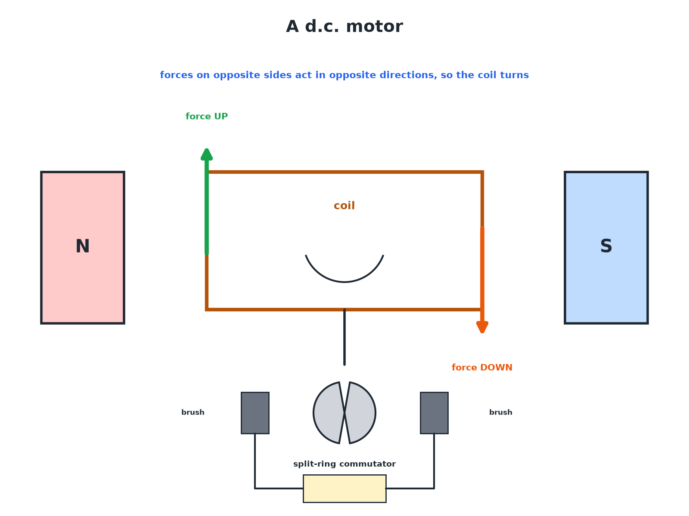

AQA GCSE PHYSICS · PAPER 2 · HIGHER TIER ONLY
A d.c. Motor
The two sides of the coil feel opposite forces.
Magnetism and electromagnetism
openrevise.com
Lesson 4 of 8

Slide 7

AQA GCSE PHYSICS · PAPER 2 · HIGHER TIER ONLY
How a d.c. Motor Turns
Follow the steps.
1
2
3
4
5
Current flows
Through the coil via the brushes and commutator.
Forces act
One side of the coil is pushed up, the other down (motor effect).
The coil rotates
The opposite forces turn the coil.
The commutator swaps
The split ring reverses the current each half turn.
Rotation continues
The forces always turn the coil the same way.
Magnetism and electromagnetism
openrevise.com
Lesson 4 of 8

Slide 8

AQA GCSE PHYSICS · PAPER 2 · HIGHER TIER ONLY
Increasing the Speed
Ways to make a motor faster.
Change
Why it works
Increase the current
Larger force on the coil
Stronger magnets
Larger magnetic flux density
More turns on the coil
Larger total force
Reverse the battery
Motor spins the other way
Magnetism and electromagnetism
openrevise.com
Lesson 4 of 8

Slide 9

AQA GCSE PHYSICS · PAPER 2 · HIGHER TIER ONLY
Why the Commutator Matters
Explain what would happen without the split-ring commutator.
Half a turn
The coil would turn to the vertical position
1
Without a commutator
The forces would then turn it back
2
Result
The coil would only oscillate and stop
3
ANSWER
The coil would not rotate continuously.
Magnetism and electromagnetism
openrevise.com
Lesson 4 of 8

Slide 10

AQA GCSE PHYSICS · PAPER 2 · HIGHER TIER ONLY
Key Terms
d.c. motor
A motor that uses direct current to make a coil rotate in a magnetic field.
Commutator
A split ring that reverses the current each half turn.
Brushes
Carbon contacts that touch the commutator.
Coil
A loop of wire that turns in the magnetic field.
Rotation
Turning about an axis.
Motor effect
The force on a current-carrying wire in a magnetic field.
Magnetism and electromagnetism
openrevise.com
Lesson 4 of 8

Slide 11

AQA GCSE PHYSICS · PAPER 2 · HIGHER TIER ONLY
YOUR TASK
15 minutes
Motor Build
Explain each part of a model motor: coil, magnets, commutator, brushes, battery. What happens if you reverse the battery?
Use the left-hand rule for each side.
1
WHAT A GOOD ANSWER SHOWS
The motor spins in the opposite direction.
Magnetism and electromagnetism
openrevise.com
Lesson 4 of 8
Notes:
Ask how to make it spin faster.

Slide 12

AQA GCSE PHYSICS · PAPER 2 · HIGHER TIER ONLY
Can I...?
Name the parts.
Increase the speed.
Explain the forces on the coil.
Reverse the direction.
Explain the commutator.
Say why opposite forces.
Describe rotation.
Link to the motor effect.
Magnetism and electromagnetism
openrevise.com
Lesson 4 of 8

Slide 13
AQA GCSE PHYSICS · PAPER 2 · HIGHER TIER ONLY
Summary & Exam Focus
Coil in a field feels opposite forces on opposite sides.
The split ring swaps the current direction each half turn.
This keeps the coil rotating the same way.
A larger current or stronger field makes it faster.
EXAM FOCUS
Describe the job of the split-ring commutator. (2 marks)
It reverses the current every half turn.
openrevise.com

Slide 14
AQA GCSE PHYSICS · PAPER 2 · HIGHER TIER ONLY
Exam Practice: Electric motors
Answer all questions. Use the mark allocation as a guide to how much to write. · 15 minutes
Question 1 · 2 marks · State
State two ways of increasing the speed of rotation of a d.c. motor.
Question 2 · 3 marks · Explain
Explain why the coil in a d.c. motor turns when a current flows through it.
Question 3 · 3 marks · Explain
Explain the purpose of the split-ring commutator in a d.c. motor.
Magnetism and electromagnetism
openrevise.com
Lesson 4 of 8

Slide 15
AQA GCSE PHYSICS · PAPER 2 · HIGHER TIER ONLY
Exam Practice: Electric motors (cont.)
Question 4 · 2 marks · Explain
The battery in a d.c. motor is connected the other way round. Describe and explain the effect.
Question 5 · 4 marks · Explain
A motor rotates slowly. Explain two changes that would make it rotate faster.
Magnetism and electromagnetism
openrevise.com
Lesson 4 of 8

Slide 16
AQA GCSE PHYSICS · PAPER 2 · HIGHER TIER ONLY
Question 1 · 2 marks · State
“
State two ways of increasing the speed of rotation of a d.c. motor.
HOW TO ANSWER IT
Command word: State. Worth 2 marks, so plan before writing.
Magnetism and electromagnetism
openrevise.com
Lesson 4 of 8

Slide 17
AQA GCSE PHYSICS · PAPER 2 · HIGHER TIER ONLY
Question 1 · mark scheme
2 marks available. Award a mark for each point made.
One way
1 mark
Another way
1 mark
Magnetism and electromagnetism
openrevise.com
Lesson 4 of 8

Slide 18
AQA GCSE PHYSICS · PAPER 2 · HIGHER TIER ONLY
Question 2 · 3 marks · Explain
“
Explain why the coil in a d.c. motor turns when a current flows through it.
HOW TO ANSWER IT
Command word: Explain. Worth 3 marks, so plan before writing.
Magnetism and electromagnetism
openrevise.com
Lesson 4 of 8

Slide 19
AQA GCSE PHYSICS · PAPER 2 · HIGHER TIER ONLY
Question 2 · mark scheme
3 marks available. Award a mark for each point made.
Coil in a field carrying a current experiences forces
1 mark
Current in opposite directions in the two sides
1 mark
Opposite forces turn the coil
1 mark
Magnetism and electromagnetism
openrevise.com
Lesson 4 of 8

Slide 20
AQA GCSE PHYSICS · PAPER 2 · HIGHER TIER ONLY
Question 3 · 3 marks · Explain
“
Explain the purpose of the split-ring commutator in a d.c. motor.
HOW TO ANSWER IT
Command word: Explain. Worth 3 marks, so plan before writing.
Magnetism and electromagnetism
openrevise.com
Lesson 4 of 8

Slide 21
AQA GCSE PHYSICS · PAPER 2 · HIGHER TIER ONLY
Question 3 · mark scheme
3 marks available. Award a mark for each point made.
Reverses the current
1 mark
Every half turn
1 mark
Keeps the coil turning the same way
1 mark
Magnetism and electromagnetism
openrevise.com
Lesson 4 of 8

Slide 22
AQA GCSE PHYSICS · PAPER 2 · HIGHER TIER ONLY
Question 4 · 2 marks · Explain
“
The battery in a d.c. motor is connected the other way round. Describe and explain the effect.
HOW TO ANSWER IT
Command word: Explain. Worth 2 marks, so plan before writing.
Magnetism and electromagnetism
openrevise.com
Lesson 4 of 8

Slide 23
AQA GCSE PHYSICS · PAPER 2 · HIGHER TIER ONLY
Question 4 · mark scheme
2 marks available. Award a mark for each point made.
Turns in the opposite direction
1 mark
Current (forces) reversed
1 mark
Magnetism and electromagnetism
openrevise.com
Lesson 4 of 8

Slide 24
AQA GCSE PHYSICS · PAPER 2 · HIGHER TIER ONLY
Question 5 · 4 marks · Explain
“
A motor rotates slowly. Explain two changes that would make it rotate faster.
HOW TO ANSWER IT
Command word: Explain. Worth 4 marks, so plan before writing.
Magnetism and electromagnetism
openrevise.com
Lesson 4 of 8

Slide 25
AQA GCSE PHYSICS · PAPER 2 · HIGHER TIER ONLY
Question 5 · mark scheme
4 marks available. Award a mark for each point made.
Increase the current
1 mark
Larger force
1 mark
Stronger magnets or more turns
1 mark
Larger force or flux density
1 mark
Magnetism and electromagnetism
openrevise.com
Lesson 4 of 8

