Slide 1

AQA GCSE PHYSICS · PAPER 2 · HIGHER TIER ONLY
Loudspeakers and headphones
Magnetism and electromagnetism
Lesson 5 of 8
openrevise.com

Slide 2

AQA GCSE PHYSICS · PAPER 2 · HIGHER TIER ONLY
Warm-up
Answer each one, then check.
1
What is sound?
2
What is frequency?
3
What is a.c.?
4
What is the motor effect?
5
What is a diaphragm?
Magnetism and electromagnetism
openrevise.com
Lesson 5 of 8

Slide 3
AQA GCSE PHYSICS · PAPER 2 · HIGHER TIER ONLY
Warm-up - Answers
What is sound?
A longitudinal wave
1
What is frequency?
Number of waves per second
2
What is a.c.?
Alternating current
3
What is the motor effect?
Force on a current-carrying wire in a magnetic field
4
What is a diaphragm?
A thin flexible cone or membrane
5
Magnetism and electromagnetism
openrevise.com
Lesson 5 of 8

Slide 4

AQA GCSE PHYSICS · PAPER 2 · HIGHER TIER ONLY
Learning Objectives
Describe the structure of a moving-coil loudspeaker.
1
Explain how a loudspeaker converts electrical signals into sound.
2
Explain how the frequency and loudness of the sound depend on the a.c.
3
Magnetism and electromagnetism
openrevise.com
Lesson 5 of 8

Slide 5

AQA GCSE PHYSICS · PAPER 2 · HIGHER TIER ONLY
LOUDSPEAKERS
In a loudspeaker an alternating current flows through a coil in a magnetic field. The motor effect makes the coil, and the cone attached to it, move back and forth at the same frequency as the current, producing sound waves.
Loudspeakers and headphones use the motor effect; microphones (next lessons) use the generator effect.
Magnetism and electromagnetism
openrevise.com
Lesson 5 of 8

Slide 6
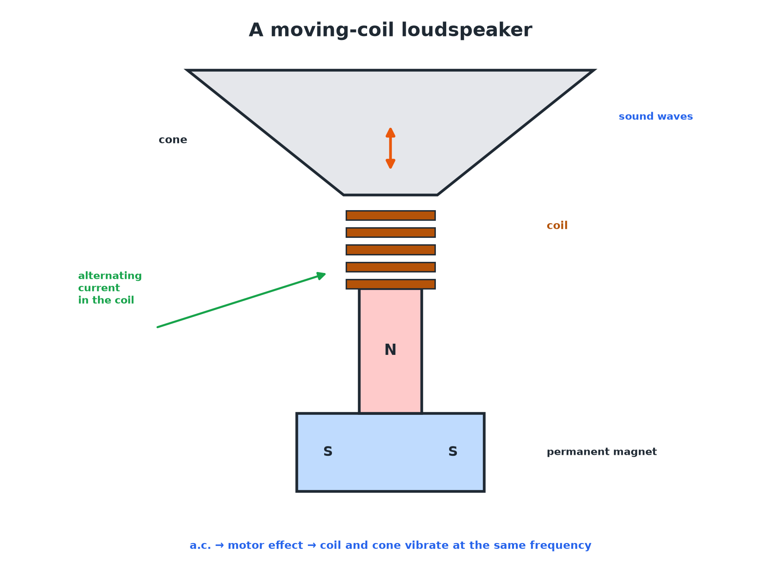

AQA GCSE PHYSICS · PAPER 2 · HIGHER TIER ONLY
A Loudspeaker
The cone moves at the frequency of the current.
Magnetism and electromagnetism
openrevise.com
Lesson 5 of 8

Slide 7

AQA GCSE PHYSICS · PAPER 2 · HIGHER TIER ONLY
How a Loudspeaker Makes Sound
Follow the steps.
1
2
3
4
5
a.c. flows
An alternating current from the amplifier flows through the coil.
The coil is in a field
The permanent magnet provides a magnetic field.
Motor effect
A force acts on the coil, changing direction as the current changes direction.
The cone vibrates
The coil moves the cone back and forth at the same frequency.
Sound waves
The vibrating cone makes longitudinal sound waves in the air.
Magnetism and electromagnetism
openrevise.com
Lesson 5 of 8

Slide 8

AQA GCSE PHYSICS · PAPER 2 · HIGHER TIER ONLY
Changing the Sound
What controls the sound?
Current
Sound
Higher frequency a.c.
Higher pitch
Larger a.c. amplitude
Louder sound (larger force, greater vibration)
Zero current
No sound
Magnetism and electromagnetism
openrevise.com
Lesson 5 of 8

Slide 9

AQA GCSE PHYSICS · PAPER 2 · HIGHER TIER ONLY
Headphones
Explain how headphones work in the same way.
Small coil
A small coil and magnet inside
1
a.c. signal
Changing current moves the coil
2
Diaphragm
A small diaphragm vibrates and creates sound
3
ANSWER
Headphones are tiny loudspeakers.
Magnetism and electromagnetism
openrevise.com
Lesson 5 of 8

Slide 10

AQA GCSE PHYSICS · PAPER 2 · HIGHER TIER ONLY
Key Terms
Loudspeaker
A device that uses the motor effect to convert electrical signals into sound.
Cone
The part of the loudspeaker that vibrates to make sound.
Alternating current
A current that repeatedly changes direction.
Frequency
The number of vibrations each second.
Amplitude
The size of the vibration.
Diaphragm
A thin vibrating membrane.
Magnetism and electromagnetism
openrevise.com
Lesson 5 of 8

Slide 11

AQA GCSE PHYSICS · PAPER 2 · HIGHER TIER ONLY
YOUR TASK
10 minutes
Speaker Soak
Write a chain of events from the amplifier to the sound reaching your ear. Then explain why the cone vibrates at the same frequency as the current.
Follow the chain.
1
WHAT A GOOD ANSWER SHOWS
a.c. → coil → motor effect → cone vibrates → sound. The force reverses each time the current reverses.
Magnetism and electromagnetism
openrevise.com
Lesson 5 of 8
Notes:
Ask what happens to the sound if the a.c. is stronger.

Slide 12

AQA GCSE PHYSICS · PAPER 2 · HIGHER TIER ONLY
Can I...?
State the parts.
Link frequency and pitch.
Name the effect used.
Link amplitude and loudness.
Explain the coil movement.
Describe headphones.
Explain the cone.
Give the energy transfer.
Magnetism and electromagnetism
openrevise.com
Lesson 5 of 8

Slide 13
AQA GCSE PHYSICS · PAPER 2 · HIGHER TIER ONLY
Summary & Exam Focus
Alternating current flows through a coil near a magnet.
The motor effect gives a force that changes direction with the current.
The coil and cone vibrate at the same frequency.
The cone makes sound waves in the air.
EXAM FOCUS
Explain why the cone in a loudspeaker vibrates. (3 marks)
Alternating current in the coil, motor effect.
openrevise.com

Slide 14
AQA GCSE PHYSICS · PAPER 2 · HIGHER TIER ONLY
Exam Practice: Loudspeakers and headphones
Answer all questions. Use the mark allocation as a guide to how much to write. · 14 minutes
Question 1 · 2 marks · State
What type of current flows through the coil of a loudspeaker? Describe how the cone moves.
Question 2 · 4 marks · Explain
Explain how a loudspeaker produces sound.
Question 3 · 2 marks · Explain
The frequency of the alternating current is increased. State the effect on the sound.
Magnetism and electromagnetism
openrevise.com
Lesson 5 of 8

Slide 15
AQA GCSE PHYSICS · PAPER 2 · HIGHER TIER ONLY
Exam Practice: Loudspeakers and headphones (cont.)
Question 4 · 2 marks · Explain
The amplitude of the current is increased. State the effect on the sound and explain.
Question 5 · 3 marks · Explain
Explain why the current in a loudspeaker must be alternating rather than direct.
Magnetism and electromagnetism
openrevise.com
Lesson 5 of 8

Slide 16
AQA GCSE PHYSICS · PAPER 2 · HIGHER TIER ONLY
Question 1 · 2 marks · State
“
What type of current flows through the coil of a loudspeaker? Describe how the cone moves.
HOW TO ANSWER IT
Command word: State. Worth 2 marks, so plan before writing.
Magnetism and electromagnetism
openrevise.com
Lesson 5 of 8

Slide 17
AQA GCSE PHYSICS · PAPER 2 · HIGHER TIER ONLY
Question 1 · mark scheme
2 marks available. Award a mark for each point made.
Alternating current
1 mark
Cone vibrates back and forth
1 mark
Magnetism and electromagnetism
openrevise.com
Lesson 5 of 8

Slide 18
AQA GCSE PHYSICS · PAPER 2 · HIGHER TIER ONLY
Question 2 · 4 marks · Explain
“
Explain how a loudspeaker produces sound.
HOW TO ANSWER IT
Command word: Explain. Worth 4 marks, so plan before writing.
Magnetism and electromagnetism
openrevise.com
Lesson 5 of 8

Slide 19
AQA GCSE PHYSICS · PAPER 2 · HIGHER TIER ONLY
Question 2 · mark scheme
4 marks available. Award a mark for each point made.
a.c. in a coil in a magnetic field
1 mark
Motor effect force
1 mark
Force changes direction so cone vibrates
1 mark
Sound waves produced
1 mark
Magnetism and electromagnetism
openrevise.com
Lesson 5 of 8

Slide 20
AQA GCSE PHYSICS · PAPER 2 · HIGHER TIER ONLY
Question 3 · 2 marks · Explain
“
The frequency of the alternating current is increased. State the effect on the sound.
HOW TO ANSWER IT
Command word: Explain. Worth 2 marks, so plan before writing.
Magnetism and electromagnetism
openrevise.com
Lesson 5 of 8

Slide 21
AQA GCSE PHYSICS · PAPER 2 · HIGHER TIER ONLY
Question 3 · mark scheme
2 marks available. Award a mark for each point made.
Higher pitch / higher frequency
1 mark
Cone vibrates faster
1 mark
Magnetism and electromagnetism
openrevise.com
Lesson 5 of 8

Slide 22
AQA GCSE PHYSICS · PAPER 2 · HIGHER TIER ONLY
Question 4 · 2 marks · Explain
“
The amplitude of the current is increased. State the effect on the sound and explain.
HOW TO ANSWER IT
Command word: Explain. Worth 2 marks, so plan before writing.
Magnetism and electromagnetism
openrevise.com
Lesson 5 of 8

Slide 23
AQA GCSE PHYSICS · PAPER 2 · HIGHER TIER ONLY
Question 4 · mark scheme
2 marks available. Award a mark for each point made.
Louder
1 mark
Larger force or larger vibration
1 mark
Magnetism and electromagnetism
openrevise.com
Lesson 5 of 8

Slide 24
AQA GCSE PHYSICS · PAPER 2 · HIGHER TIER ONLY
Question 5 · 3 marks · Explain
“
Explain why the current in a loudspeaker must be alternating rather than direct.
HOW TO ANSWER IT
Command word: Explain. Worth 3 marks, so plan before writing.
Magnetism and electromagnetism
openrevise.com
Lesson 5 of 8

Slide 25
AQA GCSE PHYSICS · PAPER 2 · HIGHER TIER ONLY
Question 5 · mark scheme
3 marks available. Award a mark for each point made.
d.c. gives a steady force in one direction
1 mark
Cone only moves once/stays displaced
1 mark
a.c. reverses the force so the cone vibrates
1 mark
Magnetism and electromagnetism
openrevise.com
Lesson 5 of 8

