Slide 1

AQA GCSE PHYSICS · PAPER 2 · FOUNDATION & HIGHER
Induced potential
Magnetism and electromagnetism
Lesson 6 of 8
openrevise.com

Slide 2

AQA GCSE PHYSICS · PAPER 2 · FOUNDATION & HIGHER
Warm-up
Answer each one, then check.
1
What does a voltmeter measure?
2
What is a magnetic field?
3
What is a current?
4
What is a coil?
5
What is a conductor?
Magnetism and electromagnetism
openrevise.com
Lesson 6 of 8

Slide 3
AQA GCSE PHYSICS · PAPER 2 · FOUNDATION & HIGHER
Warm-up - Answers
What does a voltmeter measure?
Potential difference
1
What is a magnetic field?
Region where a force acts on a magnet
2
What is a current?
A flow of charge
3
What is a coil?
Loops of wire
4
What is a conductor?
Allows current to flow
5
Magnetism and electromagnetism
openrevise.com
Lesson 6 of 8

Slide 4

AQA GCSE PHYSICS · PAPER 2 · FOUNDATION & HIGHER
Learning Objectives
Describe the generator effect.
1
Describe how a potential difference is induced in a wire or coil by moving a magnet.
2
Explain the direction of the induced current and its effect (Higher).
3
Describe the factors that increase the size of the induced potential difference.
4
Magnetism and electromagnetism
openrevise.com
Lesson 6 of 8

Slide 5

AQA GCSE PHYSICS · PAPER 2 · FOUNDATION & HIGHER
THE GENERATOR EFFECT
The generator effect is when a potential difference is induced across a conductor that moves relative to a magnetic field, or when the magnetic field through a conductor changes. If the conductor is part of a complete circuit, a current is induced.
Nothing is induced if there is no change: a stationary magnet in a stationary coil produces no potential difference.
Magnetism and electromagnetism
openrevise.com
Lesson 6 of 8

Slide 6
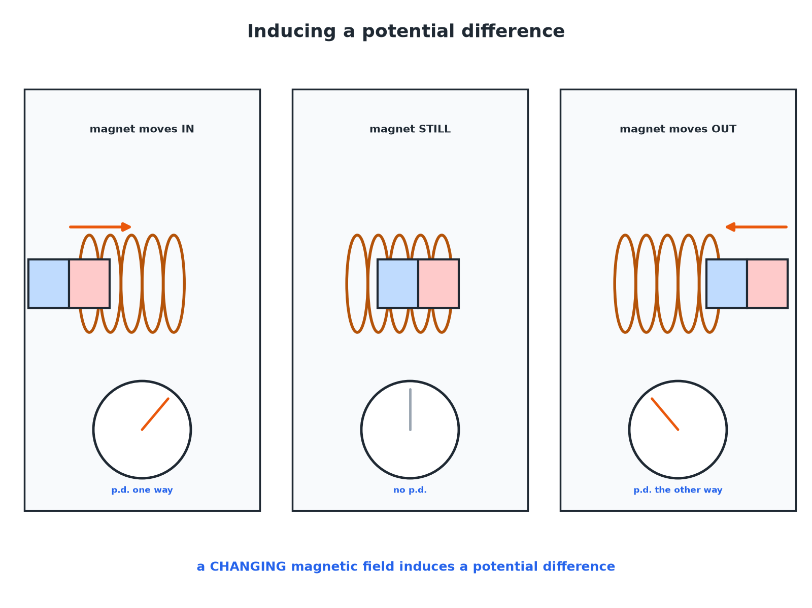

AQA GCSE PHYSICS · PAPER 2 · FOUNDATION & HIGHER
Inducing a Potential Difference
No change, no induced potential difference.
Magnetism and electromagnetism
openrevise.com
Lesson 6 of 8

Slide 7

AQA GCSE PHYSICS · PAPER 2 · FOUNDATION & HIGHER
What Changes the Induced p.d.
Learn the factors.
Change
Effect on the induced potential difference
Faster movement of the magnet
Larger
Stronger magnet
Larger
More turns on the coil
Larger
Reverse the movement
Direction of p.d. reverses
Reverse the magnet
Direction of p.d. reverses
Magnet stationary
No induced p.d.
Magnetism and electromagnetism
openrevise.com
Lesson 6 of 8

Slide 8

AQA GCSE PHYSICS · PAPER 2 · FOUNDATION & HIGHER
Why Does a Current Flow?
Explain why a current is produced when a magnet is moved into a coil connected in a circuit.
Magnetic field changes
As the magnet moves in, the field through the coil changes
1
p.d. induced
A potential difference is induced across the coil
2
Complete circuit
The induced p.d. makes a current flow
3
ANSWER
A changing field induces a p.d., and a current in a complete circuit.
Magnetism and electromagnetism
openrevise.com
Lesson 6 of 8

Slide 9

AQA GCSE PHYSICS · PAPER 2 · FOUNDATION & HIGHER
Direction of the Induced Current
Higher tier.
Its own field
The induced current produces a magnetic field of its own.
Opposes the change
This field opposes the change that produced it.
Energy
You have to do work to push the magnet in.
Conservation
That work is what gets transferred to electrical energy.
Magnetism and electromagnetism
openrevise.com
Lesson 6 of 8

Slide 10

AQA GCSE PHYSICS · PAPER 2 · FOUNDATION & HIGHER
Key Terms
Generator effect
The induction of a potential difference across a conductor when the magnetic field changes or the conductor moves in a magnetic field.
Induced potential difference
A p.d. produced by the generator effect.
Induced current
A current produced in a complete circuit by an induced p.d.
Coil
Loops of wire.
Flux
The magnetic field passing through a coil.
Galvanometer
A sensitive meter that shows small currents.
Magnetism and electromagnetism
openrevise.com
Lesson 6 of 8

Slide 11

AQA GCSE PHYSICS · PAPER 2 · FOUNDATION & HIGHER
YOUR TASK
12 minutes
Magnet in a Coil
Push a bar magnet into a coil connected to a galvanometer. Record the deflection: slowly, quickly, out, stationary. What do you notice?
Keep the coil the same.
1
WHAT A GOOD ANSWER SHOWS
Faster gives a bigger deflection; out reverses it; stationary gives zero.
Magnetism and electromagnetism
openrevise.com
Lesson 6 of 8
Notes:
Ask what else would increase the deflection.

Slide 12
AQA GCSE PHYSICS · PAPER 2 · FOUNDATION & HIGHER
Can I...?
State the generator effect.
Reverse the direction.
Say what induces a p.d.
Explain no movement, no p.d.
Say when a current flows.
Explain the opposing field.
List ways to increase it.
Link to energy.
Magnetism and electromagnetism
openrevise.com
Lesson 6 of 8

Slide 13
AQA GCSE PHYSICS · PAPER 2 · FOUNDATION & HIGHER
Summary & Exam Focus
A changing magnetic field induces a potential difference.
Bigger with faster movement, stronger magnet, more turns.
No movement gives no p.d.
Reversing the movement reverses the p.d.
EXAM FOCUS
State two ways of increasing the potential difference induced in a coil. (2 marks)
Faster movement, stronger magnet, more turns.
openrevise.com

Slide 14
AQA GCSE PHYSICS · PAPER 2 · FOUNDATION & HIGHER
Exam Practice: Induced potential
Answer all questions. Use the mark allocation as a guide to how much to write. · 15 minutes
Question 1 · 2 marks · State
A magnet is pushed into a coil of wire connected to a voltmeter. State two ways of increasing the reading on the voltmeter.
Question 2 · 3 marks · Explain
A student holds a bar magnet still inside a coil of wire connected to a voltmeter. The voltmeter reads zero. Explain why and what they…
Question 3 · 3 marks · Describe
Describe what happens to the reading on the voltmeter when the magnet is pulled out of the coil at the same speed as it was pushed in.
Magnetism and electromagnetism
openrevise.com
Lesson 6 of 8

Slide 15
AQA GCSE PHYSICS · PAPER 2 · FOUNDATION & HIGHER
Exam Practice: Induced potential (cont.)
Question 4 · 3 marks · Explain
Explain why a current flows when a magnet is moved into a coil that is part of a complete circuit.
Question 5 · 3 marks · Explain
Explain why it is harder to push a magnet into a coil connected in a complete circuit than into a coil that is not connected.
Magnetism and electromagnetism
openrevise.com
Lesson 6 of 8

Slide 16
AQA GCSE PHYSICS · PAPER 2 · FOUNDATION & HIGHER
Question 1 · 2 marks · State
“
A magnet is pushed into a coil of wire connected to a voltmeter. State two ways of increasing the reading on the voltmeter.
HOW TO ANSWER IT
Command word: State. Worth 2 marks, so plan before writing.
Magnetism and electromagnetism
openrevise.com
Lesson 6 of 8

Slide 17
AQA GCSE PHYSICS · PAPER 2 · FOUNDATION & HIGHER
Question 1 · mark scheme
2 marks available. Award a mark for each point made.
One way
1 mark
Another way
1 mark
Magnetism and electromagnetism
openrevise.com
Lesson 6 of 8

Slide 18
AQA GCSE PHYSICS · PAPER 2 · FOUNDATION & HIGHER
Question 2 · 3 marks · Explain
“
A student holds a bar magnet still inside a coil of wire connected to a voltmeter. The voltmeter reads zero. Explain why and what they should do to get a reading.
HOW TO ANSWER IT
Command word: Explain. Worth 3 marks, so plan before writing.
Magnetism and electromagnetism
openrevise.com
Lesson 6 of 8

Slide 19
AQA GCSE PHYSICS · PAPER 2 · FOUNDATION & HIGHER
Question 2 · mark scheme
3 marks available. Award a mark for each point made.
No change in field
1 mark
No p.d. induced
1 mark
Move the magnet
1 mark
Magnetism and electromagnetism
openrevise.com
Lesson 6 of 8

Slide 20
AQA GCSE PHYSICS · PAPER 2 · FOUNDATION & HIGHER
Question 3 · 3 marks · Describe
“
Describe what happens to the reading on the voltmeter when the magnet is pulled out of the coil at the same speed as it was pushed in.
HOW TO ANSWER IT
Command word: Describe. Worth 3 marks, so plan before writing.
Magnetism and electromagnetism
openrevise.com
Lesson 6 of 8

Slide 21
AQA GCSE PHYSICS · PAPER 2 · FOUNDATION & HIGHER
Question 3 · mark scheme
3 marks available. Award a mark for each point made.
A reading is shown
1 mark
Same size
1 mark
Opposite direction
1 mark
Magnetism and electromagnetism
openrevise.com
Lesson 6 of 8

Slide 22
AQA GCSE PHYSICS · PAPER 2 · FOUNDATION & HIGHER
Question 4 · 3 marks · Explain
“
Explain why a current flows when a magnet is moved into a coil that is part of a complete circuit.
HOW TO ANSWER IT
Command word: Explain. Worth 3 marks, so plan before writing.
Magnetism and electromagnetism
openrevise.com
Lesson 6 of 8

Slide 23
AQA GCSE PHYSICS · PAPER 2 · FOUNDATION & HIGHER
Question 4 · mark scheme
3 marks available. Award a mark for each point made.
Changing field through the coil
1 mark
p.d. induced
1 mark
Complete circuit so current flows
1 mark
Magnetism and electromagnetism
openrevise.com
Lesson 6 of 8

Slide 24
AQA GCSE PHYSICS · PAPER 2 · FOUNDATION & HIGHER
Question 5 · 3 marks · Explain
“
Explain why it is harder to push a magnet into a coil connected in a complete circuit than into a coil that is not connected.
HOW TO ANSWER IT
Command word: Explain. Worth 3 marks, so plan before writing.
Magnetism and electromagnetism
openrevise.com
Lesson 6 of 8

Slide 25
AQA GCSE PHYSICS · PAPER 2 · FOUNDATION & HIGHER
Question 5 · mark scheme
3 marks available. Award a mark for each point made.
Induced current produces its own field
1 mark
Opposes the motion
1 mark
Work done is transferred to electrical energy
1 mark
Magnetism and electromagnetism
openrevise.com
Lesson 6 of 8

