Slide 1

AQA GCSE PHYSICS · PAPER 2 · FOUNDATION & HIGHER
Alternators, dynamos and microphones
Magnetism and electromagnetism
Lesson 7 of 8
openrevise.com

Slide 2

AQA GCSE PHYSICS · PAPER 2 · FOUNDATION & HIGHER
Warm-up
Answer each one, then check.
1
What is a.c.?
2
What is d.c.?
3
What is the generator effect?
4
What is the UK mains frequency?
5
What is a slip ring?
Magnetism and electromagnetism
openrevise.com
Lesson 7 of 8

Slide 3
AQA GCSE PHYSICS · PAPER 2 · FOUNDATION & HIGHER
Warm-up - Answers
What is a.c.?
Alternating current
1
What is d.c.?
Direct current
2
What is the generator effect?
p.d. induced by a changing magnetic field
3
What is the UK mains frequency?
50 Hz
4
What is a slip ring?
A continuous ring that keeps contact with a brush
5
Magnetism and electromagnetism
openrevise.com
Lesson 7 of 8

Slide 4

AQA GCSE PHYSICS · PAPER 2 · FOUNDATION & HIGHER
Learning Objectives
Describe how an alternator generates an alternating current.
1
Describe how a dynamo generates direct current.
2
Interpret potential difference–time graphs from a.c. and d.c. generators.
3
Describe how a microphone converts sound to an electrical signal (Higher).
4
Magnetism and electromagnetism
openrevise.com
Lesson 7 of 8

Slide 5

AQA GCSE PHYSICS · PAPER 2 · FOUNDATION & HIGHER
GENERATORS
An alternator rotates a coil in a magnetic field using slip rings and brushes to produce an alternating potential difference. A dynamo uses a split-ring commutator so the output is direct current (p.d. in one direction).
The output increases with faster rotation, more turns or a stronger field. Faster rotation also increases the frequency.
Magnetism and electromagnetism
openrevise.com
Lesson 7 of 8

Slide 6
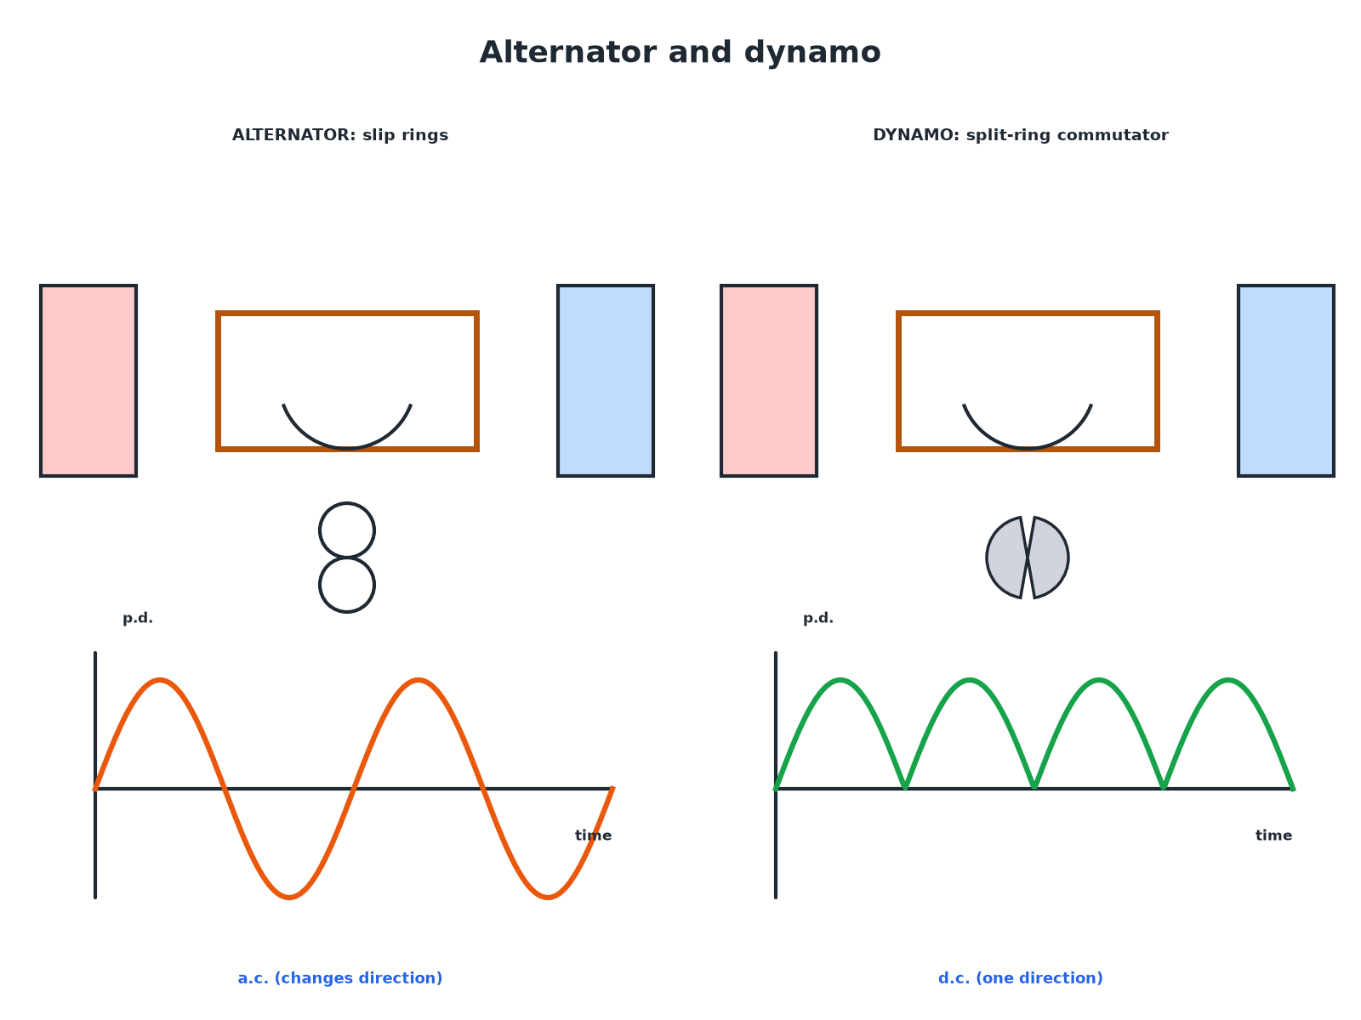

AQA GCSE PHYSICS · PAPER 2 · FOUNDATION & HIGHER
Alternator and Dynamo Graphs
Slip rings give a.c.; a commutator gives d.c.
Magnetism and electromagnetism
openrevise.com
Lesson 7 of 8

Slide 7

AQA GCSE PHYSICS · PAPER 2 · FOUNDATION & HIGHER
Alternator or Dynamo?
ALTERNATOR
DYNAMO
• Coil rotates in a magnetic field.
• Slip rings and brushes.
• Output: alternating p.d., changing direction each half turn.
• Coil rotates in a magnetic field.
• Split-ring commutator and brushes.
• Output: direct p.d., always in one direction.
Magnetism and electromagnetism
openrevise.com
Lesson 7 of 8

Slide 8

AQA GCSE PHYSICS · PAPER 2 · FOUNDATION & HIGHER
Changing the Output
Learn what changes the graph.
Change
Effect on the graph
Faster rotation
Larger amplitude and higher frequency
Stronger magnet
Larger amplitude
More turns
Larger amplitude
Slower rotation
Smaller amplitude and lower frequency
Magnetism and electromagnetism
openrevise.com
Lesson 7 of 8

Slide 9

AQA GCSE PHYSICS · PAPER 2 · FOUNDATION & HIGHER
Reading an a.c. Graph
The graph shows a sine wave with period 0.020 s. Find the frequency.
Equation
f = 1 ÷ T
1
Substitute
f = 1 ÷ 0.020
2
Answer
f = 50 Hz
3
ANSWER
50 Hz
Magnetism and electromagnetism
openrevise.com
Lesson 7 of 8

Slide 10
AQA GCSE PHYSICS · PAPER 2 · FOUNDATION & HIGHER
How a Microphone Works (Higher)
Explain how a moving-coil microphone changes sound into an electrical signal.
Sound waves
Make a diaphragm vibrate
1
Coil
Attached to the diaphragm, moves in the field of a magnet
2
Generator effect
Induces an a.c. p.d. in the coil with the same frequency as the sound
3
ANSWER
Sound vibrates the diaphragm, the coil moves in a magnetic field, and a p.d. is induced.
Magnetism and electromagnetism
openrevise.com
Lesson 7 of 8

Slide 11

AQA GCSE PHYSICS · PAPER 2 · FOUNDATION & HIGHER
Key Terms
Alternator
A generator that produces alternating current.
Dynamo
A generator that produces direct current.
Slip rings
Rings that keep the coil connected to the brushes without reversing the output.
Commutator
A split ring that reverses the connections each half turn.
Microphone
A device that converts sound into an electrical signal.
Brush
A carbon contact that touches a ring.
Magnetism and electromagnetism
openrevise.com
Lesson 7 of 8

Slide 12

AQA GCSE PHYSICS · PAPER 2 · FOUNDATION & HIGHER
YOUR TASK
12 minutes
Generator Graphs
Sketch the p.d.–time graph for an alternator. Then sketch it when the coil spins twice as fast.
Count the number of cycles.
1
WHAT A GOOD ANSWER SHOWS
Sine wave; twice as fast gives twice the amplitude and twice the frequency.
Magnetism and electromagnetism
openrevise.com
Lesson 7 of 8
Notes:
Ask learners to label the period.

Slide 13

AQA GCSE PHYSICS · PAPER 2 · FOUNDATION & HIGHER
Can I...?
Describe an alternator.
Sketch a.c. and d.c. graphs.
Describe a dynamo.
Change the output.
Name slip rings.
Describe a microphone.
Name the commutator.
Calculate frequency.
Magnetism and electromagnetism
openrevise.com
Lesson 7 of 8

Slide 14
AQA GCSE PHYSICS · PAPER 2 · FOUNDATION & HIGHER
Summary & Exam Focus
Alternator: slip rings, a.c.
Dynamo: split ring, d.c.
Faster rotation increases the p.d. and the frequency.
Microphone: sound makes a coil move in a field, inducing an a.c.
EXAM FOCUS
Explain the difference between the output of an alternator and a dynamo. (2 marks)
Alternator a.c., dynamo d.c.
openrevise.com

Slide 15
AQA GCSE PHYSICS · PAPER 2 · FOUNDATION & HIGHER
Exam Practice: Alternators, dynamos and microphones
Answer all questions. Use the mark allocation as a guide to how much to write. · 15 minutes
Question 1 · 2 marks · State
State the type of current produced by (a) an alternator and (b) a dynamo.
Question 2 · 3 marks · Explain
An alternator rotates at a constant speed. Describe how the output potential difference changes with time.
Question 3 · 3 marks · Explain
The speed of rotation of the coil in an alternator is doubled. Describe two changes to the potential difference–time graph.
Magnetism and electromagnetism
openrevise.com
Lesson 7 of 8

Slide 16
AQA GCSE PHYSICS · PAPER 2 · FOUNDATION & HIGHER
Exam Practice: Alternators, dynamos and microphones (cont.)
Question 4 · 2 marks · Calculate
A potential difference–time graph of an alternator shows one complete wave lasts 0.020 s. Calculate the frequency.
Question 5 · 4 marks · Explain
Explain how a moving-coil microphone converts sound waves into an electrical signal.
Magnetism and electromagnetism
openrevise.com
Lesson 7 of 8

Slide 17
AQA GCSE PHYSICS · PAPER 2 · FOUNDATION & HIGHER
Question 1 · 2 marks · State
“
State the type of current produced by (a) an alternator and (b) a dynamo.
HOW TO ANSWER IT
Command word: State. Worth 2 marks, so plan before writing.
Magnetism and electromagnetism
openrevise.com
Lesson 7 of 8

Slide 18
AQA GCSE PHYSICS · PAPER 2 · FOUNDATION & HIGHER
Question 1 · mark scheme
2 marks available. Award a mark for each point made.
Alternator a.c.
1 mark
Dynamo d.c.
1 mark
Magnetism and electromagnetism
openrevise.com
Lesson 7 of 8

Slide 19
AQA GCSE PHYSICS · PAPER 2 · FOUNDATION & HIGHER
Question 2 · 3 marks · Explain
“
An alternator rotates at a constant speed. Describe how the output potential difference changes with time.
HOW TO ANSWER IT
Command word: Explain. Worth 3 marks, so plan before writing.
Magnetism and electromagnetism
openrevise.com
Lesson 7 of 8

Slide 20
AQA GCSE PHYSICS · PAPER 2 · FOUNDATION & HIGHER
Question 2 · mark scheme
3 marks available. Award a mark for each point made.
Alternating or repeating pattern
1 mark
Positive and negative
1 mark
Reverses every half turn
1 mark
Magnetism and electromagnetism
openrevise.com
Lesson 7 of 8

Slide 21
AQA GCSE PHYSICS · PAPER 2 · FOUNDATION & HIGHER
Question 3 · 3 marks · Explain
“
The speed of rotation of the coil in an alternator is doubled. Describe two changes to the potential difference–time graph.
HOW TO ANSWER IT
Command word: Explain. Worth 3 marks, so plan before writing.
Magnetism and electromagnetism
openrevise.com
Lesson 7 of 8

Slide 22
AQA GCSE PHYSICS · PAPER 2 · FOUNDATION & HIGHER
Question 3 · mark scheme
3 marks available. Award a mark for each point made.
Larger amplitude
1 mark
Higher frequency
1 mark
Shorter period / more waves in same time
1 mark
Magnetism and electromagnetism
openrevise.com
Lesson 7 of 8

Slide 23
AQA GCSE PHYSICS · PAPER 2 · FOUNDATION & HIGHER
Question 4 · 2 marks · Calculate
“
A potential difference–time graph of an alternator shows one complete wave lasts 0.020 s. Calculate the frequency.
HOW TO ANSWER IT
Command word: Calculate. Worth 2 marks, so plan before writing.
Magnetism and electromagnetism
openrevise.com
Lesson 7 of 8

Slide 24
AQA GCSE PHYSICS · PAPER 2 · FOUNDATION & HIGHER
Question 4 · mark scheme
2 marks available. Award a mark for each point made.
Substitution
1 mark
50 Hz
1 mark
Magnetism and electromagnetism
openrevise.com
Lesson 7 of 8

Slide 25
AQA GCSE PHYSICS · PAPER 2 · FOUNDATION & HIGHER
Question 5 · 4 marks · Explain
“
Explain how a moving-coil microphone converts sound waves into an electrical signal.
HOW TO ANSWER IT
Command word: Explain. Worth 4 marks, so plan before writing.
Magnetism and electromagnetism
openrevise.com
Lesson 7 of 8

Slide 26
AQA GCSE PHYSICS · PAPER 2 · FOUNDATION & HIGHER
Question 5 · mark scheme
4 marks available. Award a mark for each point made.
Sound makes the diaphragm vibrate
1 mark
Coil moves in a magnetic field
1 mark
Generator effect / induced p.d.
1 mark
a.c. with the same frequency as the sound
1 mark
Magnetism and electromagnetism
openrevise.com
Lesson 7 of 8

