Slide 1

AQA GCSE PHYSICS · PAPER 2 · HIGHER TIER ONLY
Transformers
Magnetism and electromagnetism
Lesson 8 of 8
openrevise.com

Slide 2

AQA GCSE PHYSICS · PAPER 2 · HIGHER TIER ONLY
Warm-up
Answer each one, then check.
1
What is the National Grid?
2
Why is high voltage used in the grid?
3
What is power?
4
What is a.c.?
5
What is a coil?
Magnetism and electromagnetism
openrevise.com
Lesson 8 of 8

Slide 3
AQA GCSE PHYSICS · PAPER 2 · HIGHER TIER ONLY
Warm-up - Answers
What is the National Grid?
The network that transfers electrical power
1
Why is high voltage used in the grid?
To reduce energy lost as heat
2
What is power?
The rate of transfer of energy
3
What is a.c.?
Alternating current
4
What is a coil?
Loops of wire
5
Magnetism and electromagnetism
openrevise.com
Lesson 8 of 8

Slide 4

AQA GCSE PHYSICS · PAPER 2 · HIGHER TIER ONLY
Learning Objectives
Describe the structure and function of a transformer.
1
Explain how a step-up and a step-down transformer work.
2
Use V_p / V_s = n_p / n_s.
3
Use V_s I_s = V_p I_p for a 100% efficient transformer.
4
Explain why the National Grid uses transformers.
5
Magnetism and electromagnetism
openrevise.com
Lesson 8 of 8

Slide 5

AQA GCSE PHYSICS · PAPER 2 · HIGHER TIER ONLY
THE TRANSFORMER EQUATIONS
V_p/(V_s) = n_p/(n_s) and V_s × I_s = V_p × I_p
V_p, I_p, n_p are for the primary coil; V_s, I_s, n_s for the secondary. The second equation assumes 100% efficiency (power in = power out).
Magnetism and electromagnetism
openrevise.com
Lesson 8 of 8

Slide 6
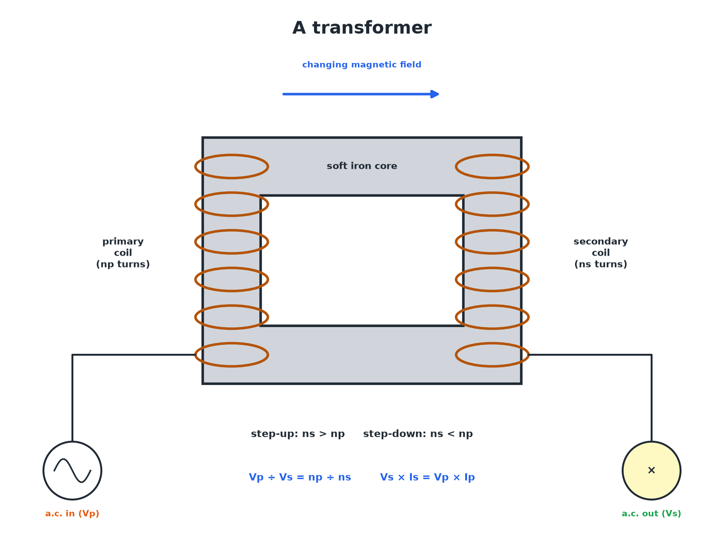

AQA GCSE PHYSICS · PAPER 2 · HIGHER TIER ONLY
A Transformer
The iron core links the magnetic field between the coils.
Magnetism and electromagnetism
openrevise.com
Lesson 8 of 8

Slide 7

AQA GCSE PHYSICS · PAPER 2 · HIGHER TIER ONLY
How a Transformer Works
Follow the steps.
1
2
3
4
5
a.c. in the primary
An alternating current flows in the primary coil.
Changing field
It produces a changing magnetic field in the iron core.
Field through the secondary
The changing field passes through the secondary coil.
Generator effect
An alternating p.d. is induced in the secondary coil.
Turns ratio
The ratio of turns sets the ratio of potential differences.
Magnetism and electromagnetism
openrevise.com
Lesson 8 of 8

Slide 8

AQA GCSE PHYSICS · PAPER 2 · HIGHER TIER ONLY
Step-up or Step-down?
STEP-UP TRANSFORMER
STEP-DOWN TRANSFORMER
• More turns on the secondary coil.
• Increases the potential difference.
• Used at power stations before the grid.
• Fewer turns on the secondary coil.
• Decreases the potential difference.
• Used near homes to bring the p.d. down to 230 V.
Magnetism and electromagnetism
openrevise.com
Lesson 8 of 8

Slide 9

AQA GCSE PHYSICS · PAPER 2 · HIGHER TIER ONLY
Using the Turns Ratio
A transformer has 200 turns on its primary coil and 1000 on its secondary. The input is 12 V. Calculate the output potential difference.
Write the equation
V_p / V_s = n_p / n_s
1
Rearrange
V_s = V_p × n_s ÷ n_p
2
Substitute
V_s = 12 × 1000 ÷ 200
3
Answer
V_s = 60 V
4
ANSWER
60 V
Magnetism and electromagnetism
openrevise.com
Lesson 8 of 8

Slide 10
AQA GCSE PHYSICS · PAPER 2 · HIGHER TIER ONLY
Power In Equals Power Out
A 100% efficient transformer has a primary p.d. of 230 V and current of 2.0 A. The secondary p.d. is 11.5 V. Calculate the secondary current.
Write the equation
V_s I_s = V_p I_p
1
Rearrange
I_s = V_p I_p ÷ V_s
2
Substitute
I_s = 230 × 2.0 ÷ 11.5
3
Answer
I_s = 40 A
4
ANSWER
40 A
Magnetism and electromagnetism
openrevise.com
Lesson 8 of 8

Slide 11

AQA GCSE PHYSICS · PAPER 2 · HIGHER TIER ONLY
Why the National Grid Uses Them
High voltage, low current.
Step-up at the power station
Raises the p.d. (up to 400 000 V) and lowers the current.
Lower current
Less energy is wasted as heat in the cables.
Step-down near homes
Reduces the p.d. to 230 V for safe use.
Efficiency
The grid is efficient because transformers waste little energy.
Magnetism and electromagnetism
openrevise.com
Lesson 8 of 8

Slide 12

AQA GCSE PHYSICS · PAPER 2 · HIGHER TIER ONLY
Key Terms
Transformer
A device that changes the potential difference of an alternating supply.
Primary coil
The input coil of a transformer.
Secondary coil
The output coil of a transformer.
Step-up transformer
A transformer that increases the potential difference.
Step-down transformer
A transformer that decreases the potential difference.
Soft iron core
A core that easily becomes magnetised and demagnetised, linking the coils.
Magnetism and electromagnetism
openrevise.com
Lesson 8 of 8

Slide 13

AQA GCSE PHYSICS · PAPER 2 · HIGHER TIER ONLY
YOUR TASK
15 minutes
Transformer Sums
A transformer has n_p = 50 and n_s = 500. Input 10 V a.c. Find V_s. If the input current is 2.0 A, find I_s assuming 100% efficiency.
Step-up: p.d. up, current down.
1
WHAT A GOOD ANSWER SHOWS
Vs = 10 × 500 ÷ 50 = 100 V. Power in = 20 W, so Is = 20 ÷ 100 = 0.20 A.
Magnetism and electromagnetism
openrevise.com
Lesson 8 of 8
Notes:
Ask what happens to the current in a step-up transformer.

Slide 14
AQA GCSE PHYSICS · PAPER 2 · HIGHER TIER ONLY
Can I...?
Name the parts.
Use power in = power out.
Explain the working.
Explain why a.c. is needed.
State step-up and step-down.
Explain the National Grid.
Use the turns ratio.
Give typical voltages.
Magnetism and electromagnetism
openrevise.com
Lesson 8 of 8

Slide 15
AQA GCSE PHYSICS · PAPER 2 · HIGHER TIER ONLY
Summary & Exam Focus
V_p / V_s = n_p / n_s.
V_s I_s = V_p I_p for 100% efficiency.
Step-up increases the p.d. and decreases the current.
a.c. is needed for a changing field.
EXAM FOCUS
A transformer has 200 primary turns and 1000 secondary turns. The input is 12 V. Calculate the output. (2 marks)
Vs = Vp × ns ÷ np.
openrevise.com

Slide 16
AQA GCSE PHYSICS · PAPER 2 · HIGHER TIER ONLY
Exam Practice: Transformers
Answer all questions. Use the mark allocation as a guide to how much to write. · 17 minutes
Question 1 · 2 marks · Calculate
A transformer has 200 turns on its primary coil and 1000 turns on its secondary coil. The input potential difference is 12 V. Calculate the…
Question 2 · 4 marks · Explain
Explain how a transformer changes the potential difference of an alternating supply.
Question 3 · 3 marks · Calculate
A transformer is 100% efficient. The primary p.d. is 230 V and the primary current is 2.0 A. The secondary p.d. is 11.5 V. Calculate the…
Magnetism and electromagnetism
openrevise.com
Lesson 8 of 8

Slide 17
AQA GCSE PHYSICS · PAPER 2 · HIGHER TIER ONLY
Exam Practice: Transformers (cont.)
Question 4 · 3 marks · Explain
Explain why a transformer does not work with a direct current.
Question 5 · 4 marks · Explain
Explain why electricity is transmitted in the National Grid at a very high potential difference.
Magnetism and electromagnetism
openrevise.com
Lesson 8 of 8

Slide 18
AQA GCSE PHYSICS · PAPER 2 · HIGHER TIER ONLY
Question 1 · 2 marks · Calculate
“
A transformer has 200 turns on its primary coil and 1000 turns on its secondary coil. The input potential difference is 12 V. Calculate the output potential difference. Use the equation: Vp ÷ Vs = np ÷ ns
HOW TO ANSWER IT
Command word: Calculate. Worth 2 marks, so plan before writing.
Magnetism and electromagnetism
openrevise.com
Lesson 8 of 8

Slide 19
AQA GCSE PHYSICS · PAPER 2 · HIGHER TIER ONLY
Question 1 · mark scheme
2 marks available. Award a mark for each point made.
Correct rearrangement and substitution
1 mark
60 V
1 mark
Magnetism and electromagnetism
openrevise.com
Lesson 8 of 8

Slide 20
AQA GCSE PHYSICS · PAPER 2 · HIGHER TIER ONLY
Question 2 · 4 marks · Explain
“
Explain how a transformer changes the potential difference of an alternating supply.
HOW TO ANSWER IT
Command word: Explain. Worth 4 marks, so plan before writing.
Magnetism and electromagnetism
openrevise.com
Lesson 8 of 8

Slide 21
AQA GCSE PHYSICS · PAPER 2 · HIGHER TIER ONLY
Question 2 · mark scheme
4 marks available. Award a mark for each point made.
a.c. in the primary makes a changing magnetic field
1 mark
Field carried by the iron core to the secondary
1 mark
Induced p.d. in the secondary (generator effect)
1 mark
Turns ratio sets the p.d. ratio
1 mark
Magnetism and electromagnetism
openrevise.com
Lesson 8 of 8

Slide 22
AQA GCSE PHYSICS · PAPER 2 · HIGHER TIER ONLY
Question 3 · 3 marks · Calculate
“
A transformer is 100% efficient. The primary p.d. is 230 V and the primary current is 2.0 A. The secondary p.d. is 11.5 V. Calculate the secondary current.
HOW TO ANSWER IT
Command word: Calculate. Worth 3 marks, so plan before writing.
Magnetism and electromagnetism
openrevise.com
Lesson 8 of 8

Slide 23
AQA GCSE PHYSICS · PAPER 2 · HIGHER TIER ONLY
Question 3 · mark scheme
3 marks available. Award a mark for each point made.
Vs Is = Vp Ip
1 mark
Correct substitution
1 mark
40 A
1 mark
Magnetism and electromagnetism
openrevise.com
Lesson 8 of 8

Slide 24
AQA GCSE PHYSICS · PAPER 2 · HIGHER TIER ONLY
Question 4 · 3 marks · Explain
“
Explain why a transformer does not work with a direct current.
HOW TO ANSWER IT
Command word: Explain. Worth 3 marks, so plan before writing.
Magnetism and electromagnetism
openrevise.com
Lesson 8 of 8

Slide 25
AQA GCSE PHYSICS · PAPER 2 · HIGHER TIER ONLY
Question 4 · mark scheme
3 marks available. Award a mark for each point made.
d.c. produces a constant field
1 mark
No change in field in the secondary
1 mark
No p.d. induced
1 mark
Magnetism and electromagnetism
openrevise.com
Lesson 8 of 8

Slide 26
AQA GCSE PHYSICS · PAPER 2 · HIGHER TIER ONLY
Question 5 · 4 marks · Explain
“
Explain why electricity is transmitted in the National Grid at a very high potential difference.
HOW TO ANSWER IT
Command word: Explain. Worth 4 marks, so plan before writing.
Magnetism and electromagnetism
openrevise.com
Lesson 8 of 8

Slide 27
AQA GCSE PHYSICS · PAPER 2 · HIGHER TIER ONLY
Question 5 · mark scheme
4 marks available. Award a mark for each point made.
Step-up transformer raises p.d.
1 mark
Current is lower for the same power
1 mark
Less energy wasted as heat
1 mark
Step-down near homes for safety
1 mark
Magnetism and electromagnetism
openrevise.com
Lesson 8 of 8

