Slide 1

AQA GCSE PHYSICS · PAPER 2 · FOUNDATION & HIGHER
Our solar system
Space physics
Lesson 1 of 4
openrevise.com

Slide 2

AQA GCSE PHYSICS · PAPER 2 · FOUNDATION & HIGHER
Warm-up
Answer each one, then check.
1
What force holds planets in orbit?
2
Name the star at the centre of our solar system.
3
Name the galaxy we live in.
4
Name three planets.
5
What is a moon?
Space physics
openrevise.com
Lesson 1 of 4

Slide 3
AQA GCSE PHYSICS · PAPER 2 · FOUNDATION & HIGHER
Warm-up - Answers
What force holds planets in orbit?
Gravity
1
Name the star at the centre of our solar system.
The Sun
2
Name the galaxy we live in.
The Milky Way
3
Name three planets.
For example Earth, Mars and Jupiter
4
What is a moon?
A natural satellite of a planet
5
Space physics
openrevise.com
Lesson 1 of 4

Slide 4

AQA GCSE PHYSICS · PAPER 2 · FOUNDATION & HIGHER
Learning Objectives
Describe the structure of the solar system and our galaxy.
1
Describe how the Sun and the planets formed.
2
Describe the orbits of planets, moons and satellites.
3
Describe the force that keeps an object in orbit.
4
Explain the difference between natural and artificial satellites.
5
Space physics
openrevise.com
Lesson 1 of 4

Slide 5

AQA GCSE PHYSICS · PAPER 2 · FOUNDATION & HIGHER
THE SOLAR SYSTEM
Our solar system is made up of the Sun at the centre, eight planets, dwarf planets, moons, asteroids and comets. It is part of the Milky Way galaxy. Gravity causes objects to orbit.
Our Sun is one of about 100 billion stars in the Milky Way galaxy.
Space physics
openrevise.com
Lesson 1 of 4

Slide 6
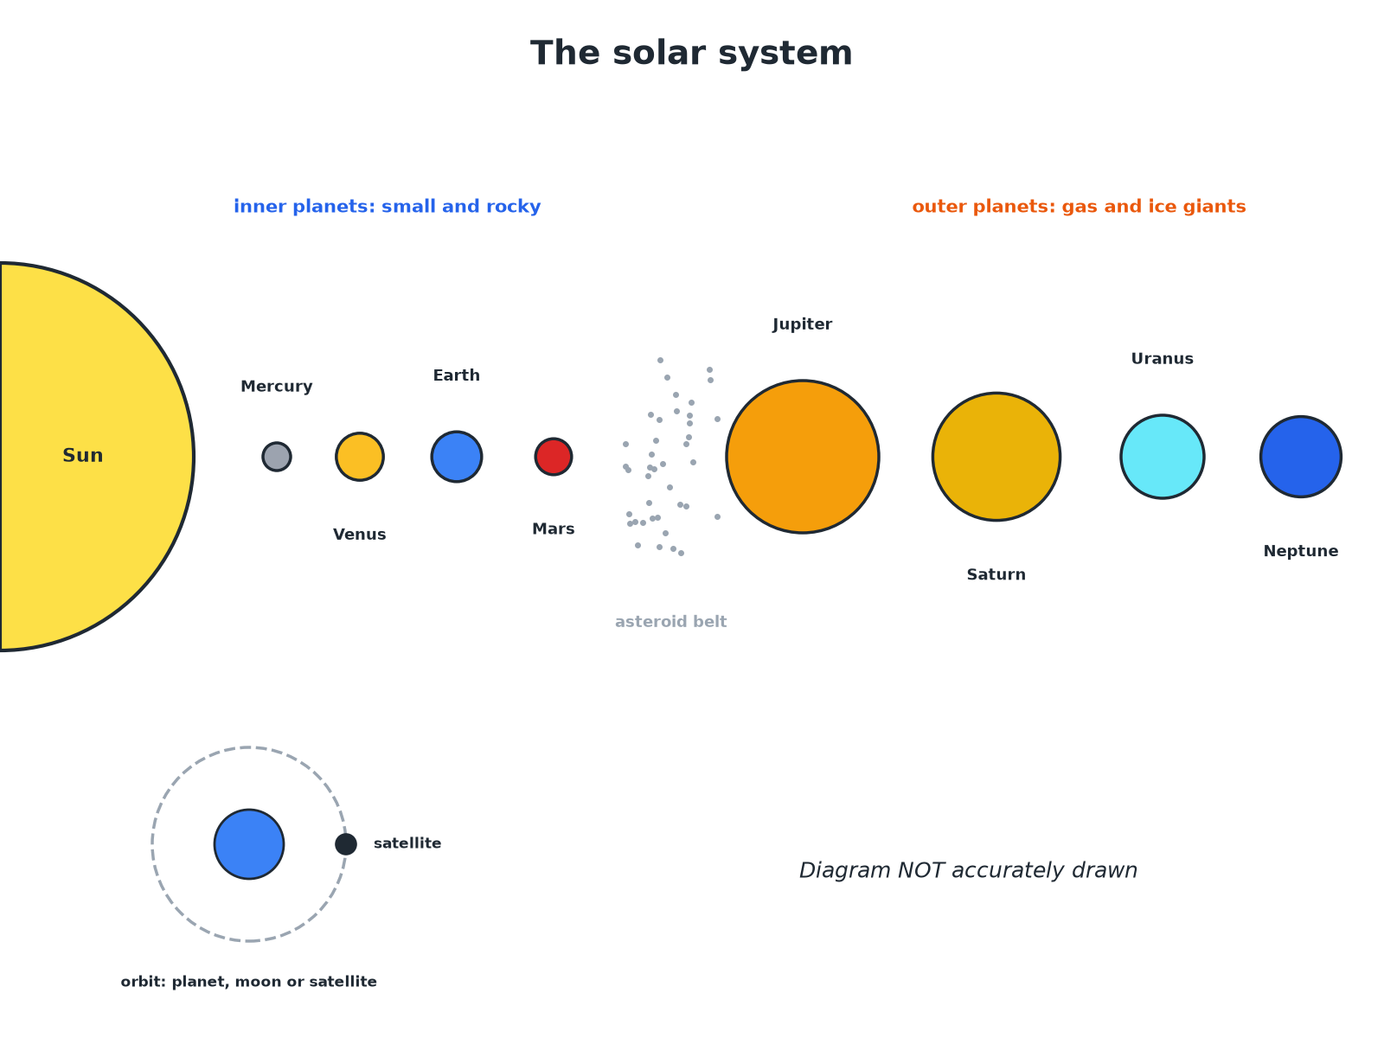

AQA GCSE PHYSICS · PAPER 2 · FOUNDATION & HIGHER
The Solar System
The four inner planets are rocky; the outer four are gas and ice giants.
Space physics
openrevise.com
Lesson 1 of 4

Slide 7

AQA GCSE PHYSICS · PAPER 2 · FOUNDATION & HIGHER
How the Solar System Formed
Follow the steps.
1
2
3
4
A nebula
A huge cloud of dust and gas collapses under gravity.
Protostar
Gravity pulls the gas together. It gets hot and dense.
A star is born
Nuclear fusion begins; the Sun starts to shine.
Planets
Material left over clumps together to form planets and moons.
Space physics
openrevise.com
Lesson 1 of 4

Slide 8

AQA GCSE PHYSICS · PAPER 2 · FOUNDATION & HIGHER
Orbits
Learn what orbits what.
Object
Orbits
Type
Planets
The Sun
Natural
Moons
A planet
Natural satellites
Weather and communications satellites
The Earth
Artificial satellites
Comets
The Sun
Elliptical orbits
Space physics
openrevise.com
Lesson 1 of 4

Slide 9

AQA GCSE PHYSICS · PAPER 2 · FOUNDATION & HIGHER
Orbits and Gravity
Explain why the Moon stays in orbit around the Earth.
Gravity
The Earth's gravity pulls the Moon towards it
1
Centripetal force
Gravity is the force towards the centre of the orbit
2
Result
The Moon keeps changing direction so it follows a circular path
3
ANSWER
Gravity acts as the force towards the centre.
Space physics
openrevise.com
Lesson 1 of 4

Slide 10

AQA GCSE PHYSICS · PAPER 2 · FOUNDATION & HIGHER
Key Facts
Learn these.
Planets
Eight; Mercury, Venus, Earth, Mars, Jupiter, Saturn, Uranus and Neptune.
Galaxy
A huge collection of billions of stars, like the Milky Way.
Dwarf planets
Small bodies that orbit the Sun but have not cleared their path, such as Pluto.
Comets
Icy bodies on very elliptical orbits round the Sun.
Space physics
openrevise.com
Lesson 1 of 4

Slide 11

AQA GCSE PHYSICS · PAPER 2 · FOUNDATION & HIGHER
Key Terms
Solar system
The Sun and all the objects that orbit it.
Galaxy
A huge group of billions of stars held together by gravity.
Natural satellite
A moon that orbits a planet.
Artificial satellite
A human-made object that orbits a planet.
Nebula
A cloud of gas and dust in space.
Orbit
The curved path of an object round another because of gravity.
Space physics
openrevise.com
Lesson 1 of 4

Slide 12

AQA GCSE PHYSICS · PAPER 2 · FOUNDATION & HIGHER
YOUR TASK
10 minutes
Solar Order
Put the planets in order from the Sun. Make a mnemonic. Then state which are rocky and which are gas giants.
Inner four rocky, outer four giants.
1
WHAT A GOOD ANSWER SHOWS
Mercury, Venus, Earth, Mars, Jupiter, Saturn, Uranus, Neptune. The first four are rocky; Jupiter and Saturn are gas giants; Uranus and Neptune are ice giants.
Space physics
openrevise.com
Lesson 1 of 4
Notes:
Ask learners where the asteroid belt is.

Slide 13
AQA GCSE PHYSICS · PAPER 2 · FOUNDATION & HIGHER
Can I...?
Describe the solar system.
Describe how planets form.
Name the eight planets.
Name natural satellites.
Define a galaxy.
Name artificial satellites.
Describe how a star forms.
Say what keeps orbits going.
Space physics
openrevise.com
Lesson 1 of 4

Slide 14
AQA GCSE PHYSICS · PAPER 2 · FOUNDATION & HIGHER
Summary & Exam Focus
Sun, eight planets, moons, asteroids and comets.
Gravity pulls a cloud of dust and gas together to form the Sun.
Moons are natural satellites; weather satellites are artificial.
Gravity is the force towards the centre of an orbit.
EXAM FOCUS
Name the force that keeps the planets in orbit round the Sun. (1 mark)
Gravity.
openrevise.com

Slide 15
AQA GCSE PHYSICS · PAPER 2 · FOUNDATION & HIGHER
Exam Practice: Our solar system
Answer all questions. Use the mark allocation as a guide to how much to write. · 14 minutes
Question 1 · 2 marks · State
Name the galaxy that contains our solar system and state what holds the galaxy together.
Question 2 · 3 marks · Describe
Describe how the Sun and the planets in our solar system were formed.
Question 3 · 2 marks · State
Give one example of a natural satellite and one example of an artificial satellite.
Space physics
openrevise.com
Lesson 1 of 4

Slide 16
AQA GCSE PHYSICS · PAPER 2 · FOUNDATION & HIGHER
Exam Practice: Our solar system (cont.)
Question 4 · 3 marks · Explain
Explain why the Moon stays in orbit around the Earth.
Question 5 · 3 marks · Explain
Explain why the outer planets take longer to orbit the Sun than the inner planets.
Space physics
openrevise.com
Lesson 1 of 4

Slide 17
AQA GCSE PHYSICS · PAPER 2 · FOUNDATION & HIGHER
Question 1 · 2 marks · State
“
Name the galaxy that contains our solar system and state what holds the galaxy together.
HOW TO ANSWER IT
Command word: State. Worth 2 marks, so plan before writing.
Space physics
openrevise.com
Lesson 1 of 4

Slide 18
AQA GCSE PHYSICS · PAPER 2 · FOUNDATION & HIGHER
Question 1 · mark scheme
2 marks available. Award a mark for each point made.
Milky Way
1 mark
Gravity
1 mark
Space physics
openrevise.com
Lesson 1 of 4

Slide 19
AQA GCSE PHYSICS · PAPER 2 · FOUNDATION & HIGHER
Question 2 · 3 marks · Describe
“
Describe how the Sun and the planets in our solar system were formed.
HOW TO ANSWER IT
Command word: Describe. Worth 3 marks, so plan before writing.
Space physics
openrevise.com
Lesson 1 of 4

Slide 20
AQA GCSE PHYSICS · PAPER 2 · FOUNDATION & HIGHER
Question 2 · mark scheme
3 marks available. Award a mark for each point made.
Gravity pulls dust and gas together
1 mark
Fusion starts forming the Sun
1 mark
Planets form from the remaining material
1 mark
Space physics
openrevise.com
Lesson 1 of 4

Slide 21
AQA GCSE PHYSICS · PAPER 2 · FOUNDATION & HIGHER
Question 3 · 2 marks · State
“
Give one example of a natural satellite and one example of an artificial satellite.
HOW TO ANSWER IT
Command word: State. Worth 2 marks, so plan before writing.
Space physics
openrevise.com
Lesson 1 of 4

Slide 22
AQA GCSE PHYSICS · PAPER 2 · FOUNDATION & HIGHER
Question 3 · mark scheme
2 marks available. Award a mark for each point made.
Natural satellite
1 mark
Artificial satellite
1 mark
Space physics
openrevise.com
Lesson 1 of 4

Slide 23
AQA GCSE PHYSICS · PAPER 2 · FOUNDATION & HIGHER
Question 4 · 3 marks · Explain
“
Explain why the Moon stays in orbit around the Earth.
HOW TO ANSWER IT
Command word: Explain. Worth 3 marks, so plan before writing.
Space physics
openrevise.com
Lesson 1 of 4

Slide 24
AQA GCSE PHYSICS · PAPER 2 · FOUNDATION & HIGHER
Question 4 · mark scheme
3 marks available. Award a mark for each point made.
Gravitational attraction between Earth and Moon
1 mark
Force is towards the centre of the orbit
1 mark
Changes direction so a curved path is followed
1 mark
Space physics
openrevise.com
Lesson 1 of 4

Slide 25
AQA GCSE PHYSICS · PAPER 2 · FOUNDATION & HIGHER
Question 5 · 3 marks · Explain
“
Explain why the outer planets take longer to orbit the Sun than the inner planets.
HOW TO ANSWER IT
Command word: Explain. Worth 3 marks, so plan before writing.
Space physics
openrevise.com
Lesson 1 of 4

Slide 26
AQA GCSE PHYSICS · PAPER 2 · FOUNDATION & HIGHER
Question 5 · mark scheme
3 marks available. Award a mark for each point made.
Longer orbit or further distance
1 mark
Weaker gravity further away
1 mark
Lower orbital speed
1 mark
Space physics
openrevise.com
Lesson 1 of 4

