Slide 1

AQA GCSE PHYSICS · PAPER 2 · FOUNDATION & HIGHER
Life cycle of a star
Space physics
Lesson 2 of 4
openrevise.com

Slide 2

AQA GCSE PHYSICS · PAPER 2 · FOUNDATION & HIGHER
Warm-up
Answer each one, then check.
1
What does the Sun produce?
2
What force pulls matter together?
3
What is fusion?
4
What is the main element in stars?
5
What is a star?
Space physics
openrevise.com
Lesson 2 of 4

Slide 3
AQA GCSE PHYSICS · PAPER 2 · FOUNDATION & HIGHER
Warm-up - Answers
What does the Sun produce?
Light and heat
1
What force pulls matter together?
Gravity
2
What is fusion?
Nuclei joining together to form a larger nucleus
3
What is the main element in stars?
Hydrogen
4
What is a star?
A huge ball of hot gas
5
Space physics
openrevise.com
Lesson 2 of 4

Slide 4

AQA GCSE PHYSICS · PAPER 2 · FOUNDATION & HIGHER
Learning Objectives
Describe the life cycle of a star like the Sun and of a star much more massive than the Sun.
1
Explain how a stable main-sequence star is formed and how it stays stable.
2
Explain how fusion in stars forms the elements.
3
Explain how elements heavier than iron are formed.
4
Space physics
openrevise.com
Lesson 2 of 4

Slide 5

AQA GCSE PHYSICS · PAPER 2 · FOUNDATION & HIGHER
STARS
A star forms from a nebula pulled together by gravity. In the main sequence, the inward force of gravity is balanced by the outward pressure from fusion energy, so the star is stable. When the hydrogen runs out, the star changes.
The mass of a star decides how it ends: a star like the Sun becomes a white dwarf; a much more massive star explodes as a supernova.
Space physics
openrevise.com
Lesson 2 of 4

Slide 6
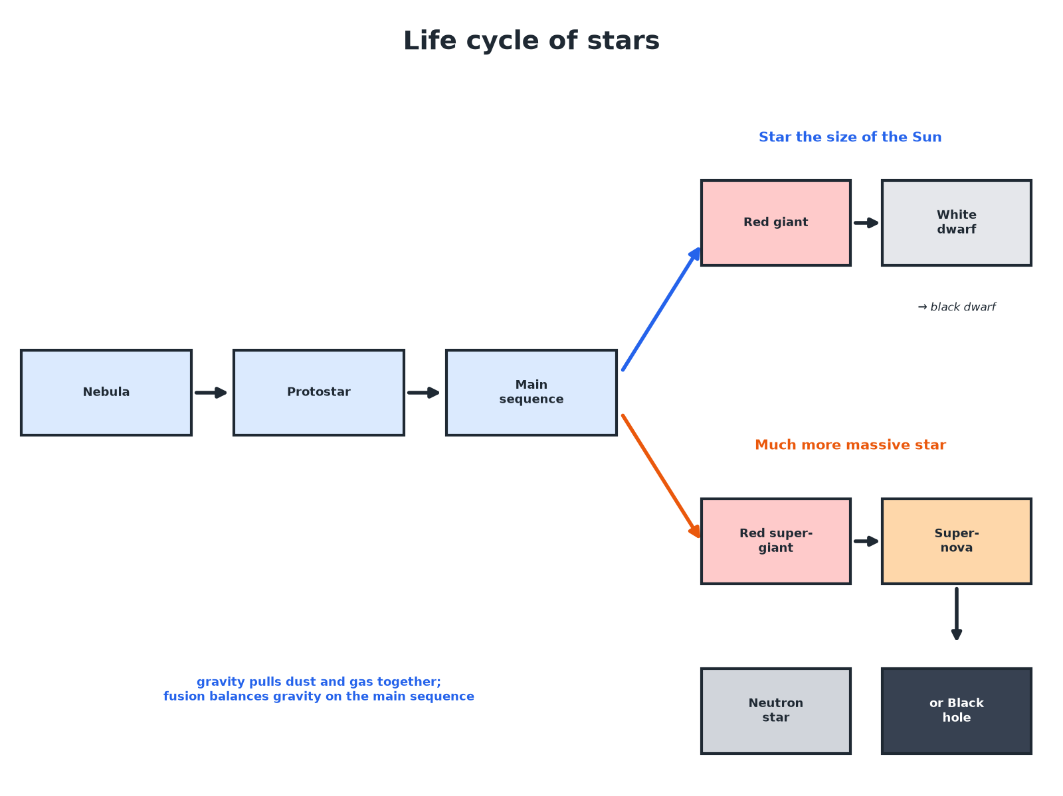

AQA GCSE PHYSICS · PAPER 2 · FOUNDATION & HIGHER
The Life Cycle of Stars
Mass decides the path after the main sequence.
Space physics
openrevise.com
Lesson 2 of 4

Slide 7

AQA GCSE PHYSICS · PAPER 2 · FOUNDATION & HIGHER
Sun-sized or Massive?
A STAR LIKE THE SUN
A MUCH MORE MASSIVE STAR
• Nebula, protostar, main sequence.
• Expands to a red giant.
• Outer layers drift away; the core shrinks to a white dwarf.
• Cools to a black dwarf.
• Nebula, protostar, main sequence.
• Expands to a red supergiant.
• Explodes as a supernova.
• Leaves a neutron star or a black hole.
Space physics
openrevise.com
Lesson 2 of 4

Slide 8

AQA GCSE PHYSICS · PAPER 2 · FOUNDATION & HIGHER
Why a Main Sequence Star Is Stable
Explain why a star stays the same size for billions of years.
Gravity
Pulls the star's matter inwards
1
Fusion
Hydrogen fuses to helium and releases energy, causing outward pressure
2
Balance
The forces balance so the star is stable
3
ANSWER
Inward gravitational force is balanced by outward thermal pressure.
Space physics
openrevise.com
Lesson 2 of 4

Slide 9
AQA GCSE PHYSICS · PAPER 2 · FOUNDATION & HIGHER
Making the Elements
Explain how heavier elements are formed.
In stars
Nuclear fusion forms elements up to iron
1
In a supernova
The explosion has enough energy to form elements heavier than iron
2
Spread
The explosion scatters elements into space; new stars and planets form from them
3
ANSWER
Fusion makes elements up to iron; supernovae make heavier ones.
Space physics
openrevise.com
Lesson 2 of 4

Slide 10

AQA GCSE PHYSICS · PAPER 2 · FOUNDATION & HIGHER
Key Points
Learn these.
Main sequence
Hydrogen fuses to helium; stable for billions of years.
Red giant
Hydrogen runs out; the star expands and cools.
Supernova
A massive star explodes.
Black hole
An object with gravity so strong that not even light escapes.
Space physics
openrevise.com
Lesson 2 of 4

Slide 11

AQA GCSE PHYSICS · PAPER 2 · FOUNDATION & HIGHER
Key Terms
Nebula
A cloud of dust and gas from which stars form.
Main sequence
The long stable stage of a star's life when hydrogen fuses to helium.
Red giant
A large, cool, red star near the end of its life.
White dwarf
A small, dense, hot star that is the core of a dead Sun-sized star.
Supernova
The explosion of a massive star at the end of its life.
Black hole
An object so dense that not even light can escape.
Space physics
openrevise.com
Lesson 2 of 4

Slide 12

AQA GCSE PHYSICS · PAPER 2 · FOUNDATION & HIGHER
YOUR TASK
12 minutes
Star Story
Write the life story of the Sun and of a star ten times as massive. Where do they differ?
Mass controls the ending.
1
WHAT A GOOD ANSWER SHOWS
Sun: nebula, protostar, main sequence, red giant, white dwarf, black dwarf. Massive star: nebula, protostar, main sequence, red supergiant, supernova, neutron star or black hole.
Space physics
openrevise.com
Lesson 2 of 4
Notes:
Ask which stage gives the heaviest elements.

Slide 13
AQA GCSE PHYSICS · PAPER 2 · FOUNDATION & HIGHER
Can I...?
Describe a nebula.
Follow a massive star's path.
Describe a protostar.
Explain fusion and elements.
Explain stability.
Define a supernova.
Follow the Sun's path.
Define a black hole.
Space physics
openrevise.com
Lesson 2 of 4

Slide 14
AQA GCSE PHYSICS · PAPER 2 · FOUNDATION & HIGHER
Summary & Exam Focus
Stable when gravity and outward pressure are balanced.
Sun-sized: red giant, white dwarf, black dwarf.
Massive: red supergiant, supernova, neutron star or black hole.
Supernovae form elements heavier than iron.
EXAM FOCUS
Describe what happens to a star like the Sun when hydrogen runs out. (3 marks)
Red giant, white dwarf, black dwarf.
openrevise.com

Slide 15
AQA GCSE PHYSICS · PAPER 2 · FOUNDATION & HIGHER
Exam Practice: Life cycle of a star
Answer all questions. Use the mark allocation as a guide to how much to write. · 17 minutes
Question 1 · 2 marks · State
Name the stages in the life cycle of a star like our Sun after the main sequence.
Question 2 · 3 marks · Explain
Explain why a star on the main sequence is stable.
Question 3 · 4 marks · Describe
Describe the life cycle of a star that is much more massive than the Sun.
Space physics
openrevise.com
Lesson 2 of 4

Slide 16
AQA GCSE PHYSICS · PAPER 2 · FOUNDATION & HIGHER
Exam Practice: Life cycle of a star (cont.)
Question 4 · 3 marks · Explain
Explain why some elements heavier than iron are found on Earth even though they cannot be made in the main sequence.
Question 5 · 4 marks · Explain
Explain how the Sun formed and why the Sun is stable.
Space physics
openrevise.com
Lesson 2 of 4

Slide 17
AQA GCSE PHYSICS · PAPER 2 · FOUNDATION & HIGHER
Question 1 · 2 marks · State
“
Name the stages in the life cycle of a star like our Sun after the main sequence.
HOW TO ANSWER IT
Command word: State. Worth 2 marks, so plan before writing.
Space physics
openrevise.com
Lesson 2 of 4

Slide 18
AQA GCSE PHYSICS · PAPER 2 · FOUNDATION & HIGHER
Question 1 · mark scheme
2 marks available. Award a mark for each point made.
Red giant
1 mark
White dwarf
1 mark
Space physics
openrevise.com
Lesson 2 of 4

Slide 19
AQA GCSE PHYSICS · PAPER 2 · FOUNDATION & HIGHER
Question 2 · 3 marks · Explain
“
Explain why a star on the main sequence is stable.
HOW TO ANSWER IT
Command word: Explain. Worth 3 marks, so plan before writing.
Space physics
openrevise.com
Lesson 2 of 4

Slide 20
AQA GCSE PHYSICS · PAPER 2 · FOUNDATION & HIGHER
Question 2 · mark scheme
3 marks available. Award a mark for each point made.
Gravity acts inwards
1 mark
Fusion energy gives outward pressure
1 mark
The forces balance
1 mark
Space physics
openrevise.com
Lesson 2 of 4

Slide 21
AQA GCSE PHYSICS · PAPER 2 · FOUNDATION & HIGHER
Question 3 · 4 marks · Describe
“
Describe the life cycle of a star that is much more massive than the Sun.
HOW TO ANSWER IT
Command word: Describe. Worth 4 marks, so plan before writing.
Space physics
openrevise.com
Lesson 2 of 4

Slide 22
AQA GCSE PHYSICS · PAPER 2 · FOUNDATION & HIGHER
Question 3 · mark scheme
4 marks available. Award a mark for each point made.
Nebula / protostar / main sequence
1 mark
Red supergiant
1 mark
Supernova
1 mark
Neutron star or black hole
1 mark
Space physics
openrevise.com
Lesson 2 of 4

Slide 23
AQA GCSE PHYSICS · PAPER 2 · FOUNDATION & HIGHER
Question 4 · 3 marks · Explain
“
Explain why some elements heavier than iron are found on Earth even though they cannot be made in the main sequence.
HOW TO ANSWER IT
Command word: Explain. Worth 3 marks, so plan before writing.
Space physics
openrevise.com
Lesson 2 of 4

Slide 24
AQA GCSE PHYSICS · PAPER 2 · FOUNDATION & HIGHER
Question 4 · mark scheme
3 marks available. Award a mark for each point made.
Supernova forms heavier elements
1 mark
Elements thrown into space
1 mark
Incorporated into new stars and planets
1 mark
Space physics
openrevise.com
Lesson 2 of 4

Slide 25
AQA GCSE PHYSICS · PAPER 2 · FOUNDATION & HIGHER
Question 5 · 4 marks · Explain
“
Explain how the Sun formed and why the Sun is stable.
HOW TO ANSWER IT
Command word: Explain. Worth 4 marks, so plan before writing.
Space physics
openrevise.com
Lesson 2 of 4

Slide 26
AQA GCSE PHYSICS · PAPER 2 · FOUNDATION & HIGHER
Question 5 · mark scheme
4 marks available. Award a mark for each point made.
Gravity pulls dust and gas together
1 mark
Fusion begins
1 mark
Gravity acts inwards
1 mark
Balanced by outward pressure
1 mark
Space physics
openrevise.com
Lesson 2 of 4

