Slide 1

AQA GCSE PHYSICS · PAPER 2 · HIGHER TIER ONLY
Orbital motion and satellites
Space physics
Lesson 3 of 4
openrevise.com

Slide 2

AQA GCSE PHYSICS · PAPER 2 · HIGHER TIER ONLY
Warm-up
Answer each one, then check.
1
What is speed?
2
What is velocity?
3
What is gravity?
4
What is an orbit?
5
What is a satellite?
Space physics
openrevise.com
Lesson 3 of 4

Slide 3
AQA GCSE PHYSICS · PAPER 2 · HIGHER TIER ONLY
Warm-up - Answers
What is speed?
Distance travelled per unit time
1
What is velocity?
Speed in a given direction
2
What is gravity?
An attractive force between masses
3
What is an orbit?
The curved path round a planet or star
4
What is a satellite?
An object that orbits a larger object
5
Space physics
openrevise.com
Lesson 3 of 4

Slide 4

AQA GCSE PHYSICS · PAPER 2 · HIGHER TIER ONLY
Learning Objectives
Explain why an object moving in a circle at constant speed has a changing velocity.
1
Explain that gravity provides the force for circular orbits.
2
Explain how orbital radius, speed and time for an orbit are linked.
3
Describe what happens if a satellite's speed changes.
4
Space physics
openrevise.com
Lesson 3 of 4

Slide 5

AQA GCSE PHYSICS · PAPER 2 · HIGHER TIER ONLY
CIRCULAR ORBITS
An object in a circular orbit moves at constant speed but its velocity is always changing because its direction is changing. The resultant force is gravity, which acts towards the centre of the orbit.
For an orbit of a given radius, the speed must be a particular value. If the speed changes, the radius changes.
Space physics
openrevise.com
Lesson 3 of 4

Slide 6
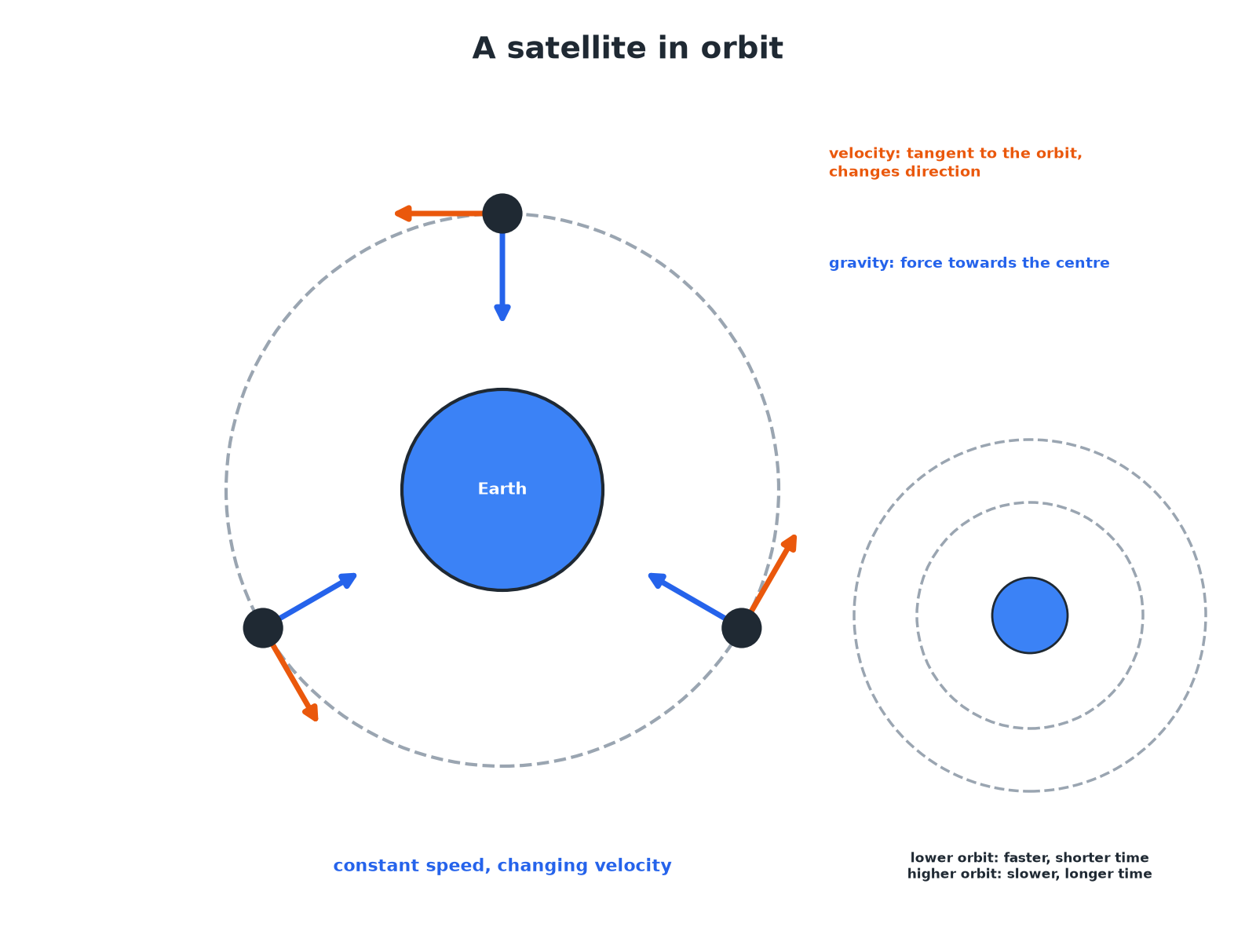

AQA GCSE PHYSICS · PAPER 2 · HIGHER TIER ONLY
A Satellite in Orbit
Velocity is tangent; force is towards the centre.
Space physics
openrevise.com
Lesson 3 of 4

Slide 7

AQA GCSE PHYSICS · PAPER 2 · HIGHER TIER ONLY
Orbits at Different Heights
Learn the links.
Orbit
Speed
Time for one orbit
Low orbit (closer)
Faster
Shorter
High orbit (further away)
Slower
Longer
Geostationary (about 36 000 km)
Matches the Earth's rotation
24 hours
If the speed changes
Radius must change too
Time changes
Space physics
openrevise.com
Lesson 3 of 4

Slide 8

AQA GCSE PHYSICS · PAPER 2 · HIGHER TIER ONLY
Constant Speed, Changing Velocity
Explain why a satellite moving at constant speed in a circle is accelerating.
Speed
Constant
1
Direction
Always changing
2
Velocity
Has speed and direction, so it changes
3
Acceleration
A change in velocity is an acceleration, towards the centre
4
ANSWER
Velocity changes because direction changes, so it accelerates.
Space physics
openrevise.com
Lesson 3 of 4

Slide 9
AQA GCSE PHYSICS · PAPER 2 · HIGHER TIER ONLY
Orbital Speed
A satellite orbits at a radius of 7000 km and completes one orbit in 5800 s. Calculate its speed.
Distance
circumference = 2πr = 2 × π × 7.0 × 10⁶ = 4.4 × 10⁷ m
1
Speed
v = d ÷ t = 4.4 × 10⁷ ÷ 5800
2
Answer
v ≈ 7600 m/s
3
ANSWER
About 7600 m/s.
Space physics
openrevise.com
Lesson 3 of 4

Slide 10

AQA GCSE PHYSICS · PAPER 2 · HIGHER TIER ONLY
Key Points
Learn these.
Gravity
Provides the force towards the centre.
Constant speed
But velocity changes.
Closer orbit
Faster and a shorter orbit time.
Change of speed
Changes the radius of the orbit.
Space physics
openrevise.com
Lesson 3 of 4

Slide 11

AQA GCSE PHYSICS · PAPER 2 · HIGHER TIER ONLY
Key Terms
Orbit
The curved path of an object round a planet or star.
Orbital speed
The speed of an object as it moves in its orbit.
Velocity
Speed in a given direction.
Geostationary orbit
An orbit with a period of 24 hours, so the satellite stays above one point on Earth.
Acceleration
A change in velocity.
Satellite
An object in orbit around a larger object.
Space physics
openrevise.com
Lesson 3 of 4

Slide 12

AQA GCSE PHYSICS · PAPER 2 · HIGHER TIER ONLY
YOUR TASK
12 minutes
Orbit Sums
Explain why a satellite does not fall to Earth even though gravity pulls on it. Then calculate its speed if one orbit of radius 7000 km takes 5800 s.
Speed = distance ÷ time.
1
WHAT A GOOD ANSWER SHOWS
It is falling but moves sideways fast enough to keep missing the Earth. v = 2π × 7.0 × 10^6 ÷ 5800 ≈ 7600 m/s.
Space physics
openrevise.com
Lesson 3 of 4
Notes:
Ask about a geostationary satellite.

Slide 13
AQA GCSE PHYSICS · PAPER 2 · HIGHER TIER ONLY
Can I...?
Define orbit.
Describe geostationary.
Explain changing velocity.
Calculate orbital speed.
Explain the force.
Explain a change in speed.
Link radius and speed.
Give examples.
Space physics
openrevise.com
Lesson 3 of 4

Slide 14
AQA GCSE PHYSICS · PAPER 2 · HIGHER TIER ONLY
Summary & Exam Focus
Constant speed but changing direction means changing velocity.
Gravity acts towards the centre.
Lower orbit: faster; higher orbit: slower.
Change of speed gives a change of radius.
EXAM FOCUS
Explain why the velocity of a satellite moving at constant speed is changing. (2 marks)
Direction changes.
openrevise.com

Slide 15
AQA GCSE PHYSICS · PAPER 2 · HIGHER TIER ONLY
Exam Practice: Orbital motion and satellites
Answer all questions. Use the mark allocation as a guide to how much to write. · 14 minutes
Question 1 · 2 marks · Explain
A satellite orbits the Earth at constant speed. Explain why its velocity is not constant.
Question 2 · 3 marks · Explain
Explain what provides the force that keeps a satellite in a circular orbit and state the direction of the force.
Question 3 · 3 marks · Calculate
A satellite completes one circular orbit of circumference 4.4 × 10^7 m in 5800 s. Calculate its orbital speed.
Space physics
openrevise.com
Lesson 3 of 4

Slide 16
AQA GCSE PHYSICS · PAPER 2 · HIGHER TIER ONLY
Exam Practice: Orbital motion and satellites (cont.)
Question 4 · 3 marks · Explain
Satellite A orbits the Earth at a smaller radius than satellite B. Compare the orbital speeds and the times taken for one orbit, and…
Question 5 · 2 marks · Explain
A geostationary satellite stays above the same point on the Earth. State the time taken for one orbit and explain why this is useful.
Space physics
openrevise.com
Lesson 3 of 4

Slide 17
AQA GCSE PHYSICS · PAPER 2 · HIGHER TIER ONLY
Question 1 · 2 marks · Explain
“
A satellite orbits the Earth at constant speed. Explain why its velocity is not constant.
HOW TO ANSWER IT
Command word: Explain. Worth 2 marks, so plan before writing.
Space physics
openrevise.com
Lesson 3 of 4

Slide 18
AQA GCSE PHYSICS · PAPER 2 · HIGHER TIER ONLY
Question 1 · mark scheme
2 marks available. Award a mark for each point made.
Velocity has direction
1 mark
Direction is changing
1 mark
Space physics
openrevise.com
Lesson 3 of 4

Slide 19
AQA GCSE PHYSICS · PAPER 2 · HIGHER TIER ONLY
Question 2 · 3 marks · Explain
“
Explain what provides the force that keeps a satellite in a circular orbit and state the direction of the force.
HOW TO ANSWER IT
Command word: Explain. Worth 3 marks, so plan before writing.
Space physics
openrevise.com
Lesson 3 of 4

Slide 20
AQA GCSE PHYSICS · PAPER 2 · HIGHER TIER ONLY
Question 2 · mark scheme
3 marks available. Award a mark for each point made.
Gravity
1 mark
Between Earth and satellite
1 mark
Towards the centre
1 mark
Space physics
openrevise.com
Lesson 3 of 4

Slide 21
AQA GCSE PHYSICS · PAPER 2 · HIGHER TIER ONLY
Question 3 · 3 marks · Calculate
“
A satellite completes one circular orbit of circumference 4.4 × 10^7 m in 5800 s. Calculate its orbital speed.
HOW TO ANSWER IT
Command word: Calculate. Worth 3 marks, so plan before writing.
Space physics
openrevise.com
Lesson 3 of 4

Slide 22
AQA GCSE PHYSICS · PAPER 2 · HIGHER TIER ONLY
Question 3 · mark scheme
3 marks available. Award a mark for each point made.
Distance ÷ time
1 mark
Correct substitution
1 mark
About 7600 m/s
1 mark
Space physics
openrevise.com
Lesson 3 of 4

Slide 23
AQA GCSE PHYSICS · PAPER 2 · HIGHER TIER ONLY
Question 4 · 3 marks · Explain
“
Satellite A orbits the Earth at a smaller radius than satellite B. Compare the orbital speeds and the times taken for one orbit, and explain the difference in speed.
HOW TO ANSWER IT
Command word: Explain. Worth 3 marks, so plan before writing.
Space physics
openrevise.com
Lesson 3 of 4

Slide 24
AQA GCSE PHYSICS · PAPER 2 · HIGHER TIER ONLY
Question 4 · mark scheme
3 marks available. Award a mark for each point made.
A faster than B
1 mark
A has a shorter orbit time
1 mark
Gravity is stronger at smaller radius, so a higher speed is needed
1 mark
Space physics
openrevise.com
Lesson 3 of 4

Slide 25
AQA GCSE PHYSICS · PAPER 2 · HIGHER TIER ONLY
Question 5 · 2 marks · Explain
“
A geostationary satellite stays above the same point on the Earth. State the time taken for one orbit and explain why this is useful.
HOW TO ANSWER IT
Command word: Explain. Worth 2 marks, so plan before writing.
Space physics
openrevise.com
Lesson 3 of 4

Slide 26
AQA GCSE PHYSICS · PAPER 2 · HIGHER TIER ONLY
Question 5 · mark scheme
2 marks available. Award a mark for each point made.
24 hours
1 mark
Fixed position above the Earth: useful for communications
1 mark
Space physics
openrevise.com
Lesson 3 of 4

