Slide 1

AQA GCSE PHYSICS · PAPER 2 · FOUNDATION & HIGHER
Red-shift and the Big Bang
Space physics
Lesson 4 of 4
openrevise.com

Slide 2

AQA GCSE PHYSICS · PAPER 2 · FOUNDATION & HIGHER
Warm-up
Answer each one, then check.
1
What is light?
2
What is wavelength?
3
What colour has the longest wavelength in visible light?
4
What is a galaxy?
5
What is an ambulance siren's pitch change called?
Space physics
openrevise.com
Lesson 4 of 4

Slide 3
AQA GCSE PHYSICS · PAPER 2 · FOUNDATION & HIGHER
Warm-up - Answers
What is light?
An electromagnetic wave
1
What is wavelength?
Distance between corresponding points on adjacent waves
2
What colour has the longest wavelength in visible light?
Red
3
What is a galaxy?
A huge group of stars
4
What is an ambulance siren's pitch change called?
The Doppler effect
5
Space physics
openrevise.com
Lesson 4 of 4

Slide 4

AQA GCSE PHYSICS · PAPER 2 · FOUNDATION & HIGHER
Learning Objectives
Explain the observed red-shift of light from distant galaxies.
1
Explain why red-shift is evidence that the universe is expanding.
2
Describe the Big Bang theory.
3
Explain why the red-shift is greater for more distant galaxies.
4
Describe dark matter and dark energy.
5
Space physics
openrevise.com
Lesson 4 of 4

Slide 5

AQA GCSE PHYSICS · PAPER 2 · FOUNDATION & HIGHER
RED-SHIFT
The light from most distant galaxies is shifted towards the red end of the spectrum: its wavelength is increased. This is red-shift. It shows the galaxies are moving away from us, and that the universe is expanding.
The more distant the galaxy, the greater the red-shift, so the faster it is moving away.
Space physics
openrevise.com
Lesson 4 of 4

Slide 6
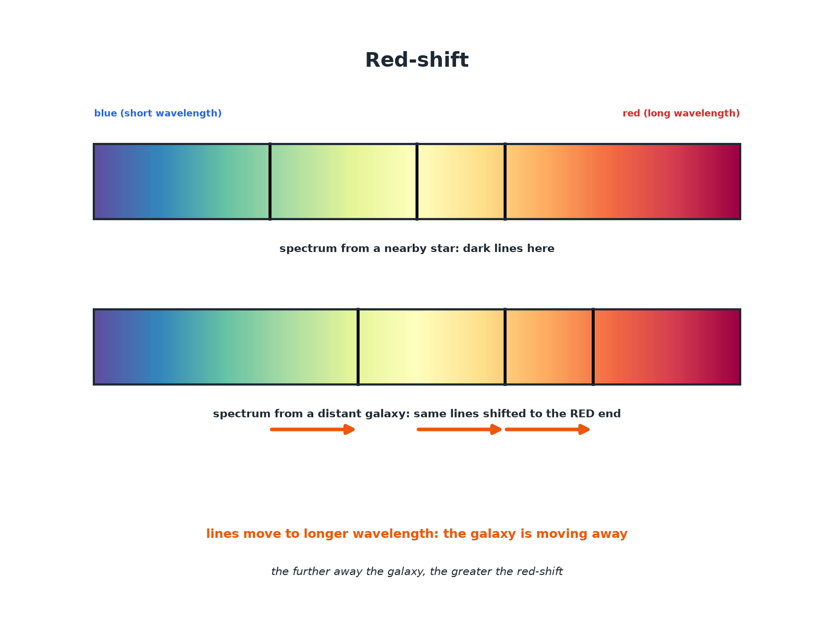

AQA GCSE PHYSICS · PAPER 2 · FOUNDATION & HIGHER
Red-shift
Longer wavelength means redder.
Space physics
openrevise.com
Lesson 4 of 4

Slide 7

AQA GCSE PHYSICS · PAPER 2 · FOUNDATION & HIGHER
The Big Bang Theory
Follow the steps.
1
2
3
4
Start
All the matter and energy in the universe was in a very small, hot, dense point.
Explosion
It expanded violently about 13.8 billion years ago.
Expansion
Space itself has been expanding ever since.
Evidence
Red-shift of galaxies and cosmic microwave background radiation (CMBR).
Space physics
openrevise.com
Lesson 4 of 4

Slide 8

AQA GCSE PHYSICS · PAPER 2 · FOUNDATION & HIGHER
Evidence for the Big Bang
Learn the two main pieces.
Evidence
What it shows
Red-shift
Galaxies are moving away and the universe is expanding; further galaxies move faster
CMBR
Leftover microwave radiation from the early universe, in all directions
Space physics
openrevise.com
Lesson 4 of 4

Slide 9

AQA GCSE PHYSICS · PAPER 2 · FOUNDATION & HIGHER
Red-shift and Distance
Galaxy A has a greater red-shift than galaxy B. What can you conclude?
Red-shift
Greater for A
1
Speed
A is moving away faster than B
2
Distance
A is further away than B
3
ANSWER
A is moving away faster and is further away than B.
Space physics
openrevise.com
Lesson 4 of 4

Slide 10

AQA GCSE PHYSICS · PAPER 2 · FOUNDATION & HIGHER
Dark Matter and Dark Energy
What we don't know.
Dark matter
Matter we cannot see that explains how galaxies rotate; it interacts gravitationally.
Dark energy
A form of energy thought to cause the universe's expansion to accelerate.
Open questions
Their nature is not yet understood.
Theories change
Scientists keep testing theories with new evidence.
Space physics
openrevise.com
Lesson 4 of 4

Slide 11
AQA GCSE PHYSICS · PAPER 2 · FOUNDATION & HIGHER
How Red-shift Is Measured
Comparing light from a galaxy with light from a lab.
1
2
3
4
Absorption lines
Elements in a star absorb particular wavelengths, giving dark lines in its spectrum.
Lab pattern
The same element on Earth gives the same pattern of lines at known wavelengths.
Compare
In light from a distant galaxy, the whole pattern is moved towards the red end.
Conclude
The wavelength has increased, so the galaxy is moving away from us.
Space physics
openrevise.com
Lesson 4 of 4

Slide 12

AQA GCSE PHYSICS · PAPER 2 · FOUNDATION & HIGHER
Further Means Faster
The key link that supports an expanding universe.
Edwin Hubble
In 1929 Hubble found that the more distant a galaxy is, the greater its red-shift, so the faster it is moving away.
What it means
If everything is moving apart, and further things faster, then everything must once have been much closer together.
Not a centre
It is space itself expanding. Observers in any galaxy would see the others moving away, like dots on a balloon being blown up.
Space physics
openrevise.com
Lesson 4 of 4

Slide 13

AQA GCSE PHYSICS · PAPER 2 · FOUNDATION & HIGHER
What We Know and What We Do Not
WELL SUPPORTED
STILL UNEXPLAINED
• The universe is expanding.
• It began about 13.8 billion years ago.
• CMBR is radiation left over from the early universe.
• Since 1998, observations of supernovae show the expansion is accelerating.
• What dark matter is made of.
• What dark energy is.
• Why the expansion is speeding up.
• Most of the universe's mass and energy cannot be seen.
Space physics
openrevise.com
Lesson 4 of 4

Slide 14

AQA GCSE PHYSICS · PAPER 2 · FOUNDATION & HIGHER
Key Terms
Red-shift
The increase in the observed wavelength of light from distant galaxies because they are moving away.
Big Bang theory
The theory that the universe began from a very small, hot, dense region and has been expanding ever since.
CMBR
Cosmic microwave background radiation; leftover microwaves from the early universe.
Dark matter
Matter that does not emit light but has gravitational effects.
Dark energy
An unknown energy thought to be driving the accelerating expansion of the universe.
Expanding universe
The idea that space is getting larger over time.
Space physics
openrevise.com
Lesson 4 of 4

Slide 15
AQA GCSE PHYSICS · PAPER 2 · FOUNDATION & HIGHER
Key Terms (cont.)
Absorption spectrum
A spectrum with dark lines where particular wavelengths have been absorbed.
Spectrum
The range of colours or wavelengths in light.
Accelerating expansion
The finding that distant galaxies are moving away faster and faster.
Space physics
openrevise.com
Lesson 4 of 4

Slide 16

AQA GCSE PHYSICS · PAPER 2 · FOUNDATION & HIGHER
YOUR TASK
10 minutes
Red-shift Talk
Explain to a partner why red-shift shows that the universe is expanding. Then explain why a galaxy twice as far away seems to move away twice as fast.
All galaxies are moving away.
1
WHAT A GOOD ANSWER SHOWS
The wavelengths are lengthened because the galaxies move away; this happens in all directions, so the universe is expanding. Further galaxies show a greater shift, so they move faster.
Space physics
openrevise.com
Lesson 4 of 4
Notes:
Ask about the Doppler effect with an ambulance.

Slide 17
AQA GCSE PHYSICS · PAPER 2 · FOUNDATION & HIGHER
Can I...?
Define red-shift.
Explain distance and red-shift.
Explain the expansion.
Define CMBR.
Describe the Big Bang.
Define dark matter.
Name the evidence.
Define dark energy.
Space physics
openrevise.com
Lesson 4 of 4

Slide 18
AQA GCSE PHYSICS · PAPER 2 · FOUNDATION & HIGHER
Summary & Exam Focus
Light from distant galaxies is shifted to longer wavelengths.
The universe is expanding.
Big Bang: small, hot, dense start about 13.8 billion years ago.
Evidence: red-shift and CMBR.
The further a galaxy, the greater its red-shift.
EXAM FOCUS
State what red-shift shows about the universe. (1 mark)
One mark: the universe is expanding, because galaxies are moving away from us. 'Galaxies are moving' alone is not enough: say away from us, or that the universe is expanding.
openrevise.com

Slide 19
AQA GCSE PHYSICS · PAPER 2 · FOUNDATION & HIGHER
Exam Practice: Red-shift and the Big Bang
Answer all questions. Use the mark allocation as a guide to how much to write. · 16 minutes
Question 1 · 2 marks · State
Describe what is meant by red-shift.
Question 2 · 3 marks · Explain
Explain why red-shift is evidence that the universe is expanding.
Question 3 · 3 marks · Describe
Describe the Big Bang theory of the origin of the universe.
Space physics
openrevise.com
Lesson 4 of 4

Slide 20
AQA GCSE PHYSICS · PAPER 2 · FOUNDATION & HIGHER
Exam Practice: Red-shift and the Big Bang (cont.)
Question 4 · 3 marks · Explain
Two galaxies are observed. Galaxy P has a greater red-shift than galaxy Q. Explain what this shows about P and Q.
Question 5 · 4 marks · Explain
Explain why the discovery of cosmic microwave background radiation (CMBR) supports the Big Bang theory, and state what is still not…
Space physics
openrevise.com
Lesson 4 of 4

Slide 21
AQA GCSE PHYSICS · PAPER 2 · FOUNDATION & HIGHER
Question 1 · 2 marks · State
“
Describe what is meant by red-shift.
HOW TO ANSWER IT
Command word: State. Worth 2 marks, so plan before writing.
Space physics
openrevise.com
Lesson 4 of 4

Slide 22
AQA GCSE PHYSICS · PAPER 2 · FOUNDATION & HIGHER
Question 1 · mark scheme
2 marks available. Award a mark for each point made.
Wavelength increases
1 mark
Shift towards the red end
1 mark
Space physics
openrevise.com
Lesson 4 of 4

Slide 23
AQA GCSE PHYSICS · PAPER 2 · FOUNDATION & HIGHER
Question 2 · 3 marks · Explain
“
Explain why red-shift is evidence that the universe is expanding.
HOW TO ANSWER IT
Command word: Explain. Worth 3 marks, so plan before writing.
Space physics
openrevise.com
Lesson 4 of 4

Slide 24
AQA GCSE PHYSICS · PAPER 2 · FOUNDATION & HIGHER
Question 2 · mark scheme
3 marks available. Award a mark for each point made.
Red-shift means the galaxies are moving away
1 mark
All directions
1 mark
Further galaxies move faster
1 mark
Space physics
openrevise.com
Lesson 4 of 4

Slide 25
AQA GCSE PHYSICS · PAPER 2 · FOUNDATION & HIGHER
Question 3 · 3 marks · Describe
“
Describe the Big Bang theory of the origin of the universe.
HOW TO ANSWER IT
Command word: Describe. Worth 3 marks, so plan before writing.
Space physics
openrevise.com
Lesson 4 of 4

Slide 26
AQA GCSE PHYSICS · PAPER 2 · FOUNDATION & HIGHER
Question 3 · mark scheme
3 marks available. Award a mark for each point made.
Small, hot, dense region
1 mark
Explosive expansion
1 mark
Still expanding
1 mark
Space physics
openrevise.com
Lesson 4 of 4

Slide 27
AQA GCSE PHYSICS · PAPER 2 · FOUNDATION & HIGHER
Question 4 · 3 marks · Explain
“
Two galaxies are observed. Galaxy P has a greater red-shift than galaxy Q. Explain what this shows about P and Q.
HOW TO ANSWER IT
Command word: Explain. Worth 3 marks, so plan before writing.
Space physics
openrevise.com
Lesson 4 of 4

Slide 28
AQA GCSE PHYSICS · PAPER 2 · FOUNDATION & HIGHER
Question 4 · mark scheme
3 marks available. Award a mark for each point made.
P moving away faster
1 mark
Greater red-shift means faster recession
1 mark
P is further away
1 mark
Space physics
openrevise.com
Lesson 4 of 4

Slide 29
AQA GCSE PHYSICS · PAPER 2 · FOUNDATION & HIGHER
Question 5 · 4 marks · Explain
“
Explain why the discovery of cosmic microwave background radiation (CMBR) supports the Big Bang theory, and state what is still not understood about the universe.
HOW TO ANSWER IT
Command word: Explain. Worth 4 marks, so plan before writing.
Space physics
openrevise.com
Lesson 4 of 4

Slide 30
AQA GCSE PHYSICS · PAPER 2 · FOUNDATION & HIGHER
Question 5 · mark scheme
4 marks available. Award a mark for each point made.
CMBR is leftover radiation from the early universe
1 mark
Observed in all directions
1 mark
Dark matter not understood
1 mark
Dark energy not understood
1 mark
Space physics
openrevise.com
Lesson 4 of 4

