Slide 1

AQA GCSE PHYSICS · PAPER 1 · FOUNDATION & HIGHER
Density of materials
Particle model of matter
Lesson 1 of 6
openrevise.com

Slide 2

AQA GCSE PHYSICS · PAPER 1 · FOUNDATION & HIGHER
Warm-up
Answer each one, then check.
1
What is the unit of mass in physics calculations?
2
How do you find the volume of a cuboid?
3
Convert 1 cm³ to m³.
4
What are the three states of matter?
5
What does displacement mean when finding volume?
Particle model of matter
openrevise.com
Lesson 1 of 6

Slide 3
AQA GCSE PHYSICS · PAPER 1 · FOUNDATION & HIGHER
Warm-up - Answers
What is the unit of mass in physics calculations?
Kilograms (kg)
1
How do you find the volume of a cuboid?
length × width × height
2
Convert 1 cm³ to m³.
1 × 10⁻⁶ m³
3
What are the three states of matter?
Solid, liquid and gas
4
What does displacement mean when finding volume?
The volume of water pushed out or the rise in water level
5
Particle model of matter
openrevise.com
Lesson 1 of 6

Slide 4

AQA GCSE PHYSICS · PAPER 1 · FOUNDATION & HIGHER
Learning Objectives
Recall and apply the equation for density.
1
Explain differences in density between solids, liquids and gases using the arrangement of particles.
2
Describe how to measure the density of regular and irregular solids and of liquids.
3
Convert between g/cm³ and kg/m³.
4
Particle model of matter
openrevise.com
Lesson 1 of 6

Slide 5

AQA GCSE PHYSICS · PAPER 1 · FOUNDATION & HIGHER
DENSITY
density = mass ÷ volume ρ= m/V
Density is in kilograms per metre cubed (kg/m³), mass in kilograms (kg) and volume in metres cubed (m³). Mass is conserved when a substance changes state.
Particle model of matter
openrevise.com
Lesson 1 of 6

Slide 6
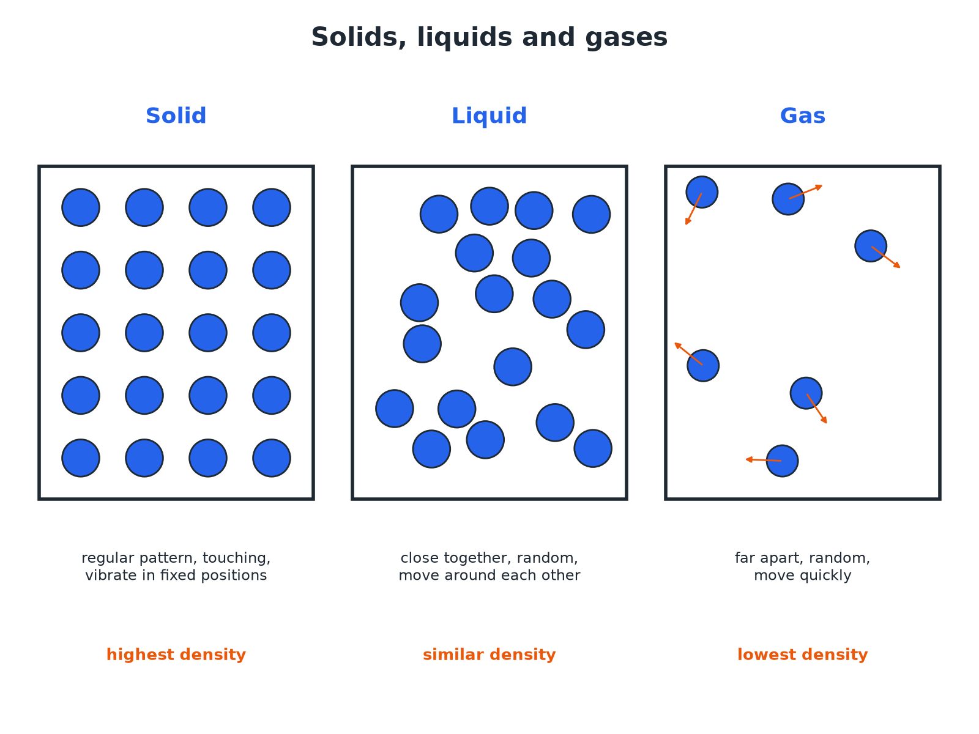

AQA GCSE PHYSICS · PAPER 1 · FOUNDATION & HIGHER
Solids, Liquids and Gases
In a solid or liquid the particles are close, so the density is high.
Particle model of matter
openrevise.com
Lesson 1 of 6

Slide 7
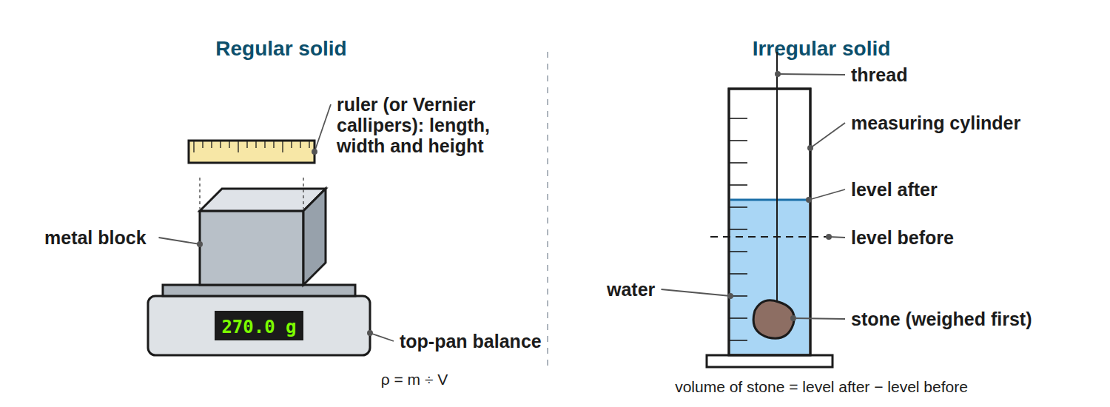
AQA GCSE PHYSICS · PAPER 1 · FOUNDATION & HIGHER
Required Practical 5: Measuring Density
Mass with a balance; volume from dimensions or by displacement.
Particle model of matter
openrevise.com
Lesson 1 of 6

Slide 8

AQA GCSE PHYSICS · PAPER 1 · FOUNDATION & HIGHER
Why the Densities Differ
Solids
Particles are packed closely in a regular arrangement: high density.
Liquids
Particles are close but randomly arranged: similar to solids, usually slightly lower.
Gases
Particles are far apart: very low density.
Mass is conserved
When a substance changes state the number of particles is unchanged, so the mass stays the same.
Particle model of matter
openrevise.com
Lesson 1 of 6

Slide 9

AQA GCSE PHYSICS · PAPER 1 · FOUNDATION & HIGHER
Required Practical 5: Method
Find the density of a solid or liquid.
1
2
3
4
5
Mass
Measure the mass on a balance (for a liquid, subtract the container's mass).
Regular solid: volume
Measure length, width and height with a ruler or micrometer and use V = l × w × h.
Irregular solid: volume
Lower it into water in a measuring cylinder, or a displacement can; the volume is the rise in water level (or the volume collected).
Liquid: volume
Read it from a measuring cylinder at eye level.
Calculate
ρ= m ÷ V; repeat and find a mean.
Particle model of matter
openrevise.com
Lesson 1 of 6

Slide 10

AQA GCSE PHYSICS · PAPER 1 · FOUNDATION & HIGHER
Density of a Block
A metal block has a mass of 0.60 kg and a volume of 0.00020 m³. Calculate its density.
Write the equation
ρ= m ÷ V
1
Substitute
ρ= 0.60 ÷ 0.00020
2
Answer
ρ= 3000 kg/m³
3
ANSWER
3000 kg/m³
Particle model of matter
openrevise.com
Lesson 1 of 6

Slide 11
AQA GCSE PHYSICS · PAPER 1 · FOUNDATION & HIGHER
Unit Conversion
A cube of side 4.0 cm has a mass of 512 g. Calculate the density in kg/m³.
Volume
4.0³ = 64 cm³ = 64 × 10⁻⁶ m³
1
Mass
512 g = 0.512 kg
2
Density
0.512 ÷ (64 × 10⁻⁶) = 8000 kg/m³
3
ANSWER
8000 kg/m³ (or 8.0 g/cm³)
Particle model of matter
openrevise.com
Lesson 1 of 6

Slide 12
AQA GCSE PHYSICS · PAPER 1 · FOUNDATION & HIGHER
Irregular Solid by Displacement
A stone of mass 45 g is lowered into a measuring cylinder. The water level rises from 50 cm³ to 68 cm³. Calculate the density in g/cm³.
Volume of stone
68 − 50 = 18 cm³
1
Density
45 ÷ 18 = 2.5 g/cm³
2
ANSWER
2.5 g/cm³ (2500 kg/m³)
Particle model of matter
openrevise.com
Lesson 1 of 6

Slide 13

AQA GCSE PHYSICS · PAPER 1 · FOUNDATION & HIGHER
Watch Out
Common mistakes.
Units
Convert cm³ to m³ (× 10⁻⁶) and g to kg (÷ 1000) before using kg/m³.
Reading volume
Read the bottom of the meniscus at eye level.
Mass conserved
Density changes with volume, not with mass, when a substance changes state.
Particle model of matter
openrevise.com
Lesson 1 of 6

Slide 14
AQA GCSE PHYSICS · PAPER 1 · FOUNDATION & HIGHER
Densities of Common Materials
Typical values in kg/m³.
Material
Density (kg/m³)
State
Air
1.2
Gas
Ice
920
Solid
Water
1000
Liquid
Aluminium
2700
Solid
Iron
7900
Solid
Gold
19 300
Solid
Particle model of matter
openrevise.com
Lesson 1 of 6

Slide 15
AQA GCSE PHYSICS · PAPER 1 · FOUNDATION & HIGHER
Converting Density Units
Two units are common, and exam answers need the right one.
1
2
3
4
Know the link
1 g/cm³ = 1000 kg/m³.
g/cm³ to kg/m³
Multiply by 1000: aluminium is 2.7 g/cm³ = 2700 kg/m³.
kg/m³ to g/cm³
Divide by 1000.
Check
Water is 1.0 g/cm³ or 1000 kg/m³; most solids are a few times denser.
Particle model of matter
openrevise.com
Lesson 1 of 6

Slide 16

AQA GCSE PHYSICS · PAPER 1 · FOUNDATION & HIGHER
CASE STUDY
Why Ice Floats
Water is unusual. When it freezes, its particles arrange into an open lattice that takes up more space than liquid water, so ice is about 8% less dense. That is why icebergs float with about a tenth of their volume above the surface, and why ponds freeze from the top down, letting fish survive underneath.
920 kg/m³
About 10%
Density of ice
Of an iceberg above the water
Particle model of matter
openrevise.com
Lesson 1 of 6

Slide 17

AQA GCSE PHYSICS · PAPER 1 · FOUNDATION & HIGHER
Key Terms
Density
Mass per unit volume of a material.
Displacement
The volume of water moved aside by an object placed in it.
Meniscus
The curved surface of a liquid in a tube.
Regular
A solid with a shape whose volume can be worked out from its dimensions.
Particle model
A model in which matter is made of tiny moving particles.
Conserved
Stays the same in total.
Particle model of matter
openrevise.com
Lesson 1 of 6

Slide 18
AQA GCSE PHYSICS · PAPER 1 · FOUNDATION & HIGHER
Key Terms (cont.)
Measuring cylinder
A cylinder marked with a volume scale, used to measure liquids.
Eureka can
A displacement can with a spout, used to collect the water an object pushes out.
kg/m³
The SI unit of density.
Particle model of matter
openrevise.com
Lesson 1 of 6

Slide 19

AQA GCSE PHYSICS · PAPER 1 · FOUNDATION & HIGHER
YOUR TASK
10 minutes
Which Floats?
Water has a density of 1000 kg/m³. A block has a mass of 0.80 kg and a volume of 0.0010 m³. Calculate its density and say if it floats.
Calculate the density.
1
Compare with water.
2
WHAT A GOOD ANSWER SHOWS
Density = 0.80 ÷ 0.0010 = 800 kg/m³. This is less than 1000 kg/m³, so it floats.
Particle model of matter
openrevise.com
Lesson 1 of 6
Notes:
Ask what would happen to a block of density 1200 kg/m³.

Slide 20
AQA GCSE PHYSICS · PAPER 1 · FOUNDATION & HIGHER
Can I...?
Recall the equation for density.
Describe measuring density of a regular solid.
Use correct units.
Describe measuring density of an irregular solid.
Convert cm³ to m³.
Read a measuring cylinder.
Explain density using particles.
Say why mass is conserved.
Particle model of matter
openrevise.com
Lesson 1 of 6

Slide 21
AQA GCSE PHYSICS · PAPER 1 · FOUNDATION & HIGHER
Summary & Exam Focus
ρ= m ÷ V.
Solids and liquids have close particles: high density; gases: far apart, low density.
Mass is conserved in changes of state.
Volume of an irregular object: use displacement.
1 g/cm³ = 1000 kg/m³.
Ice is less dense than water, so it floats.
EXAM FOCUS
A metal block has a mass of 0.60 kg and a volume of 0.00020 m³. Calculate its density. (2 marks)
Write ρ = m ÷ V, substitute 0.60 ÷ 0.00020 and give 3000 kg/m³. Check the mass is in kg and the volume in m³ before you divide.
openrevise.com

Slide 22
AQA GCSE PHYSICS · PAPER 1 · FOUNDATION & HIGHER
Exam Practice: Density of materials
Answer all questions. Use the mark allocation as a guide to how much to write. · 21 minutes
Question 1 · 2 marks · Calculate
A block of metal has a mass of 0.60 kg and a volume of 0.00020 m³. Calculate the density of the metal. Use the equation: density = mass ÷…
Question 2 · 4 marks · Calculate
A cube has sides of length 4.0 cm and a mass of 512 g. Calculate the density of the cube in kg/m³.
Question 3 · 3 marks · Use the diagram
A student measures the volume of a stone using a measuring cylinder. The mass of the stone is 45 g. Use the diagram to calculate the…
Particle model of matter
openrevise.com
Lesson 1 of 6

Slide 23
AQA GCSE PHYSICS · PAPER 1 · FOUNDATION & HIGHER
Exam Practice: Density of materials (cont.)
Question 4 · 3 marks · Explain
Explain, in terms of particles, why the density of a gas is much lower than the density of a solid.
Question 5 · 6 marks · Describe
Describe how to determine the density of an irregularly shaped solid, such as a stone. Your answer should include the apparatus, the…
Question 6 · 2 marks · Explain
1.0 kg of ice melts. Explain what happens to the mass and to the density.
Particle model of matter
openrevise.com
Lesson 1 of 6

Slide 24
AQA GCSE PHYSICS · PAPER 1 · FOUNDATION & HIGHER
Question 1 · 2 marks · Calculate
“
A block of metal has a mass of 0.60 kg and a volume of 0.00020 m³. Calculate the density of the metal. Use the equation: density = mass ÷ volume
HOW TO ANSWER IT
Command word: Calculate. Worth 2 marks, so plan before writing.
Particle model of matter
openrevise.com
Lesson 1 of 6

Slide 25
AQA GCSE PHYSICS · PAPER 1 · FOUNDATION & HIGHER
Question 1 · mark scheme
2 marks available. Award a mark for each point made.
Correct substitution
1 mark
3000 kg/m³
1 mark
Particle model of matter
openrevise.com
Lesson 1 of 6

Slide 26
AQA GCSE PHYSICS · PAPER 1 · FOUNDATION & HIGHER
Question 2 · 4 marks · Calculate
“
A cube has sides of length 4.0 cm and a mass of 512 g. Calculate the density of the cube in kg/m³.
HOW TO ANSWER IT
Command word: Calculate. Worth 4 marks, so plan before writing.
Particle model of matter
openrevise.com
Lesson 1 of 6

Slide 27
AQA GCSE PHYSICS · PAPER 1 · FOUNDATION & HIGHER
Question 2 · mark scheme
4 marks available. Award a mark for each point made.
Volume = 64 cm³
1 mark
Converts to m³ and kg
1 mark
Correct substitution
1 mark
8000 kg/m³
1 mark
Particle model of matter
openrevise.com
Lesson 1 of 6

Slide 28
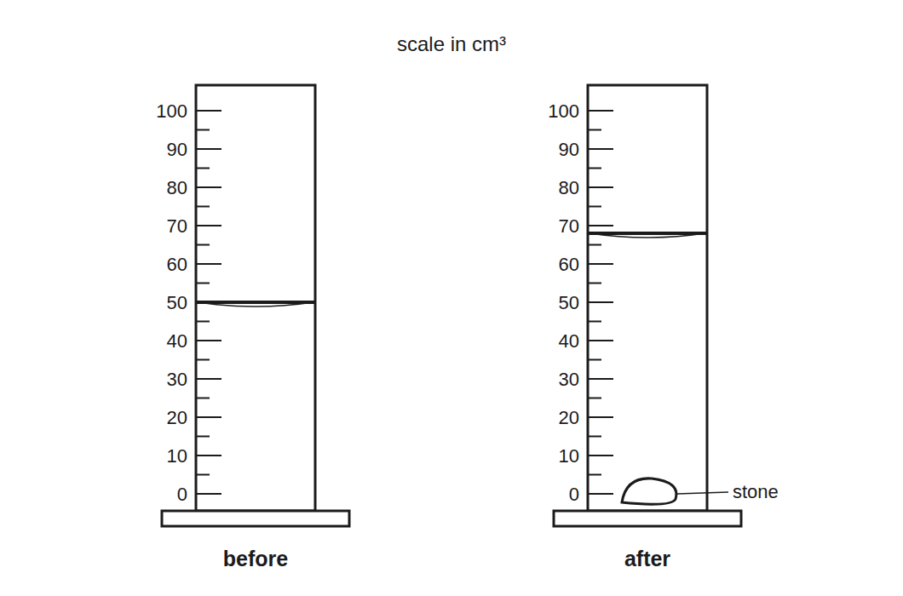
AQA GCSE PHYSICS · PAPER 1 · FOUNDATION & HIGHER
Question 3 · 3 marks · Use the diagram
A student measures the volume of a stone using a measuring cylinder. The mass of the stone is 45 g. Use the diagram to calculate the density of the stone in g/cm³. (3 marks)
Particle model of matter
openrevise.com
Lesson 1 of 6

Slide 29
AQA GCSE PHYSICS · PAPER 1 · FOUNDATION & HIGHER
Question 3 · mark scheme
3 marks available. Award a mark for each point made.
Volume of stone = 18 cm³
1 mark
Correct substitution
1 mark
2.5 g/cm³
1 mark
Particle model of matter
openrevise.com
Lesson 1 of 6

Slide 30
AQA GCSE PHYSICS · PAPER 1 · FOUNDATION & HIGHER
Question 4 · 3 marks · Explain
“
Explain, in terms of particles, why the density of a gas is much lower than the density of a solid.
HOW TO ANSWER IT
Command word: Explain. Worth 3 marks, so plan before writing.
Particle model of matter
openrevise.com
Lesson 1 of 6

Slide 31
AQA GCSE PHYSICS · PAPER 1 · FOUNDATION & HIGHER
Question 4 · mark scheme
3 marks available. Award a mark for each point made.
Particles far apart in a gas
1 mark
Close together in a solid
1 mark
More volume for the same mass so lower density
1 mark
Particle model of matter
openrevise.com
Lesson 1 of 6

Slide 32
AQA GCSE PHYSICS · PAPER 1 · FOUNDATION & HIGHER
Question 5 · 6 marks · Describe
“
Describe how to determine the density of an irregularly shaped solid, such as a stone. Your answer should include the apparatus, the measurements and the calculation.
HOW TO ANSWER IT
Command word: Describe. Worth 6 marks, so plan before writing.
Particle model of matter
openrevise.com
Lesson 1 of 6

Slide 33
AQA GCSE PHYSICS · PAPER 1 · FOUNDATION & HIGHER
Question 5 · mark scheme
6 marks available. Award a mark for each point made.
Level 3 (5 to 6 marks): a complete method with a balance to measure mass, a measuring cylinder or displacement can with water, the volume from the change in water level, the calculation of density = mass ÷ volume and a repeat or precaution
5 to 6 marks
Level 2 (3 to 4 marks): a method covering mass and volume but with some detail missing
3 to 4 marks
Level 1 (1 to 2 marks): simple statements about measuring mass or volume
1 to 2 marks
Particle model of matter
openrevise.com
Lesson 1 of 6

Slide 34
AQA GCSE PHYSICS · PAPER 1 · FOUNDATION & HIGHER
Question 6 · 2 marks · Explain
“
1.0 kg of ice melts. Explain what happens to the mass and to the density.
HOW TO ANSWER IT
Command word: Explain. Worth 2 marks, so plan before writing.
Particle model of matter
openrevise.com
Lesson 1 of 6

Slide 35
AQA GCSE PHYSICS · PAPER 1 · FOUNDATION & HIGHER
Question 6 · mark scheme
2 marks available. Award a mark for each point made.
Mass stays the same (conserved)
1 mark
Density changes because the volume changes
1 mark
Particle model of matter
openrevise.com
Lesson 1 of 6

