Slide 1

AQA GCSE PHYSICS · PAPER 1 · FOUNDATION & HIGHER
The development of the model of the atom
Atomic structure
Lesson 3 of 10
openrevise.com

Slide 2

AQA GCSE PHYSICS · PAPER 1 · FOUNDATION & HIGHER
Warm-up
Answer each one, then check.
1
Who discovered the electron?
2
What is a scientific model?
3
What is an alpha particle?
4
What is evidence?
5
Who discovered the neutron?
Atomic structure
openrevise.com
Lesson 3 of 10

Slide 3
AQA GCSE PHYSICS · PAPER 1 · FOUNDATION & HIGHER
Warm-up - Answers
Who discovered the electron?
J. J. Thomson
1
What is a scientific model?
A simplified representation used to explain observations
2
What is an alpha particle?
Two protons and two neutrons (a helium nucleus)
3
What is evidence?
Results from experiments that support or reject an idea
4
Who discovered the neutron?
James Chadwick
5
Atomic structure
openrevise.com
Lesson 3 of 10

Slide 4

AQA GCSE PHYSICS · PAPER 1 · FOUNDATION & HIGHER
Learning Objectives
Describe how the atomic model has changed over time.
1
Describe the plum pudding model and the nuclear model.
2
Explain why the alpha particle scattering experiment led to the nuclear model.
3
Describe the contributions of Bohr, the discovery of the proton and Chadwick's neutron.
4
Atomic structure
openrevise.com
Lesson 3 of 10

Slide 5

AQA GCSE PHYSICS · PAPER 1 · FOUNDATION & HIGHER
CHANGING MODELS
New experimental evidence may lead to a scientific model being changed or replaced.
The atom has been thought of as a solid sphere, a plum pudding, a nuclear atom, then with electrons in specific orbits, and finally with protons and neutrons in the nucleus.
Atomic structure
openrevise.com
Lesson 3 of 10

Slide 6
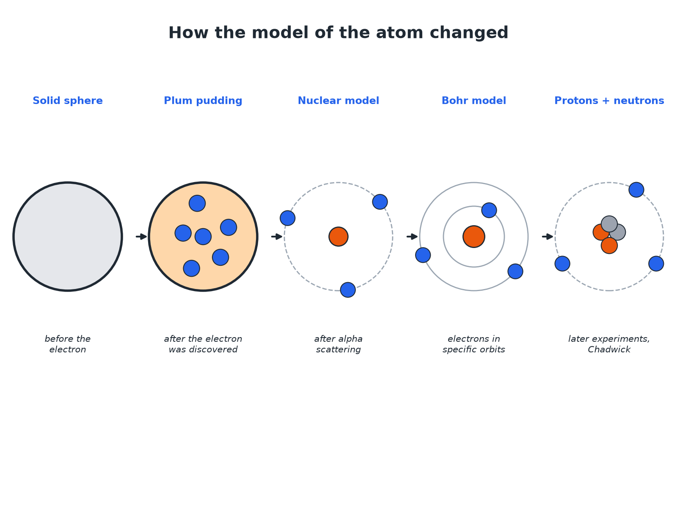

AQA GCSE PHYSICS · PAPER 1 · FOUNDATION & HIGHER
How the Atom Model Changed
Each new model came from new evidence.
Atomic structure
openrevise.com
Lesson 3 of 10

Slide 7
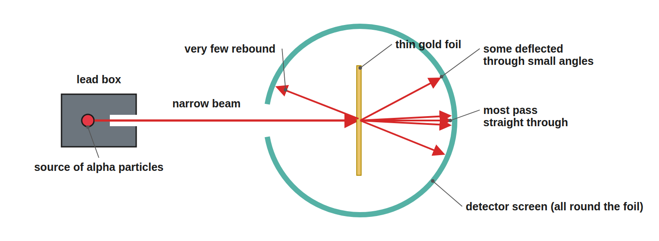
AQA GCSE PHYSICS · PAPER 1 · FOUNDATION & HIGHER
The Alpha Scattering Experiment
Most alpha particles passed straight through.
Atomic structure
openrevise.com
Lesson 3 of 10

Slide 8

AQA GCSE PHYSICS · PAPER 1 · FOUNDATION & HIGHER
Evidence and Conclusions
Match each result to its explanation.
Observation
Conclusion
Most alpha particles went straight through
Most of the atom is empty space
Some were deflected through small angles
The nucleus is positive and repels the positive alpha particles
A very few bounced back
The mass is concentrated in a tiny, dense, charged nucleus
Atomic structure
openrevise.com
Lesson 3 of 10

Slide 9

AQA GCSE PHYSICS · PAPER 1 · FOUNDATION & HIGHER
Plum Pudding or Nuclear?
PLUM PUDDING MODEL
NUCLEAR MODEL
• A ball of positive charge.
• Negative electrons embedded in it.
• Charge and mass spread throughout the atom.
• A tiny, positively charged nucleus at the centre.
• Electrons orbit at a distance.
• Most of the atom is empty space.
Atomic structure
openrevise.com
Lesson 3 of 10

Slide 10

AQA GCSE PHYSICS · PAPER 1 · FOUNDATION & HIGHER
Why the Model Changed
Explain why the results of the alpha scattering experiment led to the plum pudding model being replaced.
Plum pudding prediction
Alpha particles should pass through with only small deflections
1
Result
Some were deflected by large angles and a few rebounded
2
Conclusion
A concentrated, positive nucleus must exist, so the nuclear model replaced the plum pudding model
3
ANSWER
The scattering results could not be explained by the plum pudding model, so the nuclear model replaced it.
Atomic structure
openrevise.com
Lesson 3 of 10

Slide 11

AQA GCSE PHYSICS · PAPER 1 · FOUNDATION & HIGHER
The Story
Learn the sequence.
Before the electron
Atoms were thought to be tiny spheres that could not be divided.
Discovery of the electron
Led to the plum pudding model.
Alpha scattering
Led to the nuclear model; the nucleus was charged.
Atomic structure
openrevise.com
Lesson 3 of 10

Slide 12
AQA GCSE PHYSICS · PAPER 1 · FOUNDATION & HIGHER
The Story (cont.)
Bohr
Adapted the nuclear model with electrons orbiting at specific distances; his calculations agreed with experiments.
Protons
The nucleus's charge was divided into whole-number units: protons.
Chadwick
Provided evidence for neutrons about 20 years after the nucleus was accepted.
Atomic structure
openrevise.com
Lesson 3 of 10

Slide 13

AQA GCSE PHYSICS · PAPER 1 · FOUNDATION & HIGHER
Key Terms
Model
A representation used to explain observations.
Plum pudding model
A ball of positive charge with electrons embedded.
Alpha scattering
An experiment in which alpha particles are fired at gold foil.
Nuclear model
An atom with a small, dense, positive nucleus.
Bohr model
Electrons orbit the nucleus at specific distances.
Evidence
Experimental results that support or contradict a model.
Atomic structure
openrevise.com
Lesson 3 of 10

Slide 14

AQA GCSE PHYSICS · PAPER 1 · FOUNDATION & HIGHER
YOUR TASK
12 minutes
Predict the Result
If the plum pudding model were correct, what would happen to alpha particles fired at gold foil? What actually happened, and what did it show?
Predict with plum pudding.
1
Compare with the result.
2
WHAT A GOOD ANSWER SHOWS
They would pass through with small deflections. In fact most passed straight through, some were deflected by large angles and a few bounced back, showing a small dense positive nucleus.
Atomic structure
openrevise.com
Lesson 3 of 10
Notes:
Discuss how science changes when evidence changes.

Slide 15
AQA GCSE PHYSICS · PAPER 1 · FOUNDATION & HIGHER
Can I...?
Describe the plum pudding model.
Say what Bohr added.
Describe the nuclear model.
Say what Chadwick showed.
Describe the alpha scattering results.
Explain why models change.
Explain why the model changed.
Order the models.
Atomic structure
openrevise.com
Lesson 3 of 10

Slide 16
AQA GCSE PHYSICS · PAPER 1 · FOUNDATION & HIGHER
Summary & Exam Focus
Plum pudding: ball of positive charge with electrons in it.
Nuclear: small positive nucleus with electrons around it.
Alpha scattering evidence changed the model.
Bohr: specific orbits. Chadwick: neutrons.
EXAM FOCUS
Describe the difference between the plum pudding model and the nuclear model of the atom. (3 marks)
Say where the positive charge and mass are in each.
openrevise.com

Slide 17
AQA GCSE PHYSICS · PAPER 1 · FOUNDATION & HIGHER
Exam Practice: The development of the model of the atom
Answer all questions. Use the mark allocation as a guide to how much to write. · 18 minutes
Question 1 · 2 marks · Describe
Describe the plum pudding model of the atom.
Question 2 · 4 marks · Explain
The diagram shows the paths of alpha particles fired at thin gold foil. Explain how these results led to the nuclear model of the atom.
Question 3 · 3 marks · Describe
Describe how the nuclear model of the atom differs from the plum pudding model.
Atomic structure
openrevise.com
Lesson 3 of 10

Slide 18
AQA GCSE PHYSICS · PAPER 1 · FOUNDATION & HIGHER
Exam Practice: The development of the model of the atom (cont.)
Question 4 · 2 marks · State
State two ways in which Bohr changed the nuclear model, or what the later experiments showed.
Question 5 · 6 marks · Explain
Describe how the model of the atom has changed, from the idea of a solid sphere to the model with protons and neutrons in the nucleus…
Atomic structure
openrevise.com
Lesson 3 of 10

Slide 19
AQA GCSE PHYSICS · PAPER 1 · FOUNDATION & HIGHER
Question 1 · 2 marks · Describe
“
Describe the plum pudding model of the atom.
HOW TO ANSWER IT
Command word: Describe. Worth 2 marks, so plan before writing.
Atomic structure
openrevise.com
Lesson 3 of 10

Slide 20
AQA GCSE PHYSICS · PAPER 1 · FOUNDATION & HIGHER
Question 1 · mark scheme
2 marks available. Award a mark for each point made.
Ball of positive charge
1 mark
Electrons embedded in it
1 mark
Atomic structure
openrevise.com
Lesson 3 of 10

Slide 21
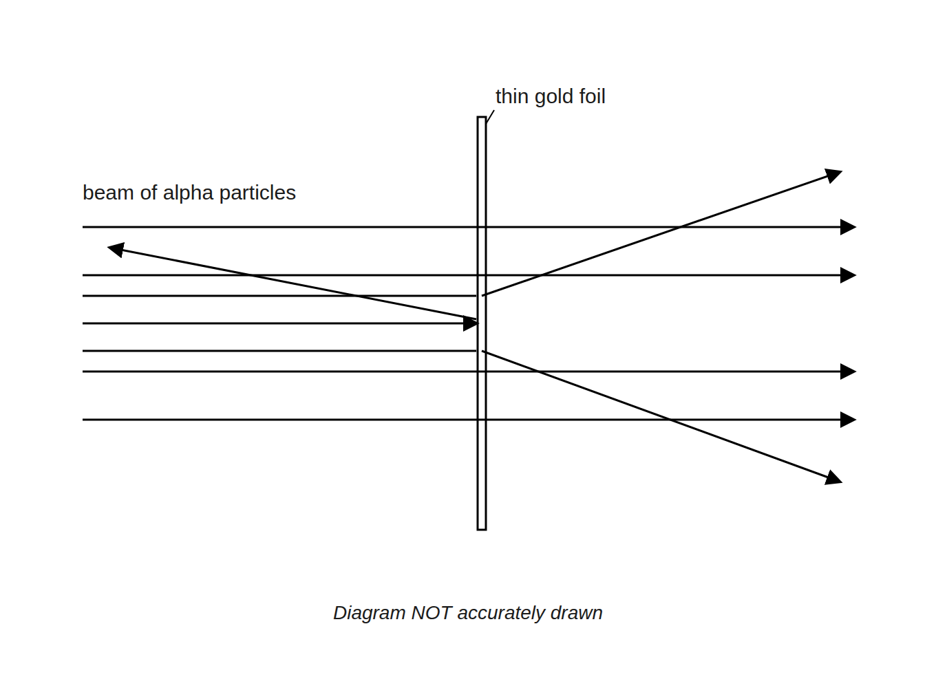
AQA GCSE PHYSICS · PAPER 1 · FOUNDATION & HIGHER
Question 2 · 4 marks · Explain
The diagram shows the paths of alpha particles fired at thin gold foil. Explain how these results led to the nuclear model of the atom. (4 marks)
Atomic structure
openrevise.com
Lesson 3 of 10

Slide 22
AQA GCSE PHYSICS · PAPER 1 · FOUNDATION & HIGHER
Question 2 · mark scheme
4 marks available. Award a mark for each point made.
Most went straight through so the atom is mostly empty space
1 mark
Some deflected: the nucleus is positive
1 mark
A few rebounded: mass concentrated in a small nucleus
1 mark
Plum pudding could not explain this
1 mark
Atomic structure
openrevise.com
Lesson 3 of 10

Slide 23
AQA GCSE PHYSICS · PAPER 1 · FOUNDATION & HIGHER
Question 3 · 3 marks · Describe
“
Describe how the nuclear model of the atom differs from the plum pudding model.
HOW TO ANSWER IT
Command word: Describe. Worth 3 marks, so plan before writing.
Atomic structure
openrevise.com
Lesson 3 of 10

Slide 24
AQA GCSE PHYSICS · PAPER 1 · FOUNDATION & HIGHER
Question 3 · mark scheme
3 marks available. Award a mark for each point made.
Nuclear: positive charge and mass in a small nucleus
1 mark
Electrons outside the nucleus
1 mark
Plum pudding: charge spread out
1 mark
Atomic structure
openrevise.com
Lesson 3 of 10

Slide 25
AQA GCSE PHYSICS · PAPER 1 · FOUNDATION & HIGHER
Question 4 · 2 marks · State
“
State two ways in which Bohr changed the nuclear model, or what the later experiments showed.
HOW TO ANSWER IT
Command word: State. Worth 2 marks, so plan before writing.
Atomic structure
openrevise.com
Lesson 3 of 10

Slide 26
AQA GCSE PHYSICS · PAPER 1 · FOUNDATION & HIGHER
Question 4 · mark scheme
2 marks available. Award a mark for each point made.
Electrons orbit at specific distances
1 mark
Protons and neutrons in the nucleus
1 mark
Atomic structure
openrevise.com
Lesson 3 of 10

Slide 27
AQA GCSE PHYSICS · PAPER 1 · FOUNDATION & HIGHER
Question 5 · 6 marks · Explain
“
Describe how the model of the atom has changed, from the idea of a solid sphere to the model with protons and neutrons in the nucleus. Explain why each change was made.
HOW TO ANSWER IT
Command word: Explain. Worth 6 marks, so plan before writing.
Atomic structure
openrevise.com
Lesson 3 of 10

Slide 28
AQA GCSE PHYSICS · PAPER 1 · FOUNDATION & HIGHER
Question 5 · mark scheme
6 marks available. Award a mark for each point made.
Level 3 (5 to 6 marks): a correct sequence (solid sphere, plum pudding, nuclear model, Bohr, protons and neutrons) with the evidence for at least three changes, including alpha scattering
5 to 6 marks
Level 2 (3 to 4 marks): at least three models named with some evidence
3 to 4 marks
Level 1 (1 to 2 marks): one or two models described
1 to 2 marks
Atomic structure
openrevise.com
Lesson 3 of 10

