Slide 1

AQA GCSE PHYSICS · PAPER 2 · FOUNDATION & HIGHER
Newton's Second Law
Forces
Lesson 15 of 20
openrevise.com

Slide 2

AQA GCSE PHYSICS · PAPER 2 · FOUNDATION & HIGHER
Warm-up
Answer each one, then check.
1
What is a resultant force?
2
What is acceleration?
3
What is the unit of force?
4
What is proportional?
5
What does inversely proportional mean?
Forces
openrevise.com
Lesson 15 of 20

Slide 3
AQA GCSE PHYSICS · PAPER 2 · FOUNDATION & HIGHER
Warm-up - Answers
What is a resultant force?
The single force with the same effect as all the forces
1
What is acceleration?
Rate of change of velocity
2
What is the unit of force?
Newton
3
What is proportional?
Doubling one doubles the other
4
What does inversely proportional mean?
Doubling one halves the other
5
Forces
openrevise.com
Lesson 15 of 20

Slide 4

AQA GCSE PHYSICS · PAPER 2 · FOUNDATION & HIGHER
Learning Objectives
State Newton's Second Law.
1
Recall and apply F = ma.
2
Describe how to investigate the effect of force and mass on acceleration (Required Practical 7).
3
Explain inertial mass (Higher tier).
4
Forces
openrevise.com
Lesson 15 of 20

Slide 5

AQA GCSE PHYSICS · PAPER 2 · FOUNDATION & HIGHER
NEWTON'S SECOND LAW
resultant force = mass × acceleration F = ma
The acceleration of an object is proportional to the resultant force and inversely proportional to its mass: a ∝ F and a ∝ 1/m.
Forces
openrevise.com
Lesson 15 of 20

Slide 6

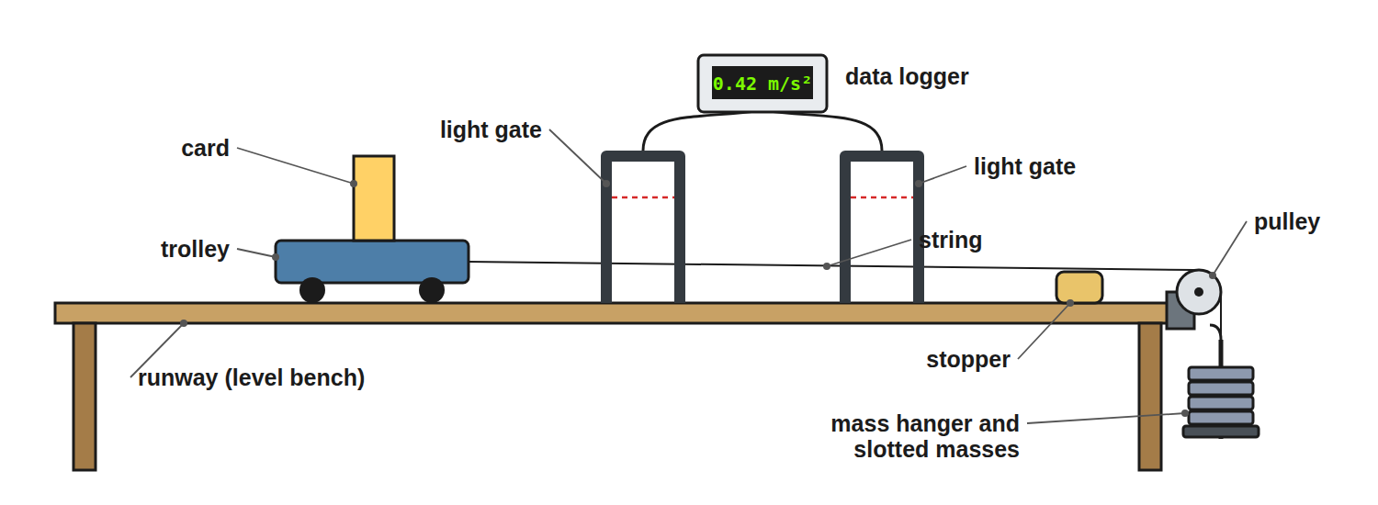
AQA GCSE PHYSICS · PAPER 2 · FOUNDATION & HIGHER
Required Practical 7: Force, Mass and Acceleration
The weight of the hanging masses provides the force.
Forces
openrevise.com
Lesson 15 of 20

Slide 7

AQA GCSE PHYSICS · PAPER 2 · FOUNDATION & HIGHER
Required Practical 7: Method
Two investigations.
1
2
3
4
5
6
Force varied
Keep the total mass constant by moving masses from the trolley to the hanger; the force is the weight of the hanging masses.
Measure acceleration
From the light gates: a = (v − u) ÷ t.
Plot
Acceleration against force: a straight line through the origin.
Mass varied
Keep the force constant and add masses to the trolley.
Plot
Acceleration against mass (a curve) or against 1/mass (a straight line).
Repeat
Take repeat readings and compensate for friction by slightly tilting the runway.
Forces
openrevise.com
Lesson 15 of 20

Slide 8

AQA GCSE PHYSICS · PAPER 2 · FOUNDATION & HIGHER
Finding Acceleration
A car of mass 1200 kg has a resultant force of 3000 N. Calculate its acceleration.
Rearrange
a = F ÷ m
1
Substitute
a = 3000 ÷ 1200
2
Answer
a = 2.5 m/s²
3
ANSWER
2.5 m/s²
Forces
openrevise.com
Lesson 15 of 20

Slide 9
AQA GCSE PHYSICS · PAPER 2 · FOUNDATION & HIGHER
Finding the Force
A 0.50 kg trolley accelerates at 4.0 m/s². Calculate the resultant force.
Write the equation
F = ma
1
Substitute
F = 0.50 × 4.0
2
Answer
F = 2.0 N
3
ANSWER
2.0 N
Forces
openrevise.com
Lesson 15 of 20

Slide 10
AQA GCSE PHYSICS · PAPER 2 · FOUNDATION & HIGHER
Using a Graph
A graph of acceleration against force for a trolley is a straight line through (2.0 N, 1.0 m/s²). Find the mass.
Gradient
a ÷ F = 1.0 ÷ 2.0 = 0.50 kg⁻¹
1
Since a = F ÷ m
Gradient = 1 ÷ m
2
Mass
m = 1 ÷ 0.50 = 2.0 kg
3
ANSWER
2.0 kg
Forces
openrevise.com
Lesson 15 of 20

Slide 11
AQA GCSE PHYSICS · PAPER 2 · FOUNDATION & HIGHER
Inertial Mass (Higher)
Explain what is meant by inertial mass.
Definition
The ratio of force to acceleration
1
Meaning
A measure of how difficult it is to change the velocity of an object
2
ANSWER
Inertial mass = force ÷ acceleration: how hard it is to change an object's velocity.
Forces
openrevise.com
Lesson 15 of 20

Slide 12

AQA GCSE PHYSICS · PAPER 2 · FOUNDATION & HIGHER
Estimating
Use sensible values.
Everyday values
A car accelerating from 0 to 27 m/s (60 mph) in 10 s has a ≈ 2.7 m/s².
Force
For a 1000 kg car: F = 1000 × 2.7 ≈ 2700 N.
Symbol ~
Means approximately.
Units
Mass in kg, a in m/s², F in N.
Forces
openrevise.com
Lesson 15 of 20

Slide 13

AQA GCSE PHYSICS · PAPER 2 · FOUNDATION & HIGHER
Key Terms
Resultant force
The net force acting on an object.
Acceleration
Rate of change of velocity.
Inertial mass
Force divided by acceleration.
Proportional
Increasing by the same factor.
Inversely proportional
One quantity halves as the other doubles.
Light gate
A sensor that times how long a card takes to pass.
Forces
openrevise.com
Lesson 15 of 20

Slide 14

AQA GCSE PHYSICS · PAPER 2 · FOUNDATION & HIGHER
YOUR TASK
10 minutes
Predict the Acceleration
A trolley has a mass of 1.0 kg and accelerates at 2.0 m/s² under a resultant force. What acceleration would the same force give a 2.0 kg trolley? What force is needed for 2.0 kg to accelerate at 2.0 m/s²?
Use F = ma.
1
Compare the masses.
2
WHAT A GOOD ANSWER SHOWS
Half the acceleration: 1.0 m/s². Force = 2.0 × 2.0 = 4.0 N.
Forces
openrevise.com
Lesson 15 of 20

Slide 15
AQA GCSE PHYSICS · PAPER 2 · FOUNDATION & HIGHER
Can I...?
State Newton's second law.
Interpret a force–acceleration graph.
Recall F = ma.
Explain inertial mass.
Rearrange for a or m.
Estimate forces on a car.
Describe Required Practical 7.
Use units.
Forces
openrevise.com
Lesson 15 of 20

Slide 16
AQA GCSE PHYSICS · PAPER 2 · FOUNDATION & HIGHER
Summary & Exam Focus
F = ma.
Acceleration ∝ force; ∝ 1/mass.
Inertial mass = force ÷ acceleration.
Use light gates to measure acceleration.
EXAM FOCUS
A 1200 kg car has a resultant force of 3000 N. Calculate its acceleration. (2 marks)
a = F ÷ m.
openrevise.com

