Slide 1

AQA GCSE PHYSICS · PAPER 2 · FOUNDATION & HIGHER
Forces and elasticity
Forces
Lesson 5 of 20
openrevise.com

Slide 2

AQA GCSE PHYSICS · PAPER 2 · FOUNDATION & HIGHER
Warm-up
Answer each one, then check.
1
What is a spring?
2
What does proportional mean?
3
Convert 6 cm to m.
4
What is elastic potential energy?
5
What is the unit of force?
Forces
openrevise.com
Lesson 5 of 20

Slide 3
AQA GCSE PHYSICS · PAPER 2 · FOUNDATION & HIGHER
Warm-up - Answers
What is a spring?
A coiled wire that can be stretched or compressed
1
What does proportional mean?
Doubling one doubles the other
2
Convert 6 cm to m.
0.06 m
3
What is elastic potential energy?
Energy stored in a stretched spring
4
What is the unit of force?
Newton
5
Forces
openrevise.com
Lesson 5 of 20

Slide 4

AQA GCSE PHYSICS · PAPER 2 · FOUNDATION & HIGHER
Learning Objectives
Explain why more than one force is needed to stretch, bend or compress an object.
1
Describe elastic and inelastic deformation.
2
Recall and apply F = ke and E_e = ½ke².
3
Interpret force-extension graphs and describe Required Practical 6.
4
Forces
openrevise.com
Lesson 5 of 20

Slide 5

AQA GCSE PHYSICS · PAPER 2 · FOUNDATION & HIGHER
HOOKE'S LAW
force = spring constant × extension F = ke
The extension of an elastic object is directly proportional to the force applied, provided the limit of proportionality is not exceeded. The same applies to compression.
Forces
openrevise.com
Lesson 5 of 20

Slide 6
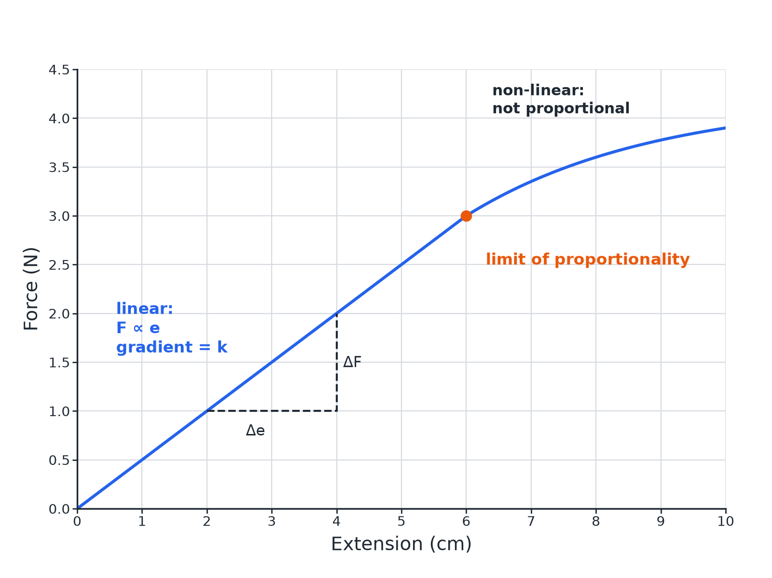

AQA GCSE PHYSICS · PAPER 2 · FOUNDATION & HIGHER
Force and Extension
Beyond the limit, the spring does not return to its original length.
Forces
openrevise.com
Lesson 5 of 20

Slide 7
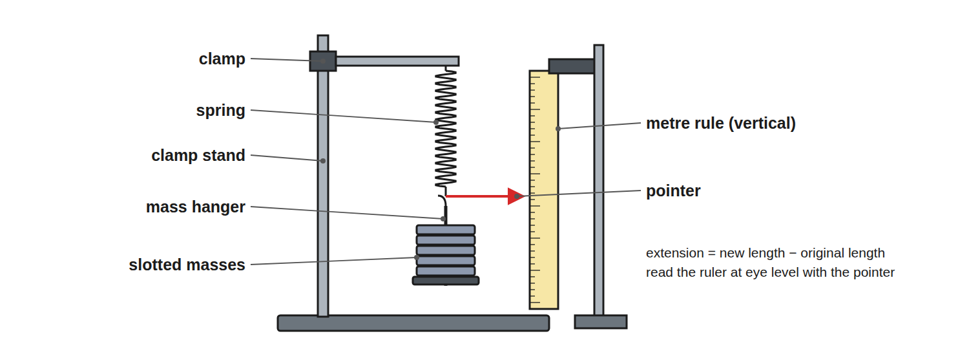
AQA GCSE PHYSICS · PAPER 2 · FOUNDATION & HIGHER
Required Practical 6: Stretching a Spring
Measure the length with each extra mass added.
Forces
openrevise.com
Lesson 5 of 20

Slide 8

AQA GCSE PHYSICS · PAPER 2 · FOUNDATION & HIGHER
Required Practical 6: Method
Investigate force and extension.
1
2
3
4
5
6
Measure the original length
With no masses on the spring.
Add a mass
Record the force (weight = mg) and the new length.
Calculate the extension
New length minus original length.
Repeat
Add masses one at a time, keeping below the limit of proportionality at first.
Plot
Force (y-axis) against extension (x-axis).
Gradient
Gradient of the straight part = spring constant k.
Forces
openrevise.com
Lesson 5 of 20

Slide 9

AQA GCSE PHYSICS · PAPER 2 · FOUNDATION & HIGHER
Spring Constant
A force of 3.0 N stretches a spring by 6.0 cm (within the limit of proportionality). Calculate the spring constant.
Convert
6.0 cm = 0.060 m
1
Rearrange
k = F ÷ e
2
Substitute
k = 3.0 ÷ 0.060
3
Answer
k = 50 N/m
4
ANSWER
50 N/m
Forces
openrevise.com
Lesson 5 of 20

Slide 10
AQA GCSE PHYSICS · PAPER 2 · FOUNDATION & HIGHER
Elastic Potential Energy
Calculate the energy stored in the spring when the extension is 0.040 m and k = 50 N/m.
Write the equation
E_e = ½ke²
1
Substitute
E_e = 0.5 × 50 × 0.040²
2
Answer
E_e = 0.040 J
3
ANSWER
0.040 J
Forces
openrevise.com
Lesson 5 of 20

Slide 11

AQA GCSE PHYSICS · PAPER 2 · FOUNDATION & HIGHER
Elastic or Inelastic?
ELASTIC DEFORMATION
INELASTIC DEFORMATION
• The object returns to its original shape when the force is removed.
• Happens within the limit of proportionality.
• The object does not return to its original shape.
• Happens beyond the limit of proportionality.
Forces
openrevise.com
Lesson 5 of 20

Slide 12

AQA GCSE PHYSICS · PAPER 2 · FOUNDATION & HIGHER
Key Ideas
Learn these.
Two forces
To stretch, bend or compress a stationary object, more than one force is needed (for example pull at both ends).
Work done
The work done on an elastic object equals the elastic potential energy stored, provided it is not inelastically deformed.
Linear
A straight line through the origin: proportional.
Non-linear
A curve: not proportional.
Forces
openrevise.com
Lesson 5 of 20

Slide 13

AQA GCSE PHYSICS · PAPER 2 · FOUNDATION & HIGHER
Key Terms
Extension
The increase in length of a spring.
Spring constant
The force needed per metre of extension (N/m).
Limit of proportionality
The point beyond which force and extension are no longer proportional.
Elastic deformation
A change of shape that is reversed when the force is removed.
Inelastic deformation
A permanent change of shape.
Linear
Following a straight line.
Forces
openrevise.com
Lesson 5 of 20

Slide 14

AQA GCSE PHYSICS · PAPER 2 · FOUNDATION & HIGHER
YOUR TASK
12 minutes
Spring Test
A spring stretches 4.0 cm when a 2.0 N force is applied. (a) Calculate k in N/m. (b) What force gives an extension of 10 cm if the limit is not exceeded? (c) What energy is stored at 10 cm?
Convert cm to m.
1
Use F = ke and Ee = ½ke².
2
WHAT A GOOD ANSWER SHOWS
(a) 50 N/m. (b) F = 50 × 0.10 = 5.0 N. (c) E = 0.5 × 50 × 0.10² = 0.25 J.
Forces
openrevise.com
Lesson 5 of 20
Notes:
Ask why the spring may not return to shape if overstretched.

Slide 15
AQA GCSE PHYSICS · PAPER 2 · FOUNDATION & HIGHER
Can I...?
State F = ke.
Describe elastic and inelastic deformation.
Convert cm to m.
Read a force-extension graph.
Calculate a spring constant.
Describe Required Practical 6.
Calculate stored energy.
Find the gradient.
Forces
openrevise.com
Lesson 5 of 20

Slide 16
AQA GCSE PHYSICS · PAPER 2 · FOUNDATION & HIGHER
Summary & Exam Focus
F = ke.
E_e = ½ke².
Beyond the limit of proportionality: non-linear, may not return.
Spring constant = gradient of the linear part.
EXAM FOCUS
A spring has a spring constant of 50 N/m. Calculate the force needed to stretch it by 0.10 m. (2 marks)
Use F = ke.
openrevise.com

Slide 17
AQA GCSE PHYSICS · PAPER 2 · FOUNDATION & HIGHER
Exam Practice: Forces and elasticity
Answer all questions. Use the mark allocation as a guide to how much to write. · 18 minutes
Question 1 · 2 marks · Calculate
A spring has a spring constant of 50 N/m. Calculate the force needed to stretch the spring by 0.10 m. Use the equation: force = spring…
Question 2 · 5 marks · Use the graph
A student investigates a spring. The graph shows how the force changes with extension. (a) State the extension at the limit of…
Question 3 · 2 marks · Describe
Describe the difference between elastic deformation and inelastic deformation of a spring.
Forces
openrevise.com
Lesson 5 of 20

Slide 18
AQA GCSE PHYSICS · PAPER 2 · FOUNDATION & HIGHER
Exam Practice: Forces and elasticity (cont.)
Question 4 · 6 marks · Describe
Describe how to investigate the relationship between the force applied to a spring and the extension of the spring. Your answer should…
Question 5 · 2 marks · Explain
Explain why two forces are needed to stretch a spring that is fixed to a wall.
Forces
openrevise.com
Lesson 5 of 20

Slide 19
AQA GCSE PHYSICS · PAPER 2 · FOUNDATION & HIGHER
Question 1 · 2 marks · Calculate
“
A spring has a spring constant of 50 N/m. Calculate the force needed to stretch the spring by 0.10 m. Use the equation: force = spring constant × extension
HOW TO ANSWER IT
Command word: Calculate. Worth 2 marks, so plan before writing.
Forces
openrevise.com
Lesson 5 of 20

Slide 20
AQA GCSE PHYSICS · PAPER 2 · FOUNDATION & HIGHER
Question 1 · mark scheme
2 marks available. Award a mark for each point made.
Correct substitution
1 mark
5.0 N
1 mark
Forces
openrevise.com
Lesson 5 of 20

Slide 21
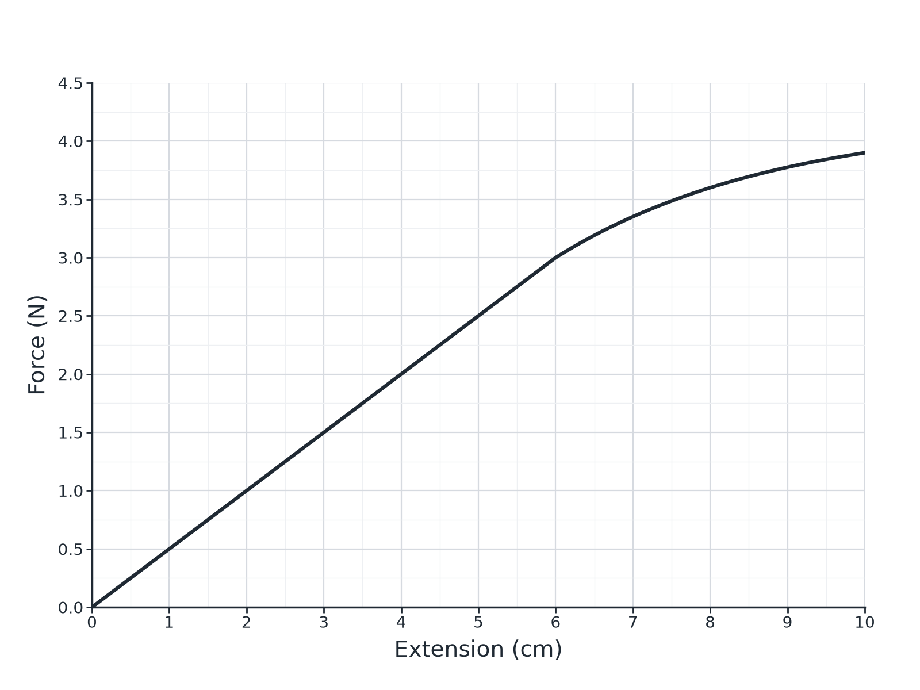
AQA GCSE PHYSICS · PAPER 2 · FOUNDATION & HIGHER
Question 2 · 5 marks · Use the graph
A student investigates a spring. The graph shows how the force changes with extension. (a) State the extension at the limit of proportionality. (b) Calculate the spring constant of the spring. (c) Calculate the elastic potential energy stored when the extension is 0.040 m. (5 marks)
Forces
openrevise.com
Lesson 5 of 20

Slide 22
AQA GCSE PHYSICS · PAPER 2 · FOUNDATION & HIGHER
Question 2 · mark scheme
5 marks available. Award a mark for each point made.
6 cm (accept 5.5 to 6.5)
1 mark
Uses 3.0 N at 0.060 m
1 mark
50 N/m
1 mark
Forces
openrevise.com
Lesson 5 of 20

Slide 23
AQA GCSE PHYSICS · PAPER 2 · FOUNDATION & HIGHER
Question 2 · mark scheme (cont.)
Correct substitution
1 mark
0.040 J
1 mark
Forces
openrevise.com
Lesson 5 of 20

Slide 24
AQA GCSE PHYSICS · PAPER 2 · FOUNDATION & HIGHER
Question 3 · 2 marks · Describe
“
Describe the difference between elastic deformation and inelastic deformation of a spring.
HOW TO ANSWER IT
Command word: Describe. Worth 2 marks, so plan before writing.
Forces
openrevise.com
Lesson 5 of 20

Slide 25
AQA GCSE PHYSICS · PAPER 2 · FOUNDATION & HIGHER
Question 3 · mark scheme
2 marks available. Award a mark for each point made.
Elastic: returns to original shape
1 mark
Inelastic: does not return
1 mark
Forces
openrevise.com
Lesson 5 of 20

Slide 26
AQA GCSE PHYSICS · PAPER 2 · FOUNDATION & HIGHER
Question 4 · 6 marks · Describe
“
Describe how to investigate the relationship between the force applied to a spring and the extension of the spring. Your answer should include the apparatus, the measurements, and how you would use them.
HOW TO ANSWER IT
Command word: Describe. Worth 6 marks, so plan before writing.
Forces
openrevise.com
Lesson 5 of 20

Slide 27
AQA GCSE PHYSICS · PAPER 2 · FOUNDATION & HIGHER
Question 4 · mark scheme
6 marks available. Award a mark for each point made.
Level 3 (5 to 6 marks): a complete method with stand, ruler and masses, original length measured, several forces (weights) applied with the new length each time, extension calculated, graph plotted and spring constant from the gradient, with a precaution (eye level, avoid overstretching)
5 to 6 marks
Level 2 (3 to 4 marks): a method covering force and extension with some detail missing
3 to 4 marks
Level 1 (1 to 2 marks): simple statements about adding masses and measuring length
1 to 2 marks
Forces
openrevise.com
Lesson 5 of 20

Slide 28
AQA GCSE PHYSICS · PAPER 2 · FOUNDATION & HIGHER
Question 5 · 2 marks · Explain
“
Explain why two forces are needed to stretch a spring that is fixed to a wall.
HOW TO ANSWER IT
Command word: Explain. Worth 2 marks, so plan before writing.
Forces
openrevise.com
Lesson 5 of 20

Slide 29
AQA GCSE PHYSICS · PAPER 2 · FOUNDATION & HIGHER
Question 5 · mark scheme
2 marks available. Award a mark for each point made.
Forces act at both ends
1 mark
Equal and opposite forces
1 mark
Forces
openrevise.com
Lesson 5 of 20

