Slide 1
AQA GCSE PHYSICS · PAPER 2 · FOUNDATION & HIGHER
Properties of waves
Waves
Lesson 2 of 12
openrevise.com

Slide 2

AQA GCSE PHYSICS · PAPER 2 · FOUNDATION & HIGHER
Warm-up
Answer each one, then check.
1
What is the unit of frequency?
2
What is the unit of wavelength?
3
What is the speed of sound in air?
4
What is a crest?
5
What is period?
Waves
openrevise.com
Lesson 2 of 12

Slide 3
AQA GCSE PHYSICS · PAPER 2 · FOUNDATION & HIGHER
Warm-up - Answers
What is the unit of frequency?
Hertz (Hz)
1
What is the unit of wavelength?
Metres (m)
2
What is the speed of sound in air?
About 330 m/s
3
What is a crest?
The highest point of a transverse wave
4
What is period?
The time for one wave to pass
5
Waves
openrevise.com
Lesson 2 of 12

Slide 4

AQA GCSE PHYSICS · PAPER 2 · FOUNDATION & HIGHER
Learning Objectives
Define amplitude, wavelength, frequency and period.
1
Recall and apply T = 1 ÷ f and v = fλ.
2
Identify amplitude and wavelength from diagrams.
3
Describe methods to measure the speed of sound and of ripples, and Required Practical 8.
4
Explain how v, f and λ change when sound passes from one medium to another (Physics only).
5
Waves
openrevise.com
Lesson 2 of 12

Slide 5

AQA GCSE PHYSICS · PAPER 2 · FOUNDATION & HIGHER
THE WAVE EQUATION
wave speed = frequency × wavelength v = fλ
Period T = 1/f. v = fλ is given on the equation sheet. Wave speed is in m/s, frequency in Hz, wavelength in m and period in s.
Waves
openrevise.com
Lesson 2 of 12

Slide 6
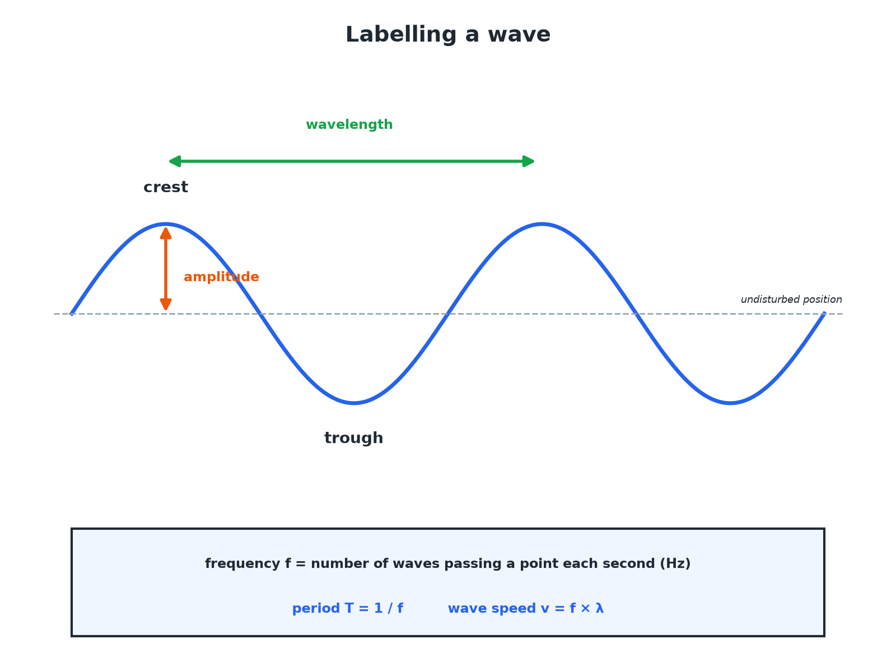

AQA GCSE PHYSICS · PAPER 2 · FOUNDATION & HIGHER
Labelling a Wave
Amplitude is measured from the undisturbed position, not from trough to crest.
Waves
openrevise.com
Lesson 2 of 12

Slide 7
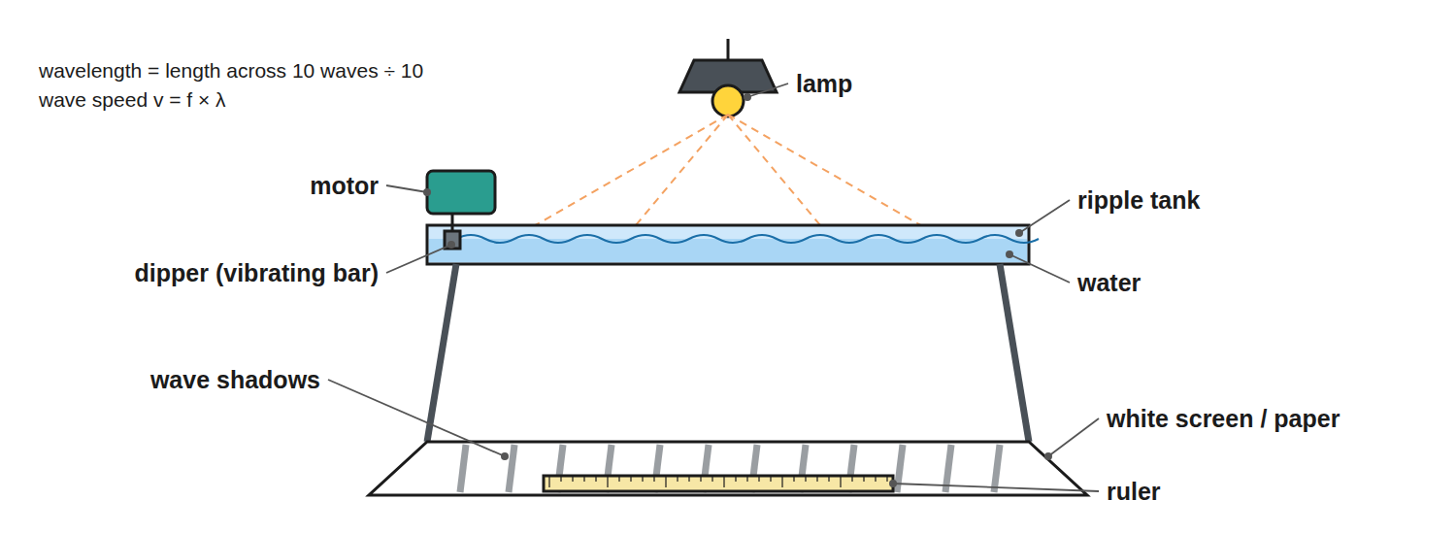
AQA GCSE PHYSICS · PAPER 2 · FOUNDATION & HIGHER
Required Practical 8: Waves in a Ripple Tank
Measure the wavelength from the pattern and the frequency from the motor.
Waves
openrevise.com
Lesson 2 of 12

Slide 8

AQA GCSE PHYSICS · PAPER 2 · FOUNDATION & HIGHER
Wave Quantities
Learn the definitions and units.
Quantity
Symbol
Unit
Meaning
Amplitude
A
m
Maximum displacement from the undisturbed position
Wavelength
λ
m
Distance between equivalent points on adjacent waves
Frequency
f
Hz
Number of waves passing a point each second
Period
T
s
Time for one complete wave
Wave speed
v
m/s
Speed at which the wave moves or transfers energy
Waves
openrevise.com
Lesson 2 of 12

Slide 9

AQA GCSE PHYSICS · PAPER 2 · FOUNDATION & HIGHER
Using the Wave Equation
Sound waves of frequency 50 Hz travel at 330 m/s. Calculate the wavelength.
Rearrange
λ= v ÷ f
1
Substitute
λ= 330 ÷ 50
2
Answer
λ= 6.6 m
3
ANSWER
6.6 m
Waves
openrevise.com
Lesson 2 of 12

Slide 10
AQA GCSE PHYSICS · PAPER 2 · FOUNDATION & HIGHER
Finding Speed
Water waves have a frequency of 2.0 Hz and a wavelength of 0.50 m. Calculate the wave speed.
Write the equation
v = fλ
1
Substitute
v = 2.0 × 0.50
2
Answer
v = 1.0 m/s
3
ANSWER
1.0 m/s
Waves
openrevise.com
Lesson 2 of 12

Slide 11
AQA GCSE PHYSICS · PAPER 2 · FOUNDATION & HIGHER
Period
A wave has a frequency of 250 Hz. Calculate the period.
Write the equation
T = 1 ÷ f
1
Substitute
T = 1 ÷ 250
2
Answer
T = 0.0040 s
3
ANSWER
0.0040 s
Waves
openrevise.com
Lesson 2 of 12

Slide 12
AQA GCSE PHYSICS · PAPER 2 · FOUNDATION & HIGHER
Speed of Sound by Echo
Describe a method to measure the speed of sound in air.
Set up
Stand a measured distance (for example 100 m) from a large wall and clap
1
Time
Start a stopwatch at the clap and stop at the echo
2
Calculate
v = distance there and back ÷ time
3
Repeat
Take several readings and find a mean
4
ANSWER
Speed = 2d ÷ t, with repeats to reduce error.
Waves
openrevise.com
Lesson 2 of 12

Slide 13
AQA GCSE PHYSICS · PAPER 2 · FOUNDATION & HIGHER
Changing Medium (Physics only)
A sound wave of frequency 500 Hz travels from air (330 m/s) into water (1500 m/s). What happens to f, v and λ?
Frequency
Unchanged: it is set by the source
1
Speed
Increases to 1500 m/s
2
Wavelength
λ= v ÷ f increases: from 0.66 m to 3.0 m
3
ANSWER
f stays the same; v and λ both increase.
Waves
openrevise.com
Lesson 2 of 12

Slide 14

AQA GCSE PHYSICS · PAPER 2 · FOUNDATION & HIGHER
Required Practical 8: Ripple Tank Method
Measuring frequency, wavelength and speed of water waves.
1
2
3
4
5
Set up
Fill a ripple tank and set the signal generator so the dipper makes steady waves; a lamp above casts shadows on paper below.
Wavelength
Measure across 10 wavelengths with a ruler on the shadow pattern and divide by 10.
Frequency
Count the waves passing a point in 10 seconds and divide by 10, or read the generator.
Speed
Calculate v = fλ.
Improve
A strobe or a photo with a ruler in shot freezes the pattern for easier measuring.
Waves
openrevise.com
Lesson 2 of 12

Slide 15

AQA GCSE PHYSICS · PAPER 2 · FOUNDATION & HIGHER
Measuring Waves on a String
The second part of Required Practical 8.
Set up
A string runs over a pulley with masses hung on the end, and a vibration generator near the other end.
Standing wave
Adjust the frequency until a clear, stationary pattern of loops appears. Measure across several half-wavelengths with a metre ruler.
Calculate
Read the frequency from the signal generator and use v = fλ. Changing the frequency changes the wavelength, but the speed stays the same for the same string and tension.
Waves
openrevise.com
Lesson 2 of 12

Slide 16

AQA GCSE PHYSICS · PAPER 2 · FOUNDATION & HIGHER
Reading a Wave Diagram
Where marks are lost on labelled diagrams.
Amplitude
Measure from the middle line (undisturbed position) to a crest, not from trough to crest.
Wavelength
Measure from one crest to the next crest, or between any two matching points.
Time axis
If the x-axis is time instead of distance, the gap between crests is the period, not the wavelength.
Waves
openrevise.com
Lesson 2 of 12

Slide 17

AQA GCSE PHYSICS · PAPER 2 · FOUNDATION & HIGHER
Key Terms
Amplitude
The maximum displacement of a point on a wave from its undisturbed position.
Wavelength
The distance from a point on one wave to the same point on the next wave.
Frequency
The number of waves passing a point each second.
Period
The time for one complete wave.
Wave speed
The speed at which energy is transferred through a medium.
Ripple tank
A shallow tray of water used to show wave behaviour.
Waves
openrevise.com
Lesson 2 of 12

Slide 18
AQA GCSE PHYSICS · PAPER 2 · FOUNDATION & HIGHER
Key Terms (cont.)
Hertz
The unit of frequency: one wave per second.
Undisturbed position
The position of the medium when no wave is passing.
Signal generator
A device that produces a vibration at a set frequency.
Waves
openrevise.com
Lesson 2 of 12

Slide 19

AQA GCSE PHYSICS · PAPER 2 · FOUNDATION & HIGHER
YOUR TASK
12 minutes
Wave Sums
Ripples have a wavelength of 4.0 cm and a frequency of 5.0 Hz. Calculate the speed in m/s. What is the period?
Convert cm to m.
1
Use v = fλ and T = 1/f.
2
WHAT A GOOD ANSWER SHOWS
λ = 0.040 m; v = 5.0 × 0.040 = 0.20 m/s. T = 1 ÷ 5.0 = 0.20 s.
Waves
openrevise.com
Lesson 2 of 12
Notes:
Ask how the speed changes if the frequency doubles.

Slide 20

AQA GCSE PHYSICS · PAPER 2 · FOUNDATION & HIGHER
Can I...?
Define amplitude.
Use T = 1 ÷ f.
Define wavelength.
Read a wave diagram.
Define frequency and period.
Describe measuring wave speed.
Use v = fλ.
Explain changes at a boundary.
Waves
openrevise.com
Lesson 2 of 12

Slide 21
AQA GCSE PHYSICS · PAPER 2 · FOUNDATION & HIGHER
Summary & Exam Focus
v = fλ and T = 1 ÷ f.
Amplitude from the undisturbed position to a crest.
Wavelength between equivalent points.
Frequency stays constant when a wave changes medium.
Measure amplitude from the middle line, not trough to crest.
Measure across several waves and divide for accuracy.
EXAM FOCUS
Sound of frequency 50 Hz travels at 330 m/s. Calculate the wavelength. (2 marks)
Rearrange v = fλ to λ = v ÷ f, substitute 330 ÷ 50 and give 6.6 m. If the frequency is given in kHz, multiply by 1000 first.
openrevise.com

Slide 22
AQA GCSE PHYSICS · PAPER 2 · FOUNDATION & HIGHER
Exam Practice: Properties of waves
Answer all questions. Use the mark allocation as a guide to how much to write. · 17 minutes
Question 1 · 2 marks · Calculate
Sound waves travel through air at 330 m/s. A sound has a frequency of 50 Hz. Calculate the wavelength of the sound waves. Use the equation…
Question 2 · 4 marks · Use the diagram
The diagram shows a water wave. (a) State the amplitude of the wave. (b) State the wavelength. (c) The wave passes a point 5 times each…
Question 3 · 2 marks · Calculate
A wave has a frequency of 250 Hz. Calculate its period.
Waves
openrevise.com
Lesson 2 of 12

Slide 23
AQA GCSE PHYSICS · PAPER 2 · FOUNDATION & HIGHER
Exam Practice: Properties of waves (cont.)
Question 4 · 4 marks · Describe
Describe how you would measure the speed of sound in air using a wall and a stopwatch.
Question 5 · 4 marks · Explain
A sound wave travels from air into water. Its frequency is 500 Hz. The speed of sound is 330 m/s in air and 1500 m/s in water. Explain what…
Waves
openrevise.com
Lesson 2 of 12

Slide 24
AQA GCSE PHYSICS · PAPER 2 · FOUNDATION & HIGHER
Question 1 · 2 marks · Calculate
“
Sound waves travel through air at 330 m/s. A sound has a frequency of 50 Hz. Calculate the wavelength of the sound waves. Use the equation: wave speed = frequency × wavelength
HOW TO ANSWER IT
Command word: Calculate. Worth 2 marks, so plan before writing.
Waves
openrevise.com
Lesson 2 of 12

Slide 25
AQA GCSE PHYSICS · PAPER 2 · FOUNDATION & HIGHER
Question 1 · mark scheme
2 marks available. Award a mark for each point made.
Rearranges to λ = v ÷ f
1 mark
6.6 m
1 mark
Waves
openrevise.com
Lesson 2 of 12

Slide 26
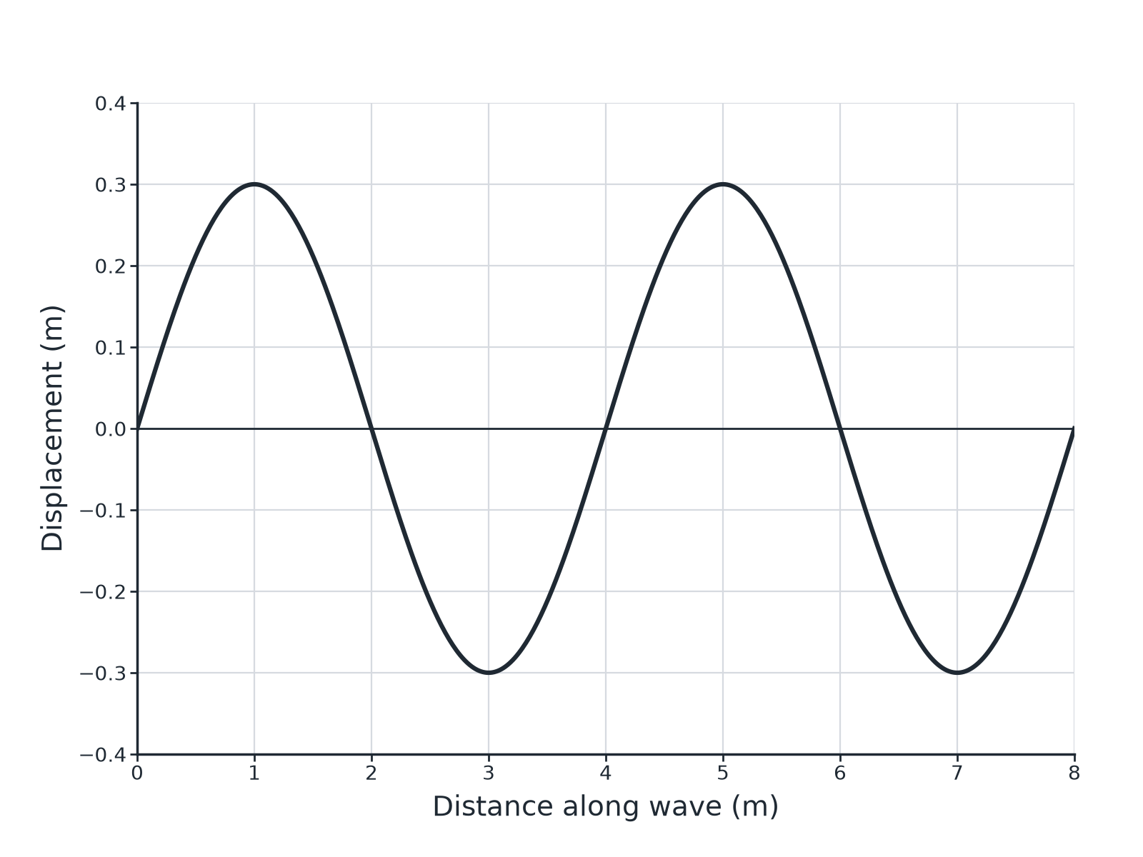
AQA GCSE PHYSICS · PAPER 2 · FOUNDATION & HIGHER
Question 2 · 4 marks · Use the diagram
The diagram shows a water wave. (a) State the amplitude of the wave. (b) State the wavelength. (c) The wave passes a point 5 times each second. Calculate the wave speed. (4 marks)
Waves
openrevise.com
Lesson 2 of 12

Slide 27
AQA GCSE PHYSICS · PAPER 2 · FOUNDATION & HIGHER
Question 2 · mark scheme
4 marks available. Award a mark for each point made.
Amplitude 0.30 m
1 mark
Wavelength 4.0 m
1 mark
Correct substitution
1 mark
20 m/s
1 mark
Waves
openrevise.com
Lesson 2 of 12

Slide 28
AQA GCSE PHYSICS · PAPER 2 · FOUNDATION & HIGHER
Question 3 · 2 marks · Calculate
“
A wave has a frequency of 250 Hz. Calculate its period.
HOW TO ANSWER IT
Command word: Calculate. Worth 2 marks, so plan before writing.
Waves
openrevise.com
Lesson 2 of 12

Slide 29
AQA GCSE PHYSICS · PAPER 2 · FOUNDATION & HIGHER
Question 3 · mark scheme
2 marks available. Award a mark for each point made.
Correct substitution
1 mark
0.0040 s
1 mark
Waves
openrevise.com
Lesson 2 of 12

Slide 30
AQA GCSE PHYSICS · PAPER 2 · FOUNDATION & HIGHER
Question 4 · 4 marks · Describe
“
Describe how you would measure the speed of sound in air using a wall and a stopwatch.
HOW TO ANSWER IT
Command word: Describe. Worth 4 marks, so plan before writing.
Waves
openrevise.com
Lesson 2 of 12

Slide 31
AQA GCSE PHYSICS · PAPER 2 · FOUNDATION & HIGHER
Question 4 · mark scheme
4 marks available. Award a mark for each point made.
Measured distance to a wall
1 mark
Timing clap to echo
1 mark
Distance travelled is there and back
1 mark
Repeat and mean
1 mark
Waves
openrevise.com
Lesson 2 of 12

Slide 32
AQA GCSE PHYSICS · PAPER 2 · FOUNDATION & HIGHER
Question 5 · 4 marks · Explain
“
A sound wave travels from air into water. Its frequency is 500 Hz. The speed of sound is 330 m/s in air and 1500 m/s in water. Explain what happens to the frequency, speed and wavelength, and calculate the wavelength in water.
HOW TO ANSWER IT
Command word: Explain. Worth 4 marks, so plan before writing.
Waves
openrevise.com
Lesson 2 of 12

Slide 33
AQA GCSE PHYSICS · PAPER 2 · FOUNDATION & HIGHER
Question 5 · mark scheme
4 marks available. Award a mark for each point made.
Frequency unchanged
1 mark
Speed increases
1 mark
Wavelength increases
1 mark
3.0 m
1 mark
Waves
openrevise.com
Lesson 2 of 12

