Slide 1
AQA GCSE PHYSICS · PAPER 2 · FOUNDATION & HIGHER
Reflection of waves
Waves
Lesson 3 of 12
openrevise.com

Slide 2

AQA GCSE PHYSICS · PAPER 2 · FOUNDATION & HIGHER
Warm-up
Answer each one, then check.
1
What is a ray?
2
What is a mirror?
3
What is a normal?
4
What is an angle?
5
Name a material that light passes through.
Waves
openrevise.com
Lesson 3 of 12

Slide 3
AQA GCSE PHYSICS · PAPER 2 · FOUNDATION & HIGHER
Warm-up - Answers
What is a ray?
A straight line showing the path of light
1
What is a mirror?
A smooth shiny surface that reflects light
2
What is a normal?
A line at right angles to a surface
3
What is an angle?
A measure of turn, in degrees
4
Name a material that light passes through.
Glass or water
5
Waves
openrevise.com
Lesson 3 of 12

Slide 4

AQA GCSE PHYSICS · PAPER 2 · FOUNDATION & HIGHER
Learning Objectives
Describe reflection, absorption and transmission of waves at a boundary.
1
State and apply the law of reflection.
2
Construct ray diagrams showing reflection at a surface.
3
Describe how to investigate the reflection of light by different surfaces.
4
Waves
openrevise.com
Lesson 3 of 12

Slide 5

AQA GCSE PHYSICS · PAPER 2 · FOUNDATION & HIGHER
REFLECTION
Waves can be reflected, absorbed or transmitted at the boundary between two materials. The angle of incidence equals the angle of reflection.
Angles are measured between the ray and the normal, a line at right angles to the surface at the point where the ray strikes it.
Waves
openrevise.com
Lesson 3 of 12

Slide 6
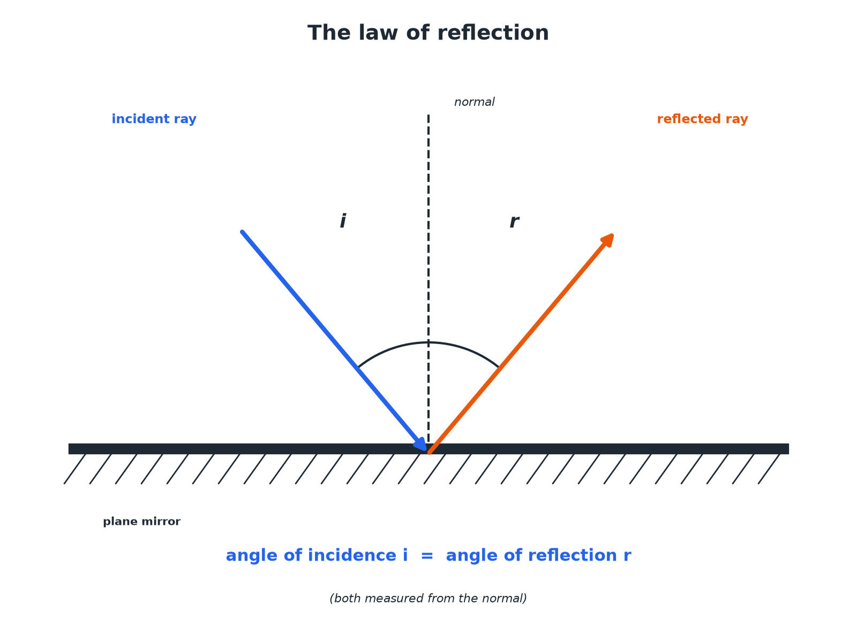

AQA GCSE PHYSICS · PAPER 2 · FOUNDATION & HIGHER
The Law of Reflection
Measure both angles from the normal.
Waves
openrevise.com
Lesson 3 of 12

Slide 7
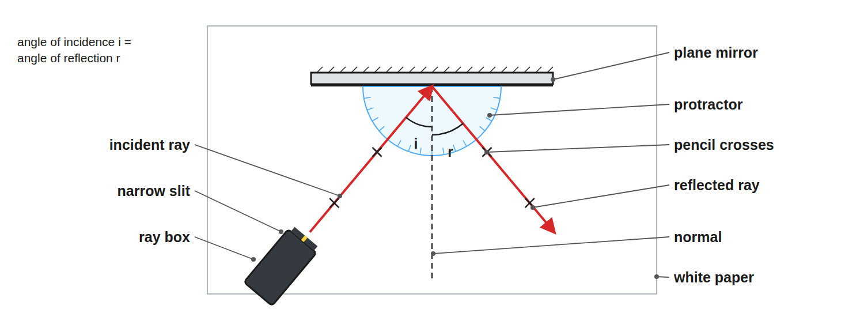
AQA GCSE PHYSICS · PAPER 2 · FOUNDATION & HIGHER
Required Practical 9: Reflection with a Ray Box
Draw the normal, then measure both angles from it.
Waves
openrevise.com
Lesson 3 of 12

Slide 8

AQA GCSE PHYSICS · PAPER 2 · FOUNDATION & HIGHER
How to Draw a Reflection Ray Diagram
Follow the steps.
1
2
3
4
5
Draw the mirror
A straight line.
Draw the normal
A dashed line at 90° to the mirror at the point of incidence.
Draw the incident ray
Toward the point, with an arrow.
Measure the angle of incidence
Between the ray and the normal.
Draw the reflected ray
At the same angle on the other side of the normal, with an arrow.
Waves
openrevise.com
Lesson 3 of 12

Slide 9

AQA GCSE PHYSICS · PAPER 2 · FOUNDATION & HIGHER
What Happens at a Boundary
Waves can do three things.
Effect
What it means
Example
Reflection
The wave bounces off the surface
Light from a mirror; an echo
Absorption
The wave's energy is transferred to the material
Black paper absorbs light and warms up
Transmission
The wave passes through the material
Light passing through glass
Waves
openrevise.com
Lesson 3 of 12

Slide 10

AQA GCSE PHYSICS · PAPER 2 · FOUNDATION & HIGHER
Finding Angles
A ray strikes a plane mirror so that the angle between the ray and the mirror surface is 50°. Find the angle of reflection.
Angle to the normal
90°− 50°= 40°
1
Law of reflection
Angle of reflection = angle of incidence
2
ANSWER
40°, measured from the normal.
Waves
openrevise.com
Lesson 3 of 12

Slide 11

AQA GCSE PHYSICS · PAPER 2 · FOUNDATION & HIGHER
Practical Tips
Get accurate results.
Narrow beam
Use a single slit so the ray is thin.
Mark the ray
Put a cross on the ray at two points and draw a line through them.
Repeat
Measure for several angles of incidence.
Conclusion
The angle of incidence equals the angle of reflection.
Waves
openrevise.com
Lesson 3 of 12

Slide 12

AQA GCSE PHYSICS · PAPER 2 · FOUNDATION & HIGHER
Key Terms
Reflection
When a wave bounces off a surface.
Absorption
When a wave's energy is taken in by a material.
Transmission
When a wave passes through a material.
Normal
A line at right angles to a surface.
Angle of incidence
The angle between the incident ray and the normal.
Angle of reflection
The angle between the reflected ray and the normal.
Waves
openrevise.com
Lesson 3 of 12

Slide 13

AQA GCSE PHYSICS · PAPER 2 · FOUNDATION & HIGHER
YOUR TASK
10 minutes
Reflect It
A ray hits a mirror at an angle of incidence of 35°. Draw a ray diagram. State the angle between the reflected ray and the mirror surface.
Draw the normal first.
1
Mirror the angle.
2
WHAT A GOOD ANSWER SHOWS
The angle of reflection is 35°. The angle to the mirror is 90° − 35° = 55°.
Waves
openrevise.com
Lesson 3 of 12

Slide 14
AQA GCSE PHYSICS · PAPER 2 · FOUNDATION & HIGHER
Can I...?
Define reflection.
Measure angles from the normal.
Define absorption and transmission.
Draw a reflected ray.
State the law of reflection.
Describe the practical.
Draw a normal.
Find an angle to the mirror.
Waves
openrevise.com
Lesson 3 of 12

Slide 15
AQA GCSE PHYSICS · PAPER 2 · FOUNDATION & HIGHER
Summary & Exam Focus
Angle of incidence = angle of reflection.
Angles measured from the normal.
Reflection, absorption, transmission.
Use a ray box, mirror and protractor.
EXAM FOCUS
State the law of reflection. (1 mark)
The angle of incidence equals the angle of reflection.
openrevise.com

