Slide 1
AQA GCSE PHYSICS · PAPER 2 · FOUNDATION & HIGHER
Refraction of waves
Waves
Lesson 4 of 12
openrevise.com

Slide 2

AQA GCSE PHYSICS · PAPER 2 · FOUNDATION & HIGHER
Warm-up
Answer each one, then check.
1
What is reflection?
2
What is a normal?
3
Does light travel faster in glass or air?
4
What is a medium?
5
What is a wavefront?
Waves
openrevise.com
Lesson 4 of 12

Slide 3
AQA GCSE PHYSICS · PAPER 2 · FOUNDATION & HIGHER
Warm-up - Answers
What is reflection?
A wave bouncing off a surface
1
What is a normal?
A line at right angles to a surface
2
Does light travel faster in glass or air?
Air
3
What is a medium?
A material a wave travels through
4
What is a wavefront?
A line joining points of a wave in the same phase
5
Waves
openrevise.com
Lesson 4 of 12

Slide 4

AQA GCSE PHYSICS · PAPER 2 · FOUNDATION & HIGHER
Learning Objectives
Describe refraction as a change in direction when a wave crosses a boundary.
1
Explain refraction in terms of the change of speed (Higher tier).
2
Construct ray diagrams for refraction at the boundary between two media.
3
Use wavefront diagrams to explain refraction (Higher tier).
4
Waves
openrevise.com
Lesson 4 of 12

Slide 5

AQA GCSE PHYSICS · PAPER 2 · FOUNDATION & HIGHER
REFRACTION
Refraction is the change in direction of a wave when it passes from one medium to another, caused by a change in the speed of the wave.
Entering a denser medium (such as glass from air) the wave slows down and bends towards the normal. Leaving the denser medium it speeds up and bends away from the normal.
Waves
openrevise.com
Lesson 4 of 12

Slide 6
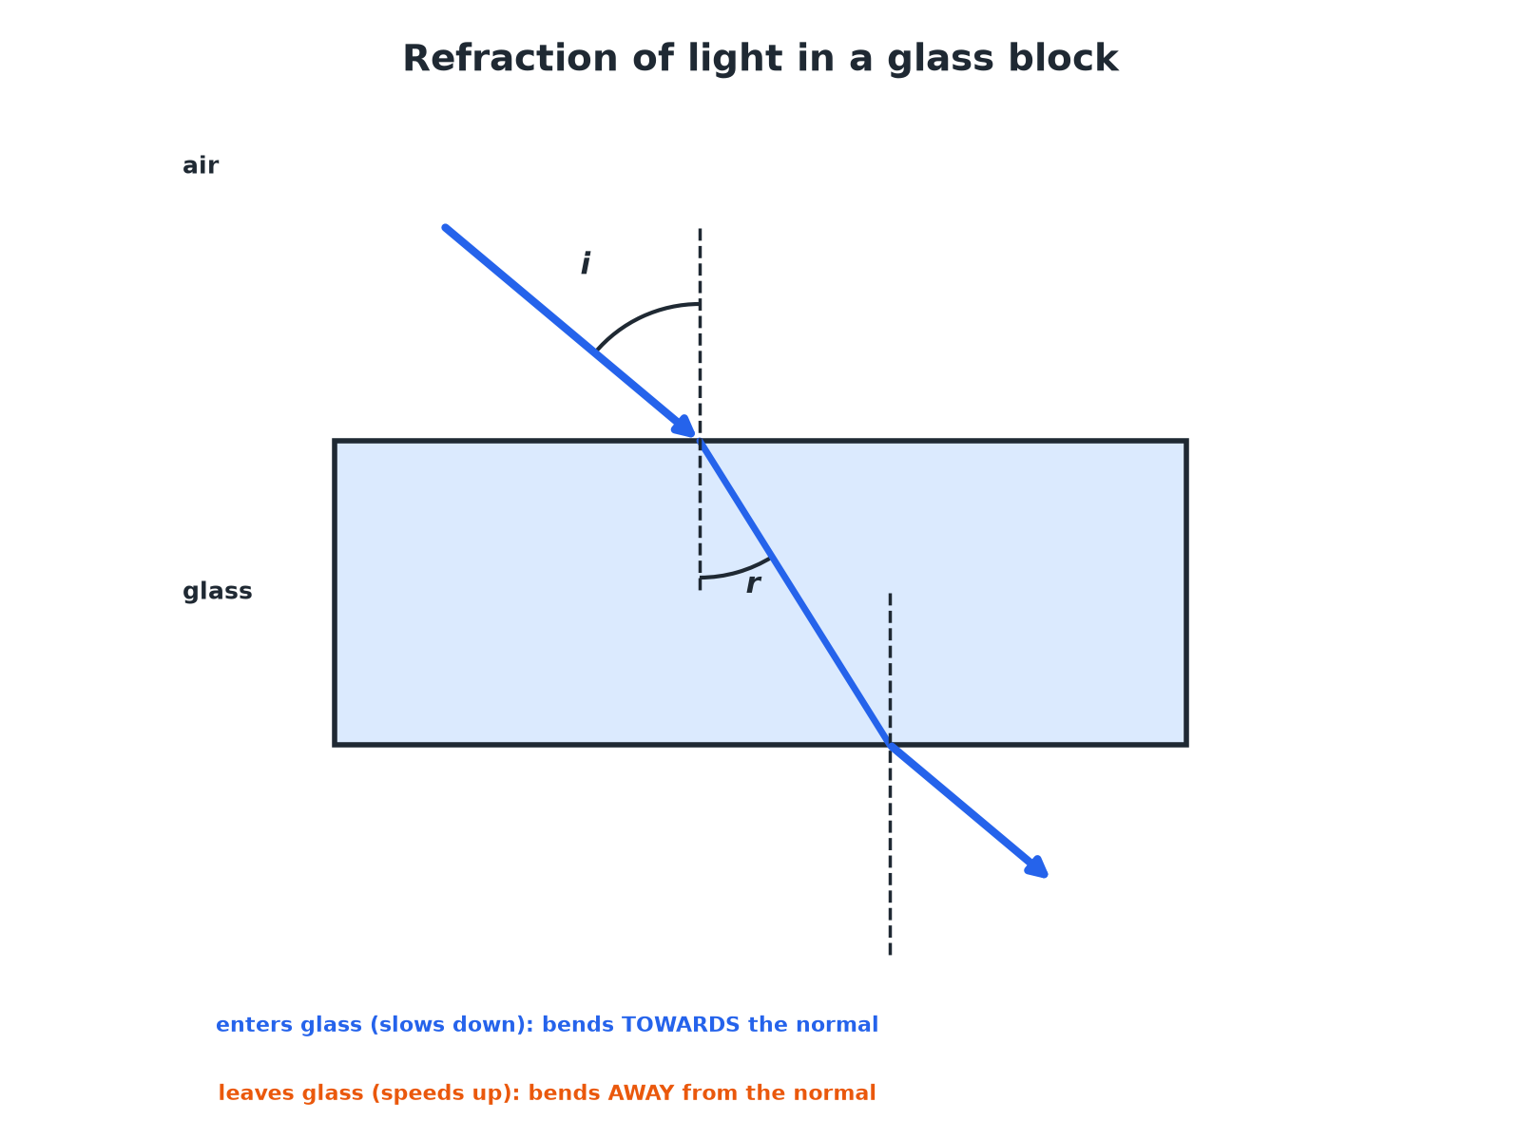

AQA GCSE PHYSICS · PAPER 2 · FOUNDATION & HIGHER
Refraction of Light
The ray emerges parallel to its original direction.
Waves
openrevise.com
Lesson 4 of 12

Slide 7
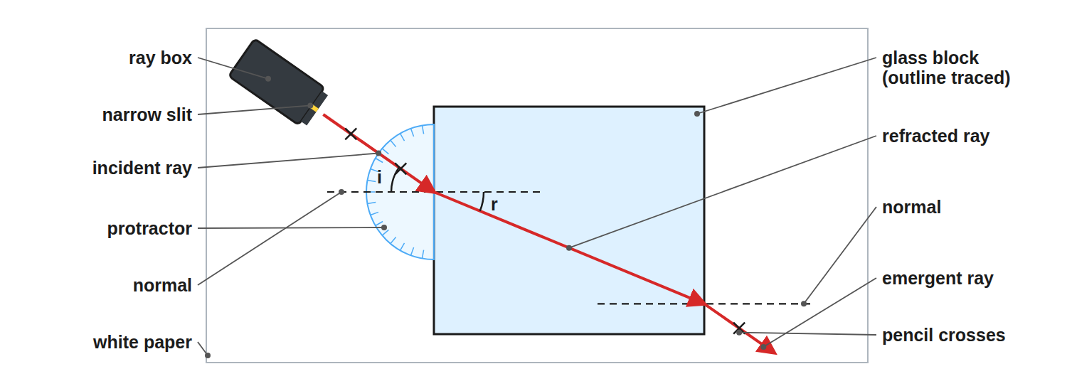
AQA GCSE PHYSICS · PAPER 2 · FOUNDATION & HIGHER
Required Practical 9: Refraction with a Glass Block
Trace the outline of the block and the rays before removing it.
Waves
openrevise.com
Lesson 4 of 12

Slide 8
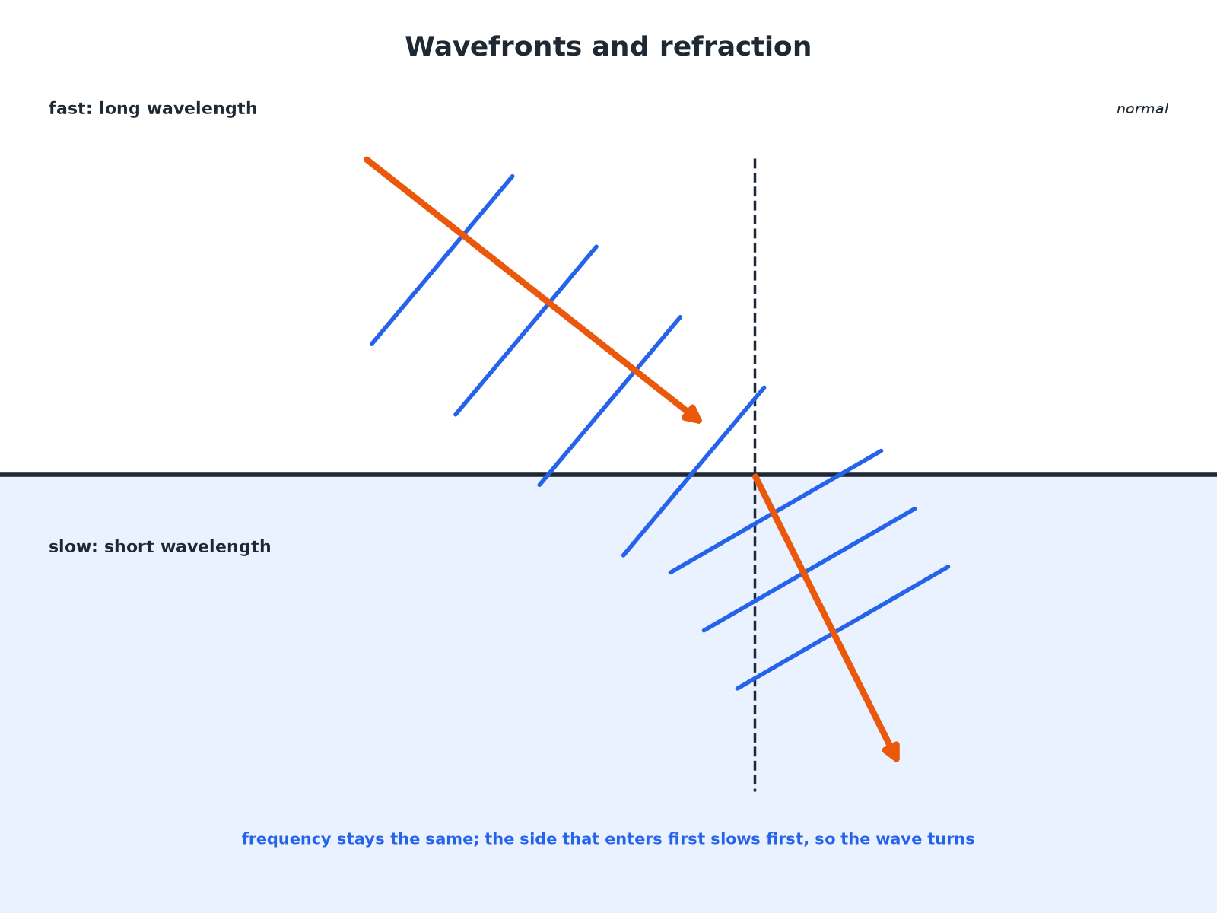
AQA GCSE PHYSICS · PAPER 2 · FOUNDATION & HIGHER
Wavefronts and Refraction (Higher)
The change of speed makes the wavefront turn.
Waves
openrevise.com
Lesson 4 of 12

Slide 9

AQA GCSE PHYSICS · PAPER 2 · FOUNDATION & HIGHER
Direction of Bending
A ray of light passes from air into glass. Describe what happens to its speed and direction.
Speed
Decreases in the glass
1
Direction
Bends towards the normal
2
ANSWER
It slows down and bends towards the normal.
Waves
openrevise.com
Lesson 4 of 12

Slide 10
AQA GCSE PHYSICS · PAPER 2 · FOUNDATION & HIGHER
Explaining with Wavefronts (Higher)
Use wavefronts to explain why a wave changes direction when it enters a slower medium at an angle.
The part of the wavefront that enters first
Slows down first
1
The rest of the wavefront
Is still travelling faster, so catches up
2
Result
The wavefront turns, so the wave direction bends towards the normal
3
ANSWER
The change of speed across the wavefront turns it.
Waves
openrevise.com
Lesson 4 of 12

Slide 11
AQA GCSE PHYSICS · PAPER 2 · FOUNDATION & HIGHER
Along the Normal
What happens to a ray that strikes the boundary at 0° to the normal?
Angle of incidence
0°: travelling along the normal
1
Direction
Does not change
2
Speed
Still changes
3
ANSWER
It is not refracted (no change in direction), but it still slows down.
Waves
openrevise.com
Lesson 4 of 12

Slide 12

AQA GCSE PHYSICS · PAPER 2 · FOUNDATION & HIGHER
Key Points
Exam-ready facts.
Cause
A change of speed when the wave moves into a different medium.
Frequency
Does not change.
Different substances
EM waves can be absorbed, transmitted, refracted or reflected depending on wavelength (Higher).
Practical
A ray box, glass block and protractor can be used to measure angles i and r.
Waves
openrevise.com
Lesson 4 of 12

Slide 13

AQA GCSE PHYSICS · PAPER 2 · FOUNDATION & HIGHER
Key Terms
Refraction
A change in direction of a wave caused by a change in speed.
Normal
A line at right angles to the boundary.
Angle of refraction
The angle between the refracted ray and the normal.
Wavefront
A line showing all points of a wave at the same stage.
Denser medium
A medium in which the wave travels more slowly.
Boundary
The surface between two media.
Waves
openrevise.com
Lesson 4 of 12

Slide 14

AQA GCSE PHYSICS · PAPER 2 · FOUNDATION & HIGHER
YOUR TASK
10 minutes
Bend the Ray
Draw a ray diagram for light going from air into water at an angle, then from water into air. Label the normal and say whether the ray bends towards or away from it each time.
Draw the normal.
1
Decide if the speed decreases or increases.
2
WHAT A GOOD ANSWER SHOWS
Air to water: slows down and bends towards the normal. Water to air: speeds up and bends away from the normal.
Waves
openrevise.com
Lesson 4 of 12
Notes:
Ask why a straw looks bent in a glass of water.

Slide 15
AQA GCSE PHYSICS · PAPER 2 · FOUNDATION & HIGHER
Can I...?
Define refraction.
Use wavefronts.
Explain it with speed.
Describe the practical.
Draw a refraction ray diagram.
Say frequency is unchanged.
Say towards or away from the normal.
Explain a ray along the normal.
Waves
openrevise.com
Lesson 4 of 12

Slide 16
AQA GCSE PHYSICS · PAPER 2 · FOUNDATION & HIGHER
Summary & Exam Focus
Refraction is a change of direction due to a change of speed.
Slows: towards the normal; speeds up: away.
Wavefronts turn when the speed changes (Higher).
Frequency stays the same.
EXAM FOCUS
Explain why a light ray bends towards the normal as it enters a glass block. (2 marks)
It slows down.
openrevise.com

Slide 17
AQA GCSE PHYSICS · PAPER 2 · FOUNDATION & HIGHER
Exam Practice: Refraction of waves
Answer all questions. Use the mark allocation as a guide to how much to write. · 16 minutes
Question 1 · 2 marks · State
A ray of light passes from air into a glass block. Describe what happens to the speed of the light and the direction of the ray.
Question 2 · 3 marks · Complete the diagram
The diagram shows a ray of light hitting a glass block. Complete the diagram to show the path of the ray through the block and out of the…
Question 3 · 3 marks · Explain
Explain why a wave is refracted when it crosses the boundary between two media at an angle.
Waves
openrevise.com
Lesson 4 of 12

Slide 18
AQA GCSE PHYSICS · PAPER 2 · FOUNDATION & HIGHER
Exam Practice: Refraction of waves (cont.)
Question 4 · 5 marks · Describe
Describe an investigation to show how a ray of light is refracted by a glass block. Your answer should include the measurements you would…
Question 5 · 2 marks · Explain
A wave travels from deep water to shallow water where it slows down. State what happens to the frequency and the wavelength.
Waves
openrevise.com
Lesson 4 of 12

Slide 19
AQA GCSE PHYSICS · PAPER 2 · FOUNDATION & HIGHER
Question 1 · 2 marks · State
“
A ray of light passes from air into a glass block. Describe what happens to the speed of the light and the direction of the ray.
HOW TO ANSWER IT
Command word: State. Worth 2 marks, so plan before writing.
Waves
openrevise.com
Lesson 4 of 12

Slide 20
AQA GCSE PHYSICS · PAPER 2 · FOUNDATION & HIGHER
Question 1 · mark scheme
2 marks available. Award a mark for each point made.
Speed decreases
1 mark
Bends towards the normal
1 mark
Waves
openrevise.com
Lesson 4 of 12

Slide 21
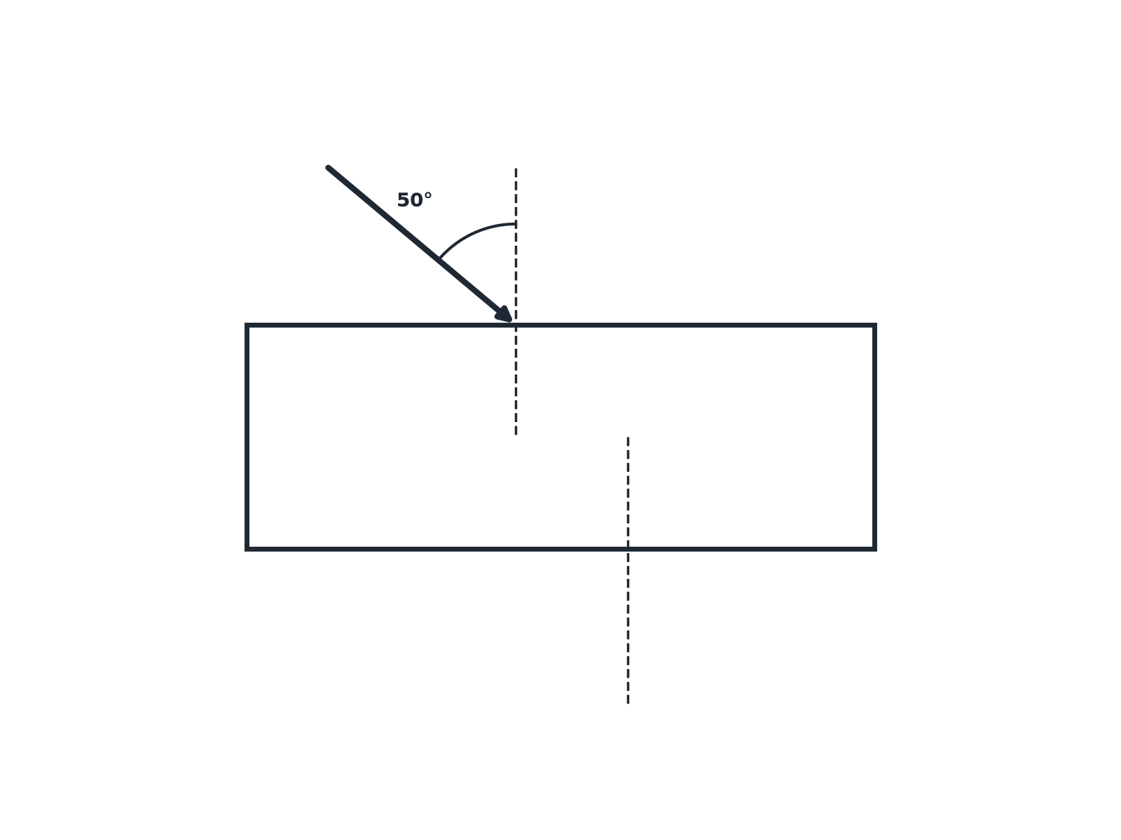
AQA GCSE PHYSICS · PAPER 2 · FOUNDATION & HIGHER
Question 2 · 3 marks · Complete the diagram
The diagram shows a ray of light hitting a glass block. Complete the diagram to show the path of the ray through the block and out of the other side. (3 marks)
Waves
openrevise.com
Lesson 4 of 12

Slide 22
AQA GCSE PHYSICS · PAPER 2 · FOUNDATION & HIGHER
Question 2 · mark scheme
3 marks available. Award a mark for each point made.
Bends towards the normal inside the glass
1 mark
Bends away from the normal on leaving
1 mark
Emergent ray parallel to the incident ray
1 mark
Waves
openrevise.com
Lesson 4 of 12

Slide 23
AQA GCSE PHYSICS · PAPER 2 · FOUNDATION & HIGHER
Question 3 · 3 marks · Explain
“
Explain why a wave is refracted when it crosses the boundary between two media at an angle.
HOW TO ANSWER IT
Command word: Explain. Worth 3 marks, so plan before writing.
Waves
openrevise.com
Lesson 4 of 12

Slide 24
AQA GCSE PHYSICS · PAPER 2 · FOUNDATION & HIGHER
Question 3 · mark scheme
3 marks available. Award a mark for each point made.
Speed changes in the new medium
1 mark
Part of the wavefront changes speed first
1 mark
So the direction changes
1 mark
Waves
openrevise.com
Lesson 4 of 12

Slide 25
AQA GCSE PHYSICS · PAPER 2 · FOUNDATION & HIGHER
Question 4 · 5 marks · Describe
“
Describe an investigation to show how a ray of light is refracted by a glass block. Your answer should include the measurements you would take and what you would conclude.
HOW TO ANSWER IT
Command word: Describe. Worth 5 marks, so plan before writing.
Waves
openrevise.com
Lesson 4 of 12

Slide 26
AQA GCSE PHYSICS · PAPER 2 · FOUNDATION & HIGHER
Question 4 · mark scheme
5 marks available. Award a mark for each point made.
Ray box, glass block on paper, outline drawn
1 mark
Incident and emergent rays marked
1 mark
Normal drawn, angles measured
1 mark
Waves
openrevise.com
Lesson 4 of 12

Slide 27
AQA GCSE PHYSICS · PAPER 2 · FOUNDATION & HIGHER
Question 4 · mark scheme (cont.)
Repeat for different angles
1 mark
Conclusion: bends towards the normal in glass
1 mark
Waves
openrevise.com
Lesson 4 of 12

Slide 28
AQA GCSE PHYSICS · PAPER 2 · FOUNDATION & HIGHER
Question 5 · 2 marks · Explain
“
A wave travels from deep water to shallow water where it slows down. State what happens to the frequency and the wavelength.
HOW TO ANSWER IT
Command word: Explain. Worth 2 marks, so plan before writing.
Waves
openrevise.com
Lesson 4 of 12

Slide 29
AQA GCSE PHYSICS · PAPER 2 · FOUNDATION & HIGHER
Question 5 · mark scheme
2 marks available. Award a mark for each point made.
Frequency unchanged
1 mark
Wavelength decreases
1 mark
Waves
openrevise.com
Lesson 4 of 12

