Slide 1

AQA GCSE PHYSICS · PAPER 2 · FOUNDATION & HIGHER
Black body radiation
Waves
Lesson 12 of 12
openrevise.com

Slide 2

AQA GCSE PHYSICS · PAPER 2 · FOUNDATION & HIGHER
Warm-up
Answer each one, then check.
1
What is infrared?
2
What makes an object hotter?
3
What is absorption?
4
What is reflection?
5
What colour surface absorbs best?
Waves
openrevise.com
Lesson 12 of 12

Slide 3
AQA GCSE PHYSICS · PAPER 2 · FOUNDATION & HIGHER
Warm-up - Answers
What is infrared?
Electromagnetic radiation felt as heat
1
What makes an object hotter?
Absorbing energy faster than it emits it
2
What is absorption?
Taking in the energy of radiation
3
What is reflection?
A wave bouncing off a surface
4
What colour surface absorbs best?
Matt black
5
Waves
openrevise.com
Lesson 12 of 12

Slide 4

AQA GCSE PHYSICS · PAPER 2 · FOUNDATION & HIGHER
Learning Objectives
State that all bodies emit and absorb infrared radiation.
1
Describe a perfect black body and why it is the best emitter.
2
Explain that the intensity and wavelength distribution of emission depend on temperature.
3
Explain how the temperature of a body or of the Earth is related to absorption and emission (Higher tier).
4
Waves
openrevise.com
Lesson 12 of 12

Slide 5

AQA GCSE PHYSICS · PAPER 2 · FOUNDATION & HIGHER
BLACK BODY RADIATION
All bodies, whatever their temperature, emit and absorb infrared radiation. The hotter the body, the more infrared it radiates in a given time.
A perfect black body absorbs all the radiation that falls on it and is also the best possible emitter.
Waves
openrevise.com
Lesson 12 of 12

Slide 6

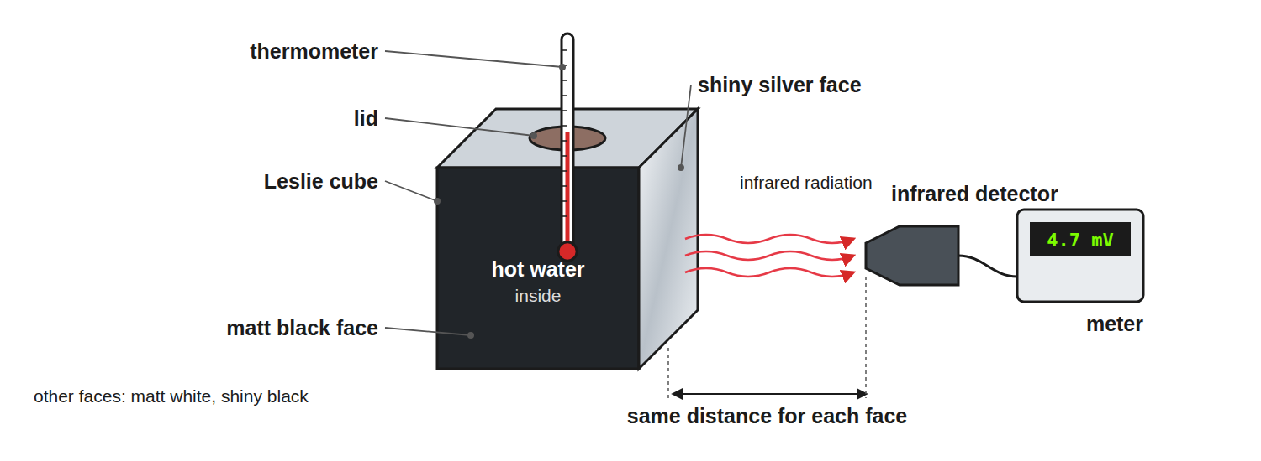
AQA GCSE PHYSICS · PAPER 2 · FOUNDATION & HIGHER
Required Practical 10: Infrared from Different Surfaces
Keep the distance and the water temperature the same for each face.
Waves
openrevise.com
Lesson 12 of 12

Slide 7
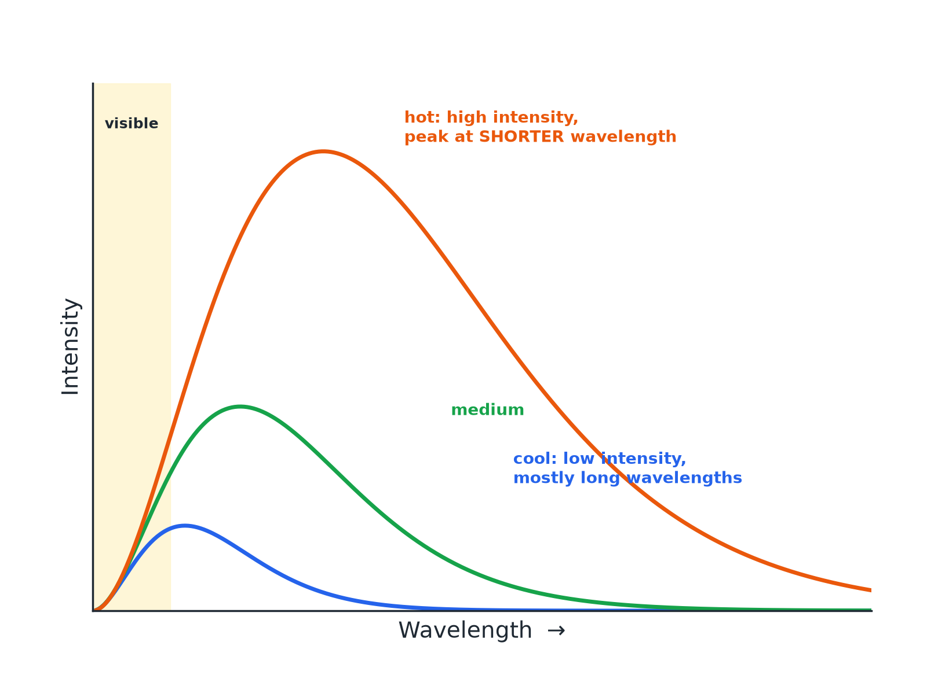
AQA GCSE PHYSICS · PAPER 2 · FOUNDATION & HIGHER
Emission at Different Temperatures
Higher temperature means greater intensity and shorter wavelengths.
Waves
openrevise.com
Lesson 12 of 12

Slide 8
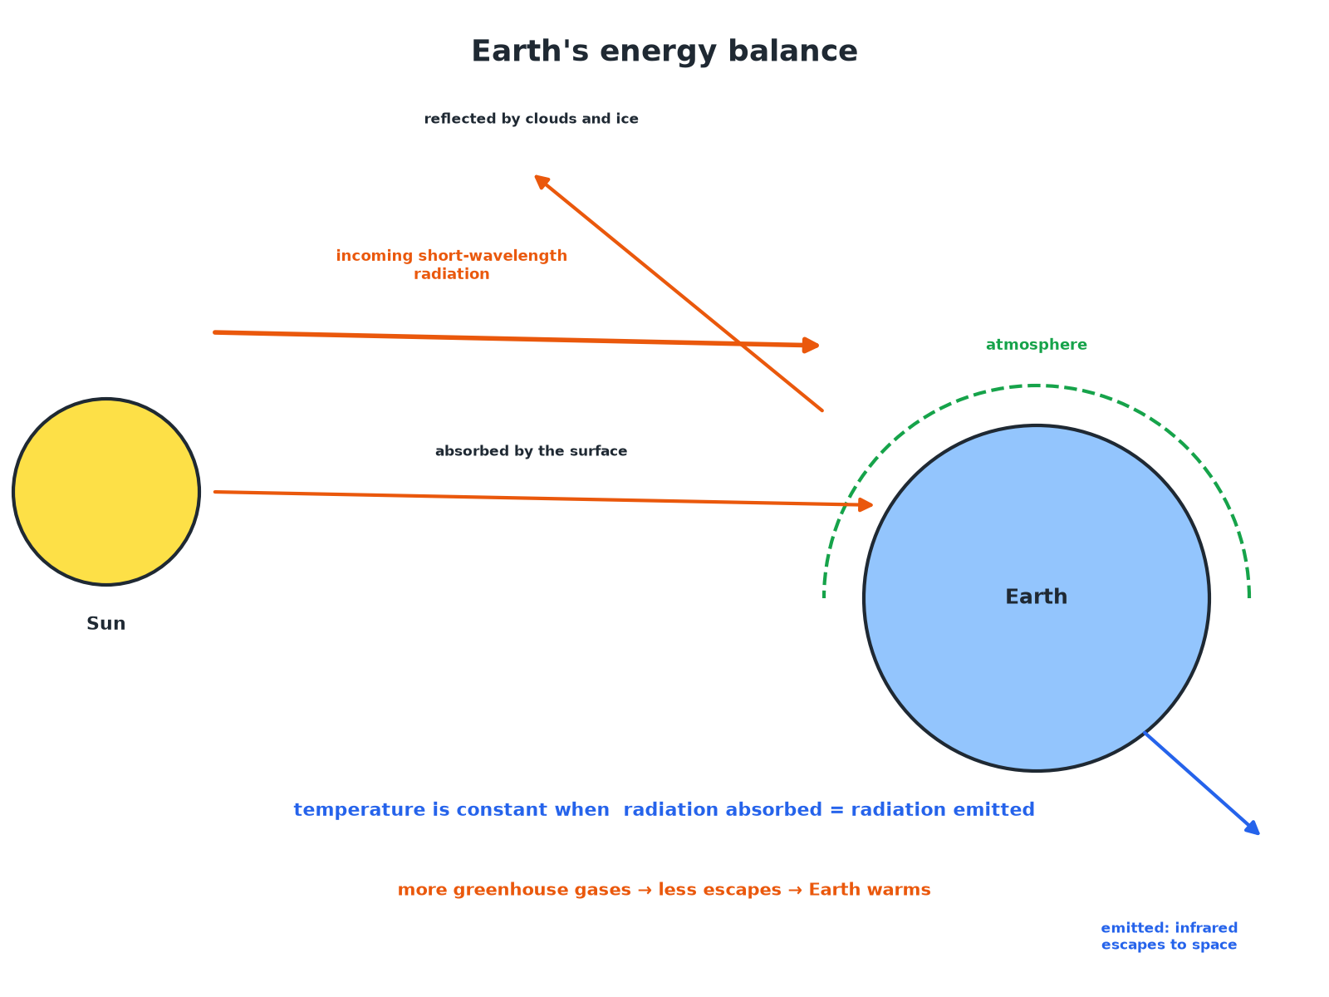
AQA GCSE PHYSICS · PAPER 2 · FOUNDATION & HIGHER
Earth's Energy Balance (Higher)
Constant temperature means absorption equals emission.
Waves
openrevise.com
Lesson 12 of 12

Slide 9

AQA GCSE PHYSICS · PAPER 2 · FOUNDATION & HIGHER
Required Practical 10: Method
Compare how surfaces radiate infrared.
1
2
3
4
5
Fill the cube
Fill a Leslie cube with hot water and put in the lid.
Detector
Hold the infrared detector at the same distance from each face.
Record
Note the detector reading for each surface.
Control
Keep the distance, water temperature and time the same.
Result
The matt black surface emits most infrared; the shiny silver surface emits least.
Waves
openrevise.com
Lesson 12 of 12

Slide 10

AQA GCSE PHYSICS · PAPER 2 · FOUNDATION & HIGHER
A Body at Constant Temperature (Higher)
Explain why a body at a constant temperature is absorbing and emitting radiation at the same rate.
Absorbing more than emitting
The temperature rises
1
Emitting more than absorbing
The temperature falls
2
Constant temperature
Absorption equals emission
3
ANSWER
If the rates are equal the temperature does not change.
Waves
openrevise.com
Lesson 12 of 12

Slide 11
AQA GCSE PHYSICS · PAPER 2 · FOUNDATION & HIGHER
The Earth's Temperature (Higher)
Explain what happens to the temperature of the Earth's surface if the atmosphere absorbs more of the infrared radiation emitted by the surface.
More is absorbed
And re-radiated back to the surface
1
Emission to space
Decreases
2
Absorption exceeds emission
So the surface temperature rises until a new balance
3
ANSWER
The temperature of the surface increases.
Waves
openrevise.com
Lesson 12 of 12

Slide 12

AQA GCSE PHYSICS · PAPER 2 · FOUNDATION & HIGHER
Key Points
Learn these.
All bodies
Emit infrared, whatever their temperature.
Hotter
More radiation in a given time and a shorter peak wavelength.
Good absorber
Also a good emitter (matt black surfaces).
Good reflector
A poor absorber and a poor emitter (shiny silver).
Waves
openrevise.com
Lesson 12 of 12

Slide 13

AQA GCSE PHYSICS · PAPER 2 · FOUNDATION & HIGHER
Key Terms
Black body
An object that absorbs all the radiation that hits it.
Emit
Give out radiation.
Absorb
Take in radiation.
Intensity
The amount of radiation per second per unit area.
Infrared
Electromagnetic radiation emitted by all objects.
Equilibrium
When absorption equals emission.
Waves
openrevise.com
Lesson 12 of 12

Slide 14

AQA GCSE PHYSICS · PAPER 2 · FOUNDATION & HIGHER
YOUR TASK
10 minutes
Hot or Cold?
Two cans of hot water, one matt black and one shiny silver, cool for 10 minutes. Which cools faster? Explain.
Compare emission.
1
Use the black body idea.
2
WHAT A GOOD ANSWER SHOWS
The matt black can, because it is a better emitter of infrared radiation, so it loses energy faster.
Waves
openrevise.com
Lesson 12 of 12
Notes:
Ask which would warm faster in the Sun.

Slide 15
AQA GCSE PHYSICS · PAPER 2 · FOUNDATION & HIGHER
Can I...?
State that all bodies emit infrared.
Explain the effect of temperature.
Define a perfect black body.
Describe the curves.
Say a good absorber is a good emitter.
Explain constant temperature.
Describe Required Practical 10.
Explain the Earth's energy balance.
Waves
openrevise.com
Lesson 12 of 12

Slide 16
AQA GCSE PHYSICS · PAPER 2 · FOUNDATION & HIGHER
Summary & Exam Focus
All bodies emit and absorb infrared.
A perfect black body absorbs all radiation and is the best emitter.
Hotter bodies emit more with shorter wavelengths.
Temperature is steady when absorption equals emission.
EXAM FOCUS
Explain why a matt black surface is a better emitter of infrared radiation than a shiny silver surface. (2 marks)
Good absorbers are good emitters.
openrevise.com

Slide 17
AQA GCSE PHYSICS · PAPER 2 · FOUNDATION & HIGHER
Exam Practice: Black body radiation
Answer all questions. Use the mark allocation as a guide to how much to write. · 17 minutes
Question 1 · 2 marks · State
State whether a matt black surface or a shiny silver surface is a better emitter of infrared radiation, and give the reason.
Question 2 · 4 marks · Describe
A student investigates how the surface of a Leslie cube affects the infrared radiation emitted. Describe how the investigation is carried…
Question 3 · 3 marks · Use the graph
The graph shows how the intensity of radiation emitted by a hot object depends on the wavelength at two different temperatures, A and B…
Waves
openrevise.com
Lesson 12 of 12

Slide 18
AQA GCSE PHYSICS · PAPER 2 · FOUNDATION & HIGHER
Exam Practice: Black body radiation (cont.)
Question 4 · 3 marks · Explain
The temperature of a cup of tea stays constant at 50 °C when it is kept warm by a heater. Explain this in terms of radiation.
Question 5 · 4 marks · Explain
Explain how the Earth's temperature is related to the radiation it absorbs and emits. Explain what happens if the atmosphere contains more…
Waves
openrevise.com
Lesson 12 of 12

Slide 19
AQA GCSE PHYSICS · PAPER 2 · FOUNDATION & HIGHER
Question 1 · 2 marks · State
“
State whether a matt black surface or a shiny silver surface is a better emitter of infrared radiation, and give the reason.
HOW TO ANSWER IT
Command word: State. Worth 2 marks, so plan before writing.
Waves
openrevise.com
Lesson 12 of 12

Slide 20
AQA GCSE PHYSICS · PAPER 2 · FOUNDATION & HIGHER
Question 1 · mark scheme
2 marks available. Award a mark for each point made.
Matt black
1 mark
Good absorber is a good emitter
1 mark
Waves
openrevise.com
Lesson 12 of 12

Slide 21
AQA GCSE PHYSICS · PAPER 2 · FOUNDATION & HIGHER
Question 2 · 4 marks · Describe
“
A student investigates how the surface of a Leslie cube affects the infrared radiation emitted. Describe how the investigation is carried out and how to keep it a fair test.
HOW TO ANSWER IT
Command word: Describe. Worth 4 marks, so plan before writing.
Waves
openrevise.com
Lesson 12 of 12

Slide 22
AQA GCSE PHYSICS · PAPER 2 · FOUNDATION & HIGHER
Question 2 · mark scheme
4 marks available. Award a mark for each point made.
Hot water in a Leslie cube
1 mark
Detector at each face
1 mark
Control distance and temperature
1 mark
Compare readings
1 mark
Waves
openrevise.com
Lesson 12 of 12

Slide 23
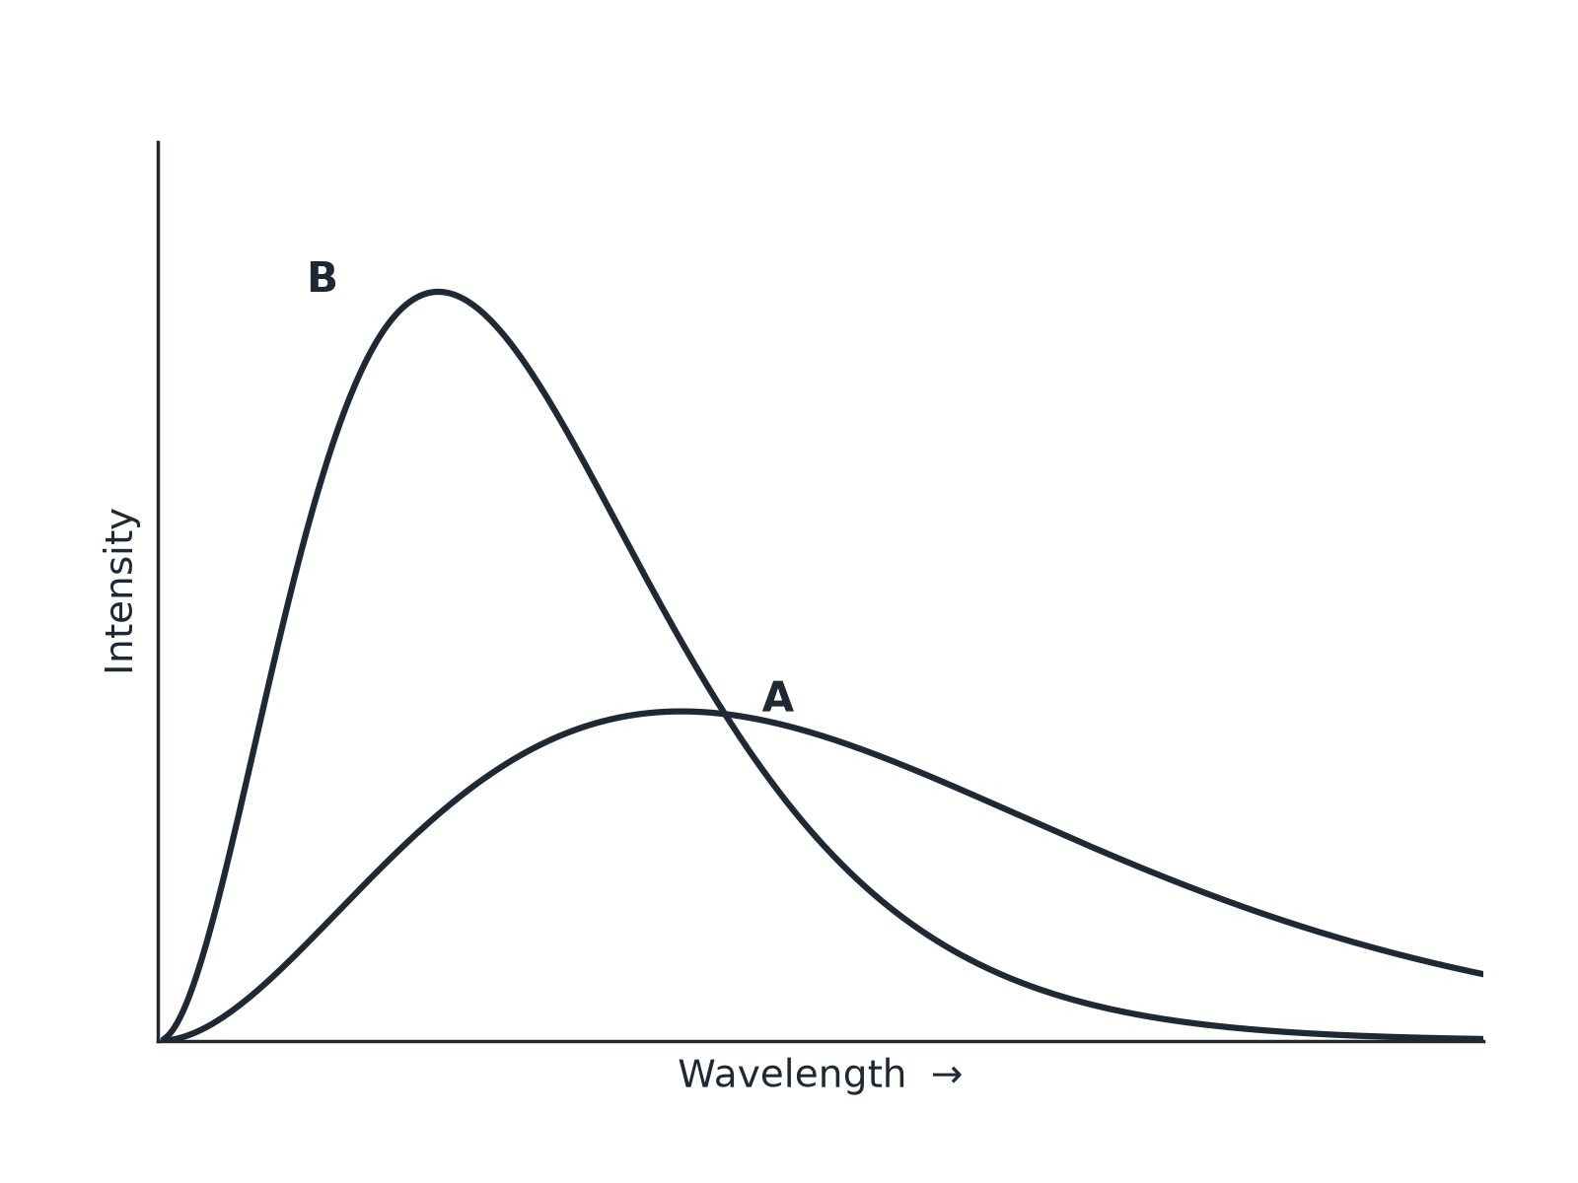
AQA GCSE PHYSICS · PAPER 2 · FOUNDATION & HIGHER
Question 3 · 3 marks · Use the graph
The graph shows how the intensity of radiation emitted by a hot object depends on the wavelength at two different temperatures, A and B. (a) Which curve is for the hotter object? (b) Give two reasons for your answer. (3 marks)
Waves
openrevise.com
Lesson 12 of 12

Slide 24
AQA GCSE PHYSICS · PAPER 2 · FOUNDATION & HIGHER
Question 3 · mark scheme
3 marks available. Award a mark for each point made.
Curve B
1 mark
Higher intensity
1 mark
Peak at shorter wavelength
1 mark
Waves
openrevise.com
Lesson 12 of 12

Slide 25
AQA GCSE PHYSICS · PAPER 2 · FOUNDATION & HIGHER
Question 4 · 3 marks · Explain
“
The temperature of a cup of tea stays constant at 50 °C when it is kept warm by a heater. Explain this in terms of radiation.
HOW TO ANSWER IT
Command word: Explain. Worth 3 marks, so plan before writing.
Waves
openrevise.com
Lesson 12 of 12

Slide 26
AQA GCSE PHYSICS · PAPER 2 · FOUNDATION & HIGHER
Question 4 · mark scheme
3 marks available. Award a mark for each point made.
Absorbs energy at some rate
1 mark
Emits at the same rate
1 mark
So constant temperature
1 mark
Waves
openrevise.com
Lesson 12 of 12

Slide 27
AQA GCSE PHYSICS · PAPER 2 · FOUNDATION & HIGHER
Question 5 · 4 marks · Explain
“
Explain how the Earth's temperature is related to the radiation it absorbs and emits. Explain what happens if the atmosphere contains more greenhouse gases.
HOW TO ANSWER IT
Command word: Explain. Worth 4 marks, so plan before writing.
Waves
openrevise.com
Lesson 12 of 12

Slide 28
AQA GCSE PHYSICS · PAPER 2 · FOUNDATION & HIGHER
Question 5 · mark scheme
4 marks available. Award a mark for each point made.
Temperature depends on absorption and emission
1 mark
Constant when equal
1 mark
Greenhouse gases absorb emitted infrared
1 mark
So the temperature increases
1 mark
Waves
openrevise.com
Lesson 12 of 12

